Slide 2
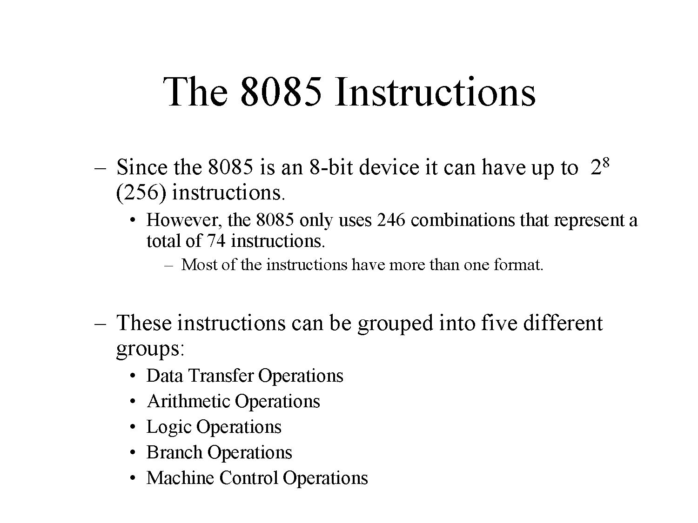

Slide 3
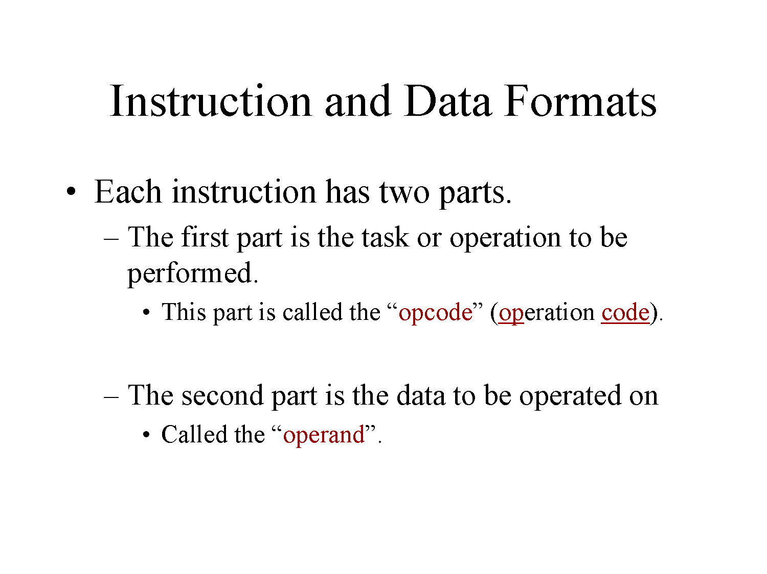

Slide 4
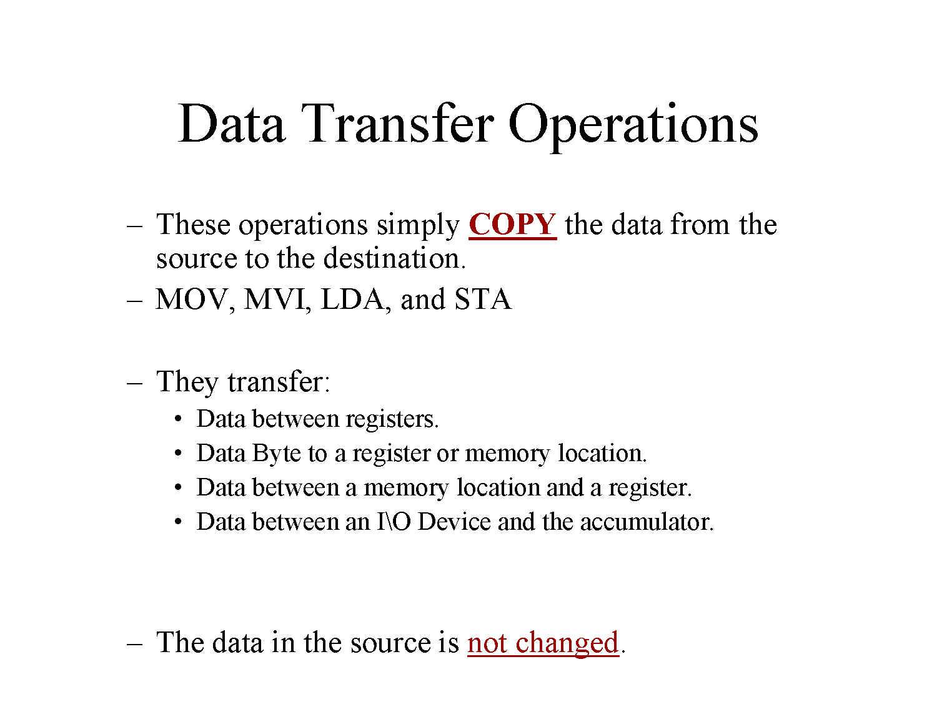

Slide 5
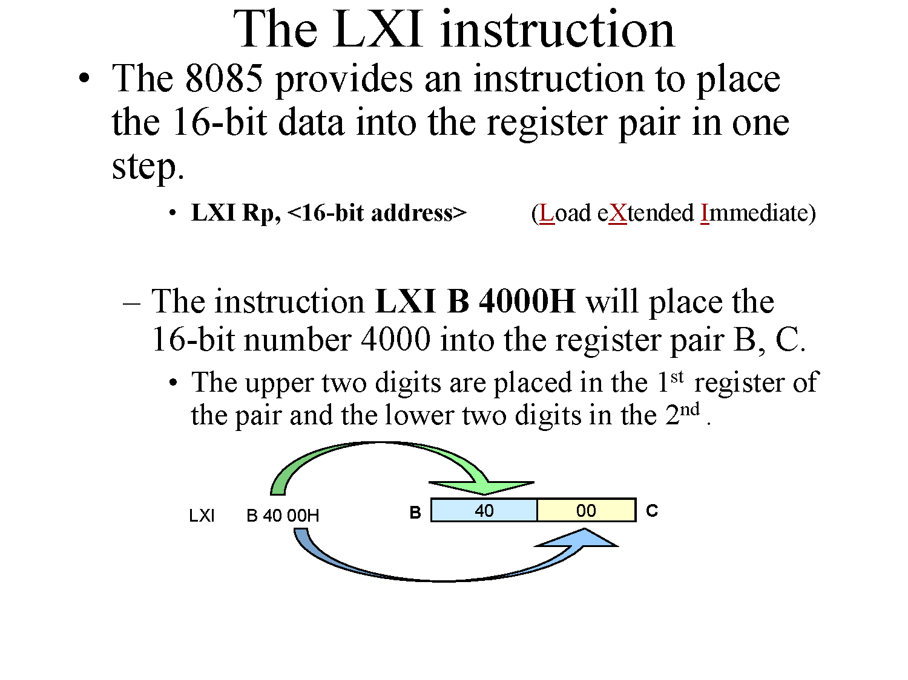

Slide 6
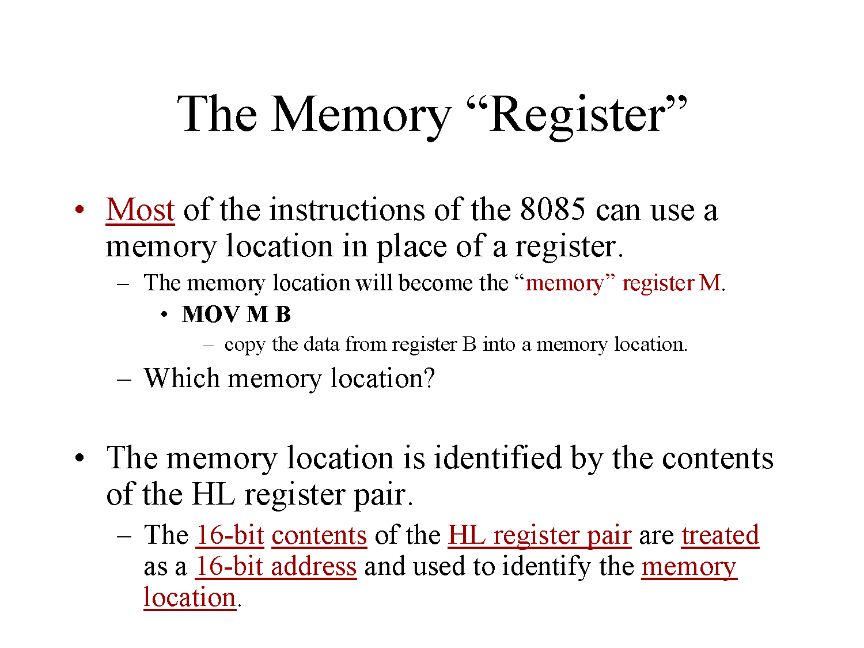

Slide 7
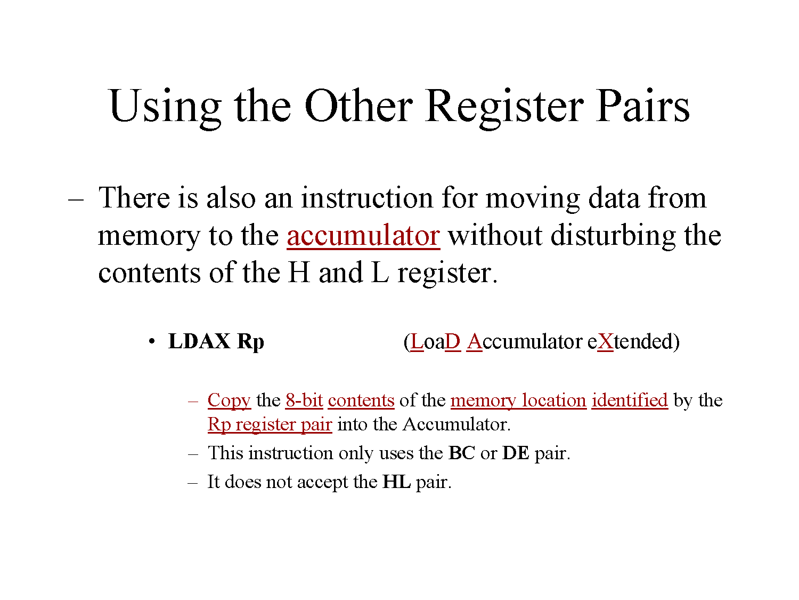

Slide 8
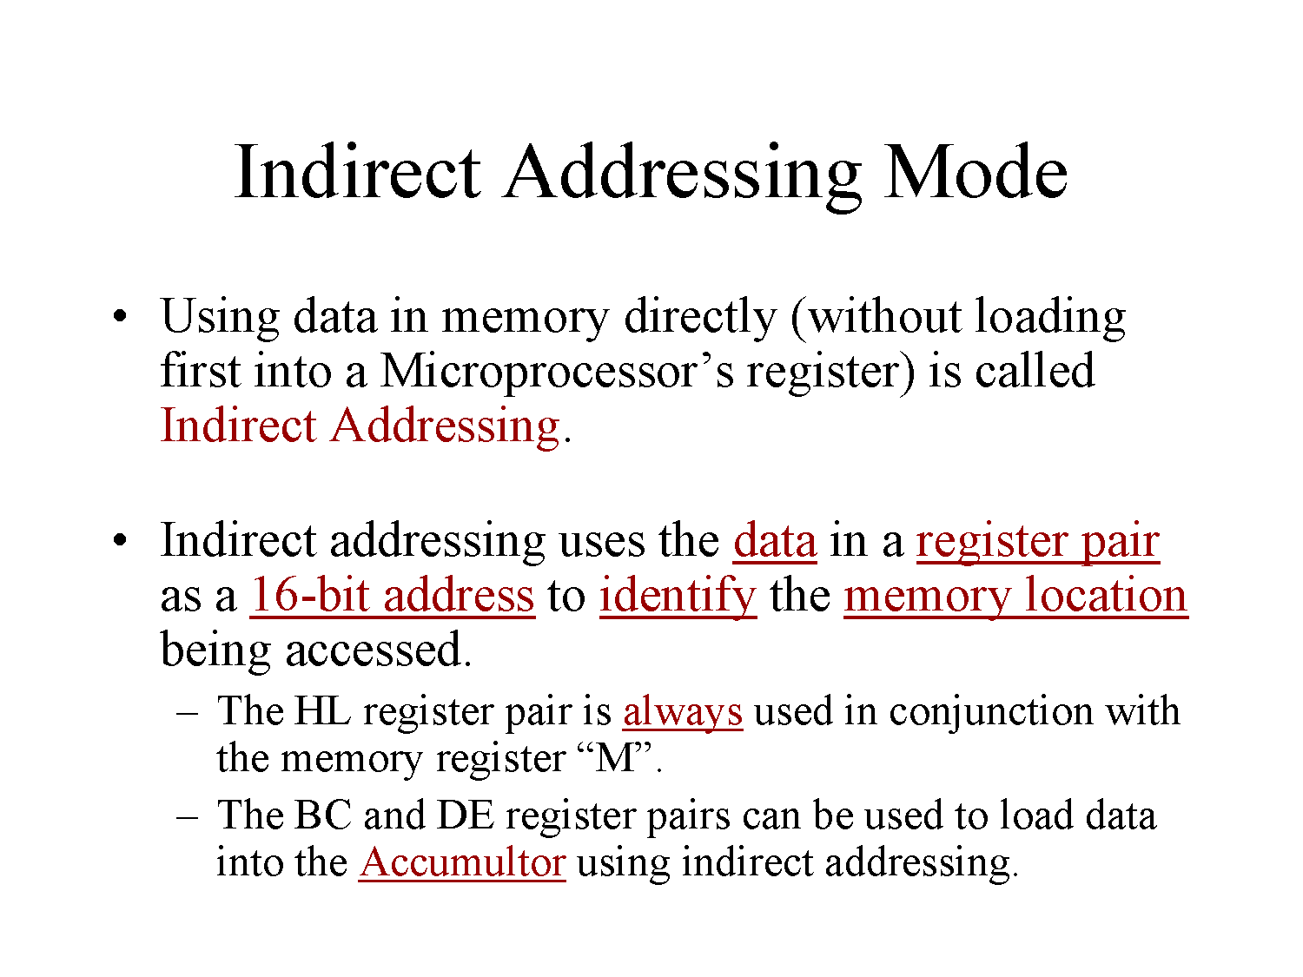

Slide 9
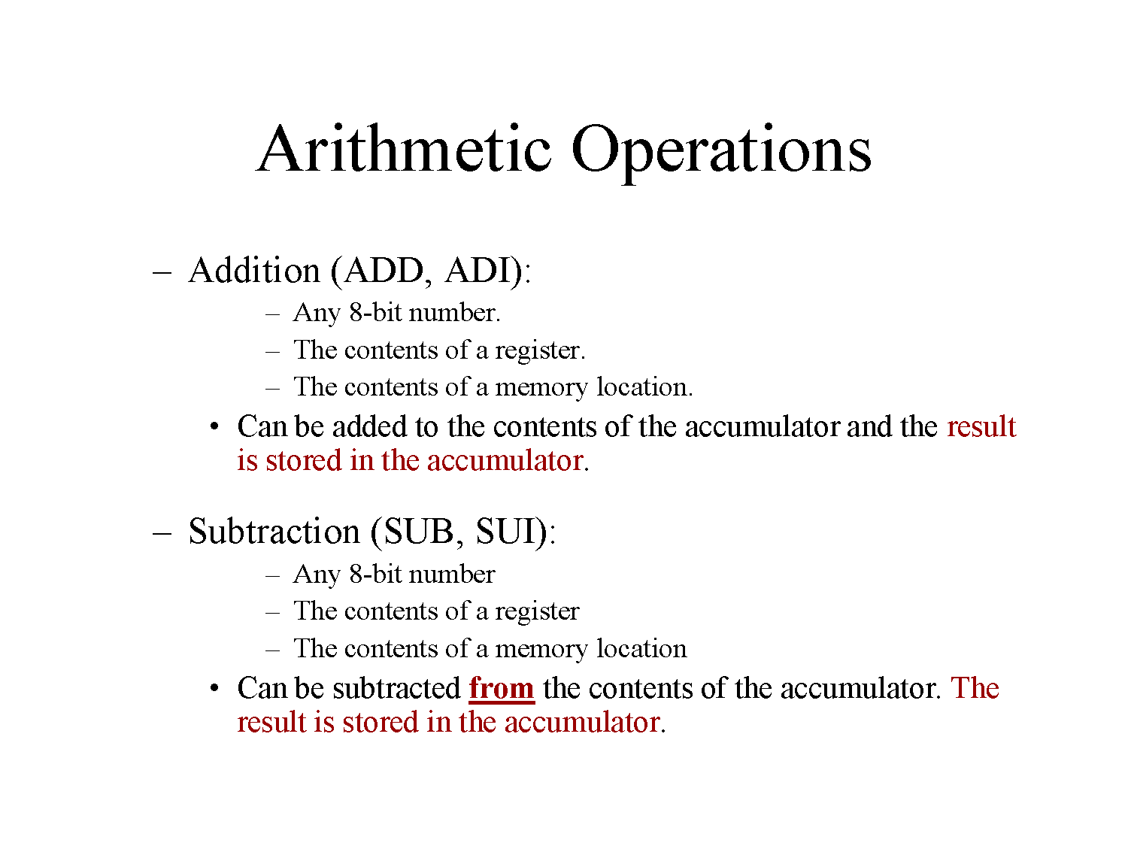

Slide 10
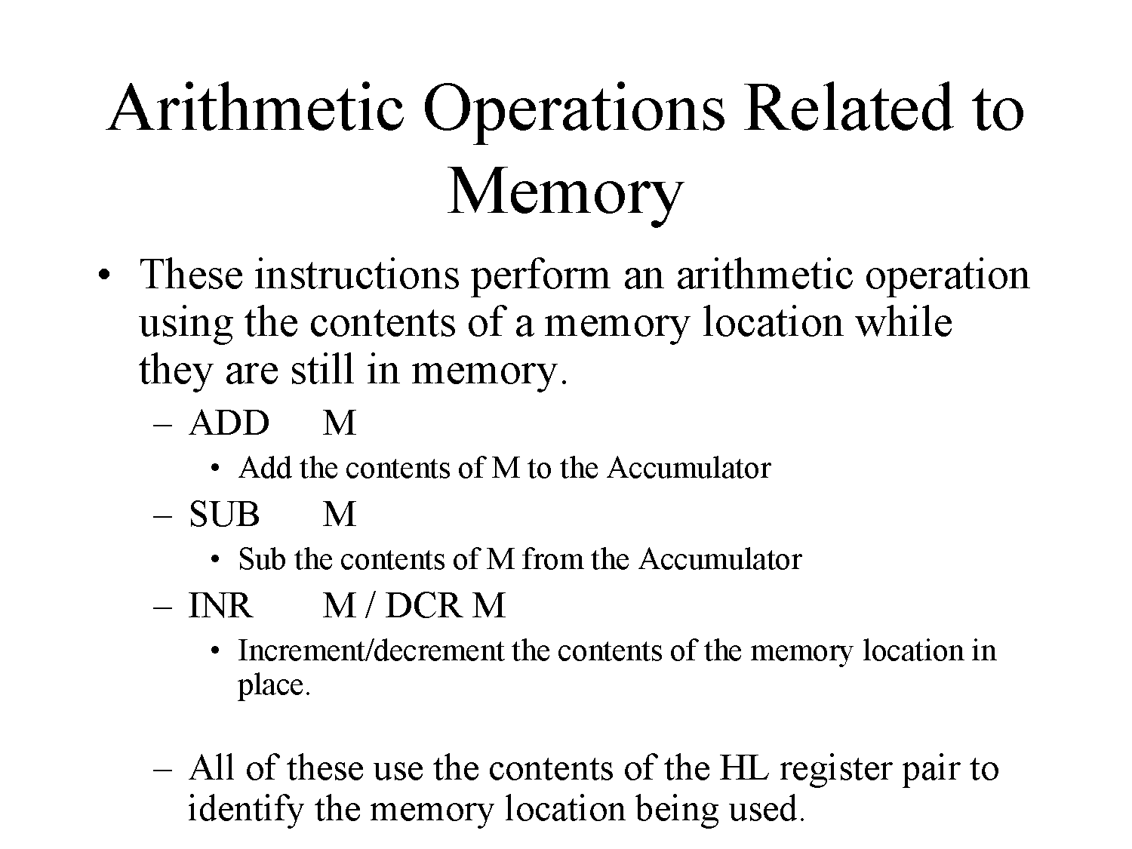

Slide 11
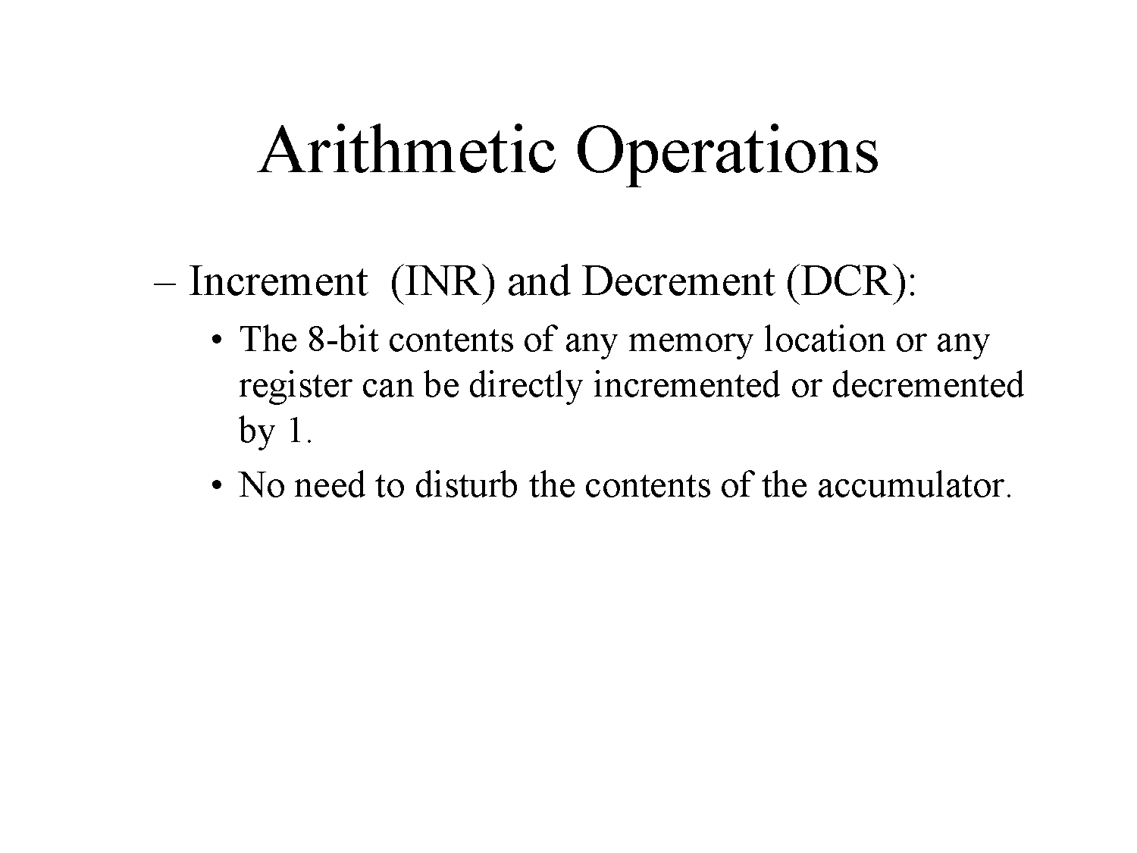

Slide 12
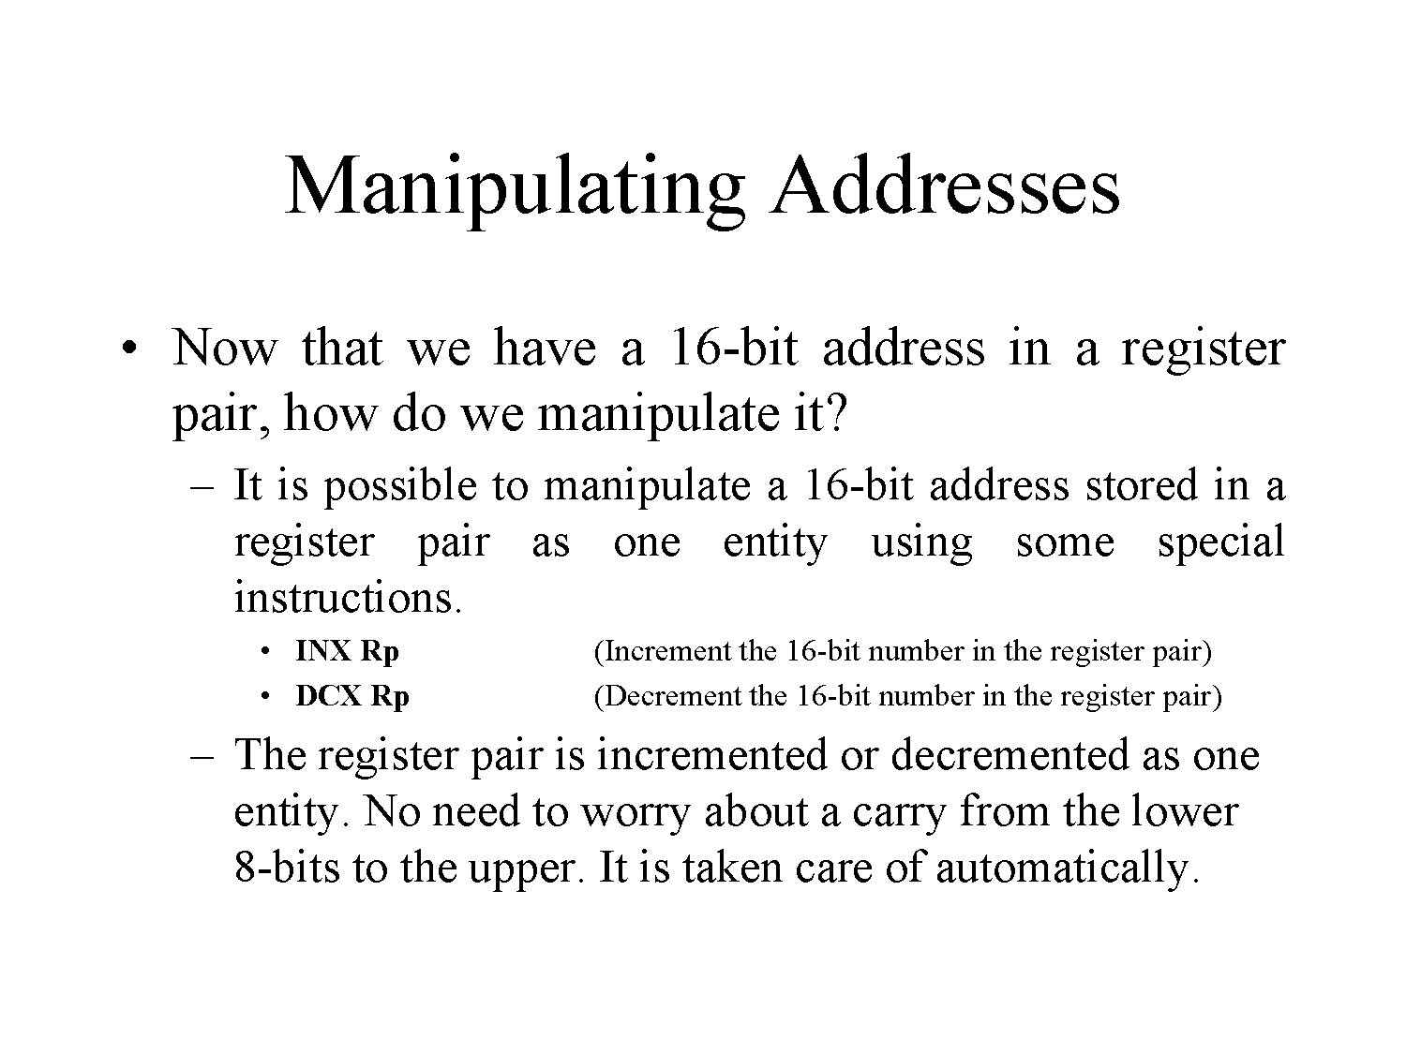

Slide 13
INSTRUCTIONS SET OF 8085
DATA TRANSFER GROUP
MOV Rd, Rs.(Move data from Rs to Rd).
Example:
MOV C,B. Move the content of register B to C.
Initially After execution
B=10H. B=10H.
C=20H. C=10H.
Flags Affected :No flags affected.
Addressing mode: Register.

Slide 14
DATA TRANSFER GROUP
MOV Rd, M (Move data from Memory to Rd).
Example:
MOV C,M. Move the content of Memory i.e. “H or L” to C.
Suppose the Data at memory pointed By HL pair at C200H is 10H.
Initially After execution
H=C2,L=00,C=30H H=C2,L=00,C=10H.
Flags Affected :No flags affected.
Addressing mode: Indirect.

Slide 15
DATA TRANSFER GROUP
MVI R, Data.(Move Immediate data to Register).
Example:
MVI B, 30H. (Move the data 30 H to Register B)
Initially After execution
B=40H B=30H
Flags Affected :No flags affected.
Addressing mode: Immediate.

Slide 16
DATA TRANSFER GROUP
LXI Rp,16 bit .(Load 16 bit data to Register pair Immediate).
Example:
LXI SP, C200H. (Load Stack pointer with C200H).
Initially After execution
SP=C800H SP=C200H.
Flags Affected :No flags affected.
Addressing mode: Immediate.

Slide 17
DATA TRANSFER GROUP
STA address.(Store Acc data to address).
Example:
STA C200H. (Move the data from Acc to C200H).
Suppose in Acc the data is 10H.
Initially After execution
A=10H, C200=20H C200=10H , A=10H
Flags Affected :No flags affected.
Addressing mode: Direct.

Slide 18
DATA TRANSFER GROUP
LHLD address.(Load HL pair with data from address).
Example:
LHLD C200H. (Move the data from C200 to HL pair).
Suppose at C200 the data is 20H,30H .
Initially After execution
H=10H,L=20H H=20H,L=30H.
C2=20H,00=30H C2=20H,00=30H
Flags Affected :No flags affected.
Addressing mode: Direct.

Slide 19
DATA TRANSFER GROUP
XCHG (Exchange the data from HL pair to DE pair)
Example : XCHG
Initially After execution
H=20H,L=30H, H=40H,L=70H.
D=40H,E=70H. D=20H,E=30H.
Flags Affected :No flags affected.
Addressing mode: Register.

Slide 20
DATA TRANSFER GROUP
IN 8 bit address (Move the data from address to Acc)
Example: IN 80H
Move the data from 80H port address to Accumulator.
Suppose data at 80H is 39H.
Initially After execution
A=20H. A=39H
Flags Affected :No flags affected.
Addressing mode: Direct.

Slide 21
DATA TRANSFER GROUP
OUT 8 bit address (Move the data from Acc to address)
Example: OUT 80H
Move the data from Acc to port address 80H.
Suppose data at Acc is 39H.
Initially After execution
A=39H. 80=10H. A=39H,80=39H.
Flags Affected :No flags affected.
Addressing mode: Direct.

Slide 22
DATA TRANSFER GROUP
Example:Write a program to exchange contents of memory location D000H to D001H
LDA D000H Load Acc with data from D000
MOV B,A Move the data to B
LDA D0001H Load Acc with data from D001
STA 2000H Store Acc data at D000
MOV A,B Move B’s data to A
STA 2001H Store data from D000 to D0001
RST1 Stop.

Slide 23
ARITHMETIC GROUP
ADD R (ADD register content with Acc and result in A ).
Example:
ADD C. (ADD the content of C with A).
Suppose the Data at C register is 10H.
Initially After execution
. C= 10H ,A=10H A=20H,C=10H.
Flags Affected :All flags are modified.
Addressing mode: Register

Slide 24
ARITHMEIC GROUP
ADD M(ADD H or L Reg content with Acc and result in A ).
Example:
ADD M. (ADD the content of HL with A).
Suppose the Data at memory pointed by HL register 1020H is 10H.
Initially After execution
. H= 10H ,L=20H . H=10H,L=20H.
A=20H,C=10H. A=30H.
Flags Affected :All flags are modified.
Addressing mode: Register Indirect.

Slide 25
ARITHMETIC GROUP
ADI Data(ADD immediate data with Acc and result in A ).
Example:
ADI 30H. (ADD 30H with A).
Initially After execution
A=20H, A=50H.
Flags Affected :All flags are modified.
Addressing mode: Immediate.

Slide 26
ARITHMETIC GROUP
ADC R (ADD register content with Acc and carry and result in A ).
Example:
ADC C. (ADD the content of C with A with carry).
Suppose the Data at C register is 10H and carry is 01H.
Initially After execution
. C= 10H ,A=10H A=21H,C=10H.
Flags Affected :All flags are modified.
Addressing mode: Register

Slide 27
ARITHMETIC GROUP
Example: Write a program to perform 16 bit addition of 1234H& 4321H. Store answer at H & L registers.
MVI B,21H B=21H
MVI A,34H A=34H
MVI C,43H C=43H
MVI D,12H D=12H
ADD B A=34+21H
MOV L,A L=55H
MOV A,C A=43H
ADC D A=43+12H
MOV H,A H=55H
RST1 STOP.

Slide 28
Assembly language program to add two numbers
MVI A, 2H ;Copy value 2H in register A
MVI B, 4H ;Copy value 4H in register B
ADD B ;A = A + B
Note:
Assembly language is specific to a given processor
For e.g. assembly language of 8085 is different than that of Motorola 6800 microprocessor

Slide 29
1. Data Transfer (Copy) Operations
Load a 8-bit number in a Register
Copy from Register to Register
Copy between Register and Memory
Copy between Input/Output Port and Accumulator
Load a 16-bit number in a Register pair
Copy between Register pair and Stack memory

Slide 30
Example Data Transfer (Copy) Operations / Instructions
Load a 8-bit number 4F in register B
Copy from Register B to Register A
Load a 16-bit number 2050 in Register pair HL
Copy from Register B to Memory Address 2050
Copy between Input/Output Port and Accumulator
MVI B, 4FH
MOV A,B
LXI H, 2050H
MOV M,B
OUT 01H
IN 07H

Slide 31
2. Arithmetic Operations
Addition of two 8-bit numbers
Subtraction of two 8-bit numbers
Increment/ Decrement a 8-bit number

Slide 32
Example Arithmetic Operations / Instructions
Add a 8-bit number 32H to Accumulator
Add contents of Register B to Accumulator
Subtract a 8-bit number 32H from Accumulator
Subtract contents of Register C from Accumulator
Increment the contents of Register D by 1
Decrement the contents of Register E by 1
ADI 32H
ADD B
SUI 32H
SUB C
INR D
DCR E

Slide 33
3. Logical & Bit Manipulation Operations
AND two 8-bit numbers
OR two 8-bit numbers
Exclusive-OR two 8-bit numbers
Compare two 8-bit numbers
Complement
Rotate Left/Right Accumulator bits

Slide 34
Example Logical & Bit Manipulation Operations / Instructions
Logically AND Register H with Accumulator
Logically OR Register L with Accumulator
Logically XOR Register B with Accumulator
Compare contents of Register C with Accumulator
Complement Accumulator
Rotate Accumulator Left
ANA H
ORA L
XRA B
CMP C
CMA
RAL

Slide 35
4. Branching Operations
These operations are used to control the flow of program execution
Jumps
Conditional jumps
Unconditional jumps
Call & Return
Conditional Call & Return
Unconditional Call & Return

Slide 36
Example Branching Operations / Instructions
Jump to a 16-bit Address 2080H if Carry flag is SET
Unconditional Jump
Call a subroutine with its 16-bit Address
Return back from the Call
Call a subroutine with its 16-bit Address if Carry flag is RESET
Return if Zero flag is SET
JC 2080H
JMP 2050H
CALL 3050H
RET
CNC 3050H
RZ

Slide 37
5. Machine Control Instructions
These instructions affect the operation of the processor. For e.g.
HLT Stop program execution
NOP Do not perform any operation

Slide 38
4. Writing a Assembly Language Program
Steps to write a program
Analyze the problem
Develop program Logic
Write an Algorithm
Make a Flowchart
Write program Instructions using Assembly language of 8085

Slide 39
Program 8085 in Assembly language to add two 8-bit numbers and store 8-bit result in register C.
Analyze the problem
Addition of two 8-bit numbers to be done
Program Logic
Add two numbers
Store result in register C
Example
10011001 (99H) A
+00111001 (39H) D
11010010 (D2H) C

Slide 40
3. Algorithm
Translation to 8085 operations
Get two numbers
Add them
Store result
Stop
Load 1st no. in register D
Load 2nd no. in register E
Copy register D to A
Add register E to A
Copy A to register C
Stop processing

Slide 41
4. Make a Flowchart
Start
Load 1st no. in register D
Load 2nd no. in register E
Load Registers D, E
Copy D to A
Copy register D to A
Add register E to A
Add A and E
Copy A to register C
Copy A to C
Stop processing
Stop

Slide 42
5. Assembly Language Program
Get two numbers
Add them
Store result
Stop
Load 1st no. in register D
Load 2nd no. in register E
MVI D, 2H
MVI E, 3H
Copy register D to A
Add register E to A
MOV A, D
ADD E
Copy A to register C
MOV C, A
Stop processing
HLT

Slide 43
Program 8085 in Assembly language to add two 8-bit numbers. Result can be more than 8-bits.
Analyze the problem
Result of addition of two 8-bit numbers can be 9-bit
Example
10011001 (99H) A
+10011001 (99H) B
100110010 (132H)
The 9th bit in the result is called CARRY bit.

Slide 44
How 8085 does it?
Adds register A and B
Stores 8-bit result in A
SETS carry flag (CY) to indicate carry bit
10011001
99H
A
+
10011001
99H
B
0
1
10011001
00110010
99H
32H
A
CY

Slide 45
Storing result in Register memory
CY
A
1
10011001
32H
Register B
Register C
Step-1 Copy A to C
Step-2
Clear register B
Increment B by 1

Slide 46
2. Program Logic
Add two numbers
Copy 8-bit result in A to C
If CARRY is generated
Handle it
Result is in register pair BC

Slide 47
3. Algorithm
Translation to 8085 operations
Load two numbers in registers D, E
Add them
Store 8 bit result in C
Check CARRY flag
If CARRY flag is SET
Store CARRY in register B
Stop
Load registers D, E
Copy register D to A
Add register E to A
Copy A to register C
Copy A to register C
Use Conditional Jump instructions
Clear register B
Increment B
Stop processing

Slide 48
4. Make a Flowchart
Start
If
CARRY
NOT SET
Load Registers D, E
False
Clear B
Copy D to A
Increment B
True
Add A and E
Copy A to C
Stop

Slide 49
5. Assembly Language Program
Load registers D, E
MVI D, 2H
MVI E, 3H
Copy register D to A
Add register E to A
MOV A, D
ADD E
Copy A to register C
Copy A to register C
MOV C, A
Use Conditional Jump instructions
JNC END
Clear register B
Increment B
MVI B, 0H
INR B
Stop processing
HLT
END:

Slide 50
4. Addressing Modes of 8085
Format of a typical Assembly language instruction is given below-
[Label:] Mnemonic [Operands] [;comments]
HLT
MVI A, 20H
MOV M, A ;Copy A to memory location whose address is stored in register pair HL
LOAD: LDA 2050H ;Load A with contents of memory location with address 2050H
READ: IN 07H ;Read data from Input port with address 07H

Slide 51
The various formats of specifying operands are called addressing modes
Addressing modes of 8085
Register Addressing
Immediate Addressing
Memory Addressing
Input/Output Addressing

Slide 52
1. Register Addressing
Operands are one of the internal registers of 8085
Examples-
MOV A, B
ADD C

Slide 53
2. Immediate Addressing
Value of the operand is given in the instruction itself
Example-
MVI A, 20H
LXI H, 2050H
ADI 30H
SUI 10H

Slide 54
3. Memory Addressing
One of the operands is a memory location
Depending on how address of memory location is specified, memory addressing is of two types
Direct addressing
Indirect addressing

Slide 55
3(a) Direct Addressing
16-bit Address of the memory location is specified in the instruction directly
Examples-
LDA 2050H ;load A with contents of memory location with address 2050H
STA 3050H ;store A with contents of memory location with address 3050H

Slide 56
3(b) Indirect Addressing
A memory pointer register is used to store the address of the memory location
Example-
MOV M, A ;copy register A to memory location whose address is stored in register pair HL
H
L
A
30H
20H
50H
2050H
30H

Slide 57
4. Input/Output Addressing
8-bit address of the port is directly specified in the instruction
Examples-
IN 07H
OUT 21H

Slide 58
5. Instruction & Data Formats
8085 Instruction set can be classified according to size (in bytes) as
1-byte Instructions
2-byte Instructions
3-byte Instructions

