Slide 1
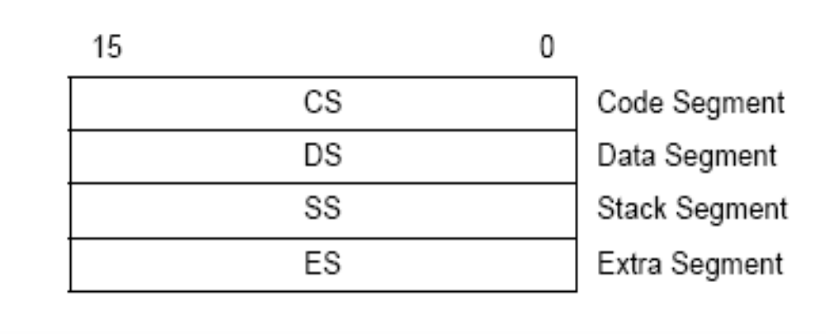
Segment Registers
If a location 109F0 of Code Segment is to be addressed to fetch
An instruction, the physical address will be calculated as follows
CSR = 010A
IP = F950
Effective Address = 109F0

Slide 2
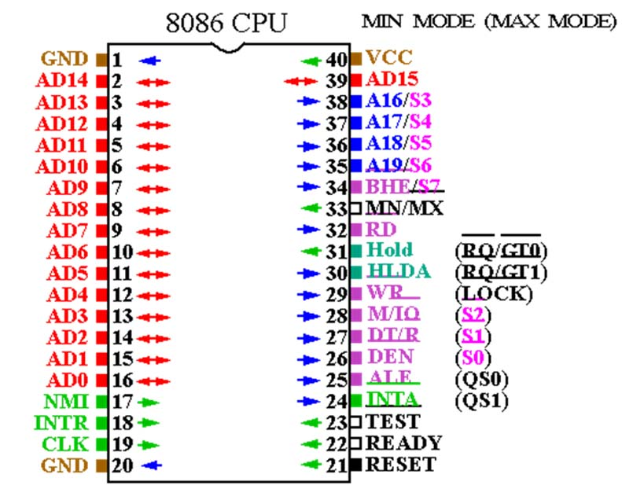

Slide 3
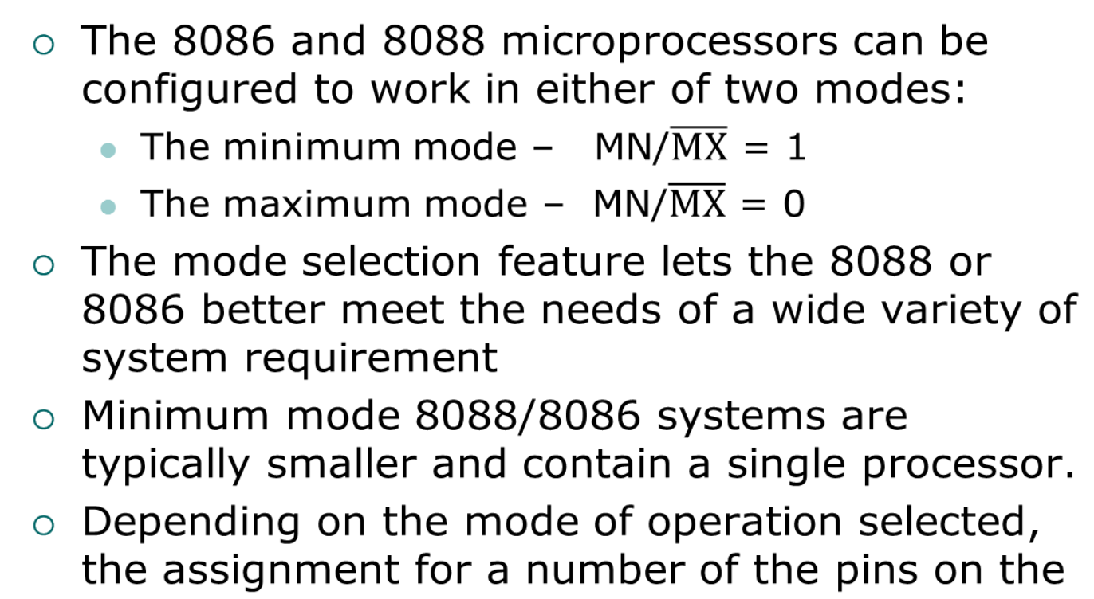
Minimum-Mode and Maximum-
Mode System

Slide 4
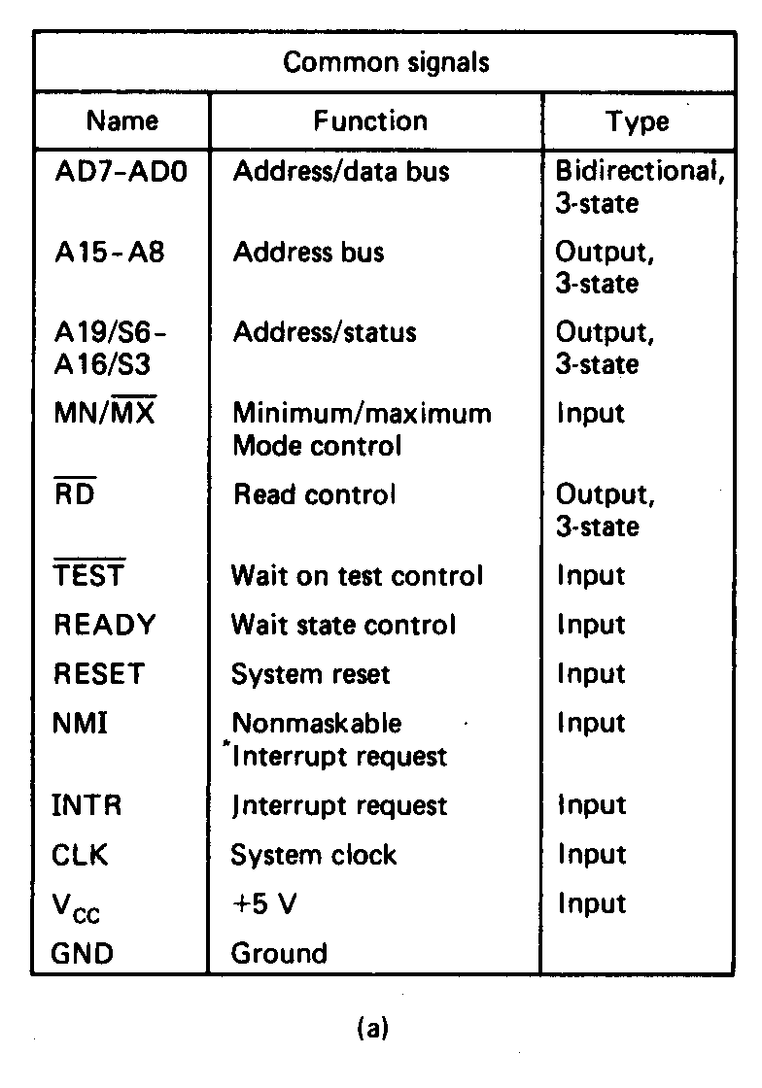
Minimum-Mode and Maximum-
Mode System (cont.)
Signals common to both minimum and maximum mode

Slide 5
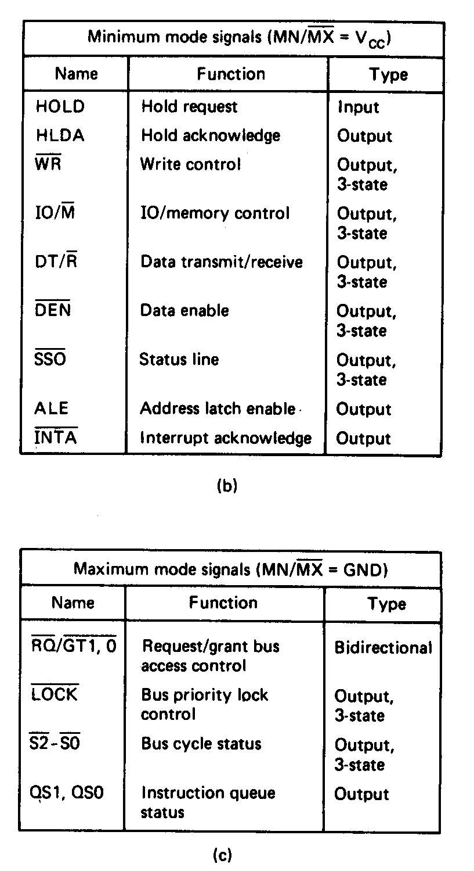
Minimum-Mode and Maximum-
Mode System (cont.)
Unique minimum-mode signals

Slide 6
Minimum-Mode and Maximum-
Mode System (cont.)
Unique maximum-mode signals

Slide 7
PIN DESCRIPTION -8086
Pin 1, 20
Ground
Pin 40
Vcc
Pin 19
CLK
Pin 17
INTR
Pin 18
NMI

Slide 8
AD₁₅ –AD₀ [ Pin 2- 16 &39]
The signal have dual function as in case of the 8085. They act as bus during the first part of machine cycle and as data bus in the later part.
A₁₉/S₆ –A₁₆/S₃ [Pin 35- 38]
Contains address information in the first part and status bits in the later part. The status bits, when decoded, indicates the type of operations (eg. Memory access) being performed and the segment register being used.
S4 S3 SEGMENT REGISTER
0 0 ES
0 1 SS
1 0 CS
1 1 DS
S₅ = IF
S₆ = 0 (ALWAYS)

Slide 9
BHE/S₇ [pin 34]
MN/MX [pin 33]
High – Minimum Mode Operation
Low – Maximum Mode Operation
RD [pin 32]
Read or receive data from M or I/O device
TEST [pin 23]
Relate to wait instruction. The instruction puts the 8086 in idle state which ends only when the TEST input goes low

Slide 10
READY [Pin 22]
Ready is a signal provided by the memory or I/O devices to the microprocesssor.When READY = High, the microprocessor proceeds to process the data in usual manner. When READY = Low, the micropressor goes into wait state and waits for READY to become High.
RESET [Pin 21]
Resets the Processor

Slide 11
……….PIN DESCRIPTION
DEN
Data bus Enable. This signal, when low indicates that the microprocessor address/data bus is to be used as data bus.
HOLD
HLDA

Slide 12
Minimum Mode pin Functions
Pin 24 -31
INTA - Pin 24
ALE - Pin 25
Address Latch Enable. Since data and address are multiplexed on a single bus. ALE is output high to identify a valid address.
DEN -Pin 26
Data Bus Enable. This signal, when low indicates that the microprocessor address/data bus is to be used as data bus.

Slide 13
DT/R - Pin 27
Data transmission/ Receive
M/ IO – Pin 28
WR – Pin 29
HOLD – Pin 30
HLDA - Pin 31

Slide 14
Addressing Modes
Implied Addressing – The data value/data address is implicitly associated with the instruction
Register Addressing – The data is specified by referring the register or the register pair in which the data is present
Immediate Addressing – The data itself is provided in the instruction
Direct Addressing – The instruction operand specifies the memory address where data is located

Slide 15
Addressing Modes
Register indirect addressing – The instruction specifies a register containing an address, where data is located
Based - 8-bit or 16-bit instruction operand is added to the contents of a base register (BX or BP), the resulting value is a pointer to location where data resides
Indexed - 8-bit or 16-bit instruction operand is added to the contents of an index register (SI or DI), the resulting value is a pointer to location where data resides

Slide 16
Addressing Modes
Based Indexed - the contents of a base register (BX or BP) is added to the contents of an index register (SI or DI), the resulting value is a pointer to location where data resides
Based Indexed with displacement - 8-bit or 16-bit instruction operand is added to the contents of a base register (BX or BP) and index register (SI or DI), the resulting value is a pointer to location where data resides

Slide 17
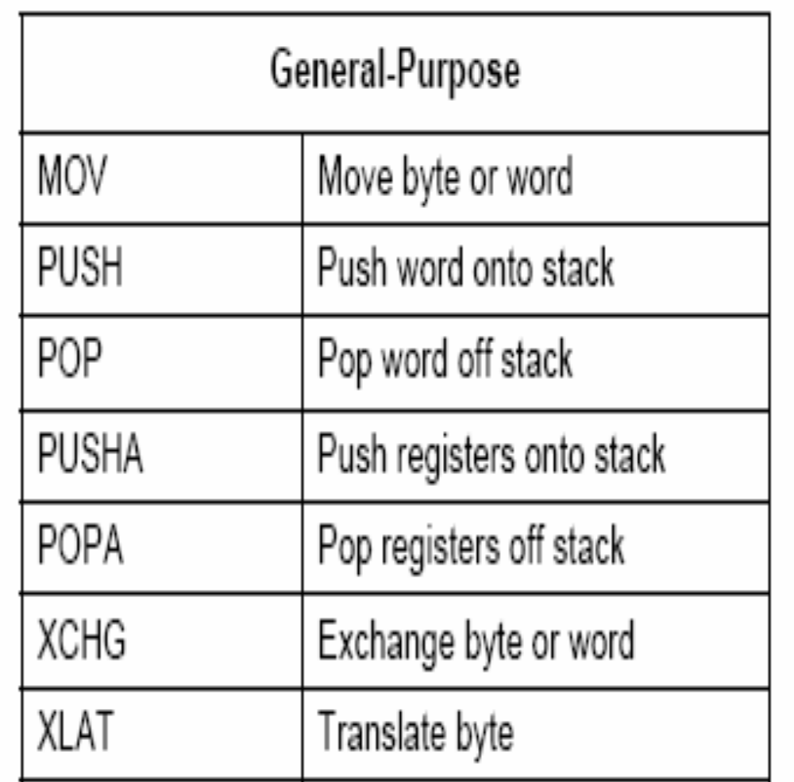
Data Transfer Instructions

Slide 18
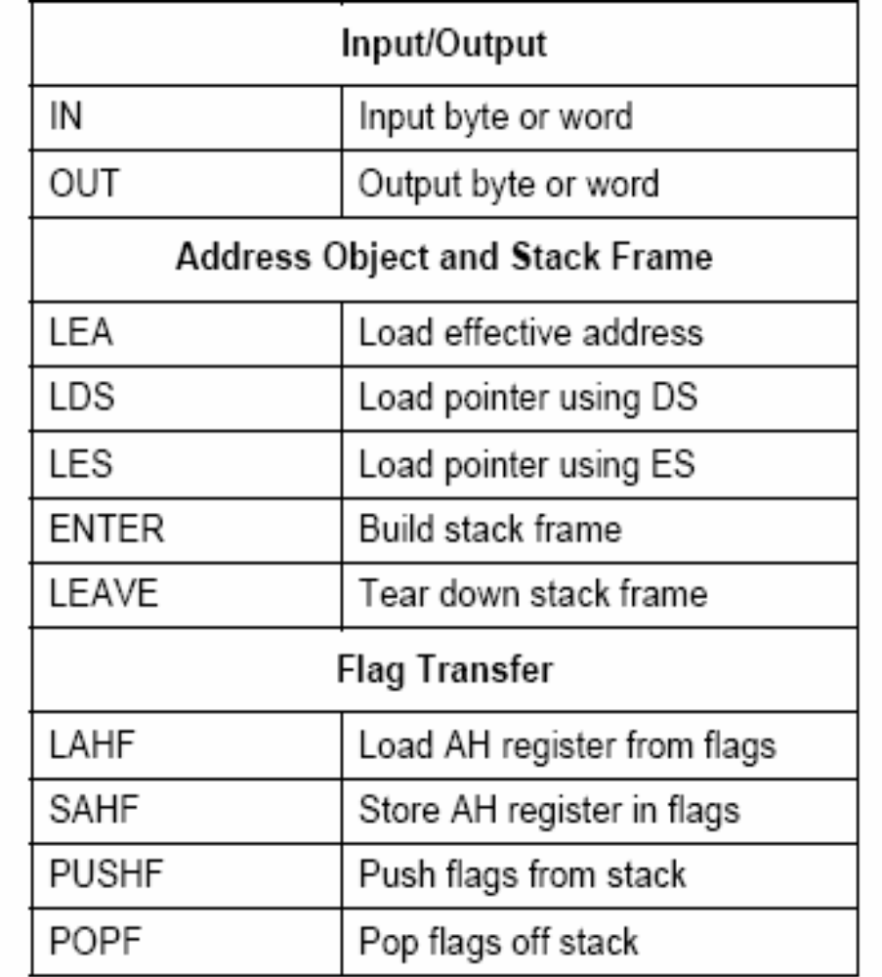
Data Transfer Instructions

Slide 19
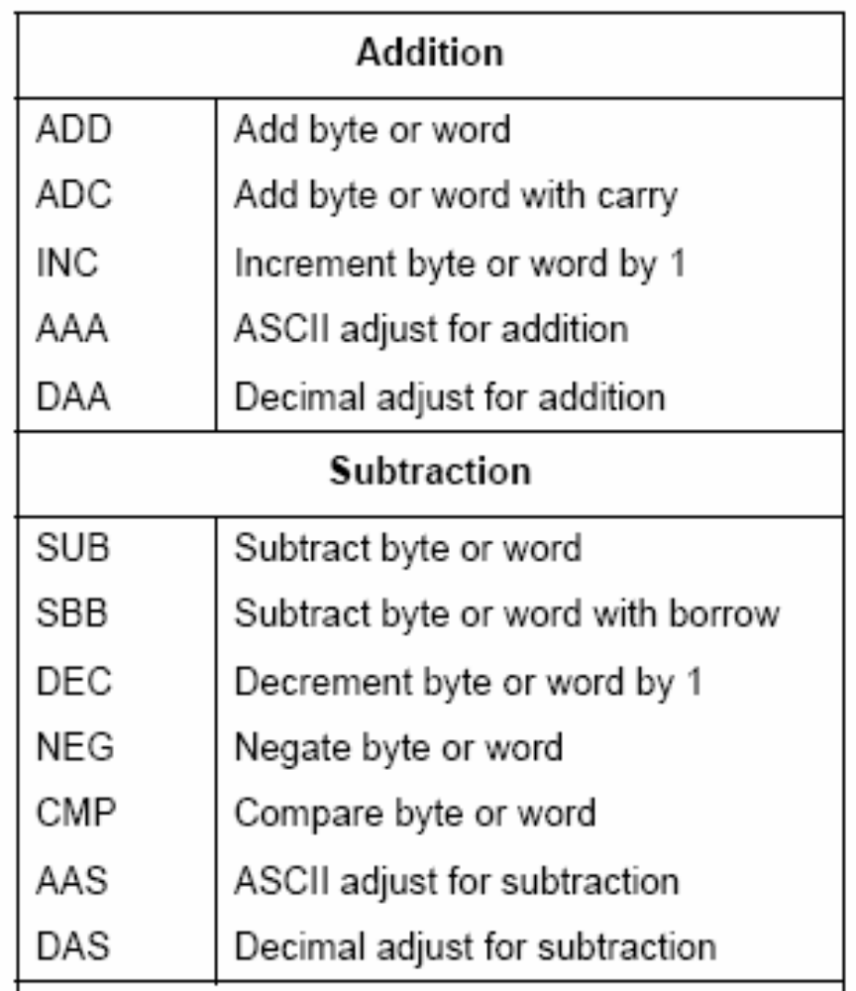
Arithmetic Instructions

Slide 20
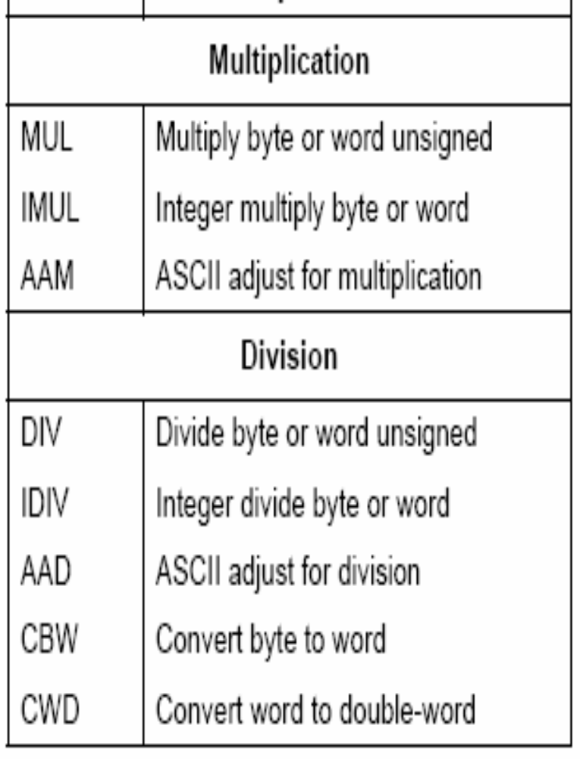
Arithmetic Instructions

Slide 21
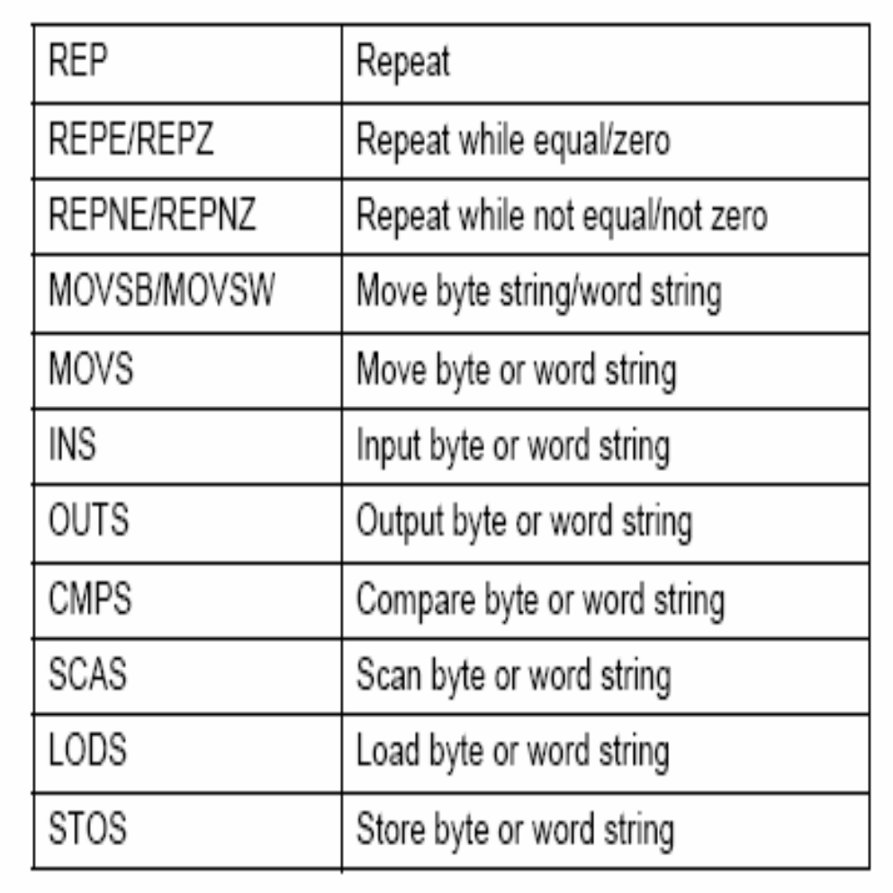
String Instructions

Slide 22
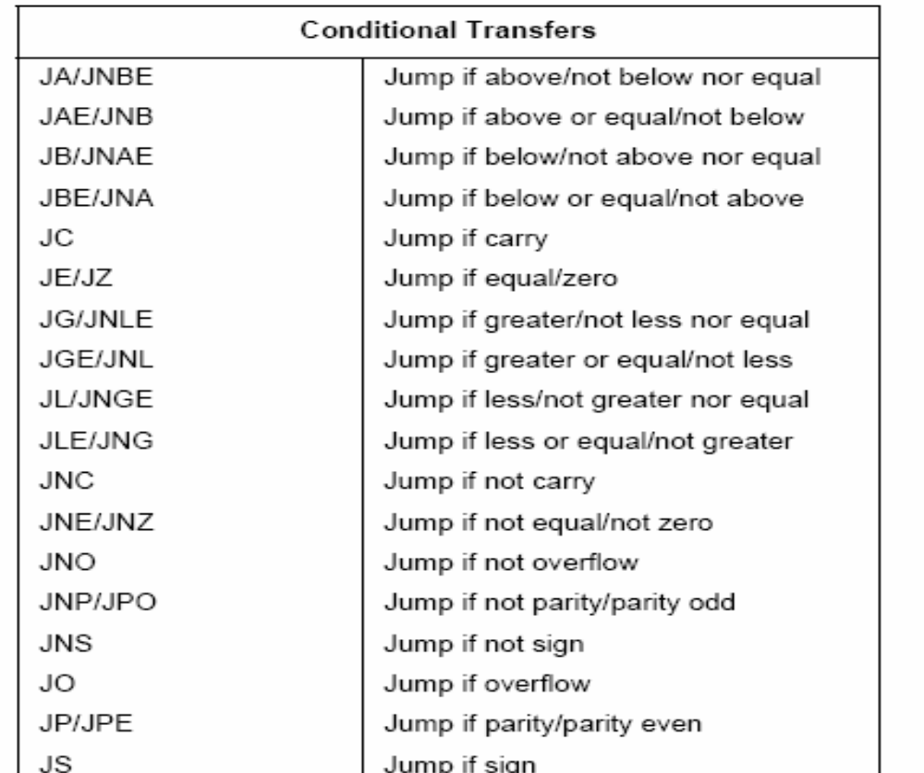
Program Transfer Instructions

Slide 23
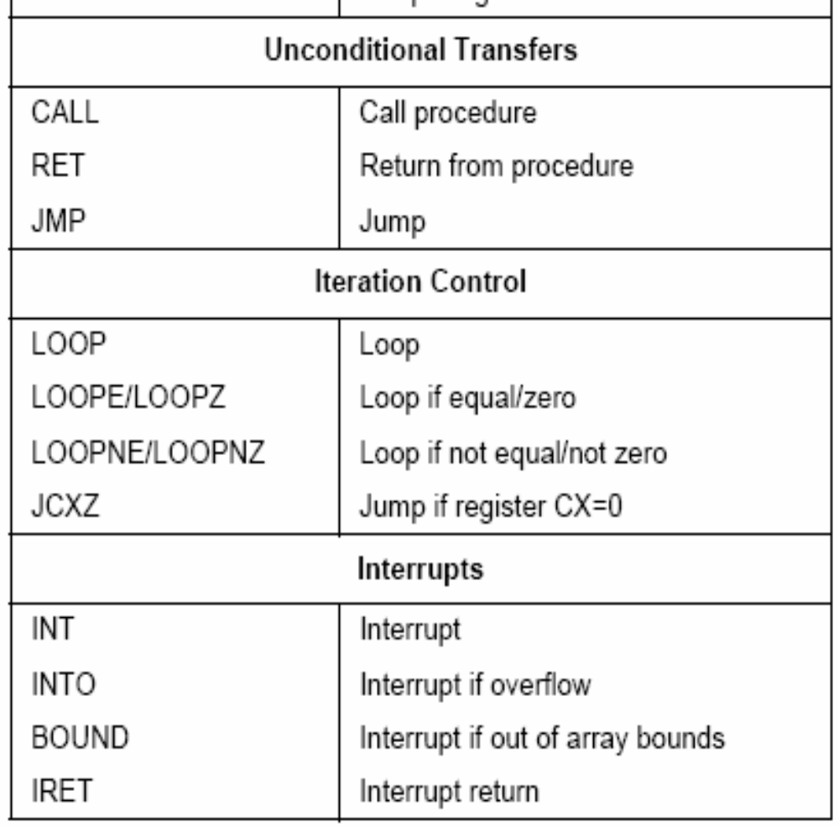
Program Transfer Instructions

Slide 24
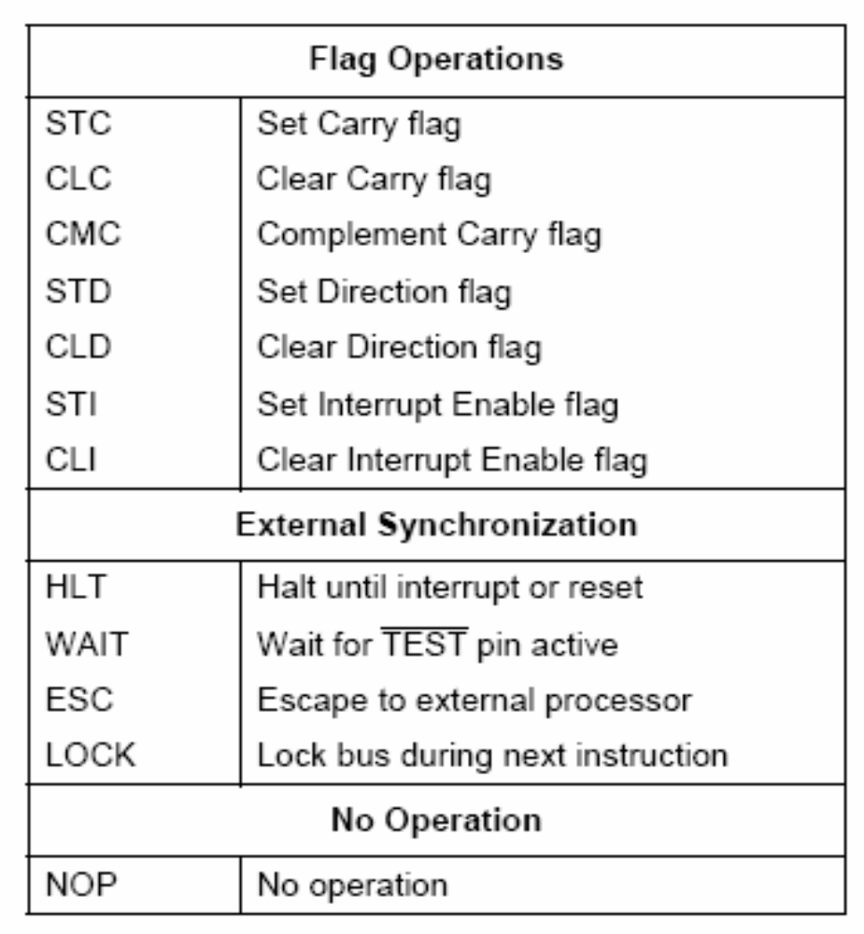
Processor Control Instructions

Slide 25
Assembler Directives
Assembler directives give instruction to the assembler where as other instructions discussed in the above section give instruction to the 8086 microprocessor
Assembler directives are specific for a particular assembler
However all the popular assemblers like the Intel 8086 macro assembler, the turbo assembler and the IBM macro assembler use common assembler directives

Slide 26
Important Directives
The ASSUME directive tell the assembler the name of the logical segment it should use for a specified segment
The DB directive is used to declare a byte-type variable or to set aside one or more storage locations of type byte in memory (Define Byte)
The DD directive is used to declare a variable of type doubleword or to reserve memory locations which can be accessed as type doubleword (Define Doubleword)
The DQ directive is used to tell the assembler to declare a variable 4 words in length or to reverse 4 words of storage in memory (Define Quadword)

Slide 27
Important Directives
The ENDS directive is used with the name of a segment to indicate the end of that logical segment
The EQU is used to give a name to some value or symbol

Slide 28
Assembly Language Program
Writing assembly language programs for 8086 is slightly different from that of writing assembly language programs for 8085
In addition to the instructions that are meant for solving the problem, some additional instructions are required to complete the programs
The purpose of these additional programs is to initialize various parts of the system, such as segment registers, flags and programmable port devices
Some of the instructions are to handle the stack of the 8086 based system

Slide 29
Assembly Language Program
Another purpose of these additional instructions is to handle the programmable peripheral devices such as ports, timers and controllers
The programmable peripheral interfaces should be assigned suitable control words to make them to function in the way as we expect
The best way to approach the initialization task is to make a checklist of all the registers, programmable devices and flags in the system we are working on

Slide 30
Assembly Language Program
An 8086 assembly language program has five columns namely
  Address
  Data or code
  Labels
  Mmnemonics
  Operands
  Comments

Slide 31
Assembly Language Program
The address column is used for the address or the offset of a code byte or a data byte
The actual code bytes or data bytes are put in the data or code column
A label is a name which represents an address referred to in a jump or call instruction
Labels are put in the labels column

Slide 32
Assembly Language Program
The operands column contains the registers, memory locations or data acted upon by the instructions
A comments column gives space to describe the function of the instruction for future reference

