Slide 1
Chapter 9
Web-Based Tools
for
Electronic Commerce
Electronic Commerce

Slide 2
Objectives
Computers that support Web servers
Hardware requirements of typical Web server software packages
Fundamental duties of a Web server
Other ancillary Web server functions
Specific Web server software
Advanced Web server tools

Slide 3
Web Server Hardware and
Performance Evaluation
Key question is whether a company should host their own Web site
Find out what management and sales staff want to accomplish with a server
  Whom do they want to reach?
  Will the server run transactions?
  How involved will the staff be on a daily basis?

Slide 4
Third-party or Internet Service Provider
Web and e-commerce novices do not need hardware or software to launch a site
Fills the often time-consuming staffing requirements
Company does not need to establish a direct Internet connection

Slide 5
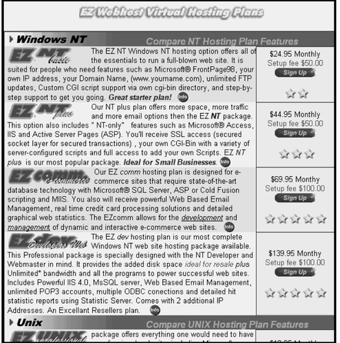
Web Hosting Options

Slide 6
Web Platform Choices
Faster servers are better than slower ones
Good choice for the present, and for the future
Intranet and external traffic demands
Operating systems supported
Scalable

Slide 7
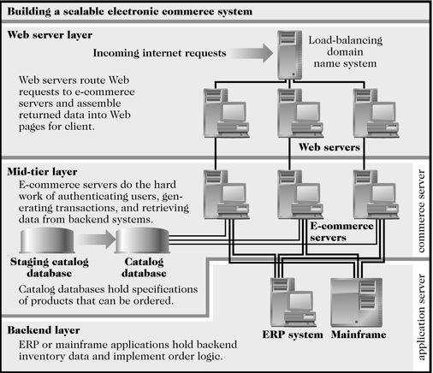

Building a Scalable Electronic Commerce System

Slide 8
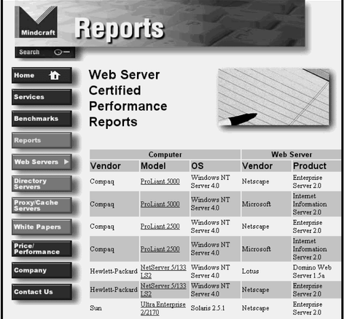
Mindcraft Web Server Performance Reports

Slide 9
Web Server Performance Evaluation
Benchmarking
  Used to compare performance of hardware and software
Connection speed
How many users can the server handle
  Throughput is the number of HTTP requests processed at one time
Mix and type of Web pages affect performance

Slide 10
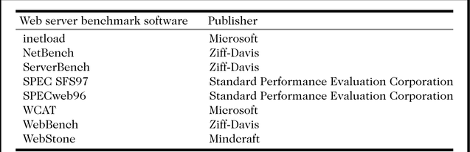

Web Server Benchmark Software

Slide 11
Web Server Software
Feature Sets
Core Capabilities
  Process and respond to Web client requests using the HTTP protocol
Security
  Validation of username and password
  Processing certificates and key pairs
FTP
  Transferring of files to or from the server

Slide 12
Web Server Software
Feature Sets
Searching
  Searches the existing site or entire Web for documents
  Indexing provides full-text indexes for files stored on the server
Data Analysis
  Capture visitor information
    Who, how long, date & time, what pages were visited.

Slide 13
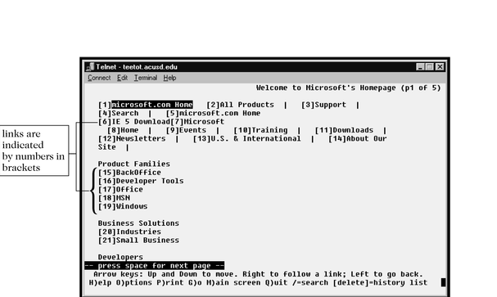
Using Gopher To Access Microsoft.com

Slide 14
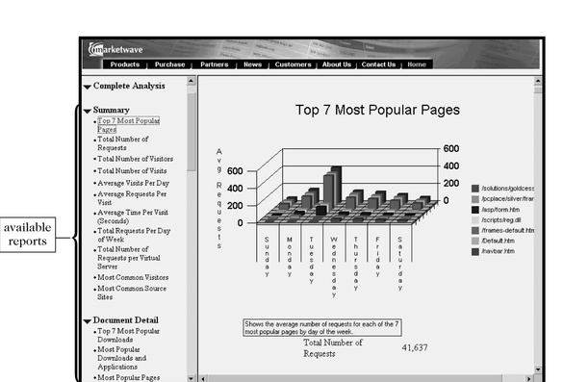

Web Server Log File Report

Slide 15
Site Management
Web management tools
  Microsoft FrontPage
  Allaire HomeSite
Web site validation programs
  Linkbot Pro
  Big Brother
  Siteinspector

Slide 16
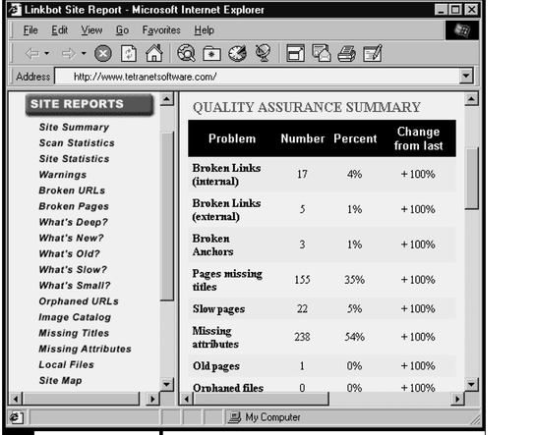

Typical Link Report

Slide 17
Site Management
Application Construction
  Uses Web editors and extensions to produce Web pages
  Don’t need to know CGI or API coding
Dynamic Content
  Information constructed in response to a Web client’s request
  Open DataBase Connectivity (ODBC)
  Active Server Pages (ASP)

Slide 18
Site Development
HTML Web page editors
Software development kits
Web page upload support
Popular software packages include
  FrontPage, Dreamweaver
  Cold Fusion, PageMill
  HoTMetaL Pro, Netscape Composer

Slide 19
Electronic Commerce
Contain templates that simplify the creation of graphics, product and company information, shopping carts, and credit card processing
Perform sales report generation on demand
Advertisements rotated and replaced automatically

Slide 20
Web Server Software and Tools
Apache Http Server
Microsoft Internet Information Server
Netscape Enterprise Server
O’Reilly WebSite Professional
Others

Slide 21
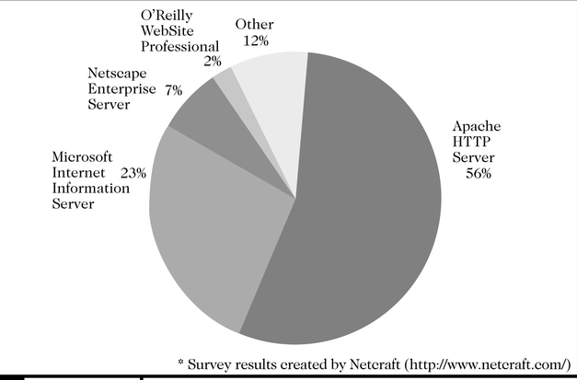
Market Share of Installed Public Web Server Software

Slide 22
Apache HTTP Server
Developed by Rob McCool at the National Center for Supercomputing Applications (NCSA) in 1994
Dominates the Web in numbers, largely because it’s free
Runs on many operating systems
  AIX, BSD/OS, FreeBSD, HP-UX, Irix, Linux, Microsoft NT, QNS, SCO, Solaris

Slide 23
Apache HTTP Server
Security is well thought out
  Password authentication
  Digital certificate authentication
  Access restrictions
Application development tools support CGI and several proprietary APIs
Supports Active Server Pages (ASP) and Java servlets

Slide 24
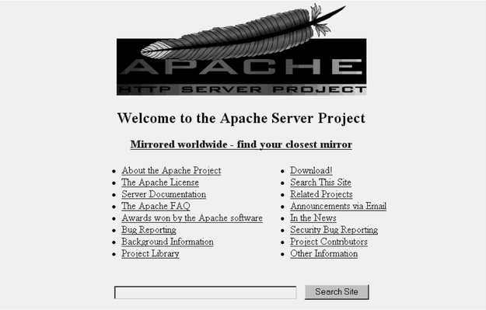

Apache’s Home Page

Slide 25
Microsoft Internet
Information Server
Bundled (free) with Microsoft Windows NT operating system
Robust and capable, suitable for small sites up to enterprise-class sites
Runs only on Windows NT
Central server management from any server on the network
Tightly integrated security with NT

Slide 26
Microsoft Internet
Information Server
Includes ASP support, along with its own Internet Services API (ISAPI)
Database support for ODBC and SQL
Most popular server software for intranet web servers, as reported by PC Magazine

Slide 27
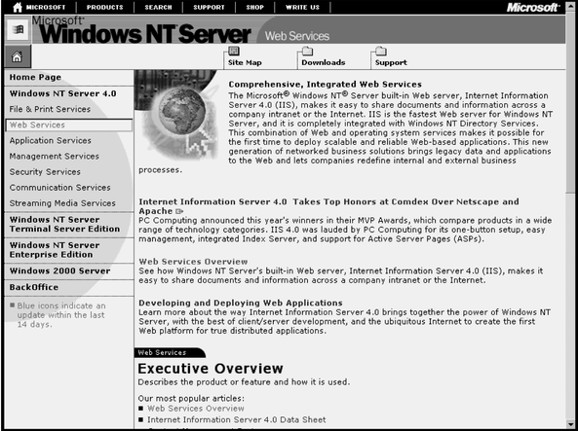
Microsoft’s Internet Information Server Home Page

Slide 28
Netscape Enterprise Server
$1,300 to $2,000 licensing fee
Free 60-day trial
Powerful development environment
  Link management
  Web publishing
  Agent services
  Upload Web pages to host computer without knowing FTP

Slide 29
Netscape Enterprise Server
Verity search engine
  Various indexing formats
    Adobe PDF, Microsoft Word and PowerPoint
    Can convert all to HTML format
Management tools to add, delete, or change user information
Password/challenge user and digital certificate authentication

Slide 30
Netscape Enterprise Server
Dynamic application development
  CGI and Netscape Server API (NSAPI)
  Java Servlet API
  LiveWire runtime environment
Database support, including ODBC
  Oracle
  Sybase
  Informix

Slide 31
Netscape Corporation Browser and Server Offerings
Figure 3-11

Slide 32
O’Reilly’s WebSite Professional
$799 licensing fee
Only supports Windows 95/98 and Windows NT
Various add-on tools
Flexible scripting
Easy installation
Good documentation

Slide 33
WebSite Professional Server Home Page
Figure 3-12

Slide 34
Other Web Server Tools
Web Portals
  “Cyber door” on the Web
  Serves as a customizable home base
  Successful portals include
    Excite
    Amazon.com
    Yahoo!
    Netscape NetCenter
    Microsoft Start

Slide 35
Yahoo! Custom Portal Page
Figure 3-13

Slide 36
Search Engines
A special kind of Web page software that finds other Web pages that match a word or phrase the user enters
Contains three major parts
  Spider, crawler, or bot – searches the Web
  Index – catalogs what is found
  Search engine utility – provides search results

Slide 37
A Search Engine Watch Report
Figure 3-14

Slide 38
Subscribing to a Web Page
Figure 3-15

Slide 39
Push Technologies
An automated delivery of specific and current information from a Web server to the user’s computer’s hard drive
May be used to provide information on
  Health benefit updates
  Employee awards
  Changes in corporate policies
  Other relevant information

Slide 40
Intelligent Agents
A program that performs functions such as information gathering, information filtering, or mediation (running in the background) on behalf of a person or entity
Examples of widely known agents:
  Auction Bot, BargainFinder
  Firefly, Kasbah

Slide 41
Using an Excite Jango Agent
Figure 3-16

Slide 42
Example Uses for Intelligent Agents
Search for the best price and characteristics of various products
Procurement
  Deciding what, when, and how much to purchase
Stock alert
  Monitors stock and notifies when certain conditions are met (purchase 100 shares if the price is below $61 per share)

