Slide 1
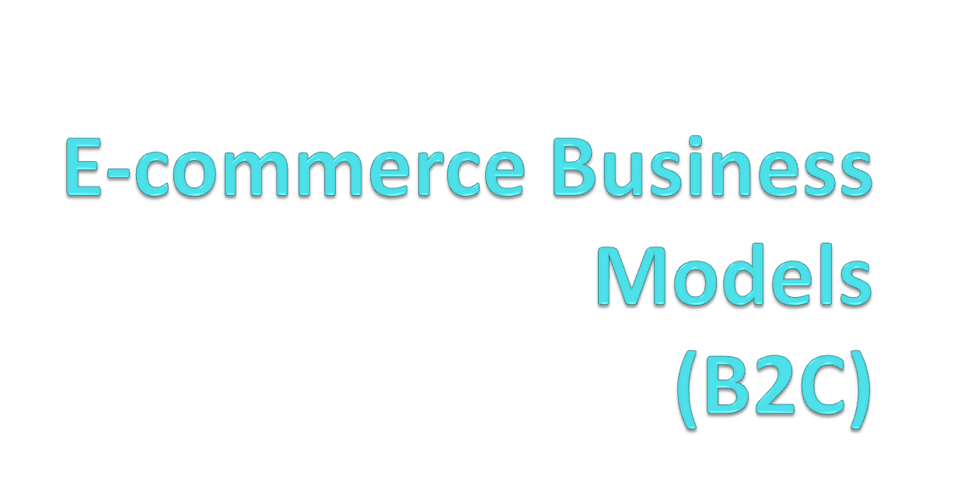

By:- Shyna

Slide 2
Definition
Business model
  A set of planned activities designed to result in a profit in a marketplace.
  A business model is the method of doing business by which a company can sustain itself that is, generate revenue. The business model spells out how a company makes money by specifying its position in the value chain.

Slide 3
Definition Cont…
E-commerce business model
A business model that aims to use and leverage the unique qualities of the Internet and the World Wide Web.
It includes the roles and relationships among a firm's customers, allies, and suppliers; the major flows of product, information, and money; and the major benefits to the participants.

Slide 4
Eight Key Ingredients of a Business Model
Business Model
Components
Key Questions
Value Proposition
Why should the customer buy from you?
Revenue model
How will you earn money?
Market opportunity
What marketspace do you intent to serve, and what is its size?
Competitive environment
Who else occupies your intended marketspace?
Competitive advantage
What special advantages does your firm bring to the marketspace?
Market strategy
How do you plan to promote your products to attract customer?
Organizational
development
What types of organizational structures within the firm are
necessary to carry out the business plan?
Management team
What kinds of experiences and background are important for
the company’s leaders to have?

Slide 5
Raw material producer
RELATION BETWEEN B2B AND B2C
manufacturer
distributor
B2B
retailer
consumer
B2C

Slide 6


Introduction to B2C E-commerce
B2C refers to a business communicating with or selling to an individual rather than a company
B2C
Customer
Business/organization
As the name suggests, it is the model involving business and consumers. In this model, online business sell to individual customers. Business to customer covers those e-commerce websites and transactions trough which organization sell goods to customer over the internet. B2C is also known as internet retailing or E-trailing.

Slide 7
Introduction to B2C E-commerce (Cont…)
This category has expanded greatly in the late 1990s with the growth of public access to the Internet.
The business-to-consumer category includes electronic shopping, information searching (e.g. railway timetables) but also interactive games delivered over the Internet.
Popular items sold using B2C model are airline tickets, books, computers, videotapes, music CDs,toys ,music, health and beauty products, jewellery etc..

Slide 8




B2C e-commerce transactions
VISA
credit card is charged
Order placed by user
Shopping cart
Order form
Order is competed
Shipping carrier picks up shipment
Sent to warehouse
E-mail is sent to customer to merchant

Slide 9
Consumer Shopping Procedure on the Internet
Basic requirement determination.
Search for available items that can meet the requirement.
Compare the candidate items with multiple perspectives
Place an Order.
Pay the Bill.
Receive the delivered items and inspect them.
Contact the vendor to get after-service and support, or to return if disappointed.

Slide 10
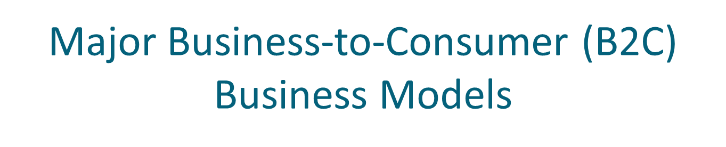
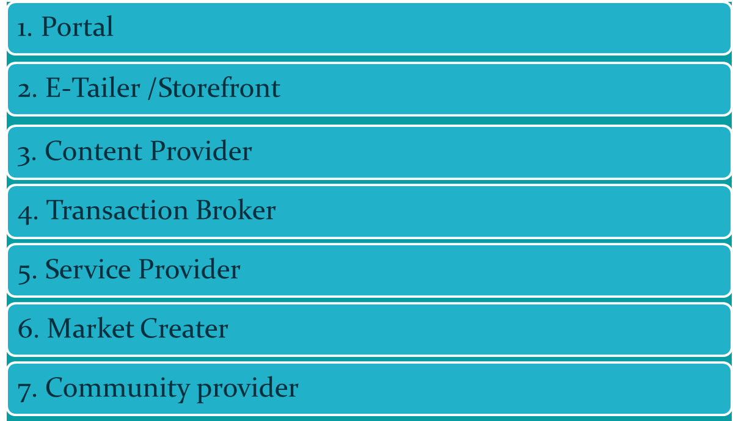

Slide 11

Business Model | Variation | Example | Description
Portal | Overview |  | Portals are “gateways” to the Internet Offers powerful Web searching tools-effiency and ease The portal business model is in addition to serving as a gateway to the Internet; It is a destination site provide an integrated package of content and services all in one place

Slide 12
B2C Business Models: Portal
An integrated package of content like
        News
        weather forecasts
        currency rates
        stock quotes
        phone and map information
Services like
        Entertainment
        Chat
        Game
        Downloads
        Shopping-auction
        E-card
        Sms service
        search

Slide 13
Business Model | Variation | Example | Description
Portal | Horizontal/ General | Yahoo.com msn.com | Offers an integrated package of services and content such as search,e-mail,chat etc. Seeks to be a user’s home base.
 | Vertical/ Specialized | iBoats.com | Offers services and products to specialized marketplace. A gateway or portal to information related to a particular industry, such as human resources, health care, insurance, automobiles, or food manufacturing. Vortals are also seen as likely business-to-business communities

Slide 14
Business Model | Variation | Example | Description
E-tailer/ Storefront | Virtual merchant | Amazon.com, ebooks.com | Online version of retail store where customers can shop 24/7 with comfort.
 | Click and mortar | Walmart.com, bestbuy.com | Online distributor channel for company that also has physical stores.
 | Catalog merchant | LandsEnd.com, llbean.com | Online version of direct catalog. The catalog merchant has generally lower prices than other retailers and lower overhead expenses due to the smaller size of store and lack of large showroom space.
 | Online mall | Fashionmall.com internetmall.com | Online version of mall.
 | Manufacturer direct | Dell.com, unionway.com | Online sales made directly by manufacturers.

Slide 15
Business Model | Variation | Example | Description
Content Provider |  | Sportsline.com, CNN.com, deviantart.com | Information and entertainment providers like newspapers, sports sites or other online sources offering up-to-date information (news, special interest , photos, video, artwork etc) to customers. Infomediaries: electronic intermediaries that control information flow in cyberspace, often aggregating information and selling it to others They do not own but aggregate and distribute the content produced by others

Slide 16
Business Model | Variation | Example | Description
SERVICE PROVIDER |  | xDrive.com, Whatsitworth toyou.com | Companies that make money by selling users a service, rather than a product. Offers services online, like consultancy, trade knowledge, expertise etc. Eg. Window updates offered by microsoft

Slide 17
Business Model | Variation | Example | Description
Transaction broker |  | E-Trade.com, Monster.com | Processors of online sales transactions, such as stock brokers and travel agents that increase customer `s productivity by helping them do things faster. It assists buyers, sellers, or both during transaction and acts as an agent for larger markets. Furthermore, they sell others products rather than their own product. Transaction brokers receive commissions for every transaction that had been successfully concluded in order to sustain their business. One legal advantage to sellers is that the seller is usually not legally responsible for the actions of transaction brokers acting within the scope of the transaction.

Slide 18
Business Model | Variation | Example | Description
Community Provider |  | About.com, iVillage.com | Sites where individuals with particular interests, hobbies and common experience can come together and compare. Communities utilize electronic tools such as forums, chat rooms, e-mail lists, message boards, and other interactive Internet mechanisms, which are usually tailored to the particular community.
Broadly, the community model comes in two basic varieties :-
Centered on relationships.
It revolve around shared interests, ideas, topics, and goals. In these communities, the development of relationships is the primary goal.

Slide 19
Community provider Model (cont..)
To maximize member involvement, community sites must offer maximum degrees of interactivity and personalization.
For example, GeoCities offers space and tools for members to set up their own Web sites and establish virtual communities within the broader GeoCities community.
Centered on tasks
Task-centered communities generally are more structured and impersonal.
The relationships established or augmented online are a means to a mutual end, such as enhanced profits.
More specifically, Web communities are established between business partners, between businesses and their customers, between different groups of customers, within companies, and between individuals and groups devoted to particular topics.

Slide 20
Business Model | Variation | Example | Description
MARKET CREATOR | Auctions and other forms of Dynamic Pricing | eBay.com, Priceline.com, upperbid.com | Web-based businesses that use internet technology to create markets that bring buyers and sellers together. The success factor is: ->Attracting sufficient critical number of sellers and buyers to the marketplace. ->Speed, ability to become operational quickly

Slide 21
English Auctions
Auction and dynamic pricing models
The bidders announce their bids until no higher bid is forthcoming
  ‘going . . . going . . . gone!’
  Ascending-price auctions
  Typically set a closing time in advance
Minimum bid plus a reserve price
Dutch Auctions
Bidding starts at a high price and drops until a bidder accepts the price
  Descending price auctions

Slide 22
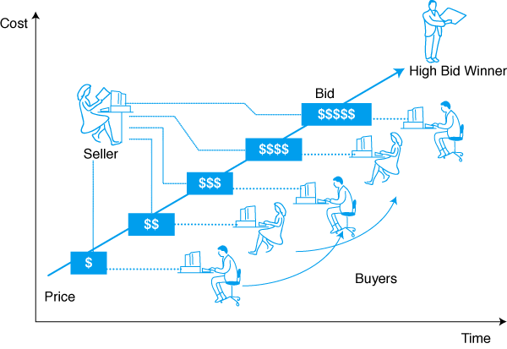
English Auction, Ascending Price

Slide 23
Sealed-Bid Auctions
Bidders submit their bids independently and are usually prohibited from sharing information with each other
First-price sealed-bid auction
  The winner pays his amount
Second-price sealed-bid auction
  The winner pays one increment over the second-highest bid received.
Double Auctions
Buyers and sellers submit bids to an auctioneer
The auctioneer matches the seller’s offers to the buyer’s offer
  E.g. New York Stock Exchange

Slide 24
Comparison-Pricing Model
Demand-Sensitive Pricing Model
Group purchasing
  Individual buyers to shop in large groups to obtain group discount
    The more people who buy a product in a single purchase, the lower the cost per person becomes
  Mercata.com, mobshop.com, demandline.com
Allows customers to poll a variety of merchants and find a desired product/service at the lowest price
Mysimon.com
  Uses intelligent-agent technology
  Offers discussion groups, customer ratings, and comparison shopping

Slide 25

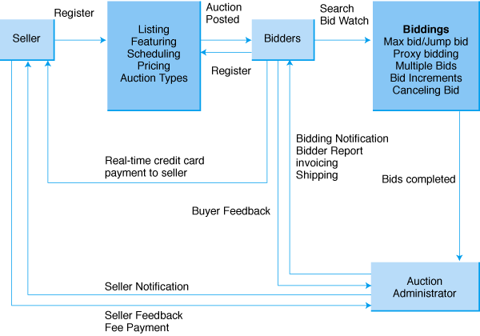

Slide 26
Capabilities and functionalities of B2C Model
With the conduction of business on the internet ,the role and importance of electronic markets has been increasing. It lets increase the efficiency of business performance .
Some of the capabilities which an electronic marketplace has, which speak of their potential are-
Instantaneous communication
It helps in quick communication between the various participants of business systems. It also helps to reduce “Time to Market”.
Global Access
the products and services offered through the electronic markets have global reach and give access to larger and new markets.

Slide 27
Customization
Electronic markets allows to customize or configure goods according to user’s need .
Increased Availability
Since e-commerce provide access to company’s site 24/7 so there is much greater availability of products.
De-intermediation
It helps in elimination the middleman, offering simplified electronic distribution and product differentiation based on customer choice.
Collaboration
They facilitate automation of transactions between electronic enterprises and support real time exchange of information and thus enable collaborative processing.

Slide 28

Thanks

