Slide 1
3-<number>
E-MARKETING 5/E
JUDY STRAUSS AND RAYMOND FROST
Chapter 3: The E-Marketing Plan
©2009 Pearson Education, Inc. Publishing as Prentice Hall

Slide 2
Chapter 3 Objectives
3-2
After reading Chapter 3, you will be able to:
  Discuss the nature and importance of an e-marketing plan and outline its 7 steps.
  Show the form of an e-marketing objective and highlight the use of an objective-strategy matrix.
  Describe the tasks that marketers complete as they create e-marketing strategies.
  List some key revenues and costs identified during the budgeting step of the planning process.
©2009 Pearson Education, Inc. Publishing as Prentice Hall

Slide 3
The Second Life Story
3-<number>
Second Life (SL) is a multiplayer online role-playing game launched in 1999.
SL had 2.3 million residents in 2008 who created SL’s 3-D virtual world.
Over 50,000 businesses, including Adidas, Pontiac, IBM, and Toyota, have a presence in SL.
  Companies are using SL to build product buzz and connect with SL’s residents.
  In-world advertising revenue in the U.S. was $186 million in 2005.
©2009 Pearson Education, Inc. Publishing as Prentice Hall

Slide 4
The Second Life Story, cont.
3-<number>
Research firm Gartner Group believes that 80 percent of active online users will join a virtual world by 2010.
  Are you or your friends a member of a virtual world today?
  Do you think you might join one in the future?
  Do you think SL represents a good business opportunity?
©2009 Pearson Education, Inc. Publishing as Prentice Hall

Slide 5
Overview of the E-Marketing
Planning Process
3-<number>
The e-marketing plan is a blueprint for e-marketing strategy formulation and implementation.
The plan serves as a road map to guide the firm, allocate resources, and make decisions.
©2009 Pearson Education, Inc. Publishing as Prentice Hall

Slide 6
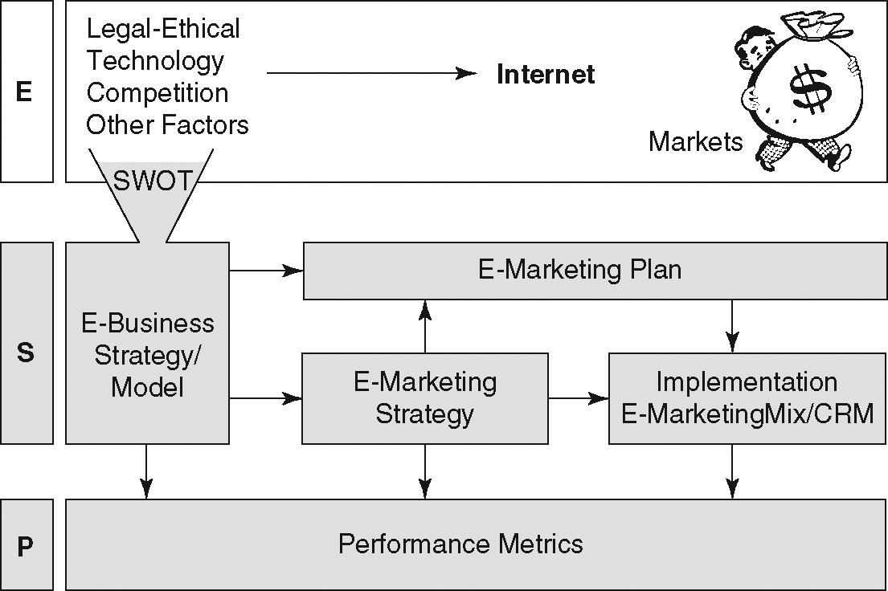
Ex 3.1
3-<number>
©2009 Pearson Education, Inc. Publishing as Prentice Hall

Slide 7
Two Common Types of Plans
3-<number>
Napkin plan
  Entrepreneurs may jot down ideas on a napkin.
  Large companies might create a just-do-it, activity-based, bottom-up plan.
The Venture Capital E-Marketing Plan is a more comprehensive plan for entrepreneurs seeking start-up capital.
©2009 Pearson Education, Inc. Publishing as Prentice Hall

Slide 8
Sources of Funding
3-<number>
Bank loans
Private funds
Angel investors
Venture capitalists (VCs)
©2009 Pearson Education, Inc. Publishing as Prentice Hall

Slide 9
Seven-Step E-Marketing Plan
3-<number>
Situation analysis
E-Marketing strategic planning
Objectives
E-Marketing strategy
Implementation plan
Budget
Evaluation plan
©2009 Pearson Education, Inc. Publishing as Prentice Hall

Slide 10
Step 1: Situation Analysis
3-<number>
Review the firm’s environmental and SWOT analyses.
Review the existing marketing plan and any other information that can be obtained about the company and its brands.
Review the firm’s e-business objectives, strategies, and performance metrics.
©2009 Pearson Education, Inc. Publishing as Prentice Hall

Slide 11
SWOT Analysis Leading to
E-Marketing Objective
3-11
Opportunities | Threats
Hispanic markets growing and untapped in our industry. Save postage costs through e-mail marketing. | Pending security law means costly software upgrades. Competitor X is aggressively using e-commerce.
Strengths | Weaknesses
Strong customer service department. Excellent Web site and database system. | Low-tech corporate culture. Seasonal business: Peak is summer months.
E-Marketing Objective: $500,000 in revenues from e-commerce in one year.
©2009 Pearson Education, Inc. Publishing as Prentice Hall

Slide 12
Step 2: E-Marketing Strategic Planning
3-<number>
Market and product strategies, called Tier 1 tasks or strategies, are outcomes of strategic planning.
  Segmentation
  Targeting
  Differentiation
  Positioning
Marketers conduct analyses to determine strategies.
  Market opportunity analysis
  Demand analysis
  Segment analysis
  Supply analysis
©2009 Pearson Education, Inc. Publishing as Prentice Hall

Slide 13
Step 3: Objectives
3-<number>
An objective in an e-marketing plan may include the following aspects:
  Task (what is to be accomplished)
  Measurable quantity (how much)
  Time frame (by when)
©2009 Pearson Education, Inc. Publishing as Prentice Hall

Slide 14
Step 3: Objectives, cont.
3-<number>
Most e-marketing plans aim to accomplish objectives such as the following:
  Increase market share
  Increase the number of comments on a blog
  Increase sales revenue
  Reduce costs
  Achieve branding goals
  Increase database size
  Achieve customer relationship management goals
  Improve supply chain management
©2009 Pearson Education, Inc. Publishing as Prentice Hall

Slide 15
Step 4: E-Marketing Strategies
3-<number>
Tier 2 strategies include strategies related to the 4 P’s and relationship management to achieve plan objectives.
  Product strategies
  Pricing strategies
    Dynamic pricing
    Online bidding
©2009 Pearson Education, Inc. Publishing as Prentice Hall

Slide 16
Step 4: E-Marketing Strategies, cont.
3-<number>
  Distribution strategies
    Direct marketing
    Agent e-business models
  Marketing communication strategies
  Relationship management strategies
    Some firms use CRM (customer relationship management) or PRM (partner relationship management) software to integrate customer communication and purchase behavior into a database.
©2009 Pearson Education, Inc. Publishing as Prentice Hall

Slide 17
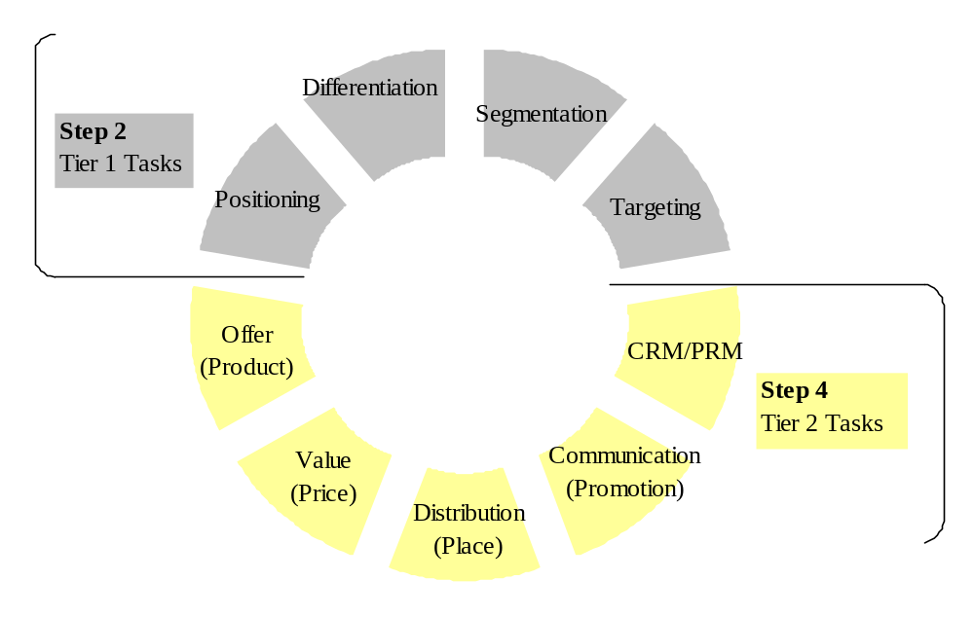
Steps 2, 3, and 4 of the E-Marketing Plan
3-17
©2009 Pearson Education, Inc. Publishing as Prentice Hall

Slide 18
Step 5: Implementation Plan
3-<number>
Tactics are used to achieve plan objectives
  Marketing mix (4 Ps) tactics
  Relationship management tactics
  Marketing organization tactics
    Staff
    Department structure
  Information-gathering tactics
    Web site log analysis
    Business intelligence and secondary research
©2009 Pearson Education, Inc. Publishing as Prentice Hall

Slide 19
Step 6: Budget
3-<number>
The plan must identify the expected returns from marketing investments, including:
  Cost/benefit analysis
  ROI calculation
  Internal rate of return (IRR) calculation
  Return on marketing investment (ROMI)
©2009 Pearson Education, Inc. Publishing as Prentice Hall

Slide 20
Revenues and Costs
3-<number>
  Revenue forecast
  Intangible benefits, such as brand equity
  Cost savings
  E-Marketing costs
    Technology
    Site design
    Salaries
    Other site development expenses
    Marketing communication
    Miscellaneous
©2009 Pearson Education, Inc. Publishing as Prentice Hall

Slide 21
Step 7: Evaluation Plan
3-<number>
Marketing plan success depends on continuous evaluation.
  E-marketers must have tracking systems in place to measure results.
  Various metrics relate to specific plan goals.
Today’s firms are ROI driven.
  E-marketers must show how intangible goals will lead to higher revenue.
  Accurate and timely metrics can help justify expenditures.
©2009 Pearson Education, Inc. Publishing as Prentice Hall

Slide 22

©2009 Pearson Education, Inc. Publishing as Prentice Hall

