Slide 1


IILM UNIVERSITY
GREATER NOIDA
Data Analytics with Python & Power BI
8-Week Internship
INTERNSHIP PRESENTATION
STUDENT NAME
Piyush Kumar
ENROLLMENT NUMBER
2410030021
PROGRAM & SEMESTER
B.Tech CSE • 5th Semester
ORGANIZATION
EduSkills Academy
IILM University • Internship Presentation
1

Slide 2
Internship Overview
A structured 8-week learning journey in data analytics
Domain
Duration
Focus
Data Analytics with Python & Power BI
8-week internship program
Python • Pandas • SQL • Power BI • Visualization
• Built foundations in Python for data analysis.
• Learned data cleaning and preprocessing with Pandas.
• Developed SQL skills for data extraction and analysis.
• Explored Power BI modeling, DAX, visualization and collaboration.
• Applied skills through real-world projects and a capstone dashboard.
IILM University • Internship Presentation
2

Slide 3
Learning Objectives
Core capabilities developed during the internship
Python for Analysis
Data Preparation
SQL Analytics
Environment setup, core Python and analytical programming.
Cleaning and preprocessing using Pandas.
SQL fundamentals, advanced SQL techniques and data extraction.
Business Intelligence
Integrated Workflow
Project Practice
Power BI basics, data modeling, DAX and advanced visuals.
Python + SQL + Power BI integration and collaboration.
Sales, customer behavior and e-commerce analytics projects.
IILM University • Internship Presentation
3

Slide 4
Python for Data Analysis
From environment setup to practical data visualization
PYTHON SKILLS
• Environment setup for data analytics.
• Core Python concepts for data analysis.
• Python for data extraction and analytical workflows.
• Python for data visualization.
• Integration of Python with Power BI.
Python
Data
Analysis
Visualization
IILM University • Internship Presentation
4

Slide 5
Data Cleaning, Pandas & SQL
Turning raw data into analysis-ready information
Data Cleaning & Preprocessing
SQL Fundamentals
Pandas-based cleaning and preprocessing workflows for reliable analysis.
SQL foundations for working with structured data and analytical queries.
Advanced SQL
Python + SQL
Advanced SQL techniques and data extraction for deeper analysis.
Integration of Python and SQL for practical data extraction workflows.
IILM University • Internship Presentation
5

Slide 6
Power BI & Business Intelligence
Building interactive dashboards and analytical models
• Power BI visualization — basics to advanced visualizations.
• Data modeling and DAX basics.
• Interactive reporting and dashboard design.
• Power BI Service and collaboration.
• Python & Power BI integration.
SALES
CUSTOMERS
GROWTH
₹ 8.4M
12.6K
18.7%
IILM University • Internship Presentation
6

Slide 7
Visualization & Integrated Analytics
Connecting tools to communicate insights clearly
Python
SQL
Power BI
Insights
Prepare & explore
Extract & query
Model & visualize
Communicate
KEY PRACTICE
• Use Python for analytical exploration and visualization.
• Use SQL for structured extraction and querying.
• Use Power BI for modeling, interactive visuals and collaboration.
IILM University • Internship Presentation
7

Slide 8
Real-World Projects
Practical application of analytics skills
01 • Sales Performance Analysis
02 • Customer Behavior Analysis
Applied data analytics concepts to study sales performance and generate business-oriented insights.
Worked with customer-oriented analytics to understand behavior patterns and support data-driven interpretation.
03 • Project Workflow
04 • Practical Integration
Practiced best practices and structured project workflow from data preparation through analysis and reporting.
Combined Python, SQL and Power BI concepts into an end-to-end analytics learning experience.
IILM University • Internship Presentation
8

Slide 9
Capstone Project
E-commerce Sales & Customer Insights Dashboard
CAPSTONE
Revenue
Orders
Customers
E-commerce Sales & Customer Insights Dashboard
₹ 4.8M
18.2K
9.7K
• Capstone project completed as part of the internship.
• Brings together analytics, visualization and dashboarding skills.
• Focuses on sales and customer insights in an e-commerce context.
IILM University • Internship Presentation
9

Slide 10
Key Skills & Outcomes
Capabilities demonstrated through the internship
Python
Pandas
Core Python for data analysis and visualization
Data cleaning & preprocessing
SQL
Power BI
Fundamentals, advanced techniques & extraction
Visualization, modeling, DAX & Service
Integration
Analytics Projects
Python + SQL + Power BI workflows
Sales, customer behavior & e-commerce dashboard
IILM University • Internship Presentation
10

Slide 11
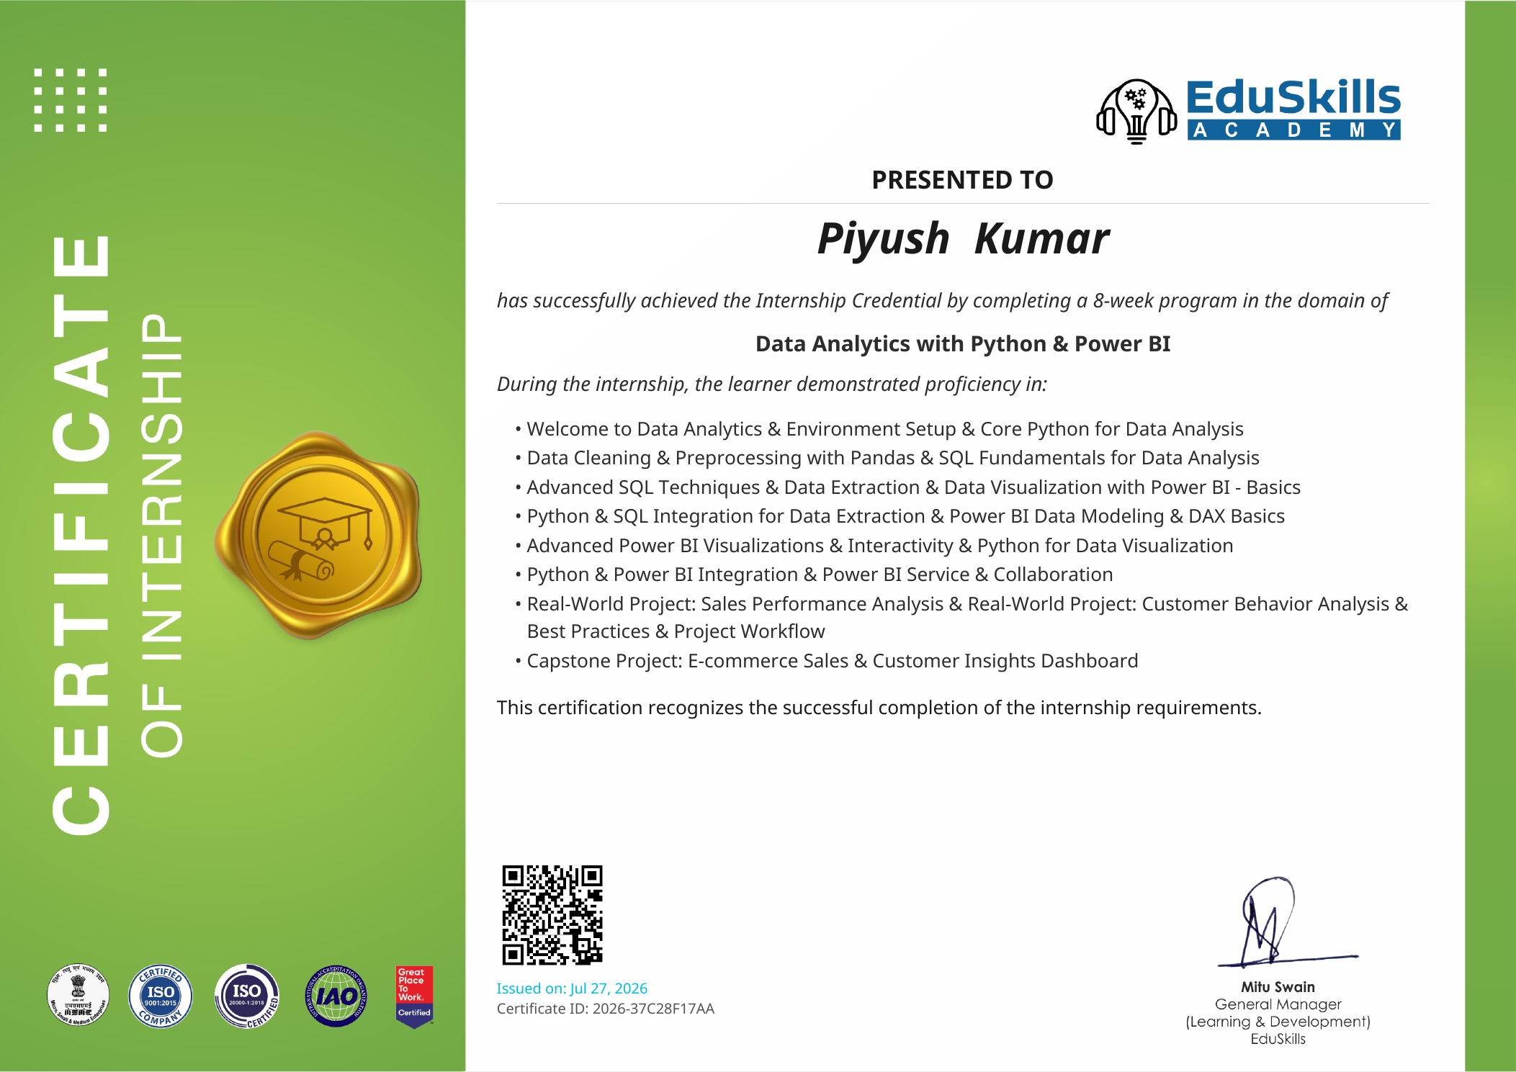
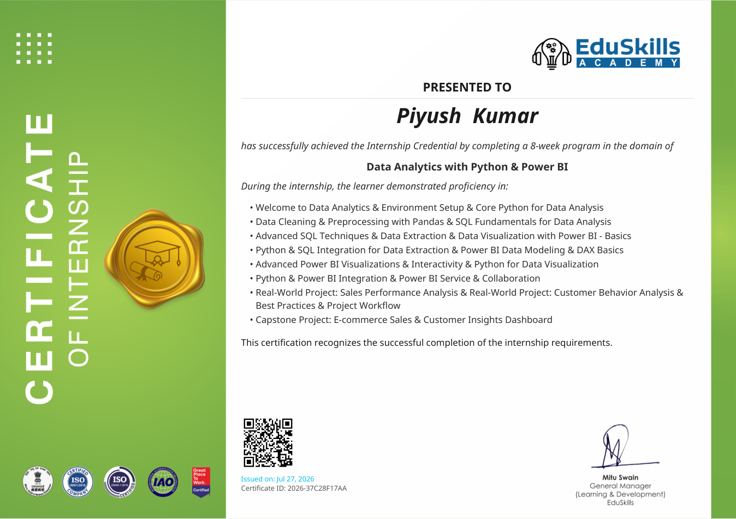
Internship Certificate
Certificate issued by EduSkills Academy
IILM University • Internship Presentation
11

Slide 12
Thank You
Internship Presentation
Data Analytics with Python & Power BI
Piyush Kumar • B.Tech CSE • IILM University, Greater Noida
8-Week Internship • EduSkills Academy

