Slide 1
Facial Expression Recognition

Slide 2
Objective
Combination of face detection and Facial-Expression Recognition
So far:
We implemented face detection and Expression recognition Using FER2013 Dataset from Kaggle
Next, we will try to do real time Expression recognition with web cam

Slide 3
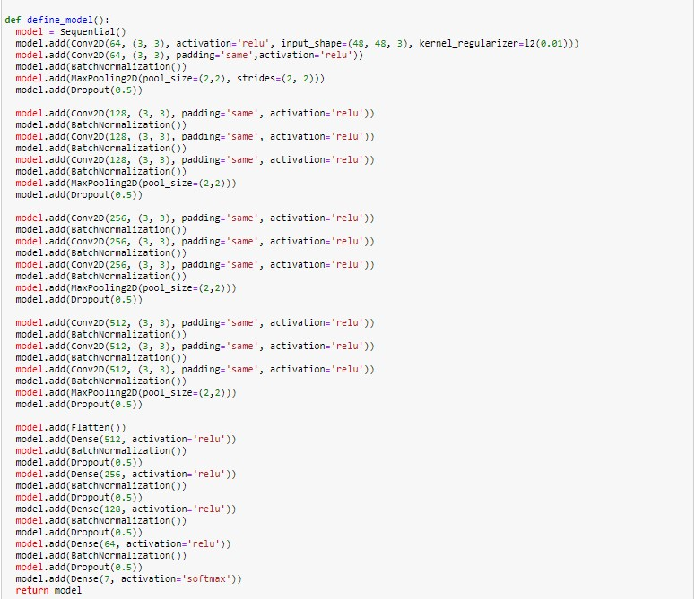
Implementations
Performing preprocessing tasks on the dataset like normalizing the data and splitting the train dataset in 4:1 ratio for training and validation phase
Defined the custom model which contains 11 convolutional layers and 5 fully connected layers.

Slide 4
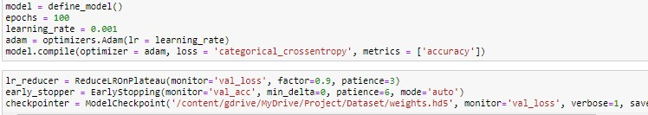
Implementations
Introduced Batch Normalization layer to deal with covariate shift and dropout layer to avoid overfitting of data
Trained the model for 100 epochs with learning rate as 0.001, Adam optimizer and loss function as categorical cross entropy

Slide 5
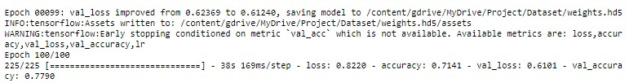
Implementations
After training for 100 epochs, the training accuracy of the model is 71%, validation accuracy is 0.77% and testing accuracy is 67.5%

Slide 6
Using Transfer Learning
Using a pre-trained MobileNetV2 model for transfer learning with FER2013.
The model contains 3,538,984 parameters out of which 3,504,872 trainable parameters. Trained the model for 50 epochs with learning rate as 0.001, Adam optimizer and loss function as categorical cross entropy
the training accuracy of the model is 95%, validation accuracy is 90.2% and testing accuracy is 66.4%.

Slide 7
Face Detection
We used MTCNN(Multi-task Cascaded Convolutional Neural Networks) to detect the human faces in the image and passing the identified face to the trained model for detecting the emotion. Drawing a box around the face of a person and displaying the person's emotion.

Slide 8
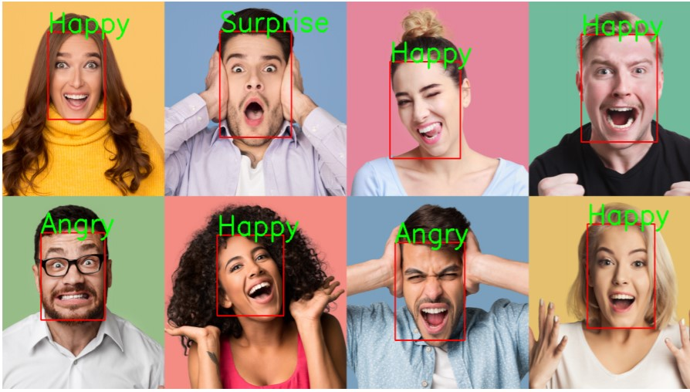
Output

