Slide 1
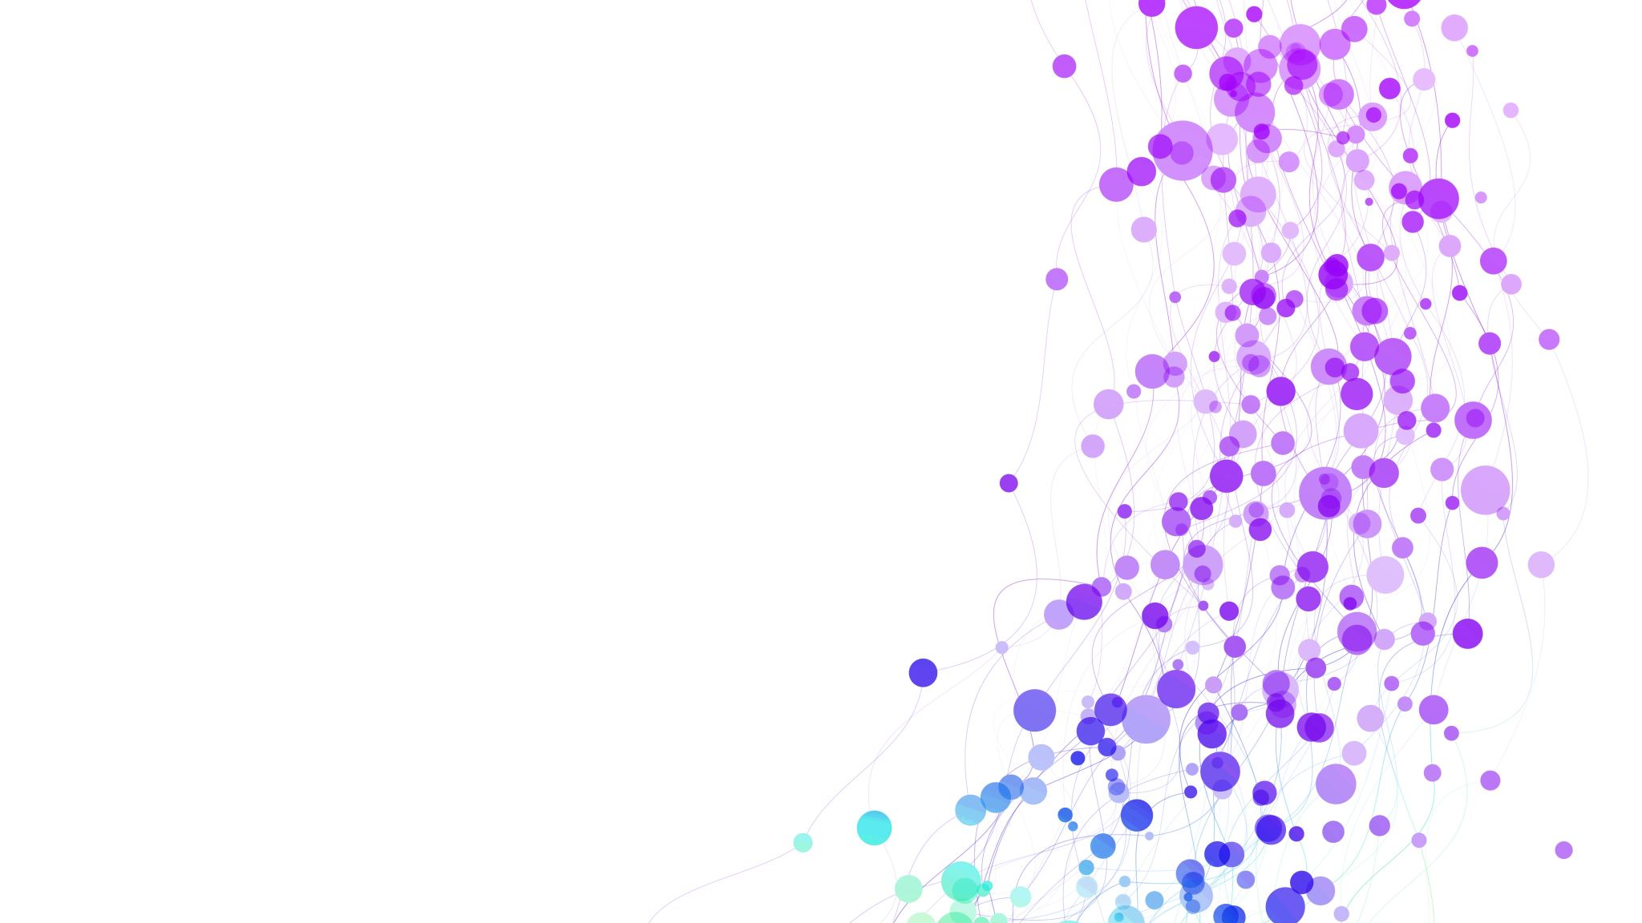
Key Insights

Slide 2
Engaging Steps:
Step 2, 6, and 9 are the most engaging steps.
Step 4 is the least engaging step.
Frequently Asked & Least Asked Questions:
Most Frequently Asked Question: "Reason for attending the event"
Least Asked Question: "What is your company's annual purchasing budget"
Top 4 Exhibitor Category
12.2 NTO: National tourism office
14.6 Gastro tourism
1.3 Hostel Motel
3.2 Authorized travel agency
Vigitors can be grouped on the basis of unique question answere
Use topic modeling to find key theme in the visitors answer
Use K-Means clustering in whicn visitors are grouped
Create Hybrid model using classical machine learning and Semantic search

Slide 3
Recommendations

Slide 4
Organize the popular categories on prime location
Promote non popular categories to attract more visitors
Improve visitor experience using personalised recommendation
Enhance exhibitor engagement
Visual anlytics Dashboard
Create Hybrid model using classical machine learning and Semantic search

