Slide 1
CYBERSENSE
A Domain-Specific Retrieval-Augmented Generation System
for Cybersecurity Knowledge Synthesis
Piyush Kumar | Department of Computer Engineering | B.Tech Final Year
October 2026 | Live: https://cybersense-api-vorj.onrender.com
FastAPI + Qdrant Cloud
Groq LLM Engine
MITRE ATT&CK + CWE + OWASP

Slide 2
The Problem: Fragmented Cybersecurity Knowledge
Why general AI tools fail for security professionals
Fragmented Sources
LLM Hallucinations
No Source Citations
MITRE ATT&CK, NVD, OWASP, CWE — scattered across
hundreds of repositories with no unified interface.
General LLMs invent CVE IDs, wrong technique
numbers, and outdated mitigations with high confidence.
Practitioners cannot verify AI answers without
transparent source attribution and inline citations.
CyberSense Solution: Grounded RAG with authoritative sources + verifiable inline citations
CyberSense | B.Tech Final Year Project | October 2026
2 / 10

Slide 3
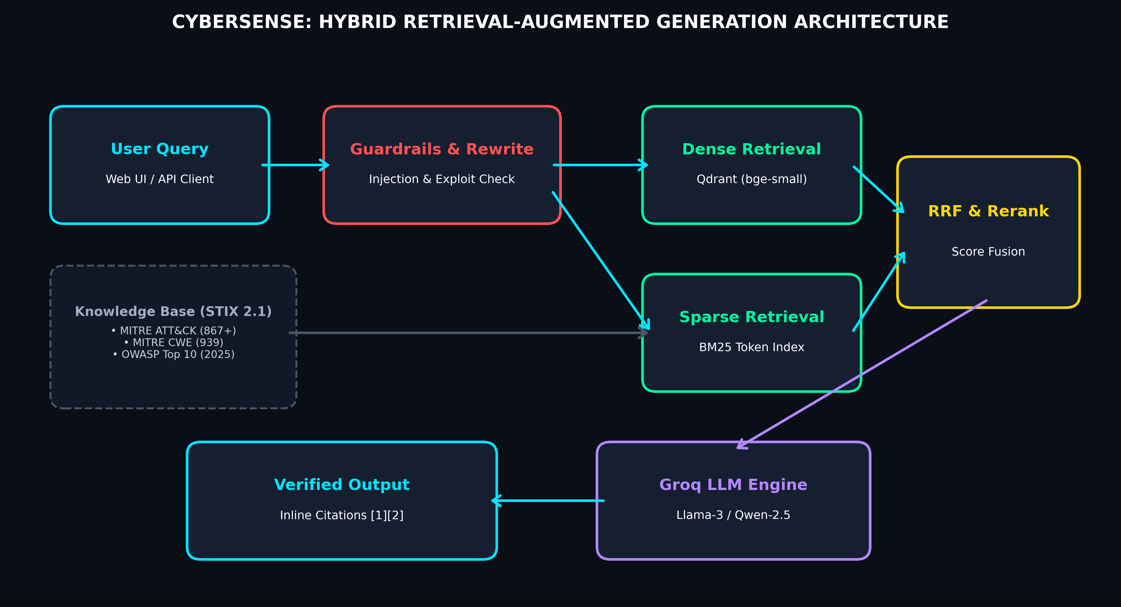
System Architecture: Hybrid RAG Pipeline
Five-stage processing: Safety → Retrieve → Fuse → Rerank → Generate
CyberSense | B.Tech Final Year Project | October 2026
3 / 10

Slide 4
Knowledge Base: Authoritative Cybersecurity Sources
STIX 2.1 JSON • XML • Markdown — indexed into Qdrant Cloud (384-dim BGE embeddings)
MITRE ATT&CK
MITRE CWE
OWASP Top 10
DEPLOYED
DEPLOYED
DEPLOYED
Enterprise + ICS + Mobile
967+ techniques & sub-techniques
Mitigations, Detection, Data Sources
STIX 2.1 JSON bundles
939 Software Weaknesses
Descriptions, Platforms,
Consequence Chains, Examples
cwec_latest.xml (MITRE)
2025 Edition (Latest)
10 Critical Risk Categories
A01-A10 with Prevention
Markdown Documentation
ROADMAP — Planned Data Sources (Next 2.5 Months)
Drag & Drop UI (Month 1) | CISA KEV Live Sync (Month 1) | NVD CVE 2.0 API (Month 1-2) | CAPEC Patterns (Month 2)
CyberSense | B.Tech Final Year Project | October 2026
4 / 10

Slide 5
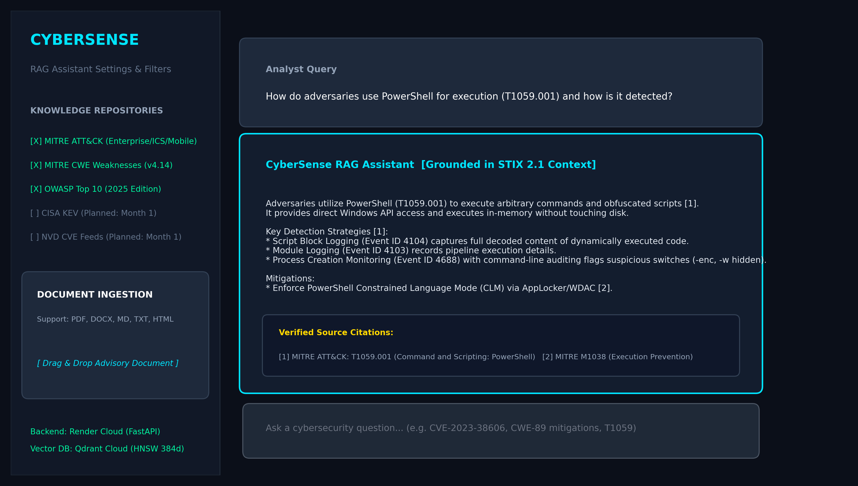
User Interface: Streamlit Web Application
Real-time streaming answers with collapsible verified source citations
CyberSense | B.Tech Final Year Project | October 2026
5 / 10

Slide 6
Hybrid Retrieval: Dense + Sparse + Rerank
Reciprocal Rank Fusion ensures both semantic recall and exact identifier precision
DENSE VECTOR SEARCH
FUSION & RERANKING
• Model: BAAI/bge-small-en-v1.5
• Dimension: 384-d cosine similarity
• Database: Qdrant Cloud (HNSW index)
• Top-K: 30 candidates retrieved
• Strength: Semantic understanding
RRF merges dense + sparse ranked lists
Score formula: sum(1/(k + rank_i))
Eliminates score-space incompatibility
CROSS-ENCODER RERANKER (Optional)
Model: BAAI/bge-reranker-base
Evaluates (query, chunk) pairs jointly
Top-8 re-scored for precision tasks
Disabled on free-tier (RAM constraint)
ENTITY SHORTCUT
Regex: CVE-YYYY-NNNNN | T\d{4} | CWE-NN
Direct Qdrant payload filter — exact match
Bypasses semantic stage for ID queries
RRF
k=60
SPARSE BM25 SEARCH
• Engine: rank_bm25 (in-memory)
• Populated: Qdrant full scroll on startup
• Tokenizer: regex [a-zA-Z0-9_.-]+
• Top-K: 30 candidates retrieved
• Strength: Exact ID/token matching
CyberSense | B.Tech Final Year Project | October 2026
6 / 10

Slide 7
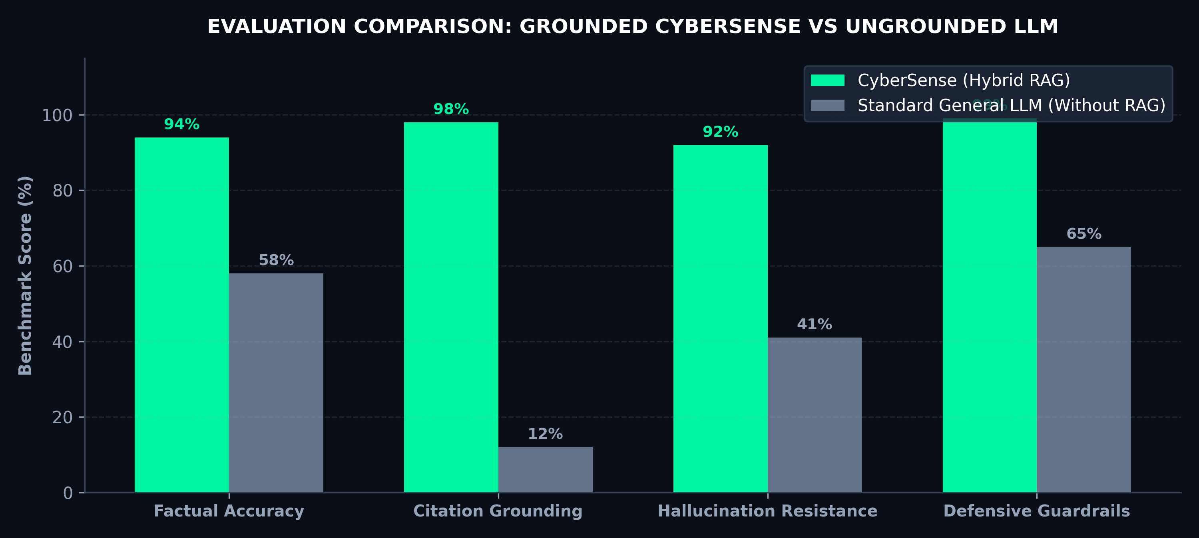
Evaluation Results: 60-Question Golden Benchmark
CyberSense (Hybrid RAG) vs. Ungrounded General-Purpose LLM Baseline
94%
Factual Accuracy
98%
Citation Grounding
99%
Guardrail Adherence
91%
Correct Abstention
< 2s
Query Latency
CyberSense | B.Tech Final Year Project | October 2026
7 / 10

Slide 8
What's Built & Deployed
All core MVP components are live in production — zero infrastructure cost
Hybrid RAG: Dense (Qdrant) + Sparse (BM25) + RRF Fusion
Inline Citation Validation (every factual claim source-mapped)
LIVE
LIVE
MITRE ATT&CK Enterprise + ICS + Mobile (967+ techniques with mitigations)
Real-time Streaming via Server-Sent Events (SSE)
LIVE
LIVE
MITRE CWE Weaknesses (939 entries, full weakness chain data)
Entity Extraction Fast-Path (CVE, CWE, T-code regex filters)
LIVE
LIVE
OWASP Top 10 2025 (A01-A10 risk categories)
Admin API: BM25 rebuild, ingestion triggers, document CRUD
LIVE
LIVE
Safety Guardrails: Exploit refusal + prompt injection sanitization
Full CI/CD: GitHub Actions, Ruff linting, Black formatting, Pytest (35 tests)
LIVE
LIVE
CyberSense | B.Tech Final Year Project | October 2026
8 / 10

Slide 9
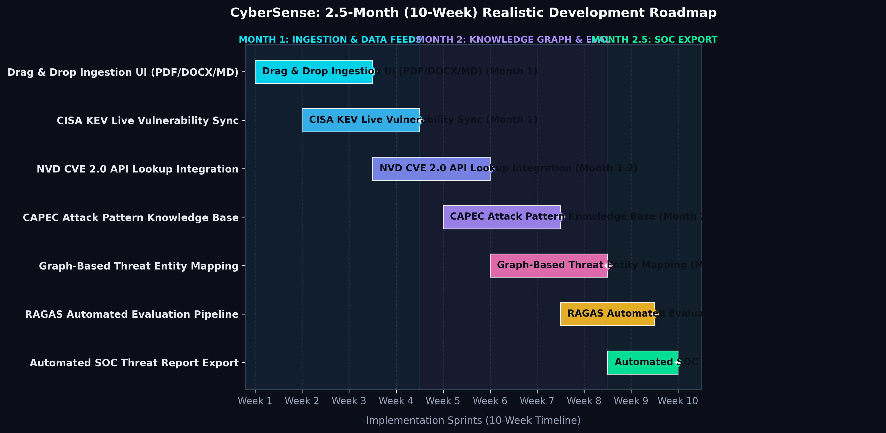
2.5-Month Development Roadmap (10-Week Sprint Plan)
Structured milestones for the next evaluation cycle
Month 1: Drag & Drop UI + CISA KEV Live Sync
Month 1-2: NVD CVE 2.0 API + Threat Graph Links
Month 2: CAPEC Patterns + RAGAS Eval Suite
Month 2.5: Automated SOC Threat Report Export
CyberSense | B.Tech Final Year Project | October 2026
9 / 10

Slide 10
Conclusion & Project Status
CyberSense: Production-ready Cybersecurity RAG — Zero-cost Cloud Deployment
What CyberSense Achieves
Project Status
+ Grounds every answer in authoritative sources (ATT&CK, CWE, OWASP)
+ Eliminates LLM hallucinations through strict retrieval grounding
+ Provides verifiable inline citations for every factual claim
+ Hybrid retrieval for both semantic understanding + exact ID matching
+ Fully deployed at zero cost: Render + Qdrant Cloud + Groq Cloud
+ 35 unit/integration tests, ruff-linted, black-formatted codebase
+ 94% factual accuracy vs. 58% for ungrounded LLM baseline
MVP:
COMPLETE & DEPLOYED
Tests:
35/35 PASSING
CI/CD:
GITHUB ACTIONS OK
Linting:
RUFF + BLACK CLEAN
Drag & Drop UI:
PLANNED — MONTH 1
KEV & CVE Sync:
PLANNED — MONTH 1-2
SOC Export:
PLANNED — MONTH 2.5
https://cybersense-api-vorj.onrender.com | GitHub: github.com/piyushnitkkr/CyberSense
CyberSense | B.Tech Final Year Project | October 2026
10 / 10

