Slide 1
Maximal Independent Set
Course Project by
Jingqiu Ding, Zhenhao he, Piyush Panchal

Slide 2
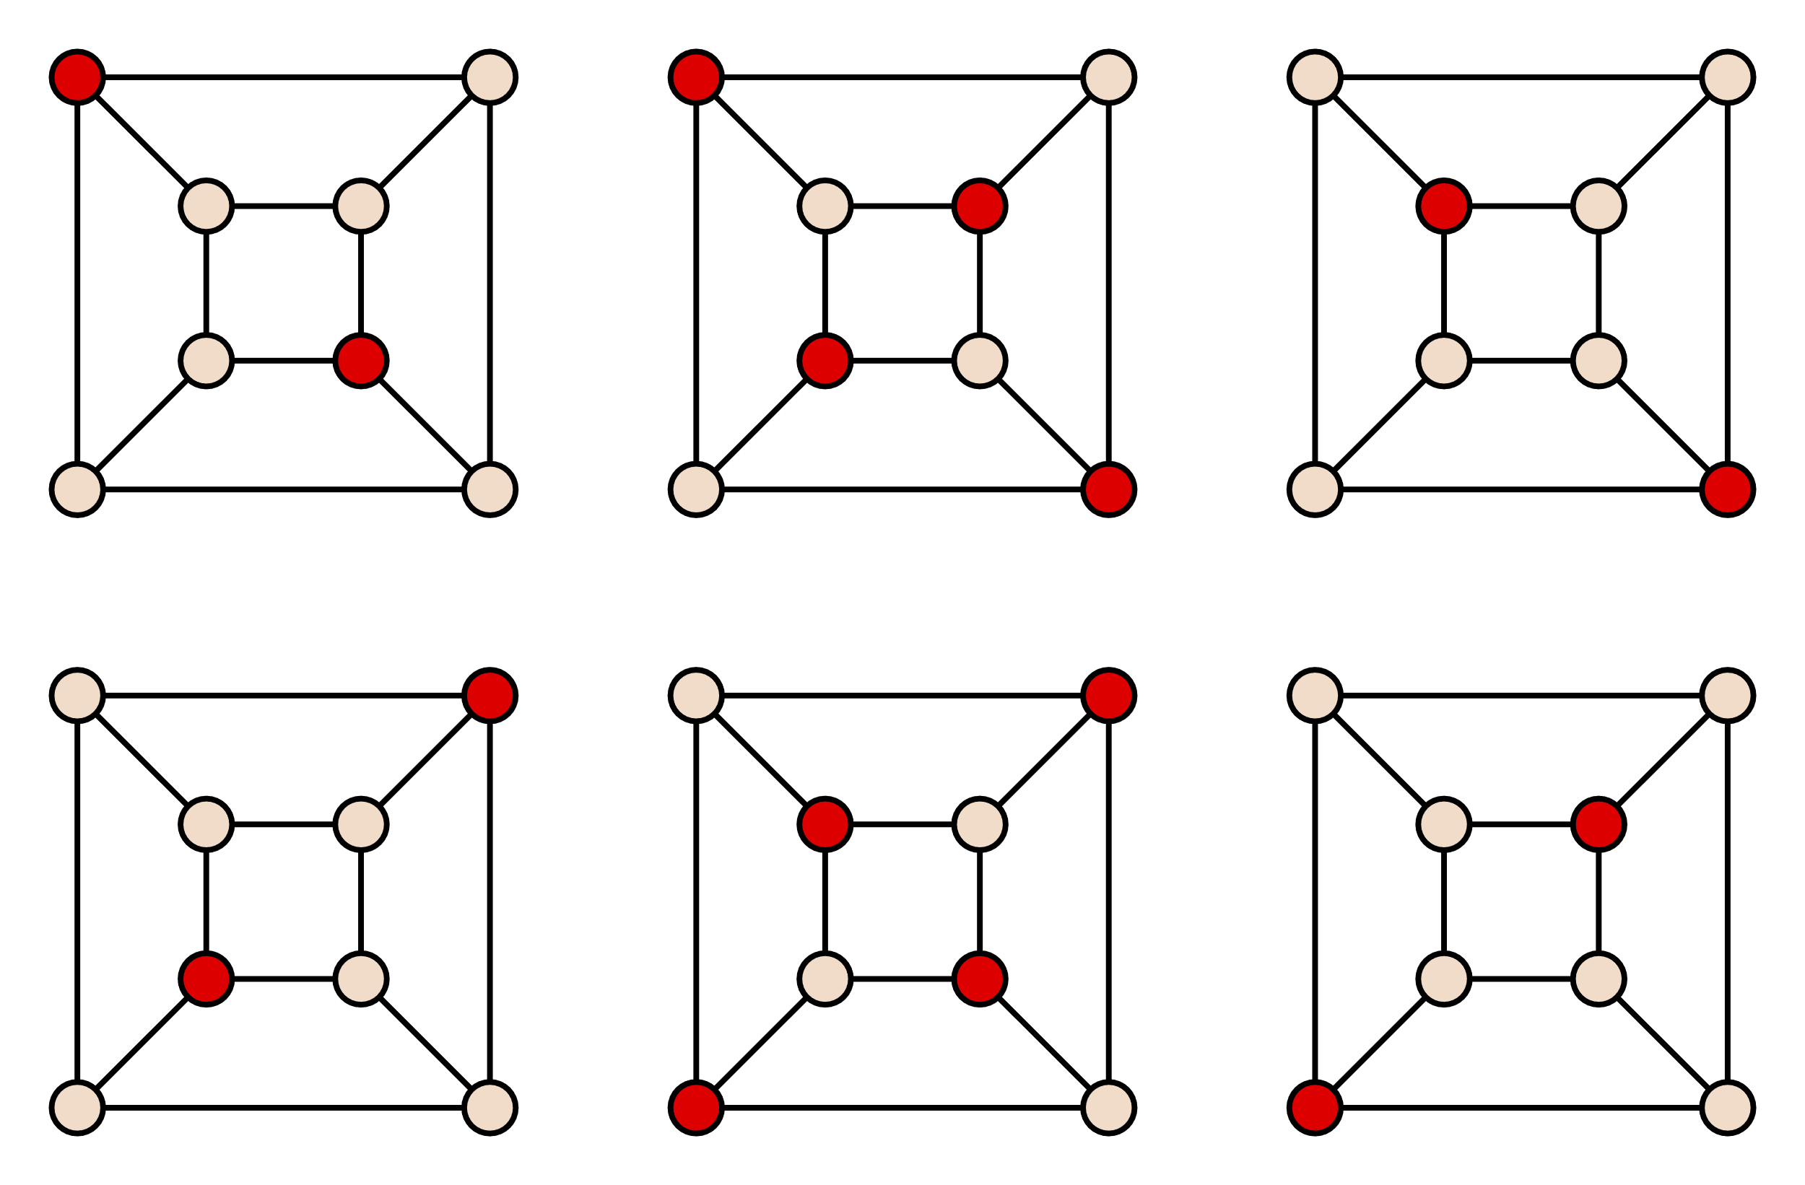
Maximal Independent Set Algorithm
Independent set : a set of vertices that share no edges.
MIS : an independent set that is not a subset of any other independent set.
NP-Hard to find a MIS
By David Eppstein - Own work, Public Domain, https://commons.wikimedia.org/w/index.php?curid=8821758

Slide 3
Sequential algorithm
Given a graph G(V,E)
Initialize I to an empty set.
While V is not empty:
Choose a node v∈V;
Add v to the set I;
Remove from V the node v and all its neighbors.
Return I.
runtime O(n)

Slide 4
Previous work in the parallel algorithm
In 1986, two efficient algorithms are put forward:
1. A fast and simple randomized parallel algorithm by NogaAlon et.al.
2. Luby’s MIS parallel algorithm

Slide 5
Time line
Literature review
Sequential Algorithm Implementation
In process
Luby’s Algorithm Implementation
Testing in Euler

Slide 6
Sequential Implementation
[Insert a graph here]
Test set: [node number, edge number] [random generated graph, RMAT]
Running platform: [cpu, core, frequency]

Slide 7
Degree of freedom calculated in parallel
[Insert a graph here]
Test set: [node number, edge number] [random generated graph, RMAT]
Running platform: [cpu, core, frequency]

