Slide 1

InstaHyre Job Analytics
Piyush Pratap Singh(pd19_073)
Debankit Dey (pd18_144) :
Yash Upadhyay (pd19_036)
Sai Eshwar (pd18_064)

Slide 2
INTRODUCTION
The job market in India is constantly evolving, with new trends emerging and old ones fading away. In this project, the focus will be on analyzing the job trends in India, including the most in-demand skills, the states with the highest number of job openings, and other useful insights.
The project aims to provide a comprehensive overview of the job market in India, using data-driven analysis to identify the key trends and patterns that are driving the market. By understanding these trends, job seekers, employers, and policymakers can make informed decisions about their career paths, hiring strategies, and workforce development initiatives.
Through this project, we hope to shed light on the current state of the job market in India, as well as provide insights into how it is likely to evolve in the future. Ultimately, our goal is to help individuals and organizations make better, more informed decisions that will enable them to thrive in an ever-changing job market.
Problem Statement :
project is to analyze the job trend in India like which skill is in most demand, state having highest no of opening , & many more useful insight

Slide 3
Strategy and Distribution of work
Web Scraping
Data Cleaning
Data Modelling
Sai Eshwar
Debankit Dey
Dashboard
Drawing Insight
Piyush Pratap Singh
In team
Yash Upadhyay

Slide 4




Project Explanation
Phase 1 | Phase 2 | Phase 3 | Phase 4
Web Scraping | Data Cleaning | Data Modelling | Dashboard & drawing Insight
Selenium Pandas | Excel: Power Query Pandas | MySQL Excel | Excel

Slide 5
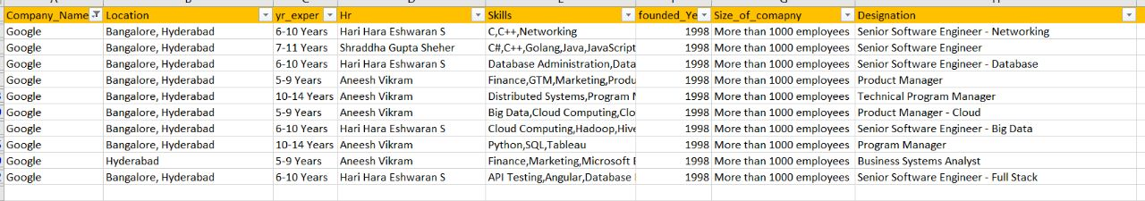
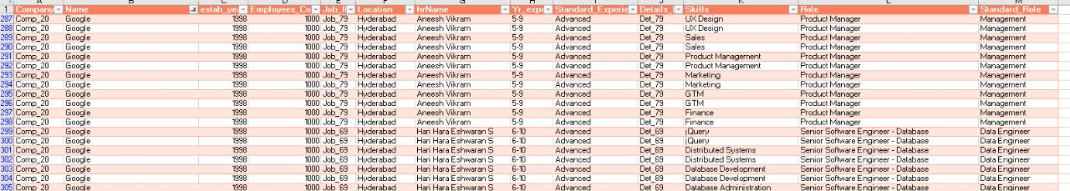
Data Pre Processing
Raw Data
Clean Data

Slide 6
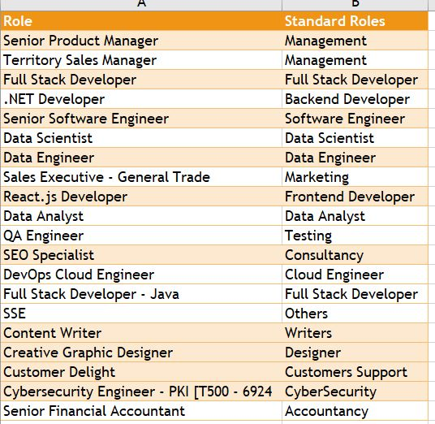
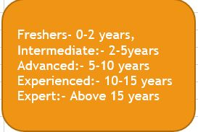
Cleaning Part

Slide 7
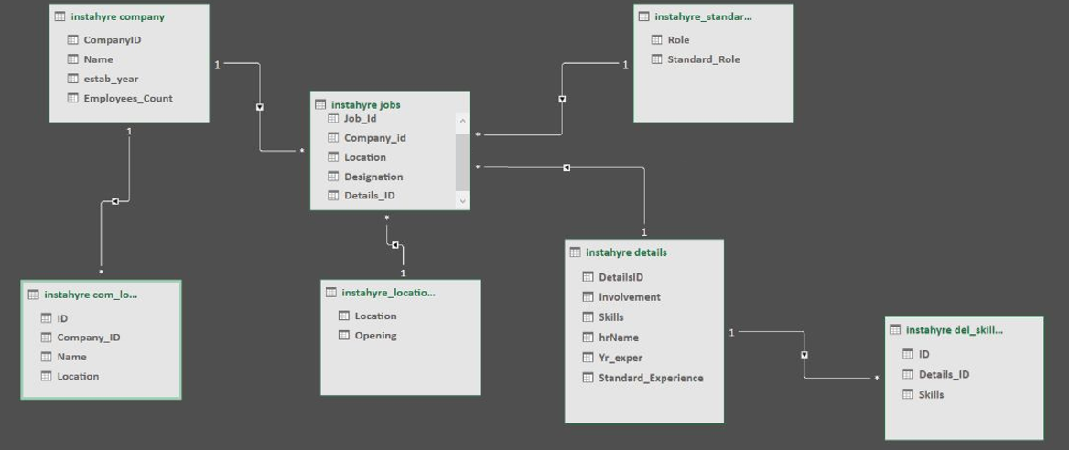
Data Modelling

Slide 8

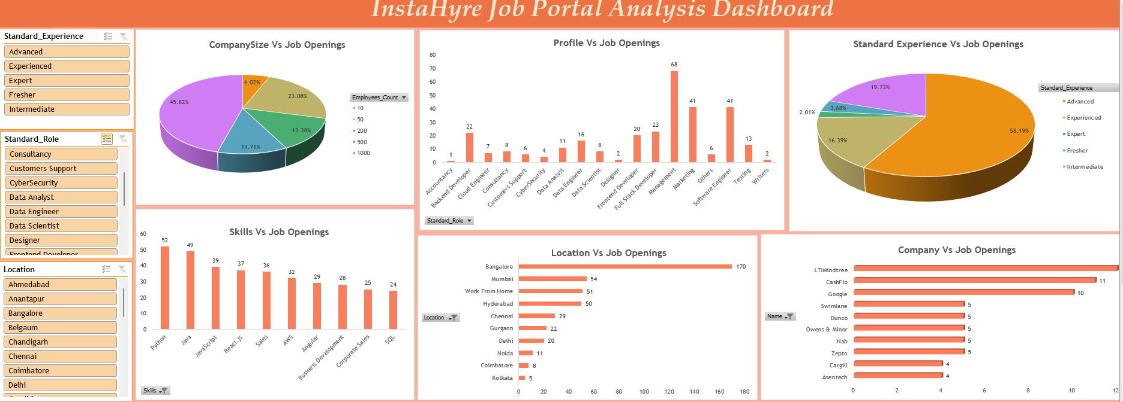
Project Insights:
After analysis the project some of the insight that we drawn are :
Top preferable state is Bangalore
Management , marketing and software engineers profile role that are in demand
Most Demanded Skill are Python , java & JavaScript
Ltimindtree , Cashflo & google are company who post most of job opening in recent time
People having (3 to 15) year of experience are more in demand than that of fresher or 15 + year of experience

Slide 9
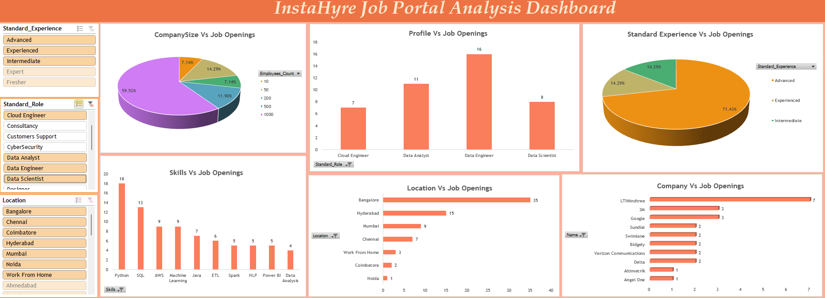
Data analyst :
role for fresher is almost zero and company hire for this role in big in size
When company want to expand their expand the current business

Slide 10
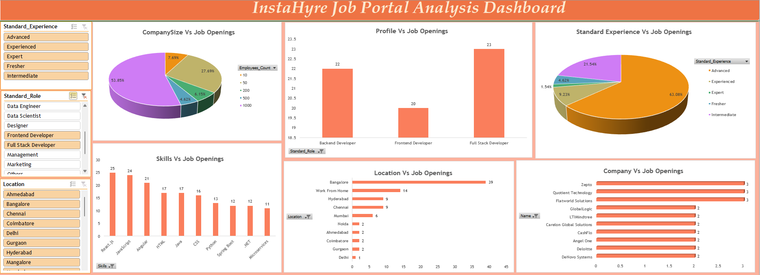
Web Developer:
job opening for all most all type of person and all company hiring either MNC or Startup
Reason : company need at least a website for represent what they are doing
The demand for the web developer is quite high in every segment of company either is small or big but the demand for data role is only in the big company

Slide 11

Problem Encounter
Non-technical | Technical
Coordination issue: Not discuss about the problem in the starting directly jump into the technical part like : webs scraping HR name issue | Web scraping: It was something new for us. It was easy to scrap the smaller data but when we got the larger data set , it was showing mismatches and errors.
Time issue: Some of us are working some of them are not, not all of them are free at the same time | Data modelling issue: In SQL we can connect multiple table but in excel we can only form relation one to one so we need to do a lot of research to figure out the thing like just to create a mega table and perform operation

Slide 12

Learning Outcome
Collaboration and teamwork
Project management
Diversity and inclusivity:
Learn new tools
Presentation and communication skills

Slide 13
Thank you
Feel free to ask open ended question . . .

