Slide 1


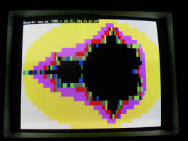
d
Tequila in 1991 was the first polymorphic virus. Polymorphic viruses make life difficult for virus scanners as they change their appearance with each new infection.

Slide 2

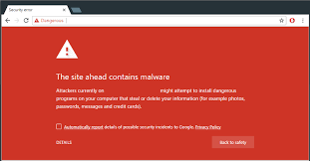
/
About 32% of all computers in the world (that is almost one in every three computers) are infected with some kind of malware.

Slide 3

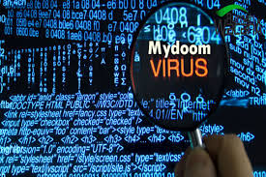
.
The most expensive computer virus of all time was referred to as MyDoom which caused $38 billion in damages. It was fast moving, infecting open networks and every computer with access to it. In 2004, this virus was estimated to impact 25% of all emails.

Slide 4

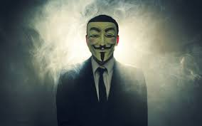
It is actually very easy to become a member of Anonymous, the most famous international network of hacking activists. Therefore, only a handful of them are elite hackers capable of exploiting security flaws in computer systems and writing viruses.

Slide 5

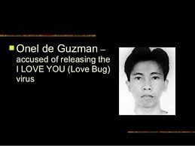
.
Created by Filipino programmers Reonel Ramones and Onel de Guzman in 2000, the computer worm known as ILOVEYOU or the Love Letter was one of the most virulent computer viruses ever. The virus was estimated to infect up to 10% of the world’s Internet-connected computers back then.

Slide 6


.
Melissa virus (March 1999) was so powerful that it forced Microsoft and many other large companies to turn off their e-mail systems until the virus could be removed completely.

Slide 7

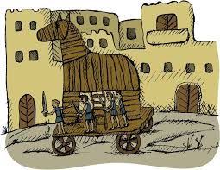
.
The name of the Trojan horse virus was derived from the Ancient Greek story of the wooden horse that was used to help Greek troops invade the city of Troy by stealth.

Slide 8

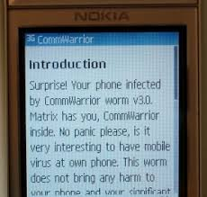
.
“Commwarrior-A” was the first known cell phone virus and it appear in March 2005.

