Slide 1
Maternal Health Progress Tracking (SDG 3.1)
CAPSTONE PROJECT
Presented By:
1. Student Name- Piyush Raj 2. College Name- Amity University Jharkhand 3. Department- B.Tech (CSE)

Slide 2
OUTLINE
Problem Statement (Should not include solution)
Proposed System/Solution
System Development Approach (Technology Used)
Algorithm & Deployment
Result (Output Image)
Conclusion
Future Scope
References

Slide 3
Problem Statement
Problem Statement 36: Maternal Health Progress Tracking (SDG 3.1)
Currently, maternal mortality remains a critical challenge for many developing countries, impacting Sustainable Development Goal (SDG) 3.1 which aims to reduce the global maternal mortality ratio (MMR) to less than 70 per 100,000 live births by 2030.
Monitoring progress on maternal health indicators such as antenatal care coverage, skilled birth attendance, and maternal mortality trends is essential for policymakers and healthcare providers. However, the lack of accessible visual data insights makes it difficult to track improvements and identify areas requiring immediate intervention.
This project focuses on leveraging IBM Cloud services to visualize and track India's progress towards SDG 3.1 using available maternal health datasets.

Slide 4
Proposed Solution
Proposed Solution: End-to-End Data Visualization Workflow on IBM Cloud
Leverage IBM Cloud Object Storage (COS) to upload and manage large-scale maternal health datasets securely.
Utilize IBM Watson Studio Jupyter Notebook to build an interactive environment for data analysis and visualization.
Perform data preprocessing to clean and transform raw data into structured formats suitable for visualization.
Extract key maternal health indicators such as:-
Maternal Mortality Ratio (MMR)
Antenatal Care Coverage (4+ visits)
Skilled Birth Attendance
Develop visualizations using Python libraries like Matplotlib and Seaborn to analyze trends and patterns.
Enable stakeholders to visually track progress towards SDG 3.1 with clear and intuitive graphs.
Provide real-time insights and observations that can assist policymakers in data-driven decision-making.
Ensure the solution is fully cloud-based, eliminating the need for local machine processing.
Maintain data scalability and security by using IBM Cloud infrastructure services.
Demonstrate a simple yet effective AI-driven analytical workflow accessible to non-technical users through IBM Cloud.

Slide 5
System Approach
System Approach for Maternal Health Data Visualization The project utilizes IBM Cloud infrastructure to build an end-to-end maternal health progress tracking system. IBM Cloud Object Storage is used to securely upload and manage the dataset, while IBM Watson Studio provides a Jupyter Notebook environment for developing the visualization workflow. Essential Python libraries such as pandas, matplotlib, seaborn, ibm_boto3, and botocore are employed for data processing, visualization, and accessing files from cloud storage.
The overall workflow involves uploading the maternal health dataset to IBM Cloud Object Storage, accessing it directly within the notebook using ibm_boto3, performing data cleaning and transformation, and visualizing key indicators like Maternal Mortality Ratio (MMR), Antenatal Care Coverage, and Skilled Birth Attendance. The entire analysis and visualization process is executed in a cloud-based setup, ensuring scalability, security, and eliminating dependency on local computing resources.

Slide 6
Algorithm & Deployment
Data Processing & Visualization Workflow with IBM Cloud Deployment
Unlike predictive machine learning models, this project focuses on data visualization and exploratory analysis to track India’s progress towards SDG 3.1. The approach involves extracting relevant indicators like Maternal Mortality Ratio (MMR), Antenatal Care Coverage (4+ visits), and Skilled Birth Attendance from a structured dataset stored in IBM Cloud Object Storage.
Using IBM Watson Studio Jupyter Notebook, the dataset is accessed, cleaned, and transformed into an analyzable format. Essential libraries like pandas handle data manipulation, while seaborn and matplotlib are used to create insightful visualizations that showcase trends and patterns.
The deployment process is completely cloud-based. Both the dataset and notebook are stored and executed on IBM Cloud, eliminating local machine dependency. The interactive notebook serves as the primary interface for data analysis and visualization, ensuring scalability and accessibility. This approach enables policymakers and stakeholders to track maternal health progress using visual insights directly from the IBM Cloud environment.

Slide 7
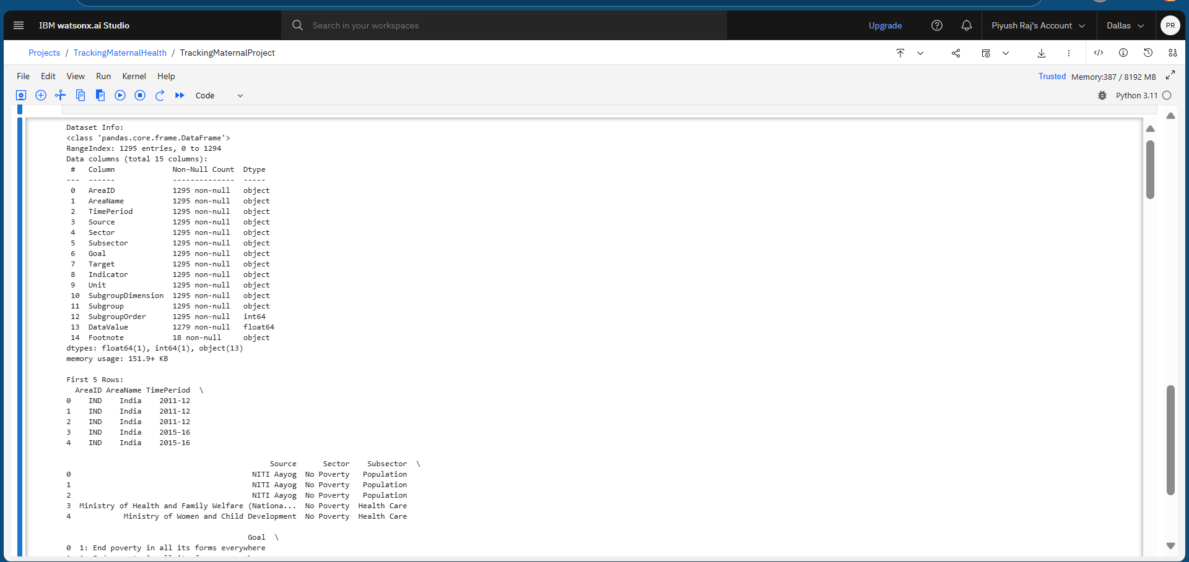
Result
Results & Visual Insights

Slide 8
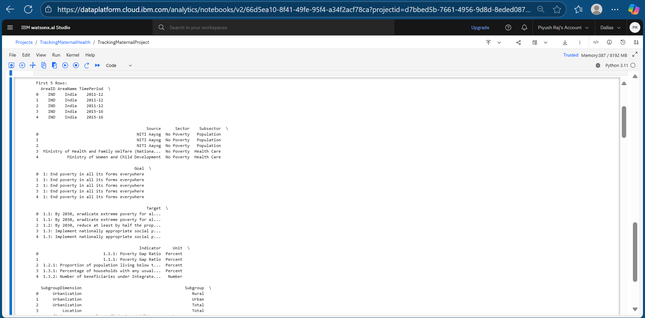

Slide 9
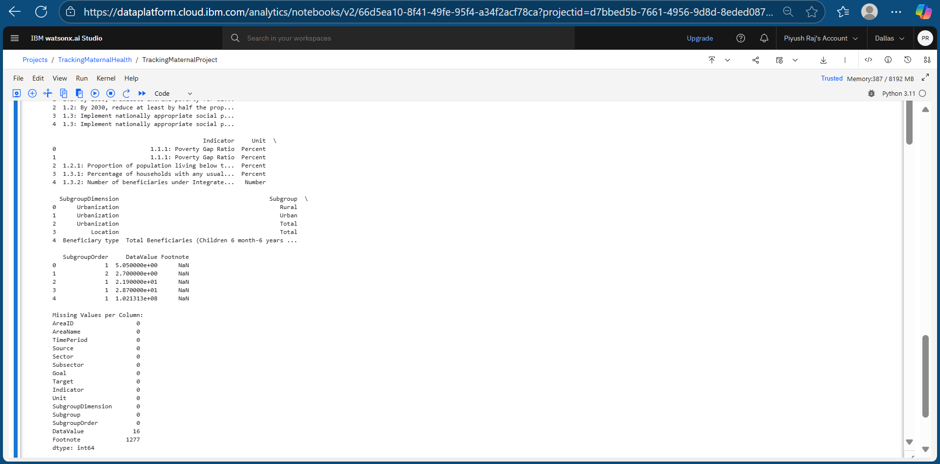

Slide 10
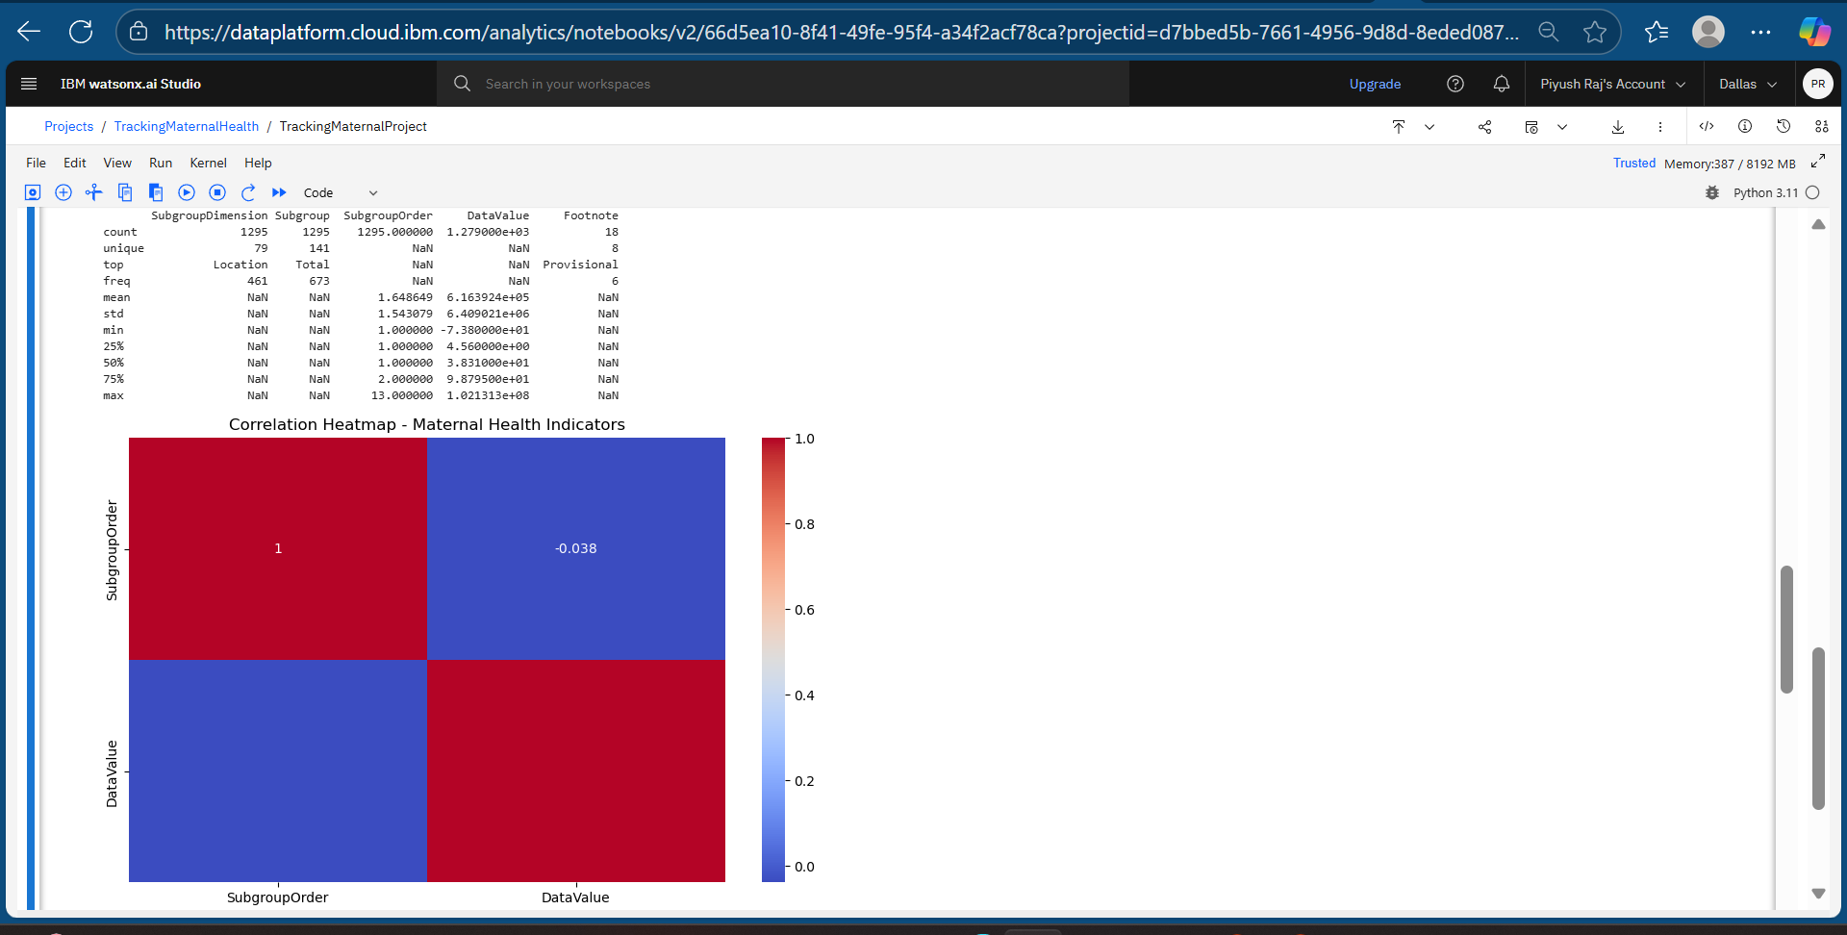

Slide 11
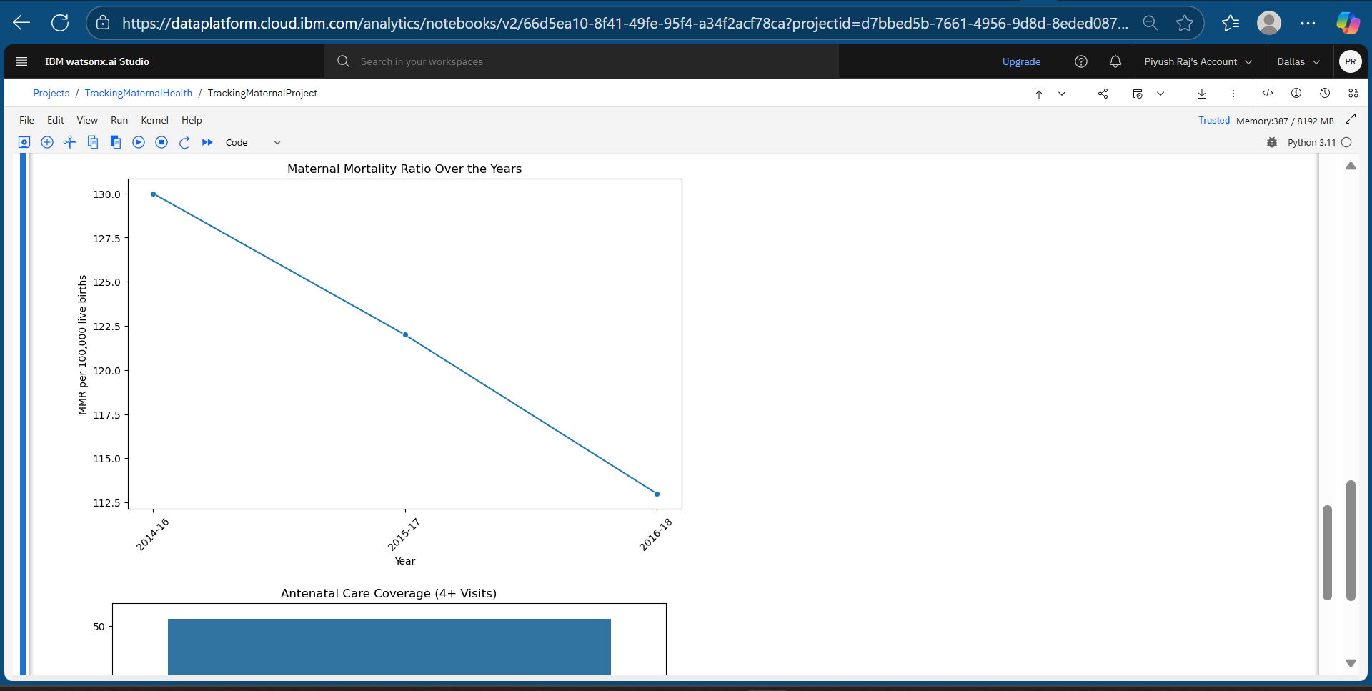

Slide 12
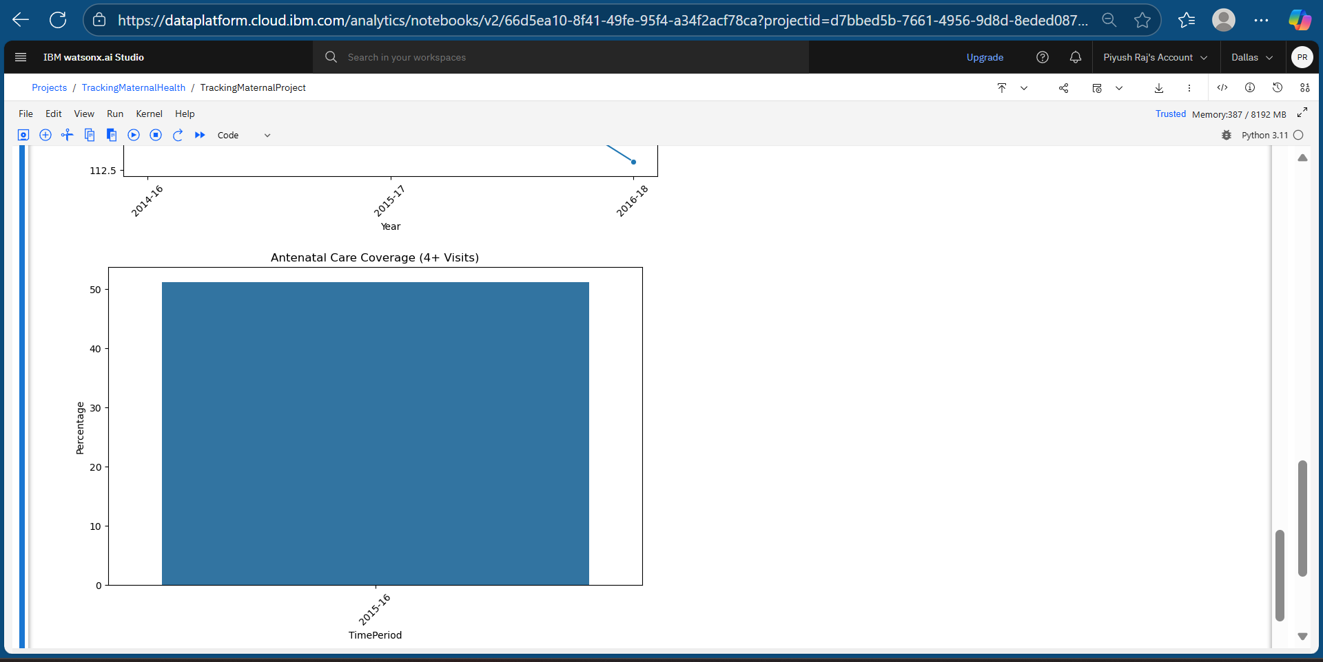
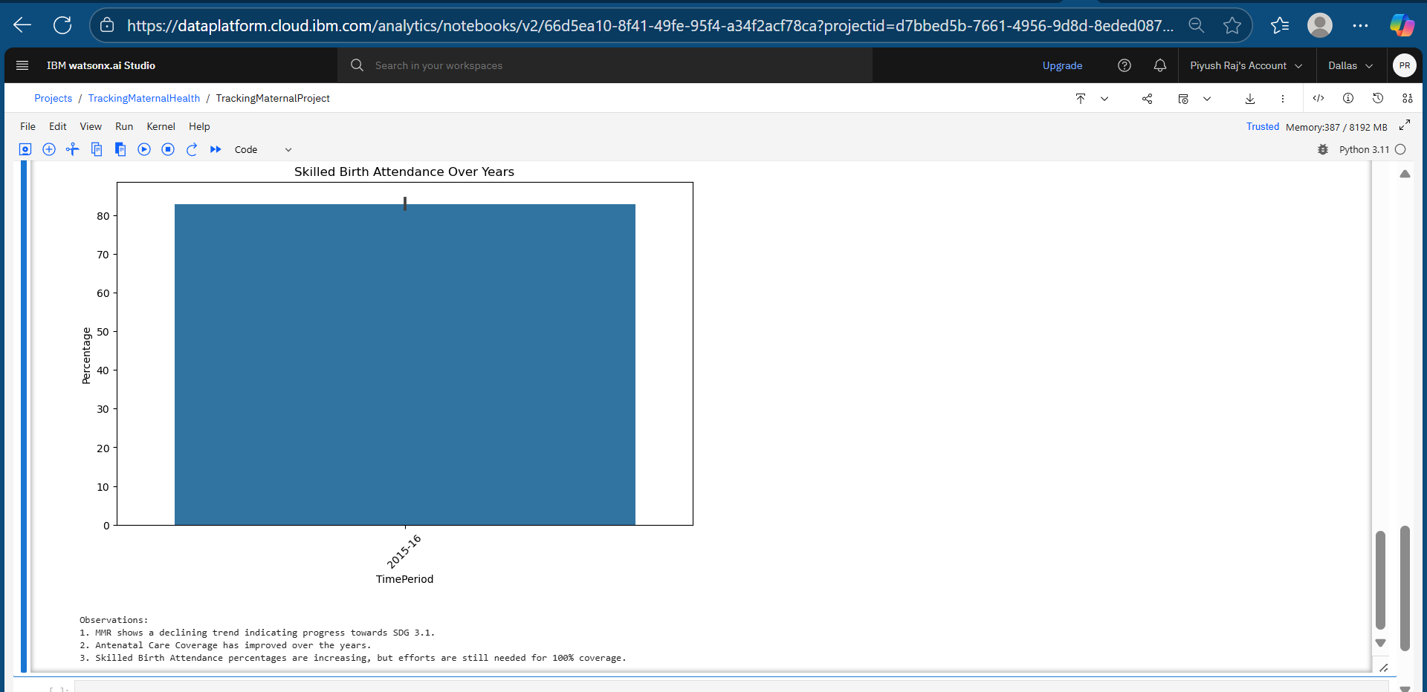

Slide 13
GITHUB LINK
piyushraj8235/MaternalHealth-SDG3.1-Visualization: IBM Cloud-based Data Visualization Project for SDG 3.1 — Maternal Health Tracking

Slide 14
Conclusion
The project successfully demonstrates how IBM Cloud services can be utilized to visualize and track progress towards Sustainable Development Goal (SDG) 3.1, focusing on maternal health indicators in India. By leveraging IBM Cloud Object Storage for secure data management and Watson Studio’s Jupyter Notebook for analysis, key metrics like Maternal Mortality Ratio (MMR), Antenatal Care Coverage, and Skilled Birth Attendance were effectively visualized.
The visual insights derived from the dataset highlighted positive trends in maternal health progress, though challenges such as data sparsity in certain indicators and the need for more granular, real-time data remain. The cloud-based approach ensured scalability, accessibility, and eliminated local system dependencies, making it easier for stakeholders to derive actionable insights.
Future enhancements can include integrating predictive analytics models to forecast maternal health trends and incorporating interactive dashboards for more dynamic data exploration.

Slide 15
Future scope
The current system can be further enhanced by integrating additional data sources such as real-time maternal health surveys, district-wise healthcare facility data, and demographic factors to provide a more comprehensive analysis. Incorporating predictive analytics models can help forecast future trends in maternal health indicators, enabling proactive decision-making by policymakers.
The system can also be expanded to cover multiple states or regions, allowing comparative studies and targeted interventions. Integration of interactive dashboards with drill-down capabilities can make data exploration more user-friendly for non-technical stakeholders. Furthermore, leveraging AI services like IBM Watson AI or cloud-native technologies such as edge computing can enhance the scalability and real-time data processing capabilities of the solution.

Slide 16
References
IBM Cloud Documentation https://cloud.ibm.com/docs (For understanding IBM Cloud services like Object Storage, Watson Studio, etc.)
Maternal Health Data Source NITI Aayog, Government of India — SDG India Index Dataset (Publicly available datasets for SDG tracking in India)
Seaborn & Matplotlib Documentation https://seaborn.pydata.org/ https://matplotlib.org/ (For building visualizations and plots)
pandas Python Library Documentation https://pandas.pydata.org/docs/ (For data preprocessing and manipulation tasks)
IBM SkillsBuild Learning Platform https://skillsbuild.org/ (For learning resources on IBM Cloud & Data Science)

Slide 17
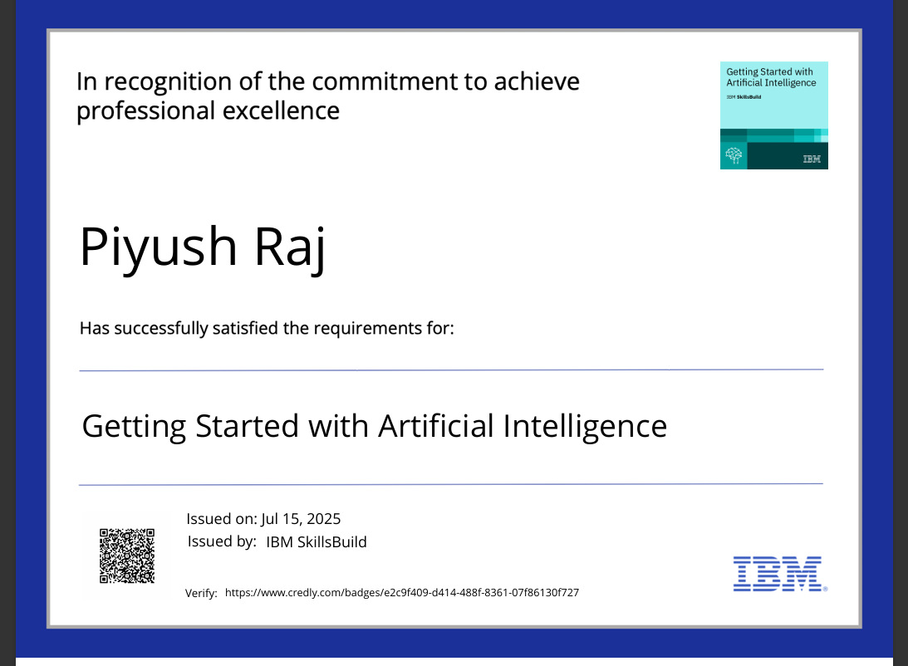
IBM Certifications

Slide 18
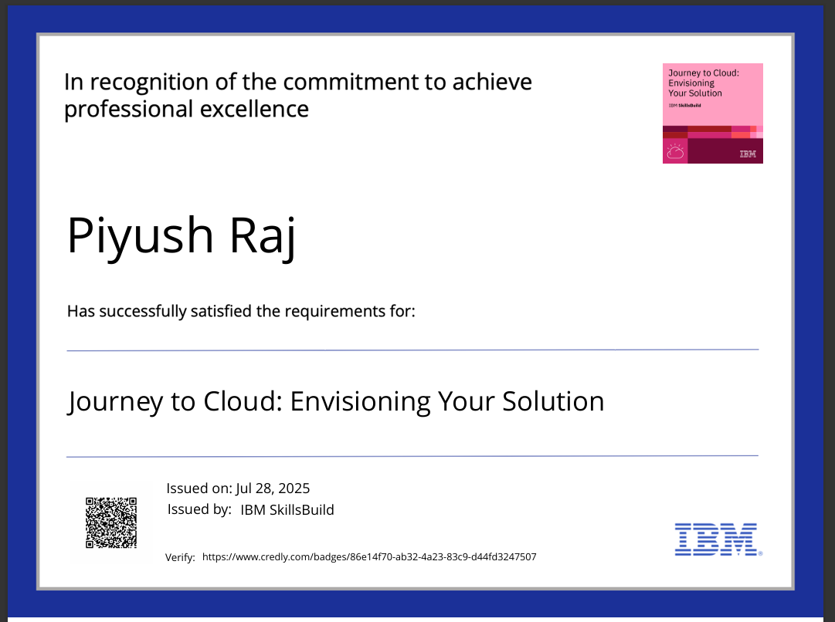
IBM Certifications

Slide 19
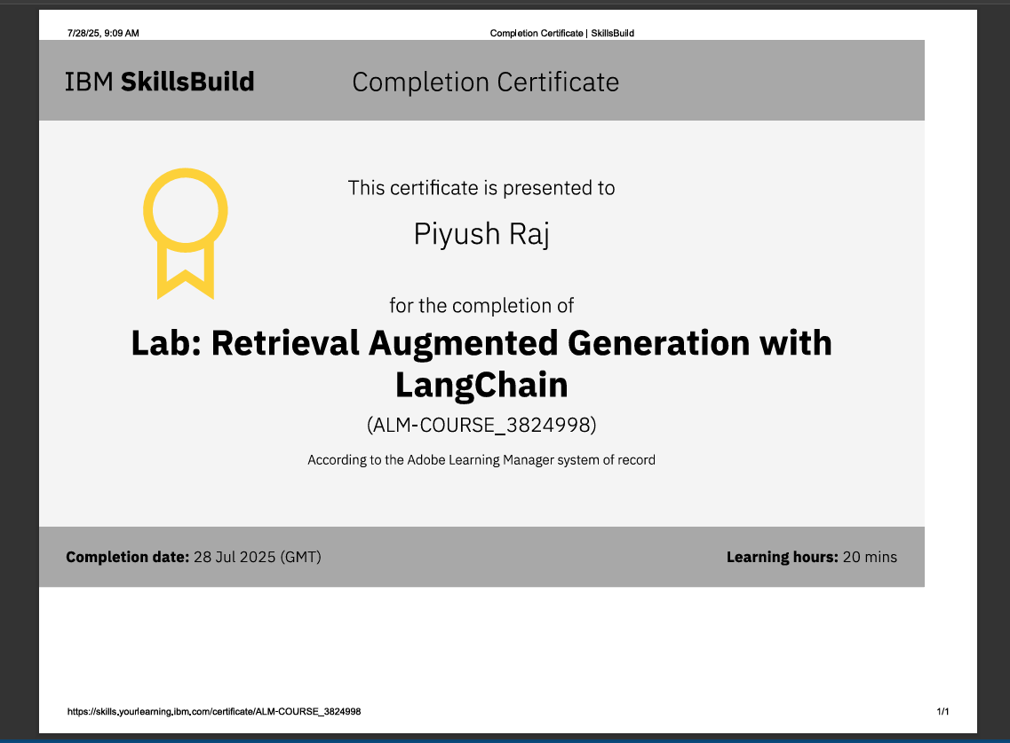
IBM Certifications

Slide 20
THANK YOU

