Slide 1
SIGN LANGUAGE RECOGNISATION
SANYAM VIKRAM
NIT JALANDHAR
27/07/18

Slide 2
Project Description
The whole idea of the project was to build a system that could be used to interact with dumb people by our virtual interviewer(windy)
One Idea was to train on limited signs for different words but that would have restricted us to certain fixed vocab.
The approach I took was to make a character based system that could recognize English alphabets(a-z) with which we can form any word and thus could communicate any message by using sign language.
Thereby enabling Dumb people to communicate with our system or computer with sign language

Slide 3
TECHNICAL CHALLENGES
HIGH NUMBER OF CLASSES(28)
NO AVAILIBILITY OF GOOD DATA FOR TRAINING ON INTERNET
NOISY BACKGROUND
VARIATION IN SKIN TONES
HIGH ACCURACY NEEDED (90+)
LOW GPU RAM(6 GB)

Slide 4
APPROACHES TO AFORESAID PROBLEM
APPROACH 1 -: FEATURE ENGENERING + NEURAL NETWORK
APPROACH 2 -: HAND DETECTOR + DEEP LEARNING BASED MODEL(CNN)+TRANSFER LEARNING

Slide 5
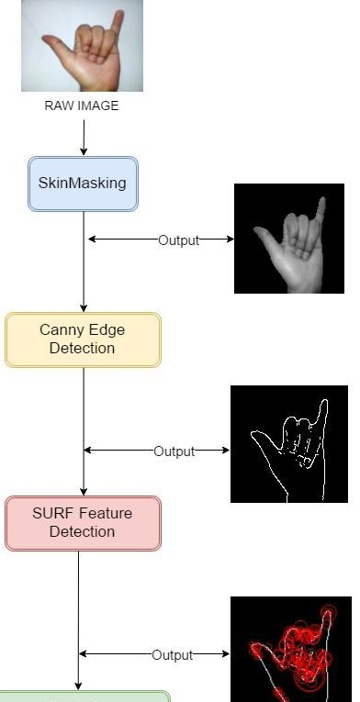
APPROACH 1
FEATURE EXTRACTION AND NEURAL NETWORK
CONVERTING BGR IMAGE INTO HSV SPACE
PERFRORMING CANNY EDGE DETECTION ON MASKED IMAGE
USING HUE VALUE FOR SKIN MASKING
PERFORMING SURF FEATURE DETECTION ON SKELETON IMAGE

Slide 6
DRAWBACKS OF APPROACHE1
THIS METHOD OF FEATURE EXTRACTION SUFERES LARGELY FROM VARIATION OF SKIN TONE AND NOSIY BACKGROUND AS IN NOISY BACKGROUND IT IS UNABLE TO PICK CONTOURS FOR DETCTION OF FINGER TIPS AND THEREBY FEEDS WRONG FEATURES TO NEURAL NETWORK MODEL

Slide 7
APPROACHE 2
HAND DETECTOR + CNN
IMAGE FROM WEBCAM
HAND DETECTOR
CROPED IMAGE
PREDICTION OF CLASS OF IMAGE
CNN
BASED DEEP LEARNING MODEL

Slide 8
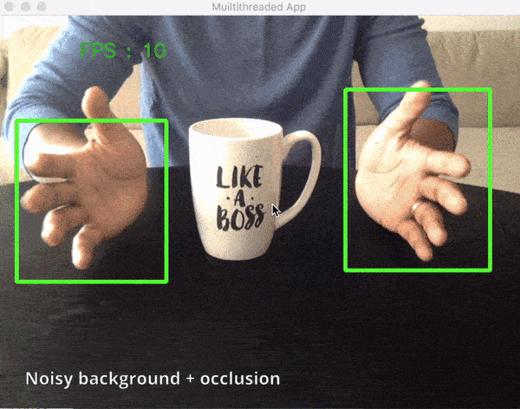
HAND DETECTOR USING SSD MOBILENET
TRAINED A HAND DETECTOR ON TOP OF TENSORFLOW OBJECTION DETECTION API BY USING SSD MOBILENET FOR HAND DETECTION
FURTHER FEEDING CROPPED IMAGE TO CNN MODEL

Slide 9
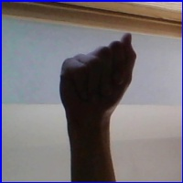

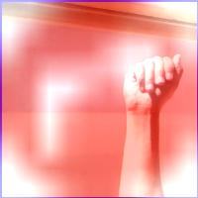
CNN BASED DEEP LEARNING MODEL
DATA ACQUISTION
DATA IS PRIMARILY TAKEN FROM 3 SOURCES AND FURTHER PROCESSED
SOURCE1 -: ASL HAND DATASET KAGGLE
SOURCE 2 -: INDIAN SIGN LANGUAGE DATASET ACQUISTED BY IIT JODHPUR
1>THE DATASET IS OF ABOUT 87000 IMAGES WITH 28 CLASSES ,THEREBY AROUND
3000 IMAGES PER CLASS
2>THE MAJOR ISSUE WITH DATA IS THAT ALL THE IMAGES IN DATA ARE HAVING PLAIN BACKGROUND SO THE MODEL ON THIS DATA WAS BADLY FAILING ON NOISY BACKGROUNDS .
SOLUTION TO THE PROBLEM WAS AUGMENTING THE IMAGES WITH LOGOS OF DIFFERENT BRANDS TO MAKE THE BACKGROUND NOISY

Slide 10
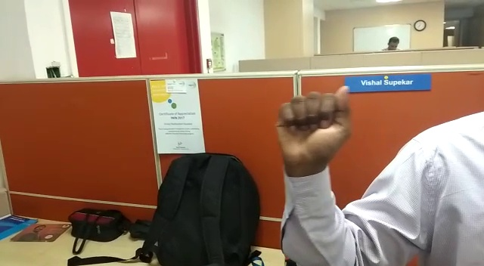
SELF ACQUISTED DATA
NEED FOR MORE NOISY AND REAL LIFE DATA
THE MODEL TRAINED ON EARLIER DATASET WAS ONLY ABLE TO ATTAIN AN ACCURACY OF 72%
SHOT 2 VIDEOS OF 1 MINUTE EACH FOR EACH CLASS AT 30 FPS
PROCESSED THE DATA INTO FRAMES BY TAKING EVERY 3RD FRAME RESULTING INTO 1200 IMAGES PER CLASS

Slide 11
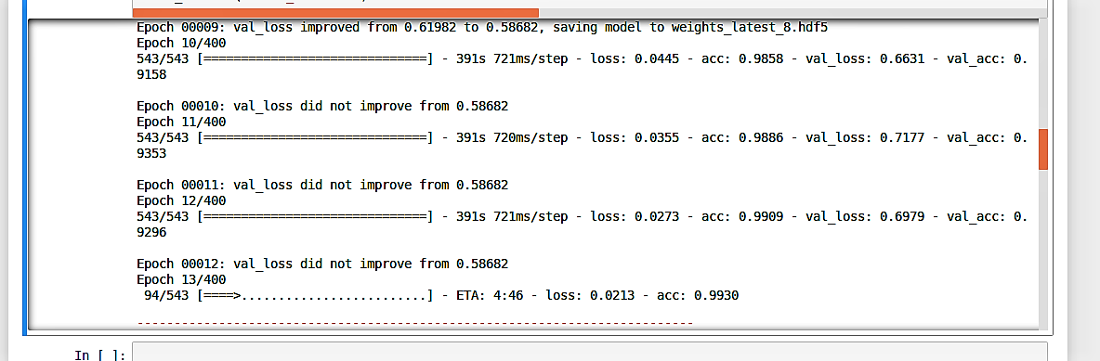
CNN BASED MODEL WITH TRANSFER LEARNING
2 FC LAYERS
WITH RELU
AND 0.5 DROPOUT AND
A SOFTMAX LAYER
TRAINED FOR 25 EPOCHS
ACCURACY OF 92 ON TEST
ARCHITECTURE USED VGG16 AND IMAGE NET WEIGHTS FOR INITILIZATION

Slide 12
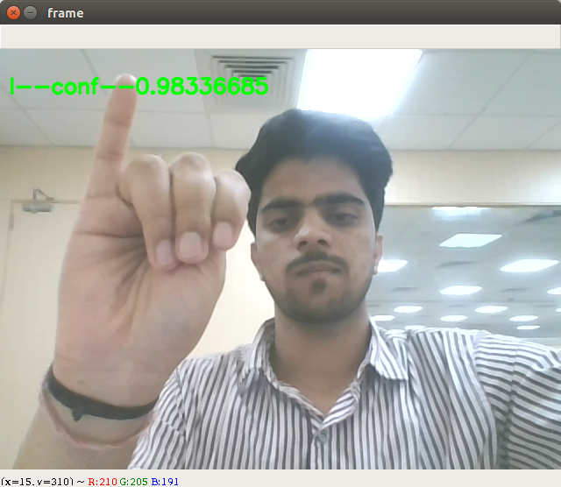
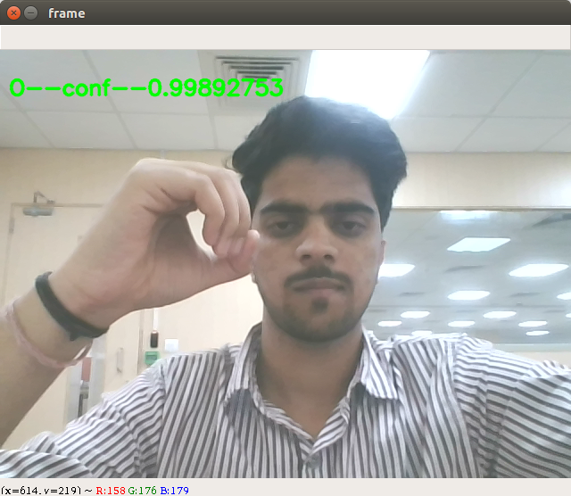
REAL TIME IMAGES FROM PROJECT

Slide 13
POSSIBLE APPLICATIONS
APPLICATION IN REAL TIME VIRTUAL INTERVIEW WITH DUMB CANDIDATES
CAN SERVE AS MEANS OF TEACHING AID FOR DUMB STUDENTS WITH E-LEARNING
CONVERSATION ENGINE FOR DUMB PEOPLE AT VARIOUS PLATFORMS

