Slide 1
NP COMPLETENESS
SUBMITTED BY:
PIYUSH SHARMA
17103110

Slide 2
WHAT IS P VS NP PROBLEM?

Slide 3
P CLASS PROBLEMS
P is a complexity class that represents the set of all decision problems that can be solved in polynomial time.

Slide 4
NP CLASS PROBLEMS
NON DETERMINISTIC POLYNOMIAL TIME
NP is a complexity class that represents the set of all decision problems for which the instances where the answer is "yes" have proofs that can be verified in polynomial time.

Slide 5
SOMETIMES, WE FIND THAT SOME NP PROBLEM IS ACTUALLY A P PROBLEM

Slide 6
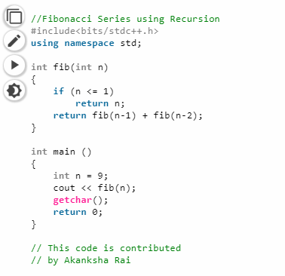
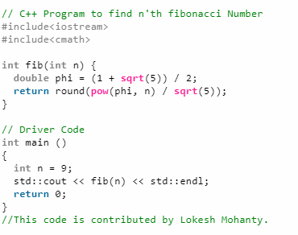
EXPONENTIAL SOLUTION
O(1)
SOLUTION

Slide 8

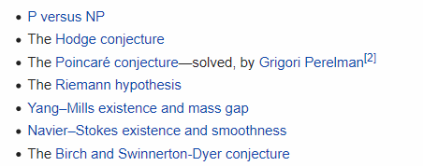
MILLENNIUM PRIZE PROBLEMS
The CLAY INSTITUTE is offering one million dollars for a solution to the P VS NP problem

Slide 9
NP COMPLETE PROBLEMS
NP-Complete is a complexity class which
represents the set of all problems X in NP for
which it is possible to reduce any other NP
problem Y to X in polynomial time.

Slide 10
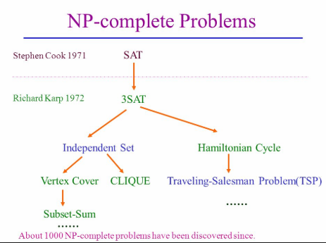

Slide 11
3 SAT PROBLEM

Slide 12
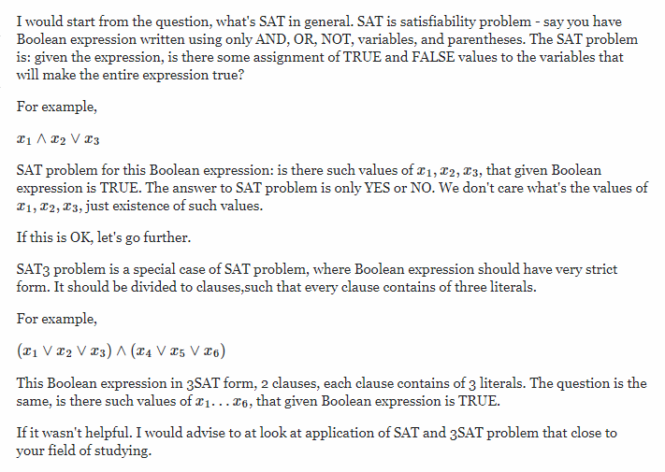

Slide 13
CLIQUE PROBLEM

Slide 14
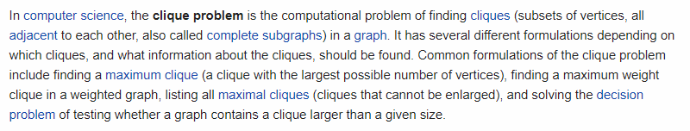

Slide 15
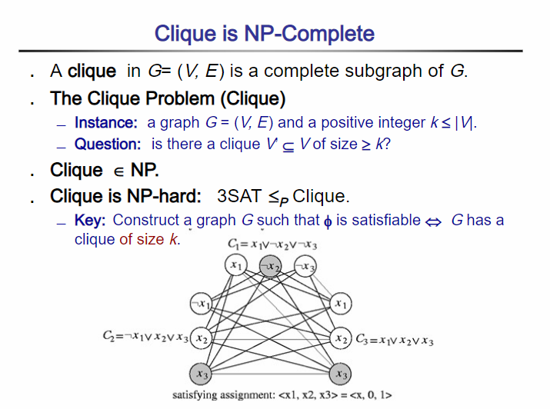

Slide 16
NP-HARD PROBLEMS
Intuitively, these are the problems that are at least as hard as the NP-complete problems. Note that NP-hard problems do not have to be in NP, and they do not have to be decision problems.

Slide 17
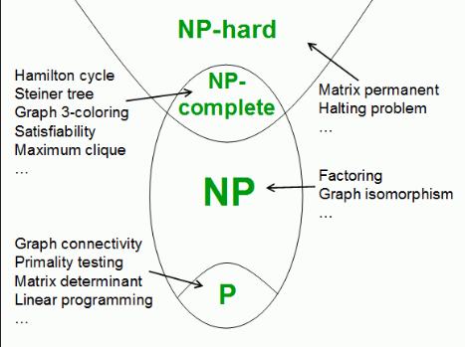

Slide 18
NP COMPLETENESS FOR ENGINEERS?

Slide 19
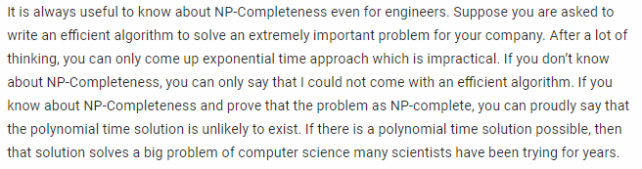

Slide 20
THANK YOU!

