Slide 1


ACROPOLIS INSTITUTE OF TECHNOLOGY AND RESEARCH
CSIT - 2
Subject :- Alexa
Topic ->Chatbot In Voiceflow
Submitted To:-
Prof.Nidhi Nigam
Submitted By:-
Piyush Soni (Vth sem)
(0827CI201131)

Slide 2
What is Alexa?
Alexa is the Amazon digital voice assistant. It can be used on smartphones and Amazon Echo products.
Which technology is used in Alexa?
Automatic speech recognition (ASR) is technology that converts spoken words into text. In short, it's the first step in enabling voice technologies like Amazon Alexa to respond when we ask, “Alexa, what's it like outside?” With ASR, voice technology can detect spoken sounds and recognize them as words.

Slide 3
How Many Programming Language in Alexa?
js, Java, Python, C#, Go, Ruby, or PowerShell.
Whose Voice in Alexa?
Ans:- Nina Rolle
Example Of Alexa?
Artificial Intelligence
With conversational AI, voice-enabled devices like Amazon Echo are enabling the sort of magical interactions we've dreamed of for decades. Through a voice user interface (VUI), voice services like Alexa can communicate with people in ways that feel effortless, solve problems, and get smarter over time.

Slide 4
How To Connect Object with Alexa?
Firstly we need to Rusberry Chip than We Put a Chip In object which we want to connect than We setup a Setting in voiceflow Than We can Use easily
Voiceflow it is the Part of Alexa .we want to connect object So we need to Firstly Voiceflow.We have to create a account on Voiceflow tutorial than Voiceflow tutorial has many option like a Voicechatbot,VoiceAssitance etc.
It is totally depend on us.
How to Connect with objcet is voicechatbot and Assitance.

Slide 5
VoiceFlow
How to create a Account
How to Start
How to add Skill
How to connect text to Text
How to connect Button in Text
How to Setup
How to Run
Project
How To share

Slide 6
How To create a Account on Voice flow
Firstly we go to the Google chrome And than Search Voiceflow tutorial Than Select First Link.
There are Show 2-3 Option To Login
1.Continue with Google.
2.Continue with email.
3.Don’t Have account.
We will do continue with Google.
Than It is ask what is you Birtdate
We wiil fill up Our Birthday Date
Now We Will reach on Voiceflow
Than Go to setting and edit our name.

Slide 7
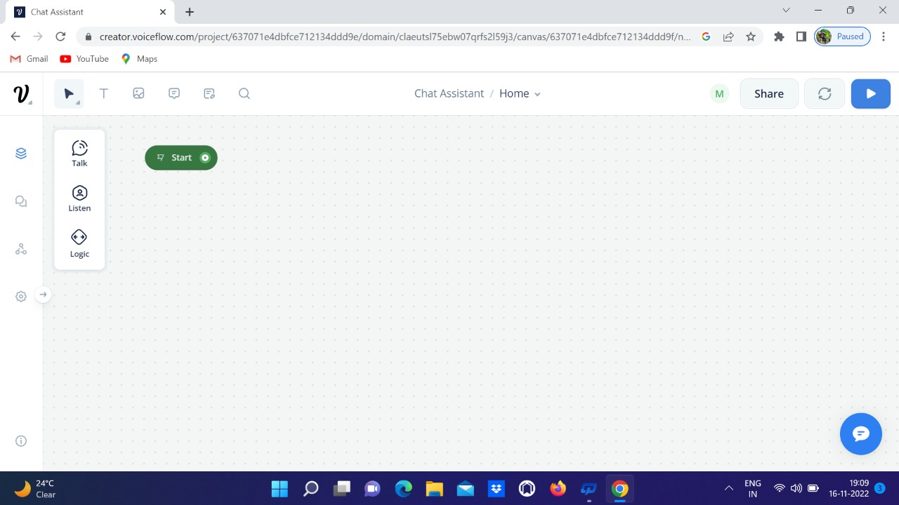
How to Start
In This Picture we see That start Button

Slide 8
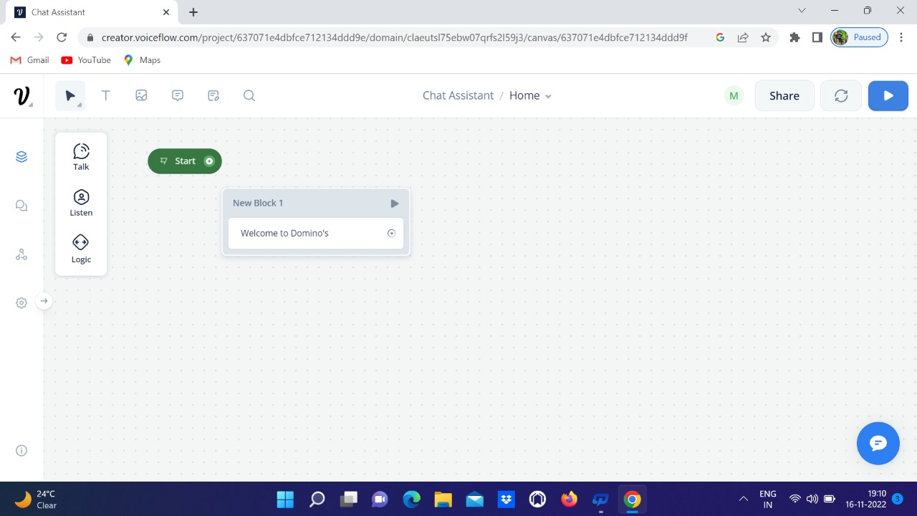
How to add Skill
In This Image We can see That Option is Talk In Talk We are selecting Text Now We add Our Skills

Slide 9
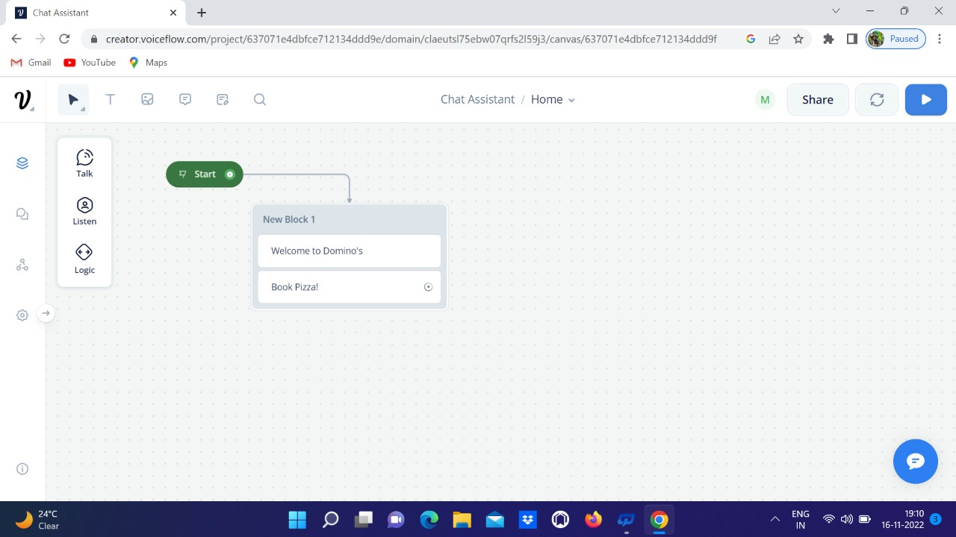
How to connect text to Text
In this image We can Clearly seen that start button connect with Text

Slide 10
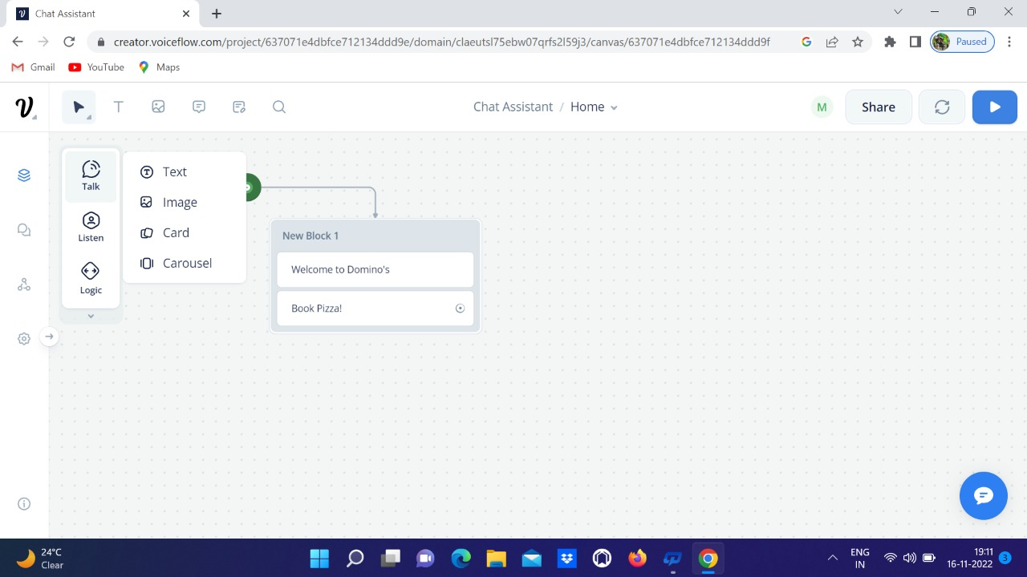

Slide 11
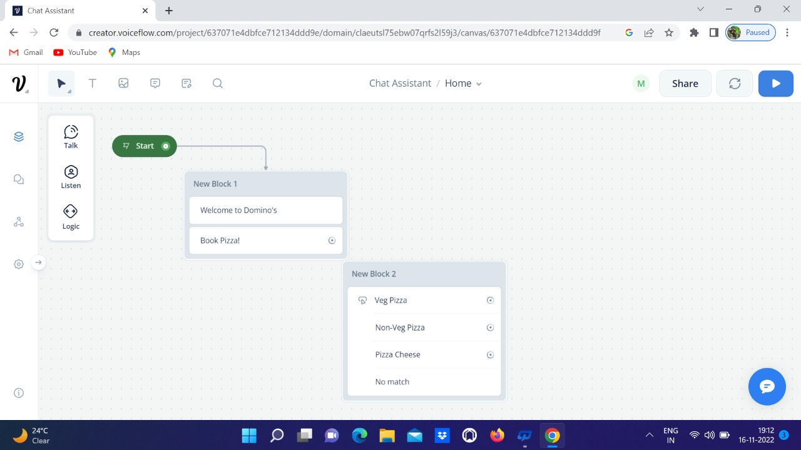
How to connect Button in Text
We Clearly seen That Talk button And Listen So we go with Listen Button Than Add Button

Slide 12
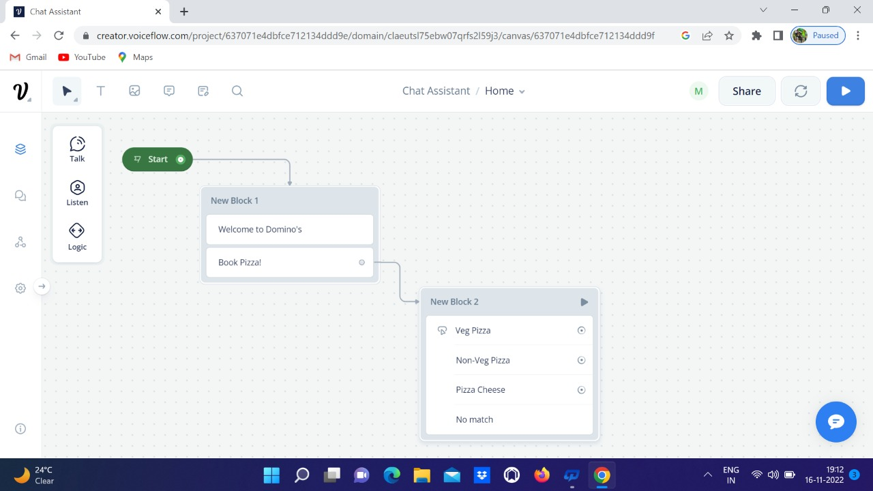

Slide 13
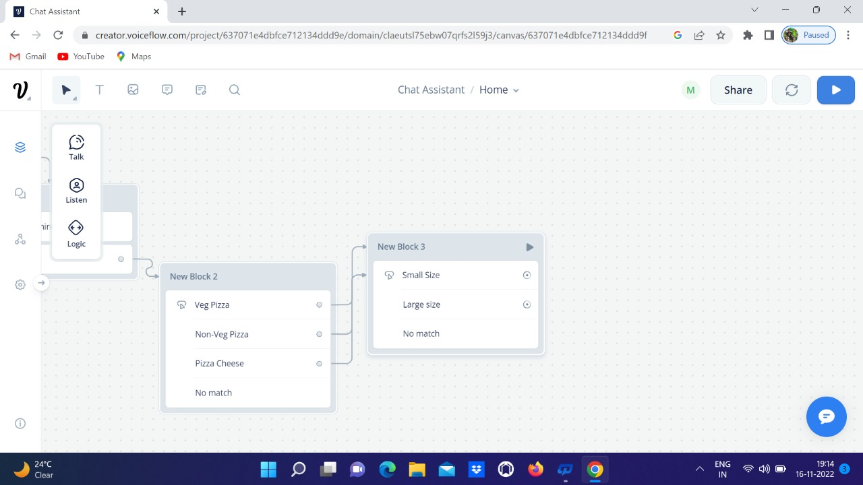

Slide 14
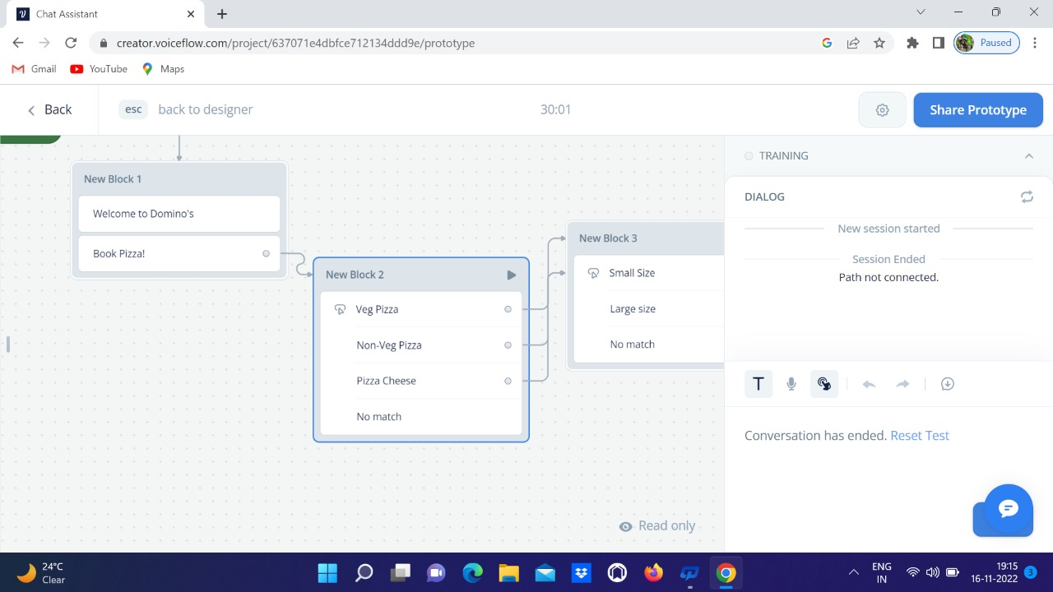
How To Setup

Slide 15
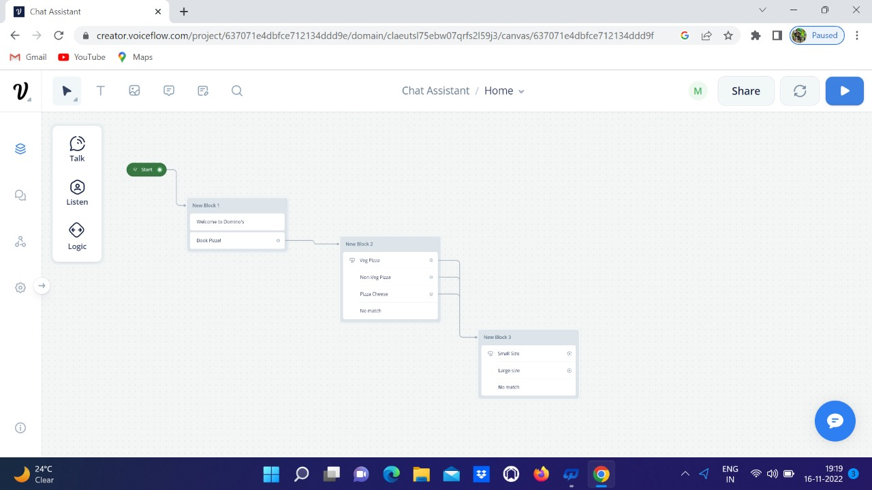

Slide 16
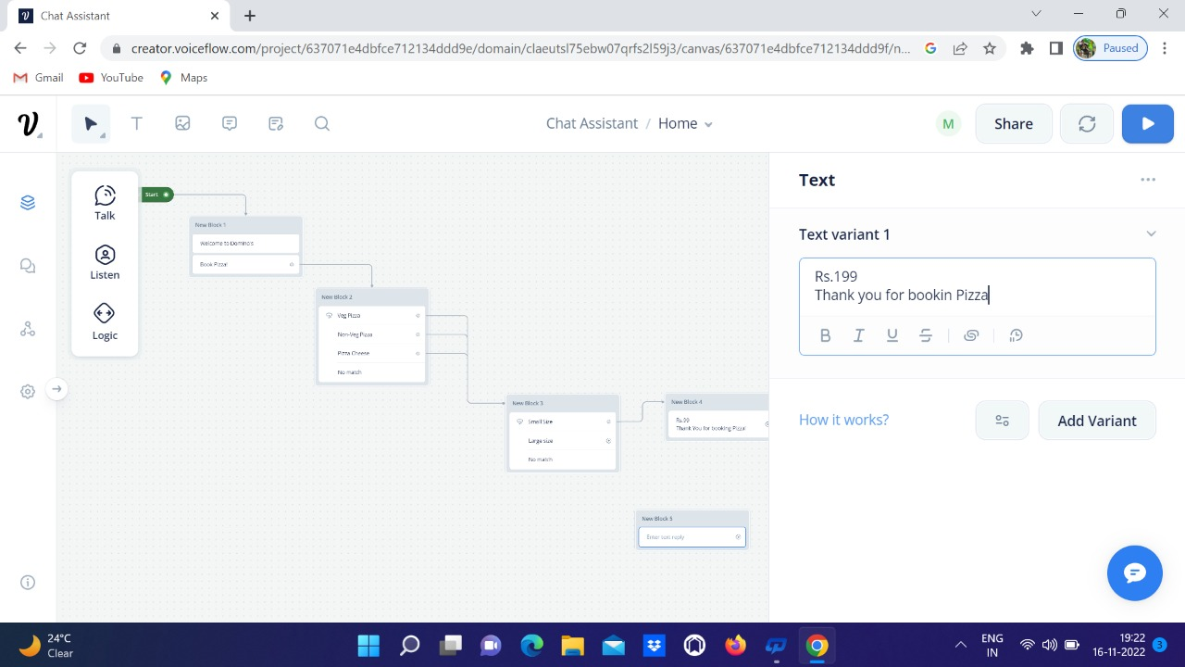
How To Run

Slide 17
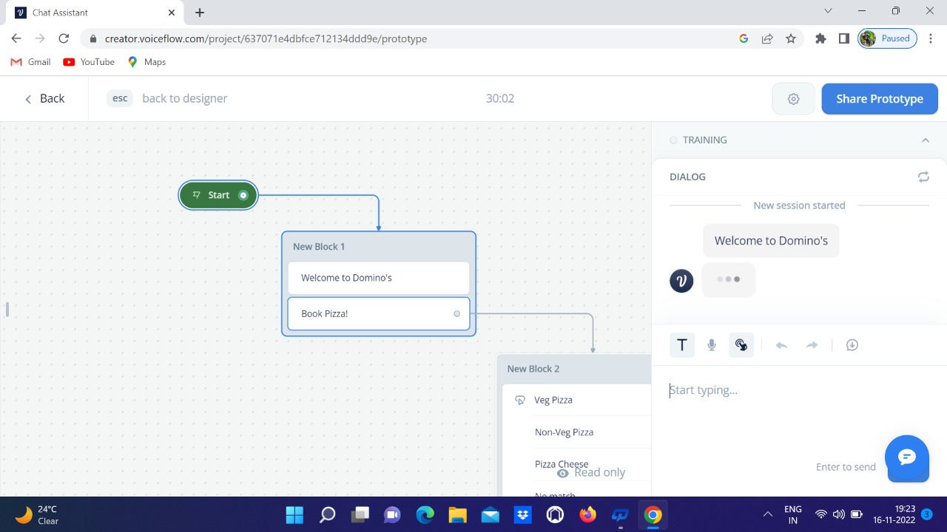
Project

Slide 18
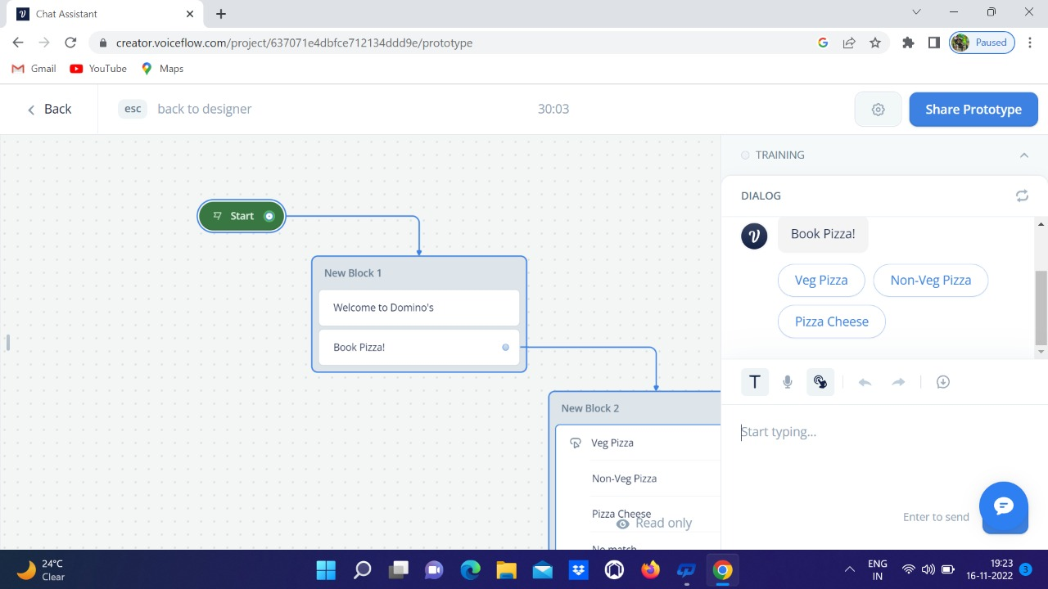

Slide 19
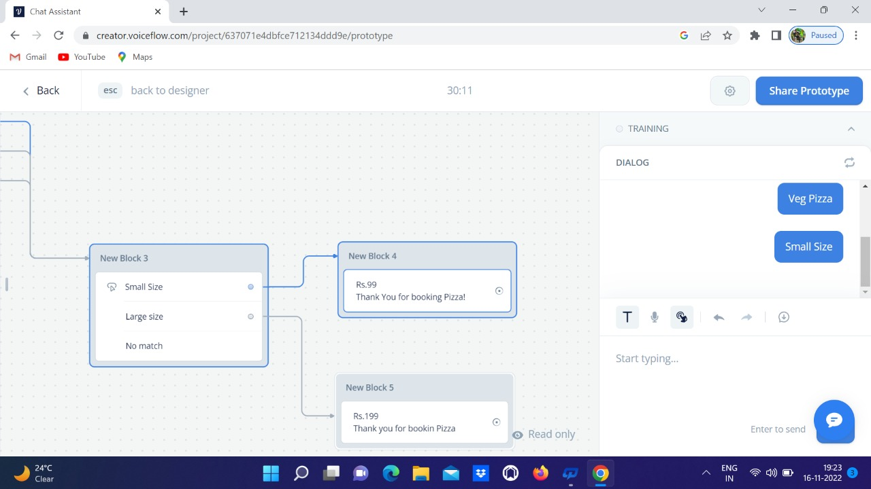

Slide 20
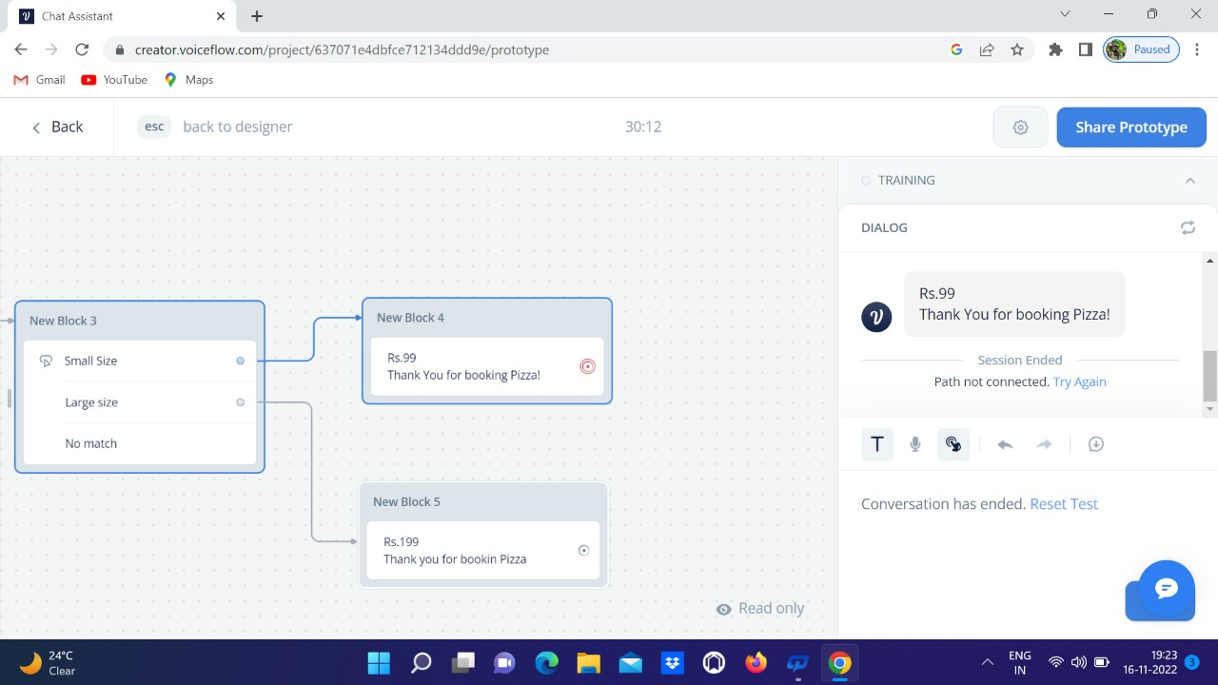
Complete Project

Slide 21
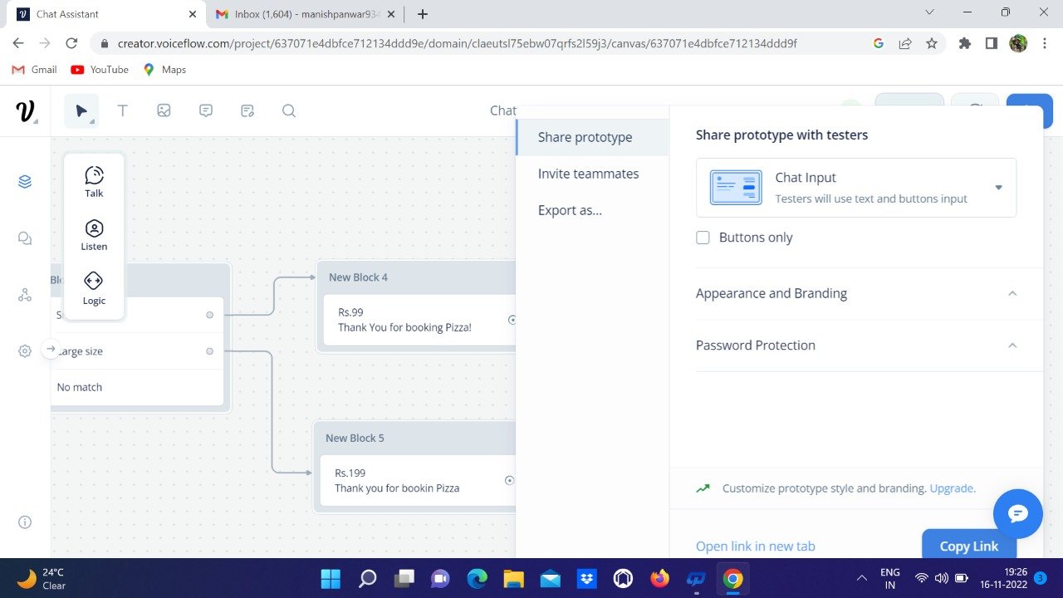
How to share

Slide 22
PROJECT LINK
https://creator.voiceflow.com/prototype/637071e4dbfce712134ddd9e

Slide 23
THANK
YOU

