Slide 1
IMAGE CAPTION GENERATION
Supervised By Dr ANAND GUPTA
PARANJAY SINGH (2020UCO1678)
PIYUSH SINGH (2020UCO1700)
SATENDER (2020UCO1655)

Slide 2
Problem Statement-
This research project addresses the central problem of extracting the information regarding the various objects and its relationship with each other in a form of text.
The core problem at hand is the automatic generation of descriptive and contextually relevant captions for a diverse range of images. Specifically, we aim to develop a computational model that can seamlessly bridge the gap between visual perception and linguistic expression by leveraging Convolutional Neural Networks (CNNs) for image feature extraction and Long Short-Term Memory (LSTM) networks for caption generation.

Slide 3
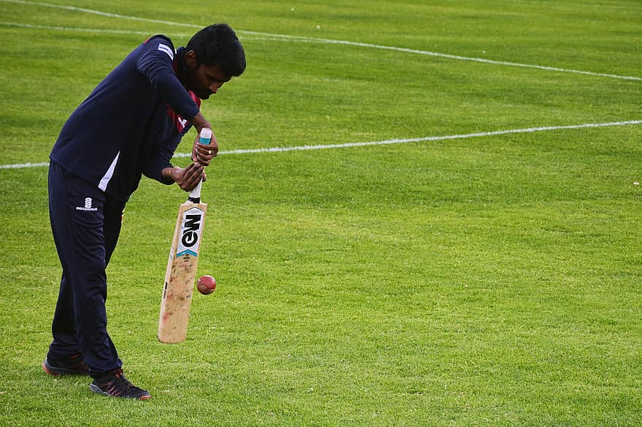
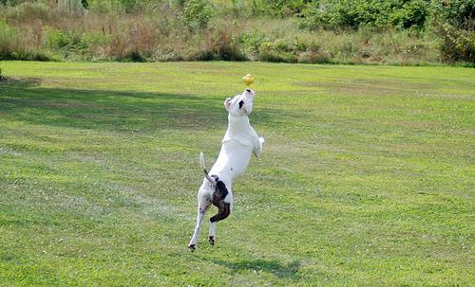
What is expected-
Dog is playing with ball
Man is playing cricket

Slide 4
Motivation-
Describing the image using caption(text) as human is quite a easy task,but for computer to detect different individual object in a image and giving a text output is a difficult task
1.Automatic Captioning can help, make Google Image Search as good as google search done via text
2.Image Caption Generator can make visual content more accessible to individuals with visual impairments
3. It enhances the ability for machines to understand and describe images is crucial for improved human-machine interaction and enables more natural and intuitive communication with AI systems.

Slide 5
Application-
Object description to the visually impaired
To do effective image searches
Self driving Cars
CCTV

Slide 6
ML model is deployed using Flask. User Interface is created using Flask and Flask bootstrap. To predict the captions for an image –
1) A pre-processed tokenizer is used, which is fitted on the captions using which ML model is trained.
2) Uploaded Image is pre-processed.
3) Features are extracted from the uploaded image.
4) Some actions are performed on the image using the tokenizer.
5) Finally image and features are passed through the ML model to generate the captions

Slide 7
Algorithm used-
1.Convolutional Neural Network
A Convolutional Neural Network (ConvNet/CNN) is a Deep Learning system that can take in an image as input, assign importance (learnable weights and biases) to various aspects/objects in the image, and distinguish between them. Convolutional neural networks are a systems that can process data in the form of a 2D matrix. Images are easily represented as a 2D matrix, and CNN is an excellent tool for working with them. It scans photos from left to right and top to bottom to extract significant elements before combining them to classify them.
2.Long Short-Term Memory
It's a type of RNN (recurrent neural network) that's well suited to solving series prediction issues. We can guess what the next phrase will be based on the preceding paragraph. It has proven to be more powerful than traditional RNNs by overcoming the limitations of RNNs with short time period memory.

Slide 8
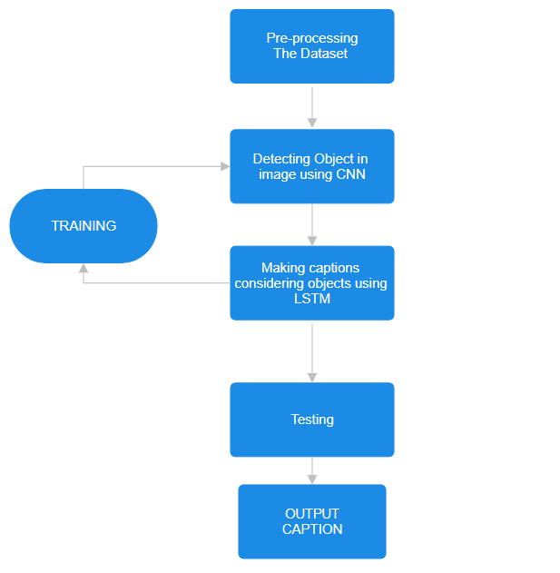
Work-Flow-

Slide 9
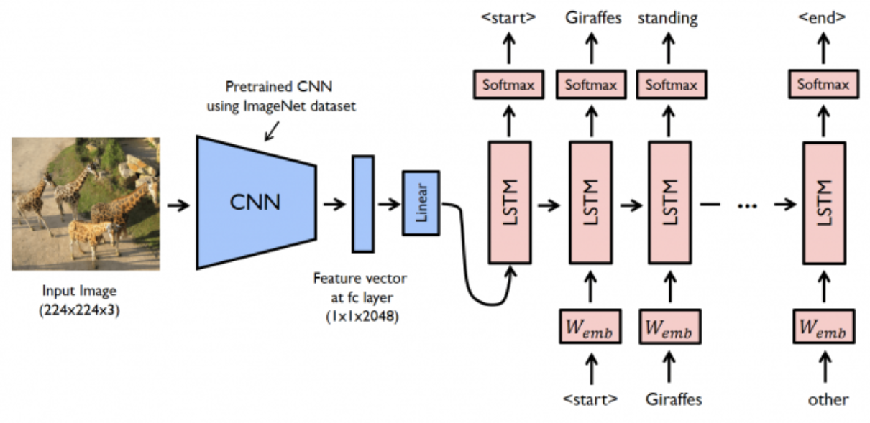

Slide 10
Dataset Used-
The Flickr_8K is used in this project as the dataset. It is a standard benchmark for sentence based image description.The Flickr_8K dataset has generic images with not any particular class or similarity. We have thus further preprocessed this data to match our needs.
Dataset consist of 8k images and each image is encoded to 5 discrete valid caption text statements.

Slide 11
Preprocessing-
IMAGE-
We need to convert every image into a fixed sized vector which can then be fed as input to the neural network.For our model we have taken the image size of(224*224)px.
CAPTIONS-
Prediction of the entire caption, given the image does not happen at once. We will predict the caption word by word. Thus, we need to encode each word into a fixed sized vector,For this part we will create two Python Dictionaries

Slide 12
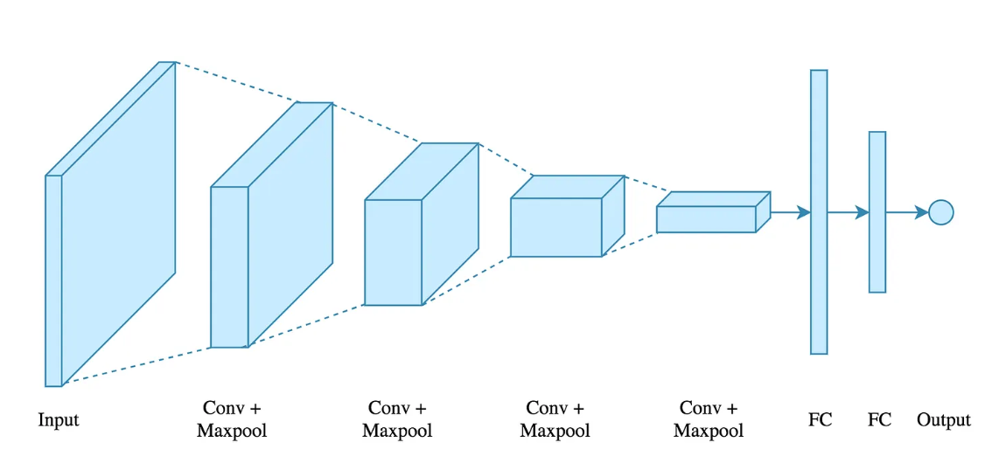
Feature Extraction-
Region-based Convolutional Neural Network(R-CNN) -
It is a method where Selective Search algorithm is used to extract different regions from the image as regions of interest.

Slide 13
Feature Extraction II
Convolutional Neural Network (CNN)
It is a deep learning technique widely used for feature extraction from visual data. It consists of the following steps:
Convolution Operation : Performs the convolution operation of the image with the set of feature detectors to generate feature maps.
Max Pooling : Extracts the most relevant features from the feature map.
Flattening : Flattens the feature map into one dimensional array.

Slide 14
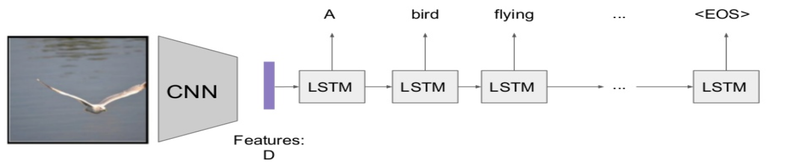
Sentence Generation-
The LSTM cell generates sequential data based upon previous inputs and the present input.
These inputs are presented in timestamps where each timestamp correspond to generation of single word with maximum probability. The further words for each sentence are generated sequentially with regard to the previous generations.

Slide 15
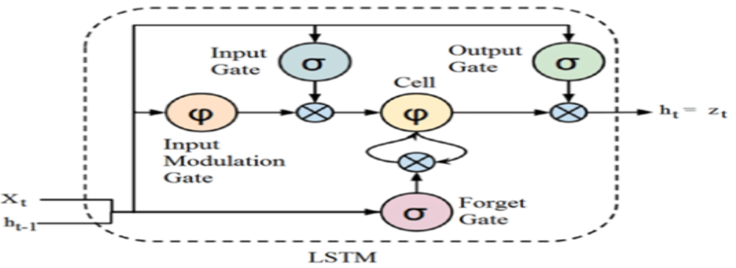
Sentence Generation II-
LSTM employs 3 gates for it’s architecture:
Forget gate : Decides which data to delete.
Input gate : Decided which data to keep in the new input.
Output gate : Determines what data should be outputted.

Slide 16
Tools Used-
Software-
PyCharm
Jupyter Notebook
Tech-
Tensorflow
Keras
VGG16(CNN model)
Numphy
LSTM (RNN model)

Slide 17
RESULT-
The model is accurately able to caption images it was tested on. Although, as the training dataset used was limited, there were a few cases where the captions generated did not capture the objects in the image well enough, but that improved with the increase in the number of epochs used while training the LSTM model

Slide 18
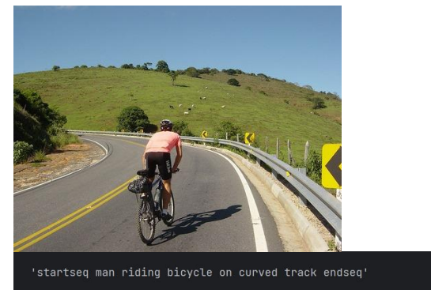
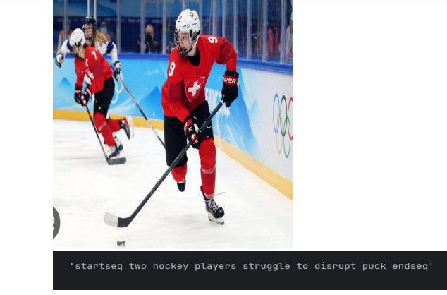
Backend (result)

Slide 19
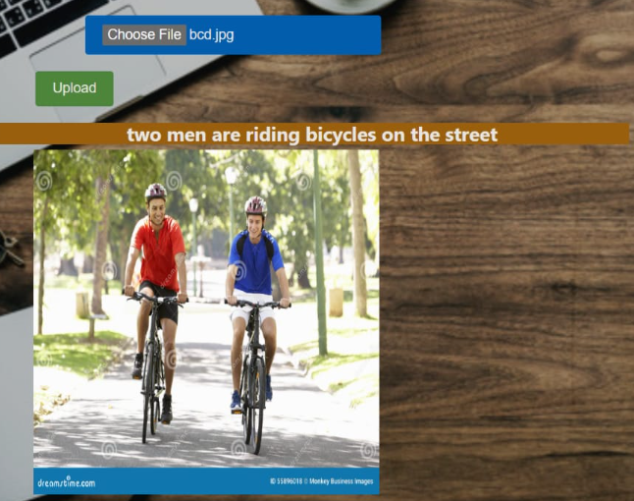
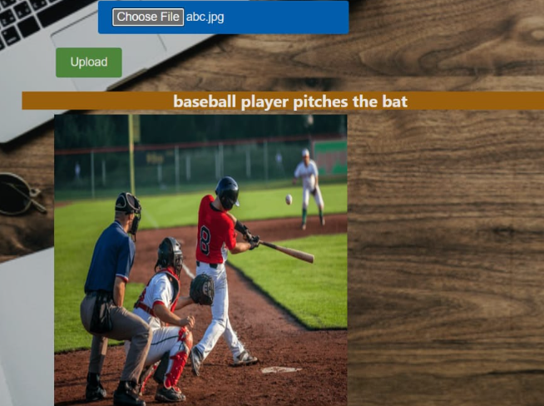
Front end

Slide 20
THANK YOU

