Slide 1
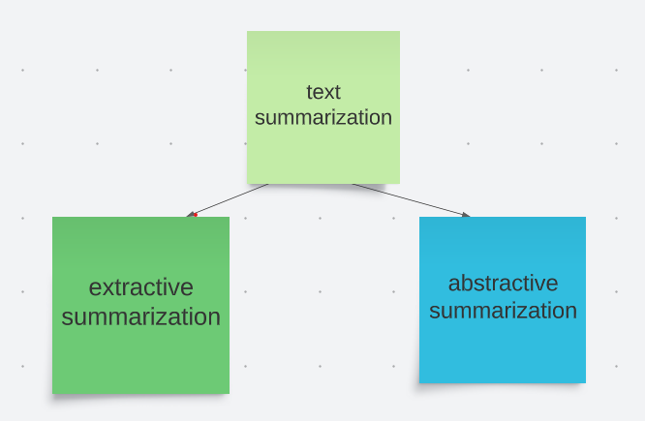
introduction
What is text summarization
Text summarization is the process of extracting the most important information from the written text and presenting it concisely while preserving the main points and importance of the original text and that is no longer than half of the original text(s).
There are two major types of text summarization methods
Extractive
abstractive

Slide 2
Why text summarization
Advancement in technology has created a large reservoir of data mainly in textual form rather than image or video
In this fast world everyone wants to grasp relevant information in minimal time
i.e. text summarization is important as
→ It saves users time by providing relevant info and enhances readability of documents.

Slide 3
Extractive abstractive
EASY TO ACHIEVE
LESS CPU CONSUMPTOIN
NLTK LIBRARY
DIFFICULT TO ACHIEVE
MORE CPU CONSUMPTION
TRANSFORMERS AND PIPELINES

Slide 4
extractive
Extractive summarization involves identifying important sections from text and generating them verbatim which produces a subset of sentences from the original text. therefore tend to accurately reflect the main idea .The downside is that extractive summaries are limited in their ability to fully capture the content . For example Imagine a highlighter. We all have used it at some point in our time, mostly during exams. We highlighted important parts from the text so that it can serve as a quick brief , This is extractive summarization Analogously, in exams if we can remember the the parts we highlighted we can cover the original text.

Slide 5
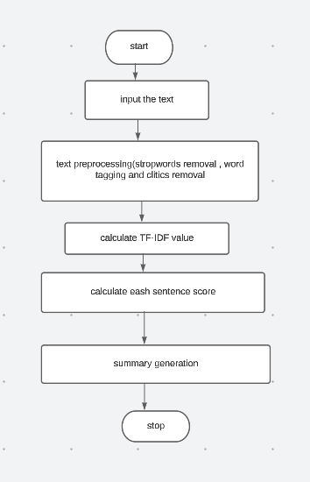
Flow chart for extractive text summarization

Slide 6
Tf-idf (term frequency-inverse document frequency)
Statistical measure used to evaluate how important a word is to a document in a corpus
->TF : it is the frequency of a term occurring in the document i.e. how important a word is to the document
-> IDF: it measure how important a word is to entire corpus
->TF-IDF can be used to determine important words | phrases to a document or set of documents
->Higher TF-IDF determine that the word | phrase is more frequent in document and more rare in the corpus hence higher the TF-IDF value more is the important of that word | phrase in the document

Slide 7
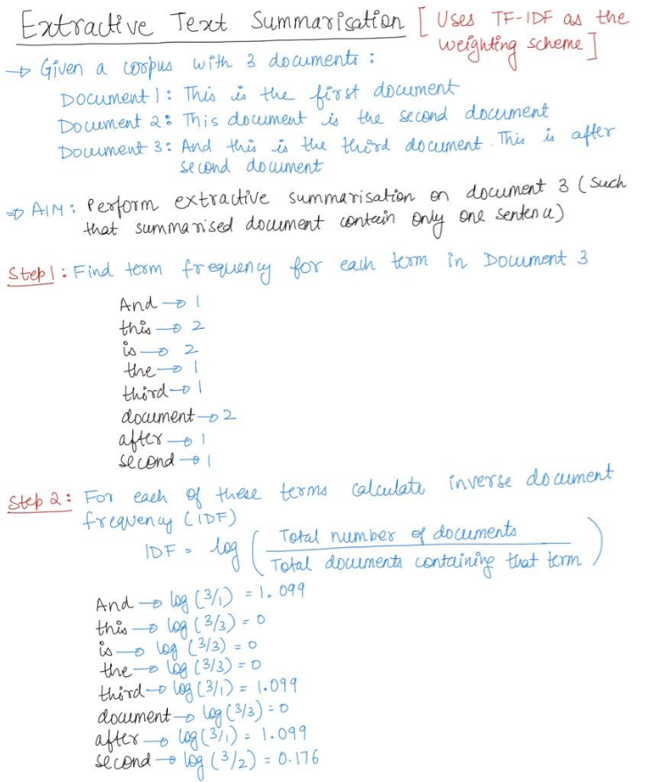
Example

Slide 8
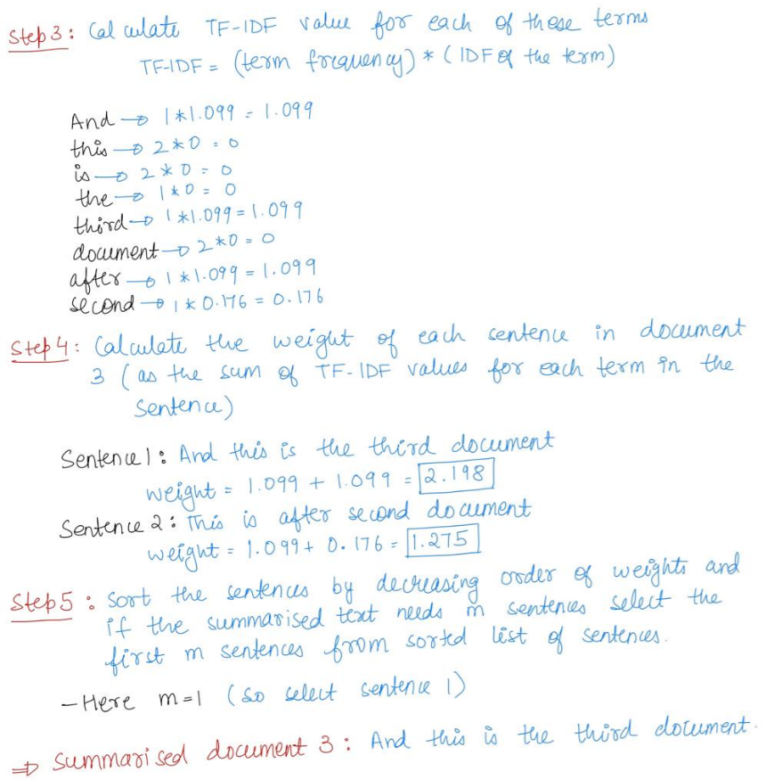

Slide 9
Abstractive
Abstractive summarization uses concept of deep learning like transformer and pipelines. It is an intelligent way to generate summary
Human beings generally write abstractive summaries
Now think of a pen and think of the analogy where you read a long text and now you decided to write a short, compact version of it in your own words. Your objective here, like the previous one, is still to represent the original text by using less words. But the difference is you create your own summarized version of the original text
Here we generally use deep machine learning, that is transformers, bi-directional transformers(BERT), GPT, etc.

Slide 10
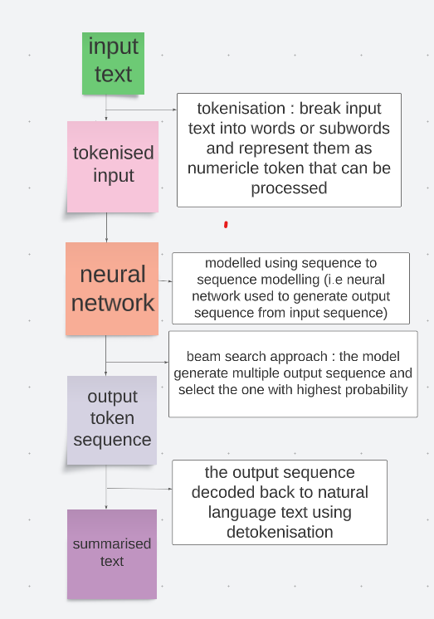
Abstractive
Abstractive text summarisation

Slide 11
Extractive vs abstractive
So which one is superior , Depends. In cases, where the important information is mostly in particular regions of text and the regions themselves are compact, extractive summarization might help by simply extracting those regions.
But in cases, there might be redundancy in the whole language. When necessary information is residing on several regions in the text and simply copying and aggregating them does not make sense, you need an abstractive summarizer that will allow you to write new summarized content from the aggregated information.
Mainly abstractive summarizer will always produce more logical, consistent and polished summaries than it’s extractive summarization.
We will be using abstractive approach for our programme.

Slide 12
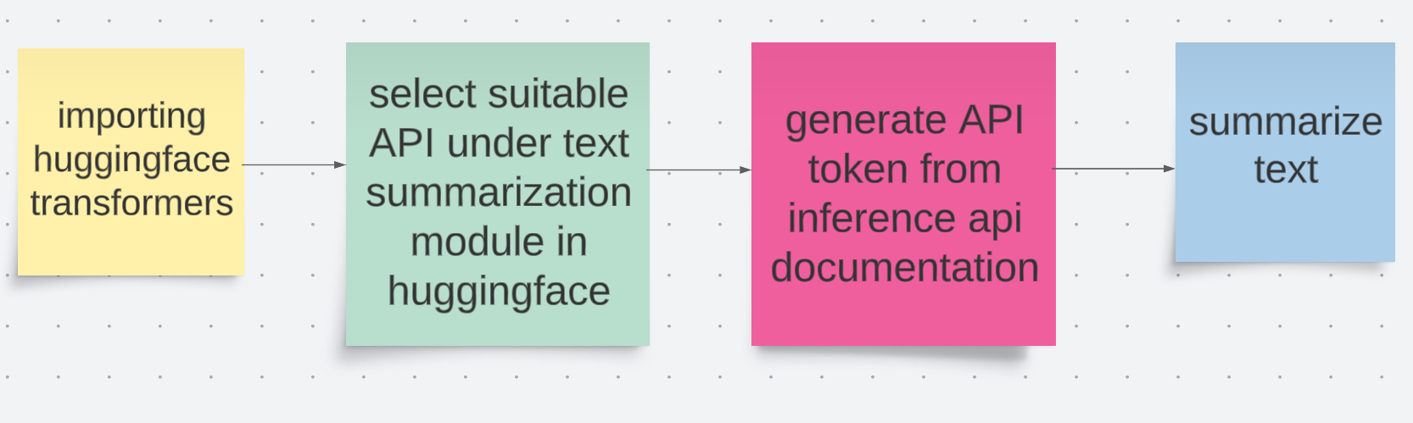
How we’re doing it

Slide 13
Tech Stack Used Hugging face for data summarization API→ THE AI community that build ,train and deploy state of art models and powered by the reference open source in natural language processing Python→ developing algorithms Flask→ for Back-end of our web app and HTML,CSS HTML AND CSS→ designing web app (front end)

Slide 14

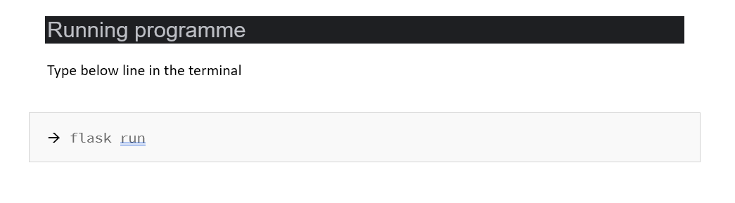
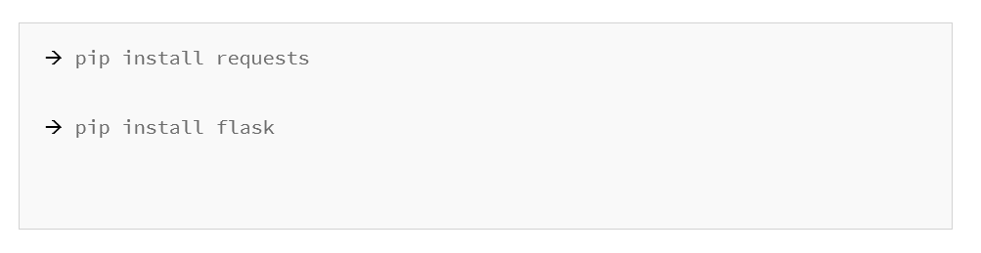
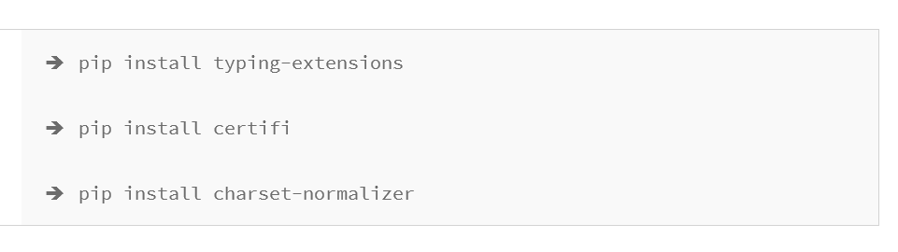

Slide 15
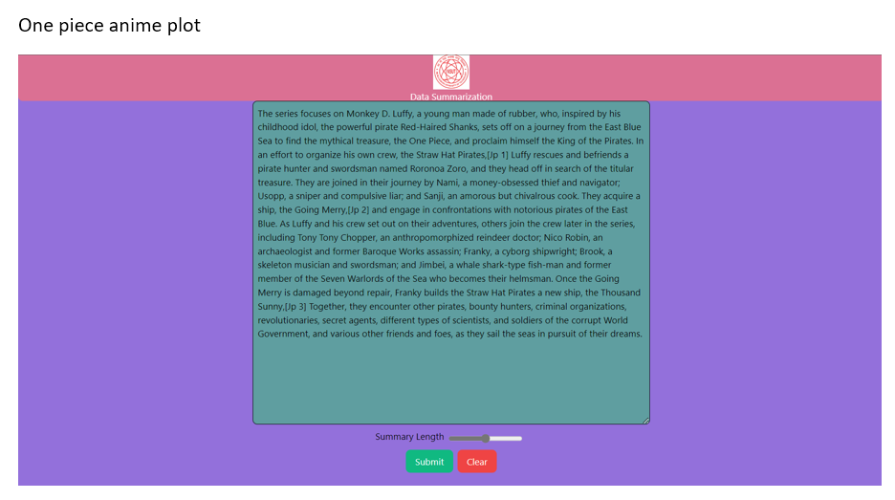

Slide 16
