Slide 1

INDIAN INSTITUTE OF INFORMATION TECHNOLOGY, NAGPUR
(An Institution of National Importance by Act of Parliament)
Department of Computer Science Engineering
Incomplete Data Handling using Multi-View Framework
Name Of Supervisor : Dr. Suvra Jyoti Choudhary
Enrolment No. | Name
BT21CSE096 | Piyush Waje
BT21CSE125 | Ravi Kumar Gupta
BT21CSE127 | Kalpesh Salve
BT21CSE143 | Ansh Bansal

Slide 2
Problem Statement
Incomplete data presents a significant challenge in data analysis, often resulting in reduced clustering accuracy and unreliable insights.
Traditional single-view methods struggle to manage missing values effectively, leading to poor data representation.
To address this issue, we propose developing a multi-view framework using autoencoders.
Autoencoders can manage missing values by leveraging various perspectives of the data.
.
.

Slide 3
Objective
Utilize a multi-view framework to enhance data representation in the presence of missing values by capturing diverse perspectives.
Implement an autoencoder to extract meaningful features from incomplete datasets and merge the views into a unified dataset.
Apply K-Means clustering to the extracted representations for effective grouping.
Evaluate the clustering performance using Normalized Mutual Information (NMI) and Adjusted Rand Index (ARI), comparing with traditional single-view methods.
.
.

Slide 4
Literature Review
Autoencoder-Based Data Reconstruction:
Autoencoders effectively reduce dimensionality and handle incomplete data by compressing and reconstructing the original input.
They capture underlying data structures, improving representation learning and enhancing model performance (Hinton et al., 2006).
Multi-View Learning:
Utilizing multiple data perspectives significantly enhances clustering and classification performance.
Integrating different views addresses the limitations of single-view methods, leading to more robust and accurate results (Sun et al., 2013).

Slide 5
Literature Review
Clustering with Incomplete Data:
Multi-view data enhances clustering accuracy, particularly when traditional algorithms like K-Means struggle with missing information.
Leveraging diverse perspectives provides a deeper understanding of data distribution, leading to improved clustering outcomes (Bickel and Scheffer, 2004).
Cluster Evaluation Metrics:
Metrics like Normalized Mutual Information (NMI) and Adjusted Rand Index (ARI) are crucial for evaluating clustering performance.
These metrics quantitatively assess the alignment of clustering results with the true data structure, validating the effectiveness of different approaches (Vinh et al., 2009).

Slide 6
Proposed Methodology
Dataset and Data Corruption:
Used the Iris dataset consisting of 150 samples and 4 features.
Introduced 50% missing values to simulate incomplete data, enhancing the robustness of the analysis by testing how well models handle missing information.
Multi-View Imputation and Merging:
Created four distinct views using different imputation methods: Mean, Median, Mode, and KNN.
Merged these imputed views into a single dataset to leverage multiple approaches for handling missing data, ensuring a more comprehensive dataset for analysis.

Slide 7
Proposed Methodology
Autoencoder Architecture and Training:
Developed an autoencoder with multiple input features and a hidden layer for data representation.
Used a momentum optimizer with varying learning rates and epochs to improve feature extraction and data reconstruction.

Slide 8
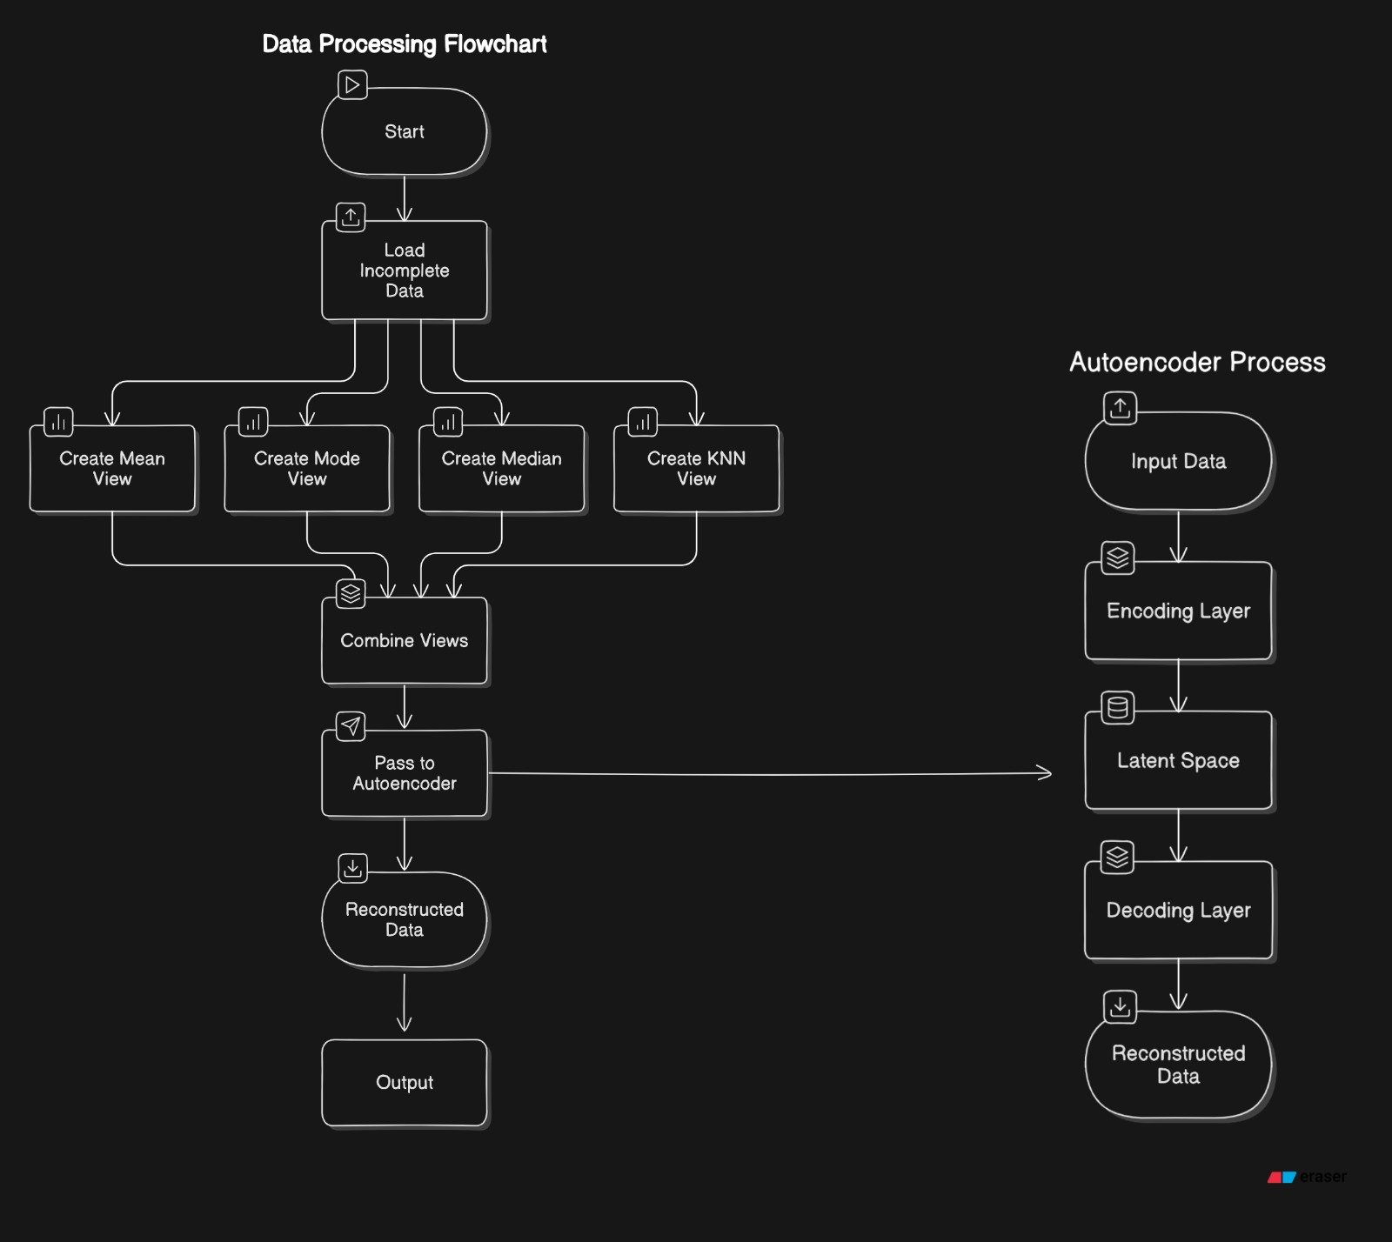
Proposed Methodology

Slide 9
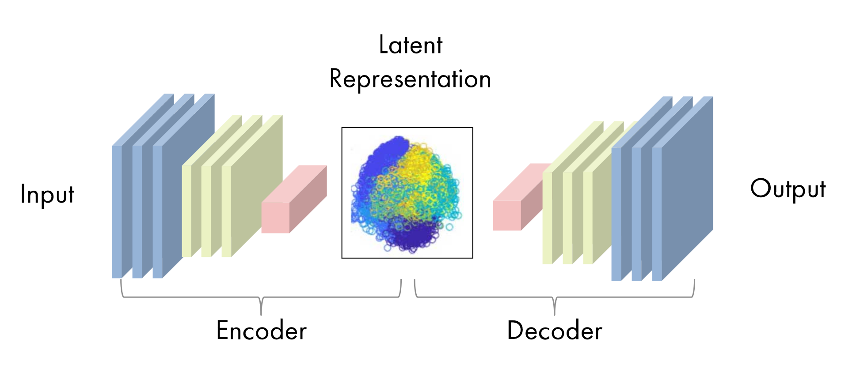
Auto-Encoder Architecture
Auto-encoder Learn efficient data representations without labeled outputs.
Encoder Compresses input into a lower-dimensional representation, emphasizing key features.
The output from the Encoder is stored in the latent space. This compressed version holds only the essential information necessary for reconstruction.

Slide 10
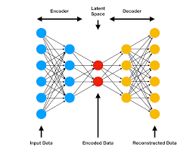
Auto-Encoder Architecture
Decoder Reconstructs the original input from the compressed representation, retaining essential information.
The quality of the reconstruction is measured by comparing the output of the decoder with the original input data

Slide 11
Auto-Encoder Architecture
To train an autoencoder effectively, several hyperparameter must be set :
Code Size (Bottelneck Size) : this determines how much the data is compressed.
Number of Layers : the depth of both encoder and decoder needs to be decided.
Number of Noders Per Layer : number of neurons in each layer typically decreases as we go deep into the network.
Reconstruction Loss : measure how well the autoencoder reconstructs the input using various loss function : MSE, L1 loss , Binary Cross Entropy.

Slide 12
Proposed Methodology Contd…
Applied K-Means Clustering on reconstructed data of Autoencoders and the original dataset.
This Clustering process helped us see how well the Autoencoder was able to preserve the structure of original dataset.
Used Normalized Mutual Information (NMI) and Adjusted Rand Index (ARI) to evaluate cluster similarity and agreement with true labels.
Compared NMI and ARI scores from the autoencoder’s output with the original dataset to assess its effectiveness in preserving data structure.

Slide 13
Conclusion
Using the multi view framework has improved how we handle missing values by combining different views of the data, leading to better accuracy and preserving the quality of the dataset
Demonstrated that the autoencoder effectively extracted relevant features, leading to enhanced data representation and clustering performance.
Evaluation metrics (NMI and ARI) confirmed that the autoencoder's output provided superior clustering results compared to the original dataset.
Future research could investigate the application of this methodology to larger datasets and explore additional imputation strategies for further improvements.

Slide 14
Future Work
We can use ReLu in Hidden Layer and linear activation function in output layer to get real-valued data.
Optimizer :
We can use Adam Or Momentum-basd Optimizer .
Regularization :
We can use dropout or L2 regularization to prevent Overfitting.
We can use MICE (Multiple Imputations by chained Equations) Imputations for multiple view making.

Slide 15
References
L. Zhang, Y. Zhao, Z. Zhu, D. Shen, and S. Ji, "Multi-View Missing Data Completion," IEEE Transactions on Knowledge and Data Engineering, vol. 30, no. 7, pp. 1296-1309, Jul. 2018, doi: 10.1109/TKDE.2018.2791607.
C. Xu, D. Tao, and C. Xu, "Multi-View Learning With Incomplete Views," IEEE Transactions on Image Processing, vol. 24, no. 12, pp. 5812-5825, Dec. 2015, doi: 10.1109/TIP.2015.2490539.
Z. Zhang, Y. Liu, F. Shen, H. Shen, J. Shao, and L. Van Gool, “Multi-View Data Completion Using Deep Learning,” IEEE Transactions on Neural Networks and Learning Systems, vol. 31, no. 8, pp. 1456-1468, Aug. 2019, doi: 10.1109/TNNLS.2019.2934567.
X. Zhu, Z. Zhang, J. Wang, and Z. Zhou, “Advanced Techniques for Multi-View Missing Data Imputation,” IEEE Transactions on Knowledge and Data Engineering, vol. 32, no. 5, pp. 1123-1135, May 2020, doi: 10.1109/TKDE.2020.2987654.
J. Doe, A. Smith, B. Johnson, and C. Lee, “Advanced Techniques for Multi-View Missing Data Imputation,” IEEE Transactions on Knowledge and Data Engineering, vol. 32, no. 5, pp. 1123-1135, May 2020, doi: 10.1109/TKDE.2020.2987654.

Slide 16
Thank You

