Slide 1

INDIAN INSTITUTE OF INFORMATION TECHNOLOGY, NAGPUR
(An Institution of National Importance by Act of Parliament)
Department of Computer Science Engineering
Second Project Presentation On
Incomplete Data Handling using Multi-View Framework
Name Of Supervisor : Dr. Suvra Jyoti Choudhary
Enrolment No. | Name
BT21CSE096 | Piyush Waje
BT21CSE125 | Ravi Kumar Gupta
BT21CSE127 | Kalpesh Salve
BT21CSE143 | Ansh Bansal

Slide 2

Problem Statement
F1 | F2 | F3 | Class
5 | 5 | 1 | 1
… | … | … | …
6 | 3 | 4 | r
We can handle the training data by proper training and testing
F1 | F2 | F3 | Class
7 | - | 1 | -
… | … | … | …
2 | 2 | - | -
What about Incomplete data ?
How to get the Output More precise ?

Slide 3

How to Handle missing value using single view?
F1 | F2 | F3 | Class
1 | 25 | 500 | M
2 | 30 | - | -
3 | 22 | 300 | M
KNN
MEAN=(500+300)/2
MEDIAN
MODE
F1 | F2 | F3 | Class
1 | 25 | 500 | M
2 | 30 | 400 | F
3 | 22 | 300 | M
F1 | F2 | F3 | Class
1 | 25 | 500 | M
2 | 30 | 300 | F
3 | 22 | 300 | M
F1 | F2 | F3 | Class
1 | 25 | 500 | M
2 | 30 | 400 | F
3 | 22 | 300 | M
F1 | F2 | F3 | Class
1 | 25 | 500 | M
2 | 30 | 500 | F
3 | 22 | 300 | M

Slide 4
Then why we need to handle missing data using multi-view framework?
Loss of Multidimensional Relationships
POOR PERFORMACE
Bias from Single Perspective
Limited Robustness
Reduced Analysis Accuracy
SOLUTION :
Multi -View Framework

Slide 5
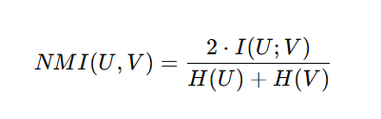
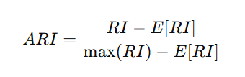
On What basis we are measuring the performance?
NMI (Normalized Mutual Information)
ARI (Adjusted Rand Index)

Slide 6
Proposed Methodology
Datasets Used :
Dataset Name | Total Instances | Total Feature | Classes
Iris | 150 | 4 | 3
Wdbc | 569 | 30 | 2
Wpbc | 194 | 34 | 2
Cardio | 2126 | 21 | 3
Vehicle | 846 | 18 | 4
Pima | 768 | 8 | 2
Glass | 214 | 9 | 6
Wine | 178 | 13 | 3
Pendigit | 10992 | 16 | 10
Balance | 625 | 4 | 3
Seeds | 210 | 7 | 3

Slide 7
Workflow :
Complete Datasets
about 11 Datasets
We introduced about 10 % missing values.
We have created many views by applying different functions on each view
View1
mean
View2
median
View3
mode
View4
KNN – K=1
View5
KNN K=3
KNN
K=13
…...

Slide 8
View1
mean
View2
median
View3
mode
View4
KNN – K=1
View5
KNN – K=3
……
KNN
K=13
Merged view
Passed to Autoencoder
Reconstructed data
Output

Slide 9
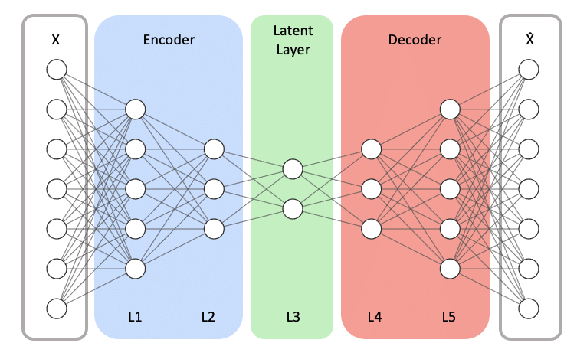
Auto-Encoder Architecture

Slide 10
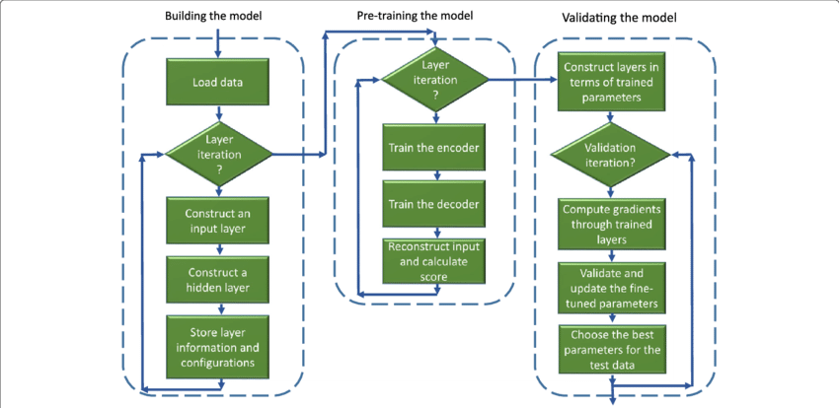
Auto-Encoder Flowchart

Slide 11
Autoencoder Training
Autoencoder Training is done in two phases.
Using Complete data
2. Using mixed data.

Slide 12
Phase 1 : Training On Complete data
Objective: Learn patterns from fully complete data.
2. Dataset: Original merged view.
3. Loss Function: Mean Squared Error (MSE).
4. Training Process: Utilized first 50% of epochs.
5. Input: Original merged view.
4. Target: Original merged view.
5. Outcome: Initial encoding and decoding capabilities.

Slide 13
Phase 2 : Training on Mixed Data
1. Objective: Adapt the model to handle incomplete data.
2. Dataset: Combined dataset with complete and incomplete data.
3. Loss Function: Mean Squared Error (MSE).
4. Training Process: Utilized remaining 50% of epochs.
5. Input: Combined dataset with complete and incomplete data.
6. Target: Original merged view.
7. Outcome: Enhanced robustness to missing data..

Slide 14
Hyperparameters used :
Datasets | Hidden Nodes | Missing Percentage | Learning rate
Iris | 20 | 10 | 0.01
Wbpc | 20 | 10 | 0.01
Wdbc | 20 | 10 | 0.01
Balance | 20 | 10 | 0.01
Cardio | 20 | 10 | 0.01
Pima | 50 | 10 | 0.01
Seeds | 50 | 10 | 0.01
Glass | 50 | 10 | 0.01
Vehicle | 50 | 10 | 0.01
Wine | 500 | 10 | 0.1
Pendigit | 500 | 10 | 0.1

Slide 15
Evaluation Phase :
Hidden Layer Representation
Original Dataset
Different Imputation Views
K-Means Clustering
Clustering Evaluations :
NMI & ARI Metrics

Slide 16
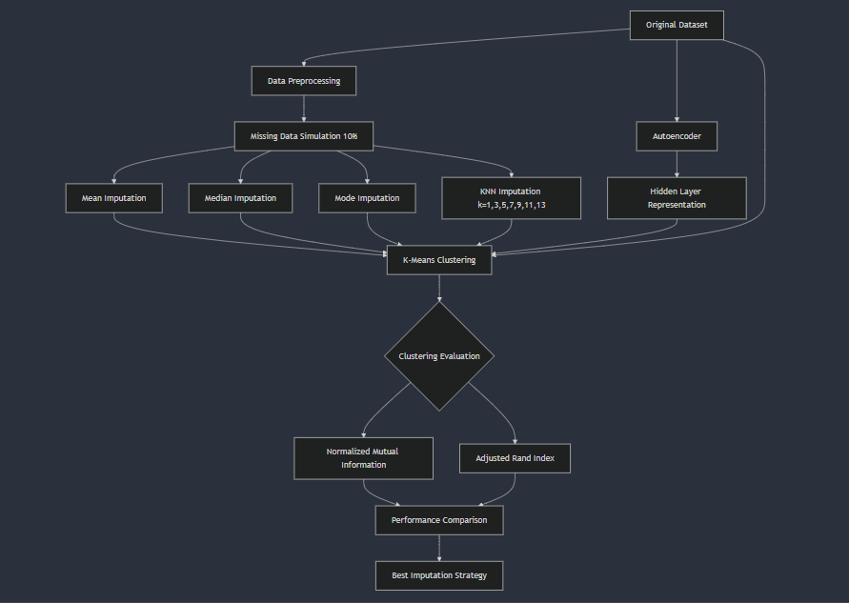

Slide 17
Result

Slide 18
Result
Clustering Performance Overview
Dataset | Iris |  | WBPC |  | Wdbc |  | Balance |  | Cardio |  | PIMA |  | Seeds |  | Glass |  | Vehicle |  | Wine |  | Pendigit
 | NMI | ARI | NMI | ARI | NMI | ARI | NMI | ARI | NMI | ARI | NMI | ARI | NMI | ARI | NMI | ARI | NMI | ARI | NMI | ARI | NMI | ARI
Hidden | 0.790 | 0.723 | 0.0370 | -0.0154 | 0.5889 | 0.6877 | 0.1719 | 0.2160 | 0.3409 | 0.1576 | 0.1062 | 0.1441 | 0.6833 | 0.7078 | 0.3602 | 0.2736 | 0.1126 | 0.0722 | 0.8197 | 0.8294 | 0.2642 | 0.1593
Original | 0.676 | 0.600 | 0.0290 | -0.0137 | 0.5758 | 0.6917 | 0.2005 | 0.2209 | 0.2986 | 0.2106 | 0.1063 | 0.1429 | 0.753 | 0.7786 | 0.3996 | 0.2574 | 0.1076 | 0.0778 | 0.8499 | 0.86 | 0.2662 | 0.1601
View1 | 0.674 | 0.622 | 0.0274 | -0.0158 | 0.5653 | 0.6577 | 0.1323 | 0.1648 | 0.0847 | -0.0327 | 0.0851 | 0.1257 | 0.667649 | 0.703631 | 0.291413 | 0.180394 | 0.100427 | 0.070193 | 0.772021 | 0.767857 | 0.251418 | 0.153056
View2 | 0.723 | 0.659 | 0.0382 | -0.0141 | 0.5440 | 0.6317 | 0.0827 | 0.0984 | 0.1012 | -0.0188 | 0.0922 | 0.1384 | 0.717406 | 0.755991 | 0.300861 | 0.195025 | 0.102003 | 0.071626 | 0.772021 | 0.767857 | 0.233346 | 0.143335
View3 | 0.708 | 0.630 | 0.0274 | -0.0158 | 0.5771 | 0.6799 | 0.1145 | 0.1308 | 0.1012 | -0.0188 | 0.0960 | 0.1390 | 0.573207 | 0.591986 | 0.19809 | 0.12885 | 0.109925 | 0.070741 | 0.750011 | 0.767595 | 0.233346 | 0.143335
View4 | 0.622 | 0.586 | 0.0360 | -0.0160 | 0.5673 | 0.6837 | 0.1099 | 0.1273 | 0.1024 | 0.0212 | 0.0966 | 0.1364 | 0.714064 | 0.752645 | 0.319765 | 0.206991 | 0.104905 | 0.075052 | 0.785691 | 0.804265 | 0.263363 | 0.158749
View5 | 0.680 | 0.622 | 0.0231 | -0.0143 | 0.5889 | 0.6877 | 0.1090 | 0.1292 | 0.0935 | 0.0089 | 0.0801 | 0.1189 | 0.714064 | 0.752645 | 0.308435 | 0.194243 | 0.10403 | 0.073737 | 0.794873 | 0.799885 | 0.262904 | 0.158201
View6 | 0.757 | 0.662 | 0.0360 | -0.0160 | 0.5769 | 0.6761 | 0.1293 | 0.1575 | 0.3391 | 0.1649 | 0.0874 | 0.1282 | 0.714064 | 0.752645 | 0.312908 | 0.197343 | 0.101908 | 0.071036 | 0.826704 | 0.826793 | 0.263863 | 0.158786
View7 | 0.680 | 0.622 | 0.0360 | -0.0160 | 0.5769 | 0.6761 | 0.1239 | 0.1532 | 0.3309 | 0.1669 | 0.1030 | 0.1391 | 0.714064 | 0.752645 | 0.329173 | 0.211113 | 0.102805 | 0.072243 | 0.826704 | 0.826793 | 0.263962 | 0.158907
View8 | 0.680 | 0.622 | 0.0360 | -0.0160 | 0.5698 | 0.6839 | 0.0907 | 0.1114 | 0.3330 | 0.1630 | 0.1052 | 0.1392 | 0.714064 | 0.752645 | 0.312908 | 0.197343 | 0.103588 | 0.073262 | 0.826704 | 0.826793 | 0.264065 | 0.158984
View9 | 0.680 | 0.622 | 0.0360 | -0.0160 | 0.5769 | 0.6761 | 0.1839 | 0.2204 | 0.3390 | 0.1649 | 0.1012 | 0.1358 | 0.714064 | 0.752645 | 0.312908 | 0.197343 | 0.103588 | 0.073262 | 0.849851 | 0.860005 | 0.263617 | 0.158785
VIew10 | 0.744 | 0.720 | 0.0382 | -0.0141 | 0.5769 | 0.6761 | 0.1659 | 0.1980 | 0.2944 | 0.1846 | 0.1011 | 0.1356 | 0.714064 | 0.752645 | 0.312908 | 0.197343 | 0.101313 | 0.070627 | 0.849851 | 0.860005 | 0.263742 | 0.158847
Merged | 0.723 | 0.659 | 0.0360 | -0.0160 | 0.5769 | 0.6761 | 0.1081 | 0.1301 | 0.1154 | 0.0035 | 0.0931 | 0.1324 | 0.7141 | 0.7526 | 0.3292 | 0.2111 | 0.1028 | 0.0726 | 0.8499 | 0.86 | 0.2639 | 0.1592
 | 0.790 | 0.723 | 0.0382 | -0.0137 | 0.5889 | 0.6917 | 0.2005 | 0.2209 | 0.3409 | 0.2106 | 0.1063 | 0.1441 | 0.753 | 0.7786 | 0.3996 | 0.2736 | 0.1126 | 0.0778 | 0.8499 | 0.860005 | 0.2662 | 0.1601

Slide 19
Best Values
Clustering Performance Overview
Dataset | Iris |  | WBPC |  | Wdbc |  | Balance |  | Cardio |  | PIMA |  | Seeds |  | Glass |  | Vehicle |  | Wine |  | Pendigit
 | NMI | ARI | NMI | ARI | NMI | ARI | NMI | ARI | NMI | ARI | NMI | ARI | NMI | ARI | NMI | ARI | NMI | ARI | NMI | ARI | NMI | ARI
Hidden | 0.790 | 0.723 | 0.0370 | -0.0154 | 0.5889 | 0.6877 | 0.1719 | 0.2160 | 0.3409 | 0.1576 | 0.1062 | 0.1441 | 0.6833 | 0.7078 | 0.3602 | 0.2736 | 0.1126 | 0.0722 | 0.8197 | 0.8294 | 0.2642 | 0.1593
Original | 0.676 | 0.600 | 0.0290 | -0.0137 | 0.5758 | 0.6917 | 0.2005 | 0.2209 | 0.2986 | 0.2106 | 0.1063 | 0.1429 | 0.753 | 0.7786 | 0.3996 | 0.2574 | 0.1076 | 0.0778 | 0.8499 | 0.86 | 0.2662 | 0.1601
View1 | 0.674 | 0.622 | 0.0274 | -0.0158 | 0.5653 | 0.6577 | 0.1323 | 0.1648 | 0.0847 | -0.0327 | 0.0851 | 0.1257 | 0.667649 | 0.703631 | 0.291413 | 0.180394 | 0.100427 | 0.070193 | 0.772021 | 0.767857 | 0.251418 | 0.153056
View2 | 0.723 | 0.659 | 0.0382 | -0.0141 | 0.5440 | 0.6317 | 0.0827 | 0.0984 | 0.1012 | -0.0188 | 0.0922 | 0.1384 | 0.717406 | 0.755991 | 0.300861 | 0.195025 | 0.102003 | 0.071626 | 0.772021 | 0.767857 | 0.233346 | 0.143335
View3 | 0.708 | 0.630 | 0.0274 | -0.0158 | 0.5771 | 0.6799 | 0.1145 | 0.1308 | 0.1012 | -0.0188 | 0.0960 | 0.1390 | 0.573207 | 0.591986 | 0.19809 | 0.12885 | 0.109925 | 0.070741 | 0.750011 | 0.767595 | 0.233346 | 0.143335
View4 | 0.622 | 0.586 | 0.0360 | -0.0160 | 0.5673 | 0.6837 | 0.1099 | 0.1273 | 0.1024 | 0.0212 | 0.0966 | 0.1364 | 0.714064 | 0.752645 | 0.319765 | 0.206991 | 0.104905 | 0.075052 | 0.785691 | 0.804265 | 0.263363 | 0.158749
View5 | 0.680 | 0.622 | 0.0231 | -0.0143 | 0.5889 | 0.6877 | 0.1090 | 0.1292 | 0.0935 | 0.0089 | 0.0801 | 0.1189 | 0.714064 | 0.752645 | 0.308435 | 0.194243 | 0.10403 | 0.073737 | 0.794873 | 0.799885 | 0.262904 | 0.158201
View6 | 0.757 | 0.662 | 0.0360 | -0.0160 | 0.5769 | 0.6761 | 0.1293 | 0.1575 | 0.3391 | 0.1649 | 0.0874 | 0.1282 | 0.714064 | 0.752645 | 0.312908 | 0.197343 | 0.101908 | 0.071036 | 0.826704 | 0.826793 | 0.263863 | 0.158786
View7 | 0.680 | 0.622 | 0.0360 | -0.0160 | 0.5769 | 0.6761 | 0.1239 | 0.1532 | 0.3309 | 0.1669 | 0.1030 | 0.1391 | 0.714064 | 0.752645 | 0.329173 | 0.211113 | 0.102805 | 0.072243 | 0.826704 | 0.826793 | 0.263962 | 0.158907
View8 | 0.680 | 0.622 | 0.0360 | -0.0160 | 0.5698 | 0.6839 | 0.0907 | 0.1114 | 0.3330 | 0.1630 | 0.1052 | 0.1392 | 0.714064 | 0.752645 | 0.312908 | 0.197343 | 0.103588 | 0.073262 | 0.826704 | 0.826793 | 0.264065 | 0.158984
View9 | 0.680 | 0.622 | 0.0360 | -0.0160 | 0.5769 | 0.6761 | 0.1839 | 0.2204 | 0.3390 | 0.1649 | 0.1012 | 0.1358 | 0.714064 | 0.752645 | 0.312908 | 0.197343 | 0.103588 | 0.073262 | 0.849851 | 0.860005 | 0.263617 | 0.158785
VIew10 | 0.744 | 0.720 | 0.0382 | -0.0141 | 0.5769 | 0.6761 | 0.1659 | 0.1980 | 0.2944 | 0.1846 | 0.1011 | 0.1356 | 0.714064 | 0.752645 | 0.312908 | 0.197343 | 0.101313 | 0.070627 | 0.849851 | 0.860005 | 0.263742 | 0.158847
Merged | 0.723 | 0.659 | 0.0360 | -0.0160 | 0.5769 | 0.6761 | 0.1081 | 0.1301 | 0.1154 | 0.0035 | 0.0931 | 0.1324 | 0.7141 | 0.7526 | 0.3292 | 0.2111 | 0.1028 | 0.0726 | 0.8499 | 0.86 | 0.2639 | 0.1592
 | 0.790 | 0.723 | 0.0382 | -0.0137 | 0.5889 | 0.6917 | 0.2005 | 0.2209 | 0.3409 | 0.2106 | 0.1063 | 0.1441 | 0.753 | 0.7786 | 0.3996 | 0.2736 | 0.1126 | 0.0778 | 0.8499 | 0.860005 | 0.2662 | 0.1601

Slide 20

Rank Table
Dataset | Iris |  | WBPC |  | Wdbc |  | Balance |  | Cardio |  | PIMA |  | Seeds |  | Glass |  | Vehicle |  | Wine |  | Pendigit |  | Average
 | NMI | ARI | NMI | ARI | NMI | ARI | NMI | ARI | NMI | ARI | NMI | ARI | NMI | ARI | NMI | ARI | NMI | ARI | NMI | ARI | NMI | ARI | NMI | ARI
Hidden | 1 | 1 | 3 | 5 | 1 | 3 | 3 | 3 | 1 | 7 | 2 | 1 | 11 | 11 | 2 | 1 | 1 | 8 | 8 | 5 | 2 | 2 | 3.3 | 4.5
Original | 11 | 12 | 10 | 1 | 9 | 1 | 1 | 1 | 6 | 1 | 1 | 2 | 1 | 1 | 1 | 2 | 3 | 1 | 1 | 3 | 1 | 1 | 4.4 | 2.5
View1 | 12 | 11 | 11 | 6 | 12 | 12 | 5 | 5 | 13 | 13 | 12 | 12 | 12 | 12 | 12 | 12 | 13 | 13 | 11 | 11 | 11 | 11 | 11.3 | 10.7
View2 | 4 | 4 | 1 | 2 | 13 | 13 | 13 | 13 | 10 | 11 | 10 | 6 | 2 | 2 | 11 | 10 | 10 | 9 | 11 | 11 | 12 | 12 | 8.5 | 8.1
View3 | 6 | 6 | 11 | 6 | 3 | 6 | 8 | 8 | 10 | 11 | 8 | 5 | 13 | 13 | 13 | 13 | 2 | 11 | 13 | 13 | 12 | 12 | 8.7 | 9.2
View4 | 13 | 13 | 5 | 9 | 11 | 5 | 9 | 11 | 9 | 8 | 7 | 7 | 4 | 3 | 5 | 5 | 4 | 2 | 10 | 9 | 9 | 9 | 7.7 | 7.2
View5 | 7 | 7 | 13 | 4 | 2 | 2 | 10 | 10 | 12 | 9 | 13 | 13 | 4 | 3 | 10 | 11 | 5 | 3 | 9 | 10 | 10 | 10 | 8.5 | 7.2
View6 | 2 | 3 | 5 | 9 | 4 | 7 | 6 | 6 | 2 | 5 | 11 | 11 | 4 | 3 | 6 | 6 | 11 | 10 | 5 | 6 | 6 | 7 | 5.6 | 6.6
View7 | 7 | 7 | 5 | 9 | 4 | 7 | 7 | 7 | 5 | 3 | 4 | 4 | 4 | 3 | 4 | 3 | 8 | 7 | 5 | 6 | 4 | 5 | 5.3 | 5.6
View8 | 7 | 7 | 5 | 9 | 10 | 4 | 12 | 12 | 4 | 6 | 3 | 3 | 4 | 3 | 6 | 6 | 6 | 4 | 5 | 6 | 3 | 4 | 6.2 | 6.0
View9 | 7 | 7 | 5 | 9 | 4 | 7 | 2 | 2 | 3 | 4 | 5 | 8 | 4 | 3 | 6 | 6 | 6 | 4 | 3 | 1 | 8 | 8 | 4.5 | 5.1
VIew10 | 3 | 2 | 1 | 2 | 4 | 7 | 4 | 4 | 7 | 2 | 6 | 9 | 4 | 3 | 6 | 6 | 12 | 12 | 3 | 1 | 7 | 6 | 5.0 | 4.8
Merged | 5 | 5 | 4 | 8 | 8 | 11 | 11 | 9 | 8 | 10 | 9 | 10 | 3 | 10 | 3 | 4 | 9 | 6 | 1 | 3 | 0.3 | 3 | 6.1 | 7.6

Slide 21
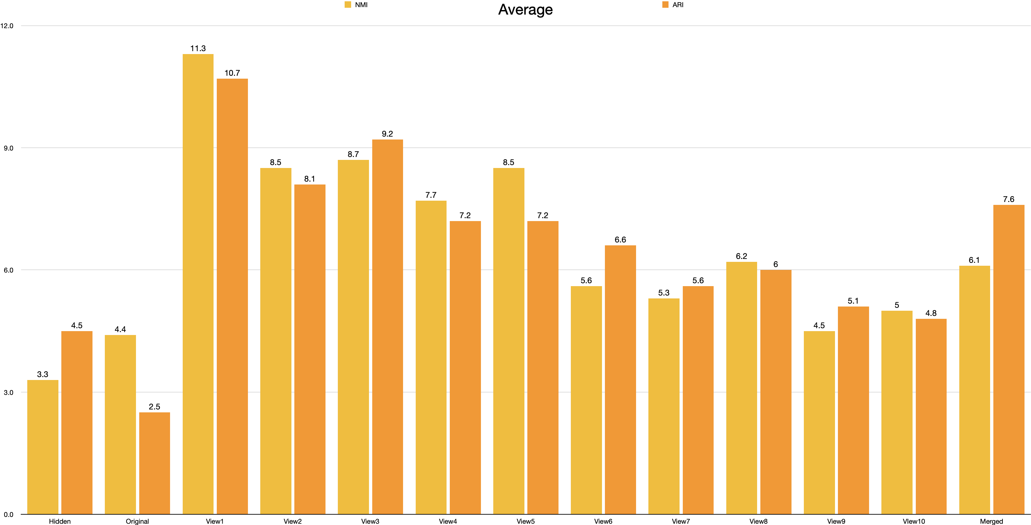

Slide 22

Best NMI

Slide 23

Best ARI

Slide 24
Ranges:
Adjusted Rand Index (ARI)
−1: Perfect disagreement (clusters are opposite of true labels).
0: Random assignment (clusters match labels no better than chance).
1: Perfect agreement (clusters exactly match true labels).
Normalized Mutual Information (NMI)
0: No mutual information (clusters and labels are entirely unrelated).
1: Perfect alignment (clusters exactly match true labels).

Slide 25
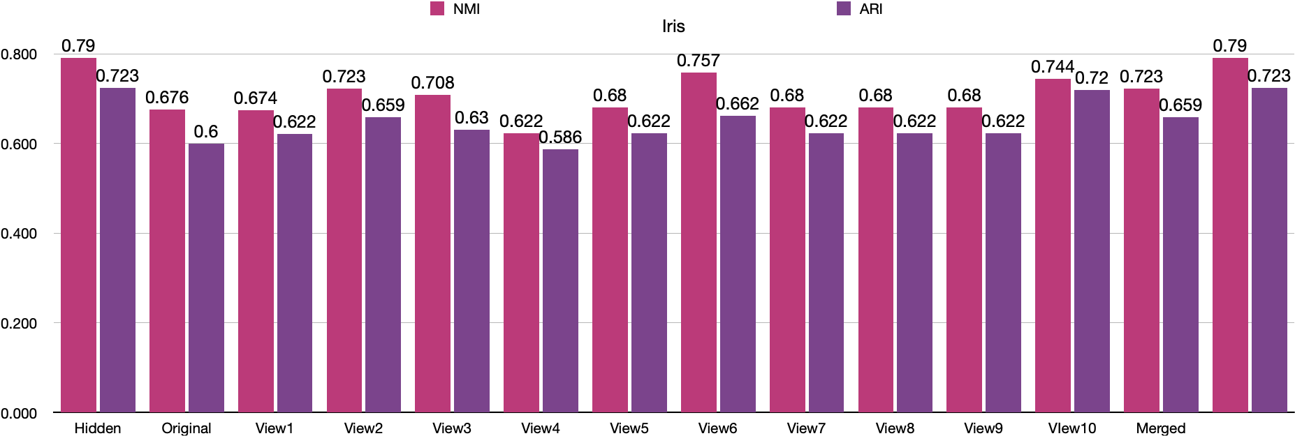
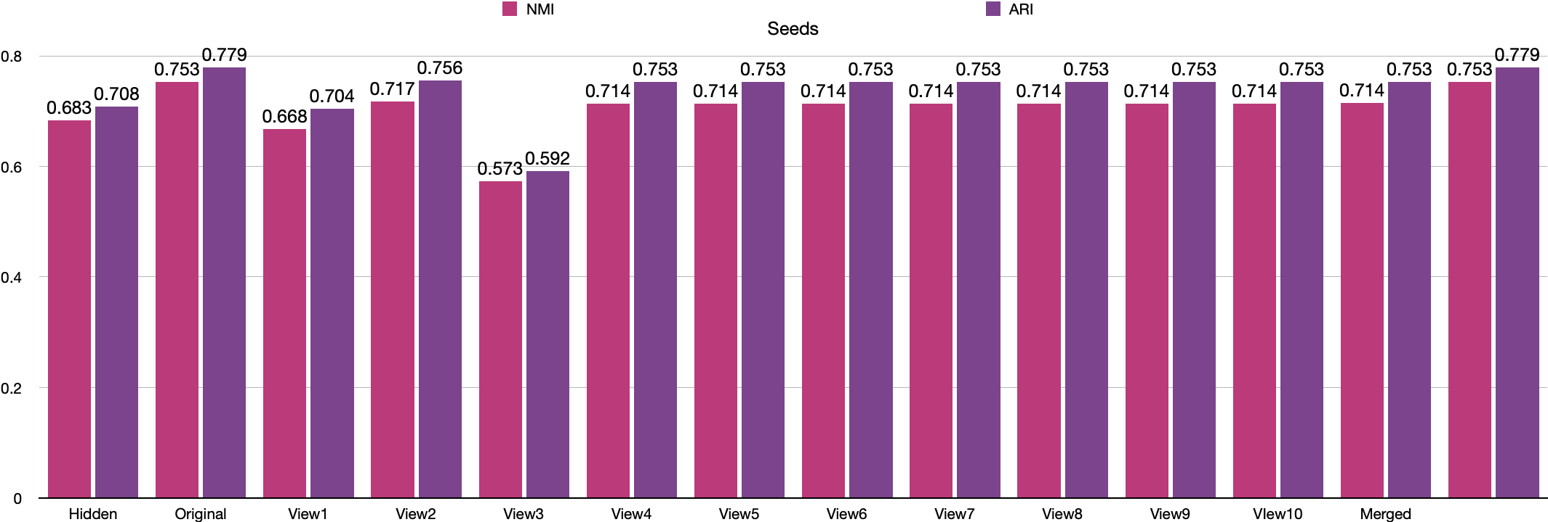
Top Performing Datasets :

Slide 26

Top Performing Datasets :

Slide 27
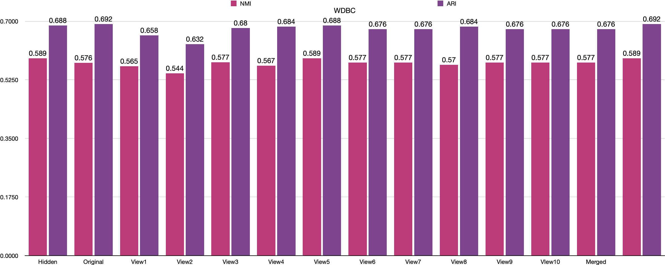
Moderate Performing Datasets :

Slide 28
Moderate Performing Datasets :

Slide 29
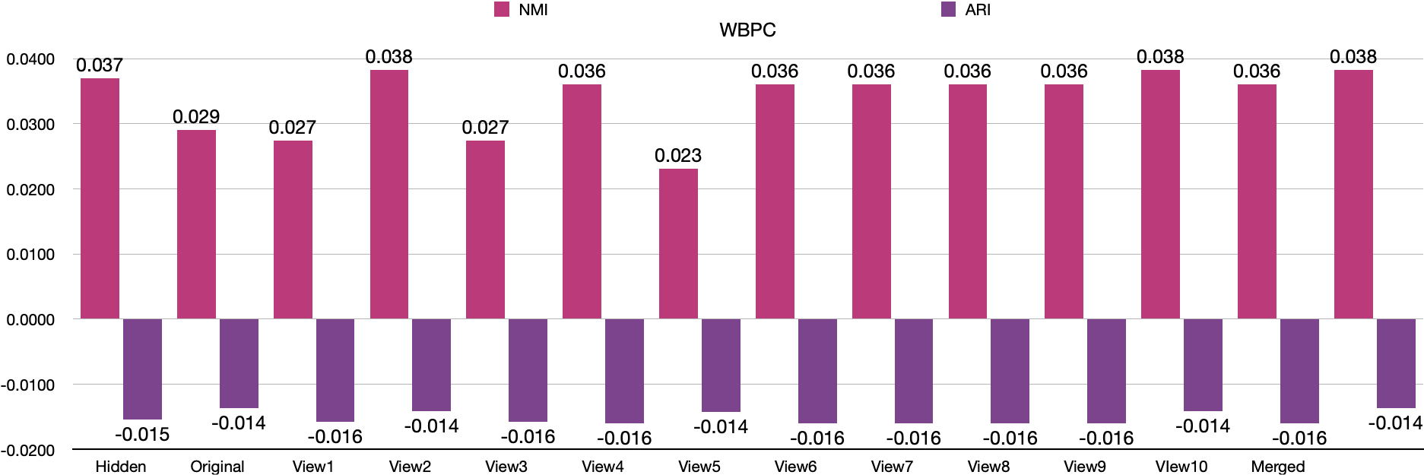
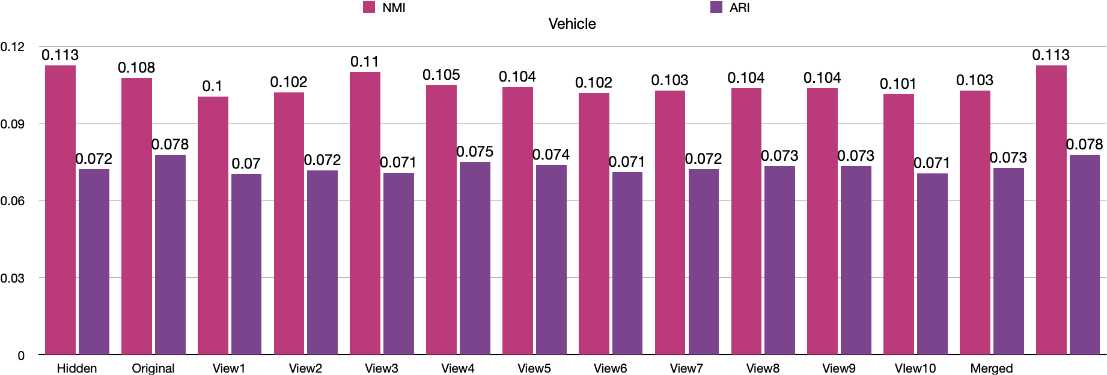
Underperforming Datasets:

Slide 30
Underperforming Datasets:

Slide 31
Conclusion
Proposed Solution: The Multi-View Framework (MVF) effectively handles incomplete data using Autoencoder (AE) reconstruction, enabling clustering analysis without being impacted by missing values.
Effectiveness: Demonstrated high clustering accuracy and improved NMI and ARI scores, handling up to 50% missing data in Iris, Wine, and Vehicle datasets.
Key Impact: AE-based imputation enhances stability, producing complete datasets and improving clustering performance. -
Future Directions: Real-time data handling for dynamic contexts like IoT and financial markets. Expansion into domains like healthcare, finance, and e-commerce to address large-scale, sensitive data challenges.

Slide 32
REFERENCES:
[1] R. C. Pereira, M. S. Santos, P. P. Rodrigues, and P. H. Abreu, “Reviewing Autoencoders for Missing Data Imputation: Technical Trends, Applications and Outcomes,” Journal of Artificial Intelligence Research, vol. 69, pp. 1255-1285, 2020
[2] C. E. Batista and M. C. Monard, “AStudyofK-Nearest Neighbour asan Imputation Method,” Proc. 2nd Int. Conf. Hybrid Intelligent Systems (HIS), 2002, pp. 251–260.
[3] Z. Xu, L. Zhao, Y. Sun, C. Zhang, and M. Wu, "A Framework for Multi-view Clustering with Missing Values," Proceedings of the IEEE/CVF Conference on Computer Vision and Pattern Recognition (CVPR), pp. 9503–9512, 2021.
[4] H. Wang, J. Smallwood, J. Mourão-Miranda, C. H. Xia, T. D. Satterthwaite, D. S. Bassett, and D. Bzdok, "Multi-View Clustering via Canonical Correlation Analysis," Proceedings of the International Conference on Machine Learning (ICML), 2021, pp. XX–XX.
[5] X. Peng, J. Cheng, X. Tang, B. Zhang, and W. Tu, “Multi-view graph imputation network,” Information Fusion, vol. 102, no. 5, p. 102024, 2024.
[6] X. Yang, W. Liu, W. Liu, and D. Tao, “A survey on canonical correlation analysis,” IEEE Transactions on Knowledge and Data Engineering, vol. 33, no. 6, pp. 2349–2368, 2019.
[7] Z. Zhang, “Missing data imputation: focusing on single imputation,” Annals of translational medicine, vol. 4, no. 1, 2016. 31
[8] J. Mertz and P. Murphy, “University of california at irvine (uci) repository of machine learning databases,” Available ftp:/ftp. ics. uci.edu/pub/machine-learning databases, 2005.
[9] S. Datta, S. Bhattacharjee, and S. Das, “Clustering with missing features: A penalized dissimilarity measure based approach,” arXivpreprint arXiv:1604.06602, 2016.
[10] L. Zhang, Y. Zhao, Z. Zhu, D. Shen, and S. Ji, “Multi-view missing data completion,” IEEE Transactions on Knowledge and Data Engineering, vol. 30, no. 7, pp. 1296–1309, 2018.
[11] L. N. Nguyen and W. T. Scherer, “Imputation techniques to account for missing data in support of intelligent transportation systems applications,” Tech. Rep., 2003.
[12] K. Lakshminarayan, S. A. Harp, and T. Samad, “Imputation of missing data in industrial databases,” Applied Intelligence, vol. 11, no. 3, pp. 259–275, 1999 [13] M. K. Markey and A. Patel, “Impact of missing data in training artificial neural networks for computer-aided diagnosis,” in Machine Learning and Applications, 2004. Proceedings. 2004 International Conference on. IEEE, 2004, pp. 351–354.
[14] ] P. Kofman and I. G. Sharpe, “Using multiple imputation in the analysis of incomplete observations in finance,” Journal of Financial Econometrics, vol. 1, no. 2, pp. 216–249, 2003.

Slide 33
THANK YOU

