Slide 1

USE HEURISTIC SEARCH TECHNIQUES TO IMPLEMENT HILL-CLIMBING ALGORITHM
AIR MINI PROJECT
Group Members :
Piyush Wani (B223064)
Mayur Sapkale (B223050)
Rahil Qureshi(B223047)

Slide 2
Contents
Introduction
What is HILL-CLIMBING ALGORITHM?
Advantages and Disadvantages
Input
Output
Conclusion
Reference

Slide 3
Introduction
Heuristic functions are used to enable search algorithms make an informed guess.
The idea is to guide the search so that it has tendency to explore the region leading to the goal.
Hill Climbing algorithm is a modification of the best first search algorithm, where we consider the best solution in the local search space instead of the global search space.

Slide 4
What is HILL-CLIMBING Algorithm ?
Hill climbing is a mathematical optimization technique which belongs to the family
of local search.
It is an iterative algorithm that starts with an arbitrary solution to a
problem, then attempts to find a better solution by making an incremental change to the solution.
Hill Climbing find optimal solution for convex problems,for other it will only find
local optima, which are not necessarily the best possible solution out of all possible solutions

Slide 5
Advantages
It uses less space than other algorithms.
It is very useful in job shop scheduling, automatic programming, circuit designing, and vehicle routing.

Slide 6
Disadvantages
It is not complete algorithm.
Local Maxima.

Slide 7

INPUT

Slide 8
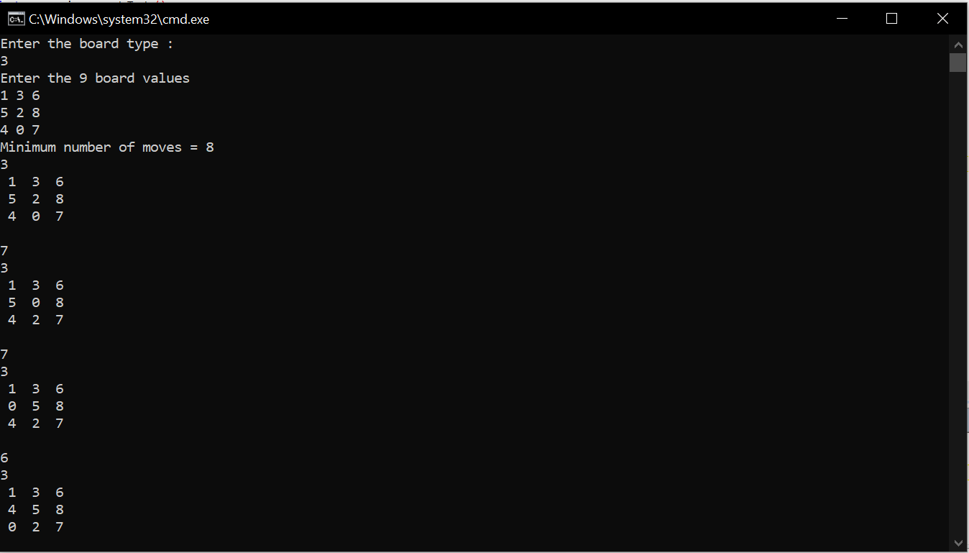
Output

Slide 9
Future Scope
We are going to run this algorithm for 8 puzzle problem. We will not consider higher variants like 16 puzzle or 24 puzzle. Since algorithm is incomplete , we will not always find the optimal solution.We will also not consider the unsolvable instances of 8 puzzle for this exercise.

Slide 10
Conclusion
We have studied the Hill Climbing algorithm using heuristic function. We have applied It solve 8 puzzle problem and observed that it does not always give the optimal solution.

Slide 11
Reference
https://en.wikipedia.org/wiki/Hill-climbing
https://www.javatpoint.com/hill-climbing-algorithm-in-ai
https://www.geeksforgeeks.org/introduction-hill-climbing-artificial-intelligence/
https://www.lancaster.ac.uk/stor-i-student-sites/matthew-randall/2020/04/01/heuristic-search-part-1-introduction-and-basic-search-methods/#:~:text=Heuristic%20search%20is%20class%20of,the%20search%20on%20that%20area.
https://techvidvan.com/tutorials/ai-heuristic-search/

Slide 12
Thank you :)

