Slide 1

Bigmart Sales Prediction
DAA MINI PROJECT
Group Members :
Piyush Wani (B223064)
Mayur Sapkale (B223050)
Rahil Qureshi(B223047)

Slide 2
Contents
Introduction
Requirement Specification
Sales Prediction Model
Result
Conclusion
Reference

Slide 3
Introduction
The data scientists at BigMart have collected 2013 sales data for 1559 products across 10 stores in different cities. Also, certain attributes of each product and store have been defined.
The aim is to build a predictive model and find out the sales of each product at a particular store.Using this model, BigMart will try to understand the properties of products and stores which play a key role in increasing sales.
Predictive Models are one of the most common applications of the Data Analytics. Predictive model can predict the different types of things.
Predictive models provide the information related to sales which will lead to optimized production of the products.

Slide 4
Requirement Specification
Python Libraries(Sklearn,Numpy,Pandas,Matplotlib) : NumPy is the fundamental package for scientific computing in Python. It is a Python library that provides a multidimensional array object and an assortment of routines for fast operations on arrays. pandas is an open source, BSD-licensed library providing high performance, easy-to-use data structures and data analysis tools for the Python programming language.
VS Code : Visual Studio Code is a free source code editor that fully supports Python and useful features such as real-time collaboration. It's highly customizable to support your classroom the way you like to teach.

Slide 5
Sales Prediction Model:
The two major components of this model. They are
1) Data Cleaning : Data cleaning or cleansing is the process of detecting and correcting (or removing) corrupt or inaccurate records from a record set, table, or database and refers to identifying incomplete, incorrect, inaccurate or irrelevant parts of the data and then replacing, modifying, or deleting the dirty or coarse data.
2) Feature Engineering : Feature engineering is the process of using domain knowledge of the data to create features that make machine learning algorithms work. If feature engineering is done correctly, it increases the predictive power of machine learning algorithms by creating features from raw data that help facilitate the machine learning process.

Slide 6
Data Cleaning
1. Deleting Rows -This method commonly used to handle the null values. Here, we either delete a particular row if it has a null value for a particular feature and a particular column if it has more than 70-75% of missing values.
2. Replacing with Mean/Median/Mode - This strategy can be applied on a feature which has numeric data like the age of a person or the ticket fare.
3. Predicting the Missing Values - Using the features which do not have missing values, we can predict the nulls with the help of a machine learning algorithm

Slide 7
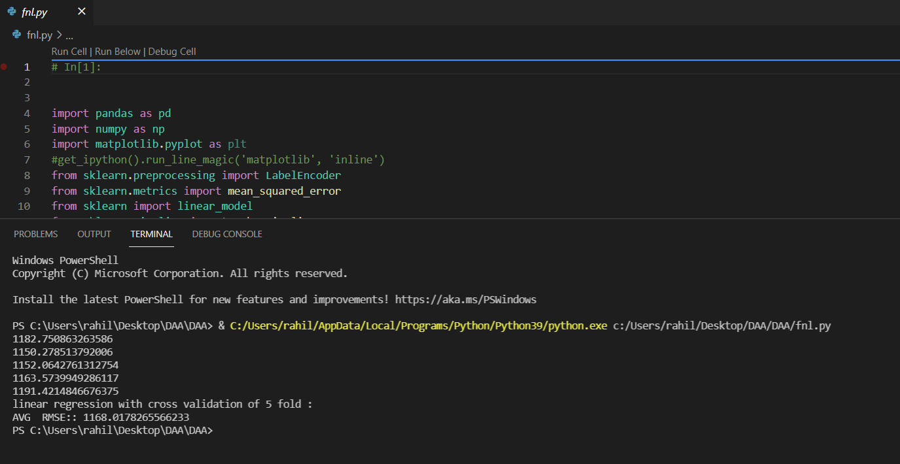
Result

Slide 8
Conclusion
With this project we have build the predictive model for predict the sales which will help the bigmart for production of the optimised cost of products in each particular project.

Slide 9
Reference
https://www.analyticsvidhya.com/blog/2017/09/common-machine-learning-algorithms/
https://www.javatpoint.com/linear-regression-in-machine-learning
https://www.javatpoint.com/machine-learning-decision-tree-classification-algorithm
https://docs.python.org/3/

Slide 10
Thank you :)

