Slide 1

Laptop Price Prediction
DMW MINI PROJECT
Group Members :
Piyush Wani
Mayur Sapkale
Rahil Qureshi

Slide 2
Contents
Introduction
Technology Used
How It works?
Future Scope
Tools Used
References

Slide 3
Introduction
Our project is a machine learning application, based on a certain specification of your future laptop it will try to guess the most accurate price.
Information such as ram size, processor,ssd,hard disk etc.

Slide 4
Problem faced during buying a laptop
Buyers are generally not aware of factors that influence the laptop price.
Many problems are faced during buying a laptop
Hence shop agents are trusted with communication between buyers and sellers.
They believe that it depends upon size, shape and colour , but It actually depends upon many factors such as Ram , Rom, Processor etc.

Slide 5
Technology Used
Machine Learning : machine learning is IT systems’ ability to recognize patterns in large databases to independently find solutions to problems. Put simply; it is an umbrella term for various techniques and tools that can help computers learn and adapt on their own
A computer program is said to learn from experience E with respect to some class of tasks T and performance measure P, if its performance at tasks in T, as measured by P, improves with experience E.

Slide 6
In general any machine learning problem can be assigned to one of two broad classification
Supervised Learning :- Supervised learning is one of the most basic types of machine learning. In this type, the machine learning algorithm is trained on labeled data. Even though the data needs to be labeled accurately for this method to work, supervised learning is extremely powerful when used in the right circumstances.
Unsupervised Learning : - Unsupervised machine learning holds the advantage of being able to work with unlabeled data. This means that human labor is not required to make the dataset machine-readable, allowing much larger datasets to be worked on by the program.

Slide 7
Type of Supervised Learning
. Regression
In regression, a single output value is produced using training data. This value is a probabilistic interpretation, which is ascertained after considering the strength of correlation among the input variables. For example, regression can help predict the price of a house based on its locality, size, etc.
In logistic regression, the output has discrete values based on a set of independent variables. This method can flounder when dealing with non-linear and multiple decision boundaries. Also, it is not flexible enough to capture complex relationships in datasets.

Slide 8
How It works ?
Collecting data : first step was to collect data we collected data from different source and merged them together to form out training data set
Then we trained the model using machine learning algorithm which in the case is logistic regression
Based on the generated result we predict the cost of the laptop

Slide 9
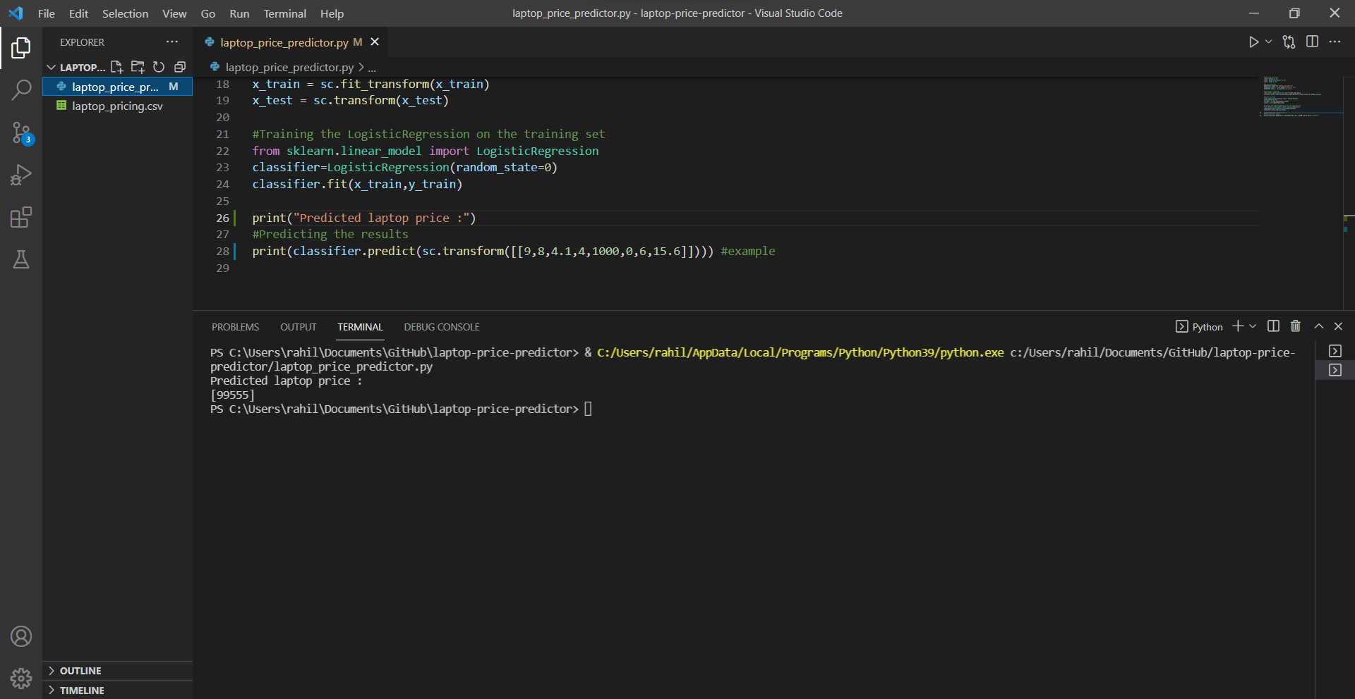
Input

Slide 10
Output

Slide 11
Future scope
We can try out other dimensionality reduction techniques like univariate feature selection and recursive feature elimination in the initial stage
We can try out other advance regression technique like random forest and bayesian ride algorithm for prediction . Since the data is highly correlated ,we should also try Elastic Net regression technique.

Slide 12
Tools Used
Python
Visual Studio
Pandas
Numpy

Slide 13
References
https://blog.exploratory.io/a-practical-guide-of-exploratory-data-analysis-with-linear-regression-part-1-9f3a182d7a92
https://www.kaggle.com/c/mercari-price-suggestion-challenge/overview
https://www.kaggle.com/c/mercari-price-suggestion-challenge/discussion/50252
https://www.kaggle.com/lopuhin/mercari-golf-0-3875-cv-in-75-loc-1900-s
https://www.appliedaicourse.com/course/11/Applied-Machine-learning-course

Slide 14
Thank you…

