Slide 1

Fetch Consumption API
STQA MINI PROJECT
Group Members :
Piyush Wani (B223064)
Mayur Sapkale (B223050)
Rahil Qureshi(B223047)

Slide 2
Contents
Introduction
What is selenium?
What is Web-Crawler?
Inputs to the API
JSON output of the API
Technology
Conclusion
Reference

Slide 3
Introduction
Fetch consumption API developed using FLASK and by using Python with selenium library.
Our web crawler crawls the website called https://wss.mahadiscom.in/ fetches the last 12 months electricity usage in units
Returns certain information of user by making calculations from data scrapped by crawler

Slide 4
What is selenium ?
Selenium is a robust tool that supports rapid development of test automation for web-based applications.
Can simulate a user navigating through pages and then assert for specific marks on the pages.
Open source, web-based testing automation tool and cross-browser compliant.
Selenium supports the languages like HTML, Java, PHP, Perl, Python, Ruby and C#.
It supports the browsers like IE, Mozilla Firefox, Safari, Google Chrome and Opera.
It supports the operating systems like Windows, Linux and Mac.
Open source tool.
Easy to use.

Slide 5
What is Web-Crawler
A web crawler is a type of bot that is typically operated by search engines like Google and Bing.
Their purpose is to index the content of websites all across the Internet so that those websites can appear in search engine results.
The Internet is constantly changing and expanding. Because it is not possible to know how many total web pages there are on the Internet, web crawler bots start from a seed, or a list of known URLs.
They crawl the web pages at those URLs first. As they crawl those webpages, they will find hyperlinks to other URLs, and they add those to the list of pages to crawl next.

Slide 6
INPUT
Host the API on localhost goto the given URL using browser.
It shows a homepage append consumer number to the URL and hit enter
Example -
http://127.0.0.1:5000/get_consumer_details/1**********12/

Slide 7
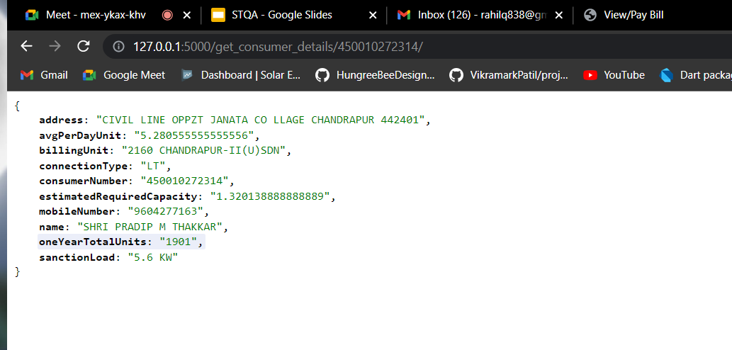
JSON output

Slide 8
TECHNOLOGY
Language :
-Python
Libraries:
-Selenium
-FLASK
Tool :
- Visual Studio

Slide 9
Future Scope
More relevant information like maximum generation at their location according to seasons.
Minimum and maximum generation period.
Nearby Solar providers

Slide 10
Conclusion
Successfully delivered information to consumer/developers about their solar panel requirement using API.
Consumer/developers dodges the calculation part using API.
Consumer/developers gets their details in less effort and quickly.

Slide 11
Reference
https://en.wikipedia.org/wiki/Selenium_(software)
https://www.selenium.dev/
https://en.wikipedia.org/wiki/Web_crawler
https://www.scrapingbee.com/blog/selenium-python/
https://medium.com/@igorzabukovec/automate-web-crawling-with-selenium-python-part-1-85113660de96
https://flask.palletsprojects.com/en/2.0.x/

Slide 12
Thank you :)

