Slide 1
INTRODUCTION
Let us introduce the issues involved in cryptography. First, we need to define some terms; then we give some taxonomies.
Topics discussed in this section:
Definitions
Two Categories

Slide 2
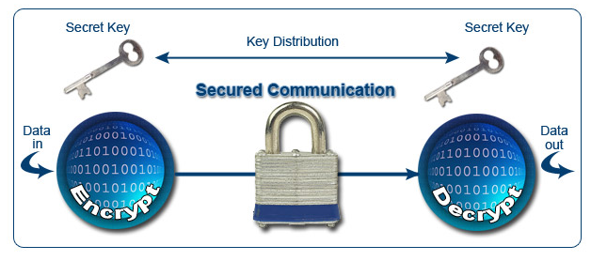
Cryptography
Cryptography is the science of writing in secret code so that no other person except the intended recipient could read.
Cryptography is the science of using mathematics to encrypt and decrypt data. Cryptography enables you to store sensitive information or transmit it across insecure networks (like the Internet) so that it cannot be read by anyone except the intended recipient.

Slide 3
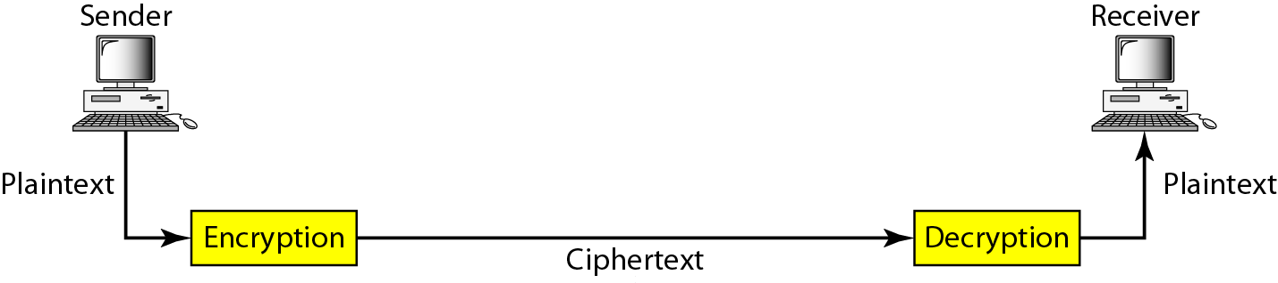
Figure 30.1 Cryptography components

Slide 4
Principals of Security
Confidentiality
Authentication
Integrity
Non-Repudiation
Access control
Availability

Slide 5
Confidentiality (Data Privacy)
The principal of confidentiality specifies that only the sender and the intended recipient Should be able to access the contents of a message.
Confidentially is achieved through encryption. Both symmetric and asymmetric encryption can be used
Confidentiality is most commonly addressed goal
The meaning of a message is concealed by encoding it
The sender encrypts the message using a cryptographic key
The recipient decrypts the message using a cryptographic key that may or may not be the same as the one used by the sender

Slide 6
Authentication
This mechanism helps establish proof of identities. The authentication process ensures that the origin of an electronic message or document is correctly identified.
A user or system can prove their identity to another who does not have personal knowledge of their identity
Accomplished using digital certificates
Kerberos is a common cryptographic authentication system
Application area: user authentication, device authentication, Cloud, IoT etc.

Slide 7
Integrity
When the contents of a message are changed after the sender sends it, but before it reaches the intended recipient, we say that the integrity of the message is lost.
It happens due to message modification.
Integrity Ensures that the message received is the same as the message that was sent
Uses hashing to create a unique message digest from the message that is sent along with the message
Recipient uses the same technique to create a second digest from the message to compare to the original one

Slide 8
Non-Repudiation
Non-repudiation is the assurance that someone cannot deny something. Typically, non-repudiation refers to the ability to ensure that a party to a contract or a communication cannot deny the authenticity of their signature on a document or the sending of a message that they originated.
Since no security technology is absolutely fool-proof, some experts warn that a digital signature alone may not always guarantee non-repudiation. It is suggested that multiple approaches be used, such as capturing unique biometric information and other data about the sender or signer that collectively would be difficult to repudiate.
Email non-repudiation involves methods such as email tracking that are designed to ensure that the sender cannot deny having sent a message and/or that the recipient cannot deny having received it.

Slide 9
Access Control
The principal of access control determines that who should be able to access and what.
It is broadly related to two areas: role management and rule management
Role management concentrate on user sides ( which user can do what)
Rule management concentrates on resource side (which resources are accessible and under what circumstances)

Slide 10
Availability
Availability of information refers to ensuring that authorized parties are able to access the information when needed.
Interruption (by the attacker) puts the availability of resources in danger.

Slide 11
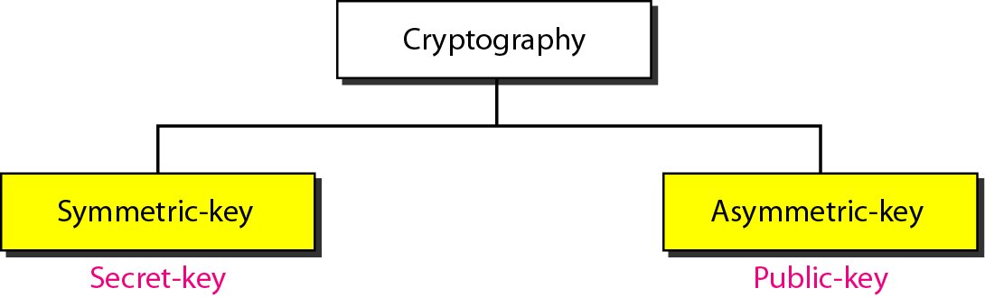
Figure 30.2 Categories of cryptography

Slide 12
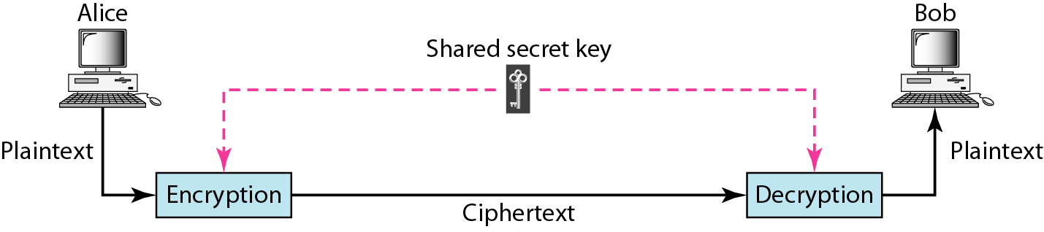
Figure 30.3 Symmetric-key cryptography
30.<number>

Slide 13

Note
In symmetric-key cryptography, the same key is used by the sender
(for encryption)
and the receiver (for decryption).
The key is shared.

Slide 14
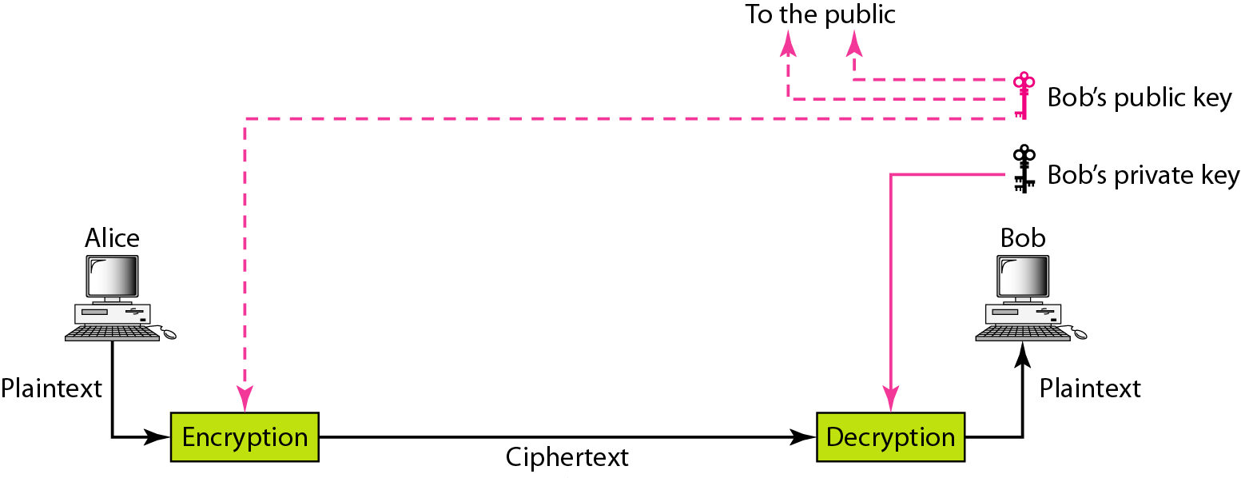
Figure 30.4 Asymmetric-key cryptography

Slide 15
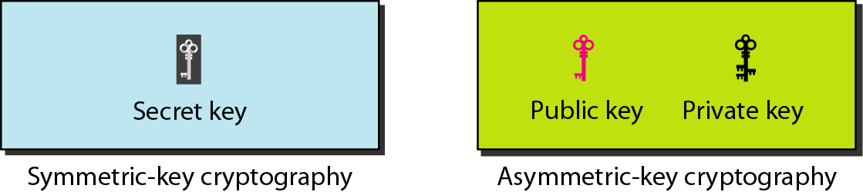
Figure 30.5 Keys used in cryptography

Slide 16
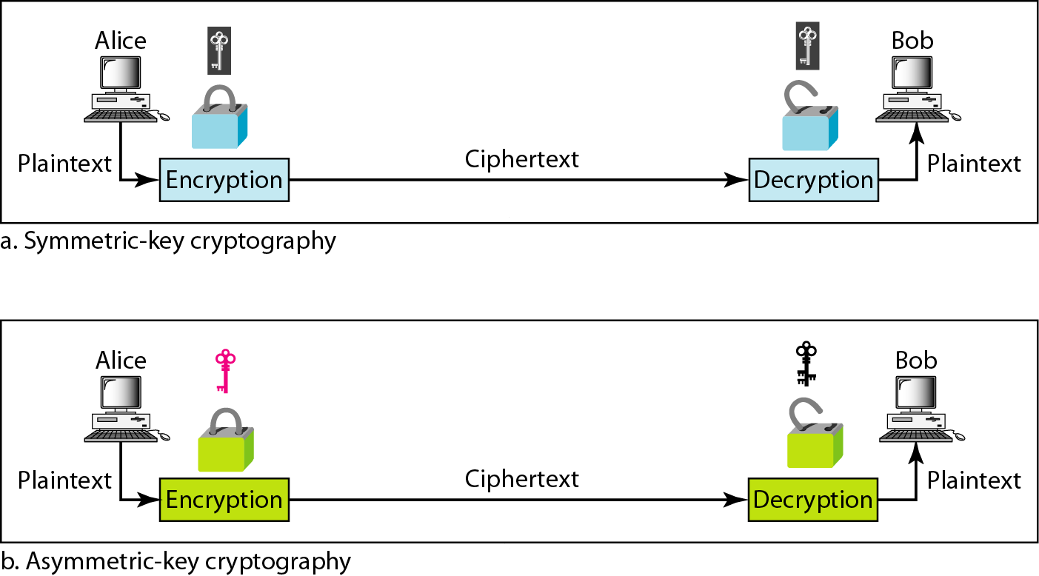
Figure 30.6 Comparison between two categories of cryptography

Slide 17
Security Threats/Attack
Active attack (Contents of the original message are modified in some way)
Passive attack (Only monitor the channel and aims to obtain transmitted information). It is very difficult to detect than active attack.
Man-in-the-middle attack
Replay Attack
Dos Attack
Impersonation Attack
Insider Attack, password guessing attack, brute-force attack
Phishing Attack
Pharming Attack (DNS Spoofing)

Slide 18
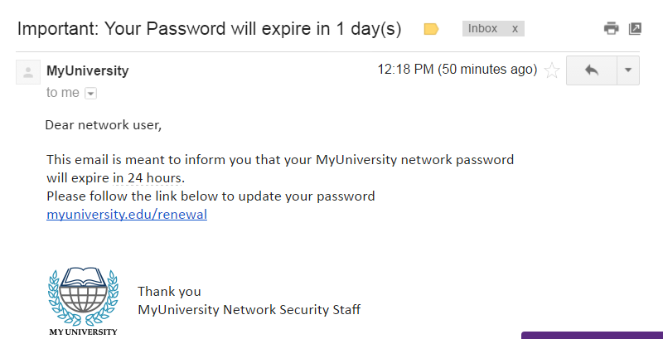
Phishing Attack
Phishing attack has become a big problem in recent times. In this attack model, the attacker set up fake website, which look like a real website(human eye will not be able to distinguish ).

Slide 19
Pharming Attack (DNS Spoofing)
Before attack
DNS Name | IP Address
www.amazon.com | 161.20.10.16
www.bob.com | 100.10.10.20
After attack
DNS Name | IP Address
www.amazon.com | 161.20.10.16
www.bob.com | 100.20.20.20
DNSSec protocol

