Slide 1
Security Threats/Attack
Active attack (Contents of the original message are modified in some way)
Passive attack (Only monitor the channel and aims to obtain transmitted information). It is very difficult to detect than active attack.
Man-in-the-middle attack
Replay Attack
Dos Attack
Impersonation Attack
Insider Attack, password guessing attack, brute-force attack
Phishing Attack
Pharming Attack (DNS Spoofing)

Slide 2
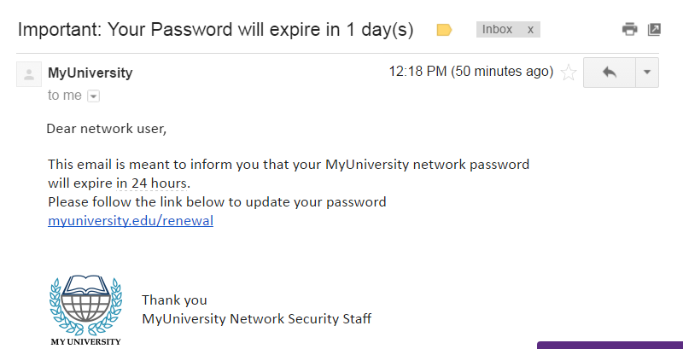
Phishing Attack
Phishing attack has become a big problem in recent times. In this attack model, the attacker set up fake website, which look like a real website(human eye will not be able to distinguish ).

Slide 3
Pharming Attack (DNS Spoofing)
Before attack
DNS Name | IP Address
www.amazon.com | 161.20.10.16
www.bob.com | 100.10.10.20
After attack
DNS Name | IP Address
www.amazon.com | 161.20.10.16
www.bob.com | 100.20.20.20
DNSSec protocol

