Slide 1
Mathematics for symmetric key cryptography
30.<number>

Slide 2
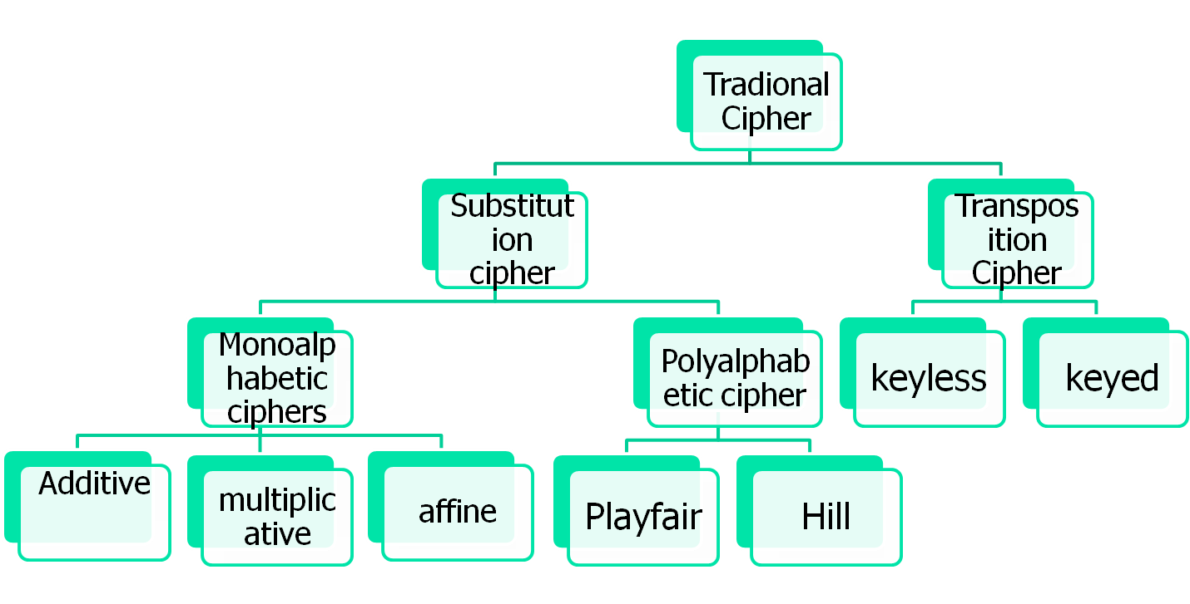
Traditional Symmetric key Ciphers
30.<number>

Slide 3
Additive/Ceaser/Shift cipher
To encrypt a message with a Caesar cipher, each letter in the message is changed using a simple rule: shift by three. Each letter is replaced by the letter three letters ahead in the alphabet. A becomes D, B becomes E, and so on. For the last letters, we can think of alphabet as a circle and "wrap around". W becomes Z, X becomes A, Y becomes B, and Z becomes C. To change a message back, each letter is replaced by the one three before it.
Algorithm
STEP-1: Read the plain text from the user.
STEP-2: Read the key value from the user.
STEP-3: If the key is positive then encrypt the text by adding the key with each
character in the plain text.
STEP-4: Else subtract the key from the plain text.
STEP-5: Display the cipher text obtained above.
30.<number>

Slide 4
Additive/Ceaser/Shift cipher
Assume that plaintext consists of lower cases letter and the ciphertext consists of upper case letter.
a | b | c | d | e | f | g | h | i | j | k | l | m | n | o | p | q | r | s | t | u | v | w | x | y | z
A | B | C | D | E | F | G | H | I | J | K | L | M | N | O | P | Q | R | S | T | U | V | W | X | Y | Z
0 | 1 | 2 | 3 | 4 | 5 | 6 | 7 | 8 | 9 | 10 | 11 | 12 | 13 | 14 | 15 | 16 | 17 | 18 | 19 | 20 | 21 | 22 | 23 | 24 | 25
Problem: use the additive cipher key=15 to encrypt the message “hello”
h=7, e=4,l=11,o=14
C=(P+K) mod 26 Ciphertext=WTAAD
P=(C-K) mod 26
30.<number>

Slide 5
Kerckhoff’s Principal
One should always assume that the attacker knows encryption and decryption algorithm.
30.<number>

Slide 6

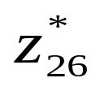
Multiplicative cipher
In this cipher, the encryption algorithm specifies multiplication of the plaintext by the key and the decryption of the algorithm specifies division of the ciphertext by the key.
Encryption:
c=(p*k) mod 26
Decryption:
P=(c* ) mod 26
In multiplicative cipher, the plaintext and ciphertext are integers in Z26;
The key is an integer in
30.<number>

Slide 7
Multiplicative cipher
Problem: What is the key domain
={1,3,5,7,9,11,15,17,19,21,23,25}
Problem: Suppose the plaintext is “hello” and the key value is 7. what is the ciphertext(XCZZU)?
30.<number>

Slide 8

Affine cipher
Combination of additive and multiplicative cipher.
First key (k1) used for multiplicative cipher and the second key is used for additive cipher (k2)
Encryption:
C=(P*k1+k2) mod 26
Decryption:
P=((C-k2) * ) mod 26
Where multiplicative inverse of k1 and (-k2) is the additive inverse of k2.
30.<number>

Slide 9
Playfair cipher
It is the example of Polyalphabetic cipher used by the British army during world war 1.
Key generation: 25 letters are arranged in 5*5 matrix and considered I and J are same character.
Key =
L | G | D | B | A
Q | M | H | E | C
U | R | N | I/J | F
X | V | S | O | K
Z | Y | W | T | P
30.<number>

Slide 10
Playfair cipher
Before encryption, if the two letters in a pair are the same, a bogus letter is inserted to separate them. After inserting bogus letter, if the number of the character in the plaintext is odd, one extra bogus character is added at the end to make the number of characters even.
Encryption:
If the two letters in a pair are located in same row of the secret key, the corresponding encrypted character for each letter is the next character to the right in same row.
If the two letters in a pair are located in same column of the secret key, the corresponding encrypted character for each letter is the letter beneath it in the same column.
If the two letters in a pair are not in the same row or column of the secret key, the corresponding encrypted character for each letter is a letter that is in its own row but in the same column as the other letter.
30.<number>

Slide 11
Playfair cipher
Plaintext : hello
Correct plaintext: helxlo
he---EC
lx----QZ
lo----BX
Ciphertext: ECQZBX
30.<number>

Slide 12

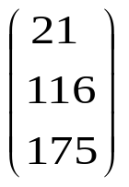
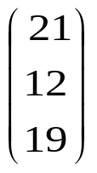
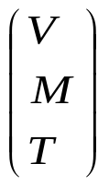
Hill cipher: example
Suppose the plaintext is “CAT”. We can represent it as 2,0,19.
So the matrix of the plaintext
Suppose the key is 6 24 1
13 16 10
20 17 15
Now multiply the two matrices
6 24 1
13 16 10 = mod 26= (Ciphertext)
20 17 15
Now multiply ciphertext with the inverse of the key matrix = Plaintext
30.<number>

Slide 13
Keyless Transposition cipher
In keyless transposition cipher, there are two methods for permutation of characters.
Method-1 (rail-fence cipher): The text is written into a table column by column and then transmitted row by row. (Number of row is fixed 2)
Method-2: The text is written into the table row by row and then transmitted column by column.
Example: method-1: Suppose alice wants to send a plaintext message “meet me at the park” to bob.
Ciphertext: memateaketethpr
m |  | e |  | m |  | a |  | t |  | e |  | a |  | k
 | e |  | t |  | e |  | t |  | h |  | p |  | r
30.<number>

Slide 14
Keyless Transposition cipher
Example: method-2: Suppose alice wants to send a plaintext message “meet me at the park” to bob. Both agrees on number of cloumn. Here cloumn=4
Ciphertext: mmtaeehreaekttp
m | e | e | t
m | e | a | t
t | h | e | p
a | r | k
30.<number>

Slide 15
Keyed cipher
In this cipher, the concept of block and key is used to permute the characters.
Suppose alice needs to send a message “enemy attacks tonight” to bob. Alice and bob have agreed to divide the text into groups of five characters and then permute the characters in each group. Add bogus character at the end if required.
E n e m y a t t a c k s t o n I g h t z
Key for encryption and decryption:
Ciphertext: eemyn taact tkons hitzg
3 | 1 | 4 | 5 | 2
1 | 2 | 3 | 4 | 5
30.<number>

Slide 16
Security attacks related to symmetric key cipher
Ciphertext only attack
Known plaintext attack
Chosen plaintext attack
Chosen ciphertext attack
30.<number>

Slide 17
Possible Types of Attack
Attacks | Things known to attacker | Things the attacker wants to find
Cipher-text only | Ciphertext of several messages, all of which are encrypted with the same encryption key. Algorithm used | Plain-text messages corresponding to these cipher-text messages Key used for encryption
Known plaintext | Ciphertext of several messages, all of which are encrypted with same encryption key Plaintext messages corresponding to the above ciphertext messages Algorithm used | Key used for decryption
30.<number>

Slide 18
Possible Types of Attack
Attack | description
Chosen Plaintext | During the chosen-plaintext attack, a cryptanalyst can choose arbitrary plaintext data to be encrypted and then he receives the corresponding ciphertext. He tries to acquire the secret encryption key or alternatively to create an algorithm which would allow him to decrypt any ciphertext messages encrypted using this key (but without actually knowing the secret key).
Chosen Ciphertext | During the chosen-ciphertext attack, a cryptanalyst can analyse any chosen ciphertexts together with their corresponding plaintexts. His goal is to acquire a secret key or to get as many information about the attacked system as possible. The attacker has capability to make the victim (who obviously knows the secret key) decrypt any ciphertext and send him back the result. By analysing the chosen ciphertext and the corresponding received plaintext, the intruder tries to guess the secret key which has been used by the victim.
30.<number>

Slide 19
Key ranges and computation time
Key size | Time required to search 1 percent of the key space | Time required to search 50 percent of the key space
56 | 1 second | 1 minutes
57 | 2 second | 2 minutes
58 | 4 second | 4 minutes
64 | 4.2 minutes | 4.2 hours
72 | 17.9 hours | 44.8 days
80 | 190.9 days | 31.4 years
90 | 535 years | 321 centuries
128 | 146 billion millennia | 8 trillion millennia
A trillion is equal to a thousand billions (1,000 x 1,000,000,000) or a million millions (1,000,000 x 1,000,000).
30.<number>

Slide 20




Diffie-Hellman Key Exchange Protocol
Whitefield Diffie and Martin Hellman devised an amazing solution to the problem of key agreement or key exchange in 1976.
Description of the algorithm: Firstly, alice and bob agrees on two large prime numbers, n and g. These two integers need not be kept secret. Alice and bob can use insecure channel to agree on them.
Alice | bob
Choose large random number x 2.Compute A= 3. Alice now send A to Bob | Choose large random number y 2.Compute B= 3. Bob now send B to Alice
Now Alice computes K1= | Now bob computes K2=
30.<number>

Slide 21
Hardness problem on Diffie-Hellman Key exchange protocol
Discrete Logarithm Problem
30.<number>

Slide 22
Diffie-Hellman Key Exchange Protocol: Example
Suppose alice and bob agrees on two large prime numbers n and g, where n=11 and g=7
Alice chooses the value of x=3
Bob independently chooses the value of y=6
Now calculate the shared secret key; (9)
30.<number>

Slide 23






Diffie-Hellman Key Exchange Protocol: MITM
Alice | Eve(Adversay) | bob
Choose large random number x 2.Compute A= 3. Alice now send A to Bob compute k1= | 1. Eve retrieves it and compute C= Now send C to bob and keep the value of A. Eve retrieves B and calculate D= Now sends D to alice K11= K22= | Choose large random number y 2.Compute B= 3. Bob now send B to Alice Computek2=
30.<number>

Slide 24
Cryptographic hash function
A cryptographic one-way hash function maps a string of arbitrary length to a string of fixed length called the hashed value. It can be symbolized as: H: X→Y, where X = {0,1}*, and Y = {0, 1}^{n}. X is a binary string of arbitrary length and Y is a binary string of fixed length n. Cryptographic one-way hash function satisfies the following properties:
Easiness: For given m ϵ X, yϵY can be easily computed such that y = H(m).
Preimage Resistant: It is hard to find m ϵ X from given y ϵ Y such that H(m) = y.
Second-Preimage Resistant: It is hard to find input mʹ ϵ X such that H(m) = H(mʹ) for given input m ϵ X and mʹ ≠ m.
Collision Resistant: It is hard to find a pair (m, mʹ) X ϵ X such that H(m) = H(mʹ), where m ≠ mʹ.
MD Hash family:: MD2, MD3, MD4, MD5
SHA hash family:: SHA-0, SHA-1, SHA-2, and SHA-3
30.<number>

