Slide 1
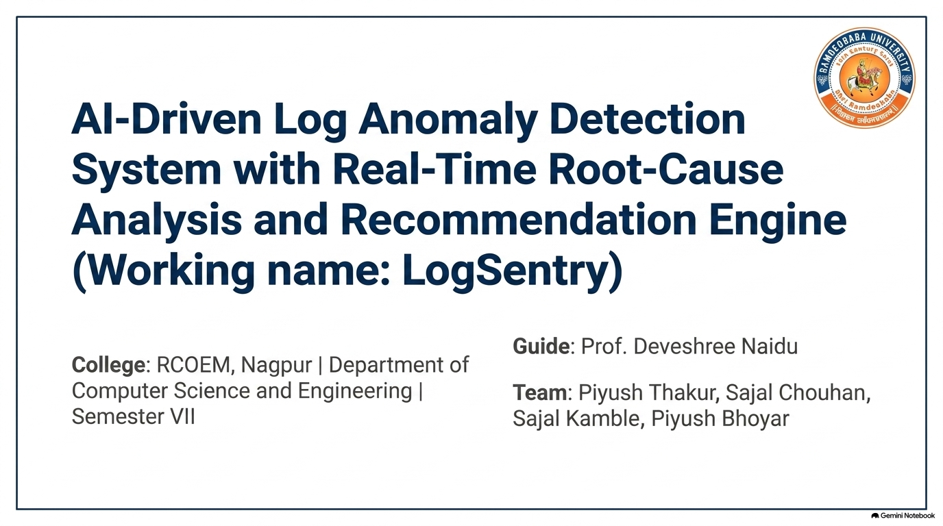
Dr.

Slide 2
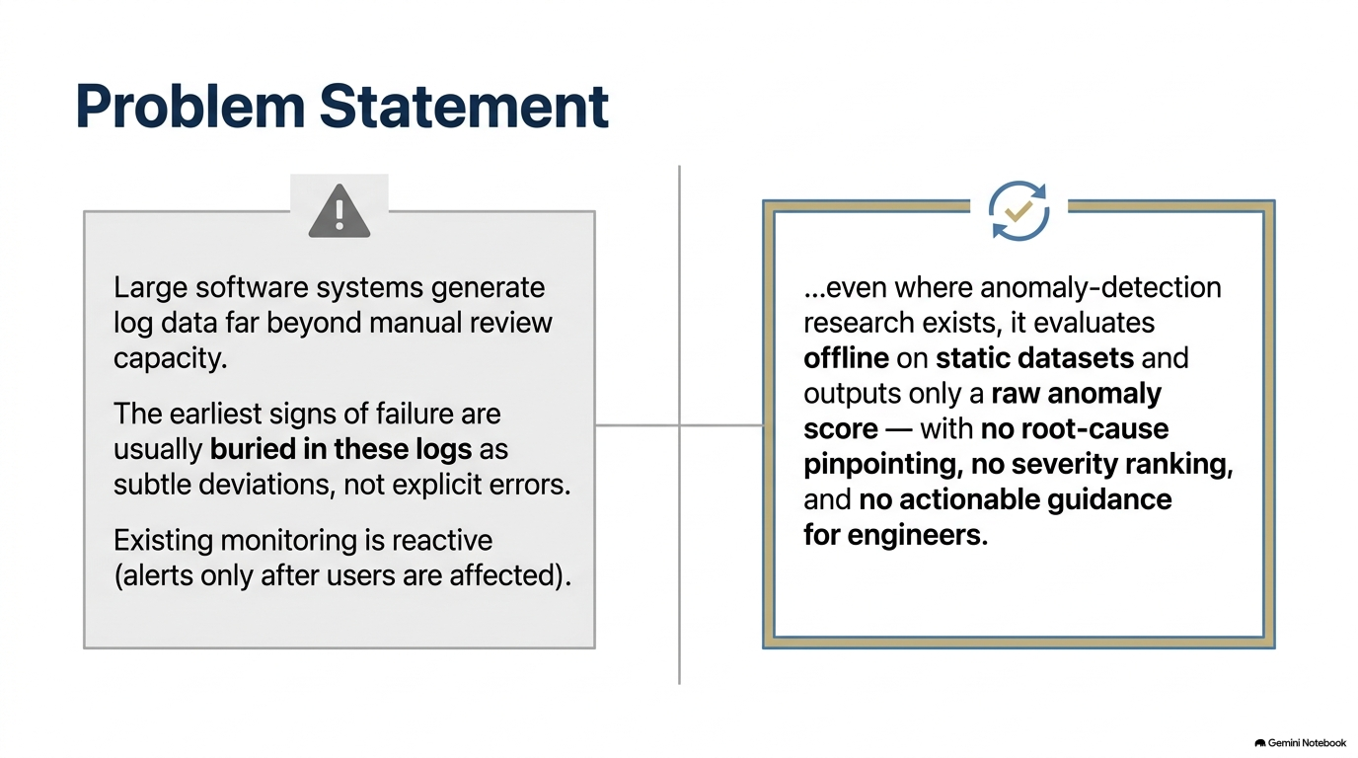

Slide 3
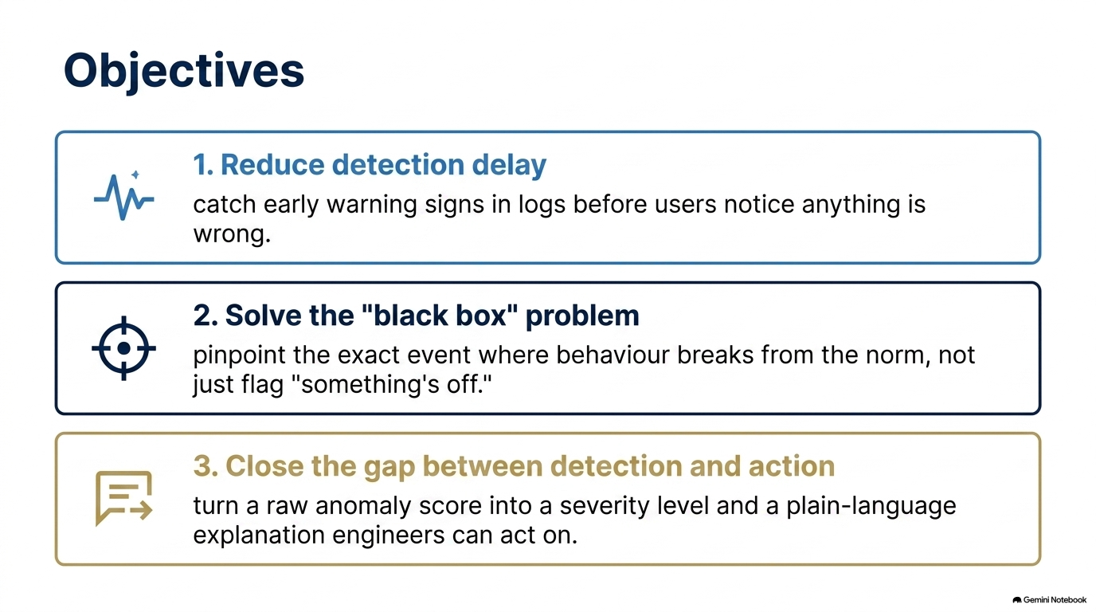

Slide 4
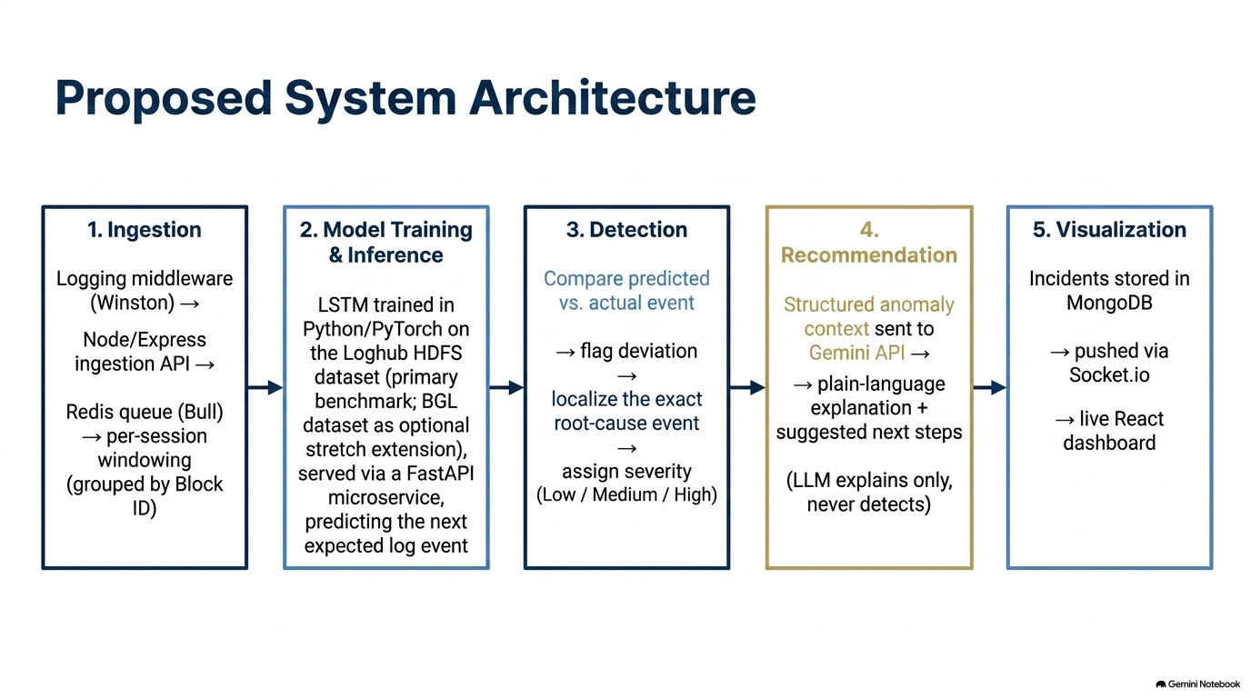
Drain3
for Parsing

Slide 5
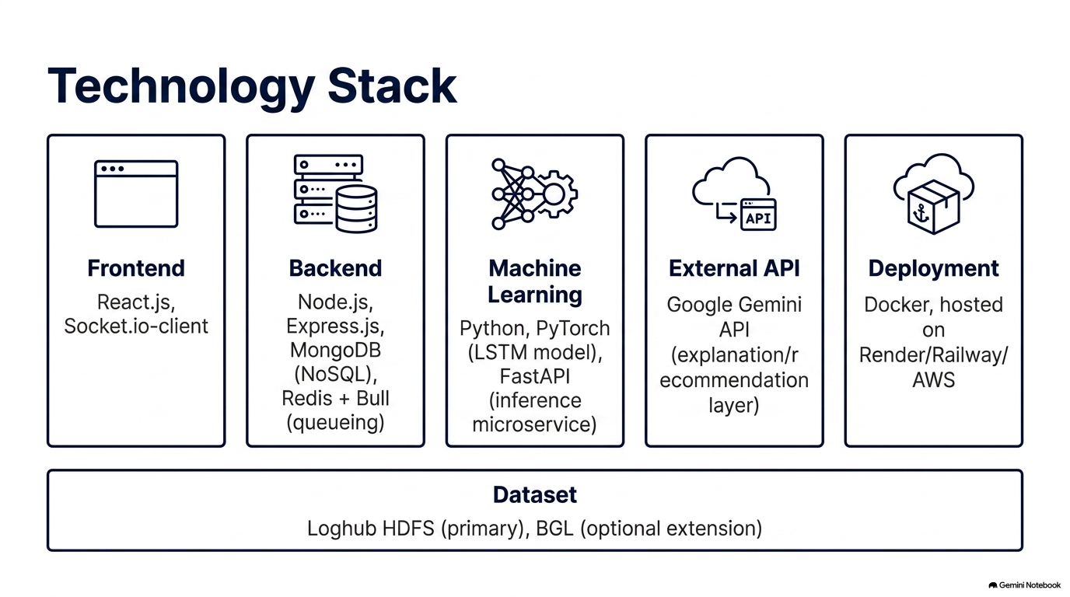

Slide 6
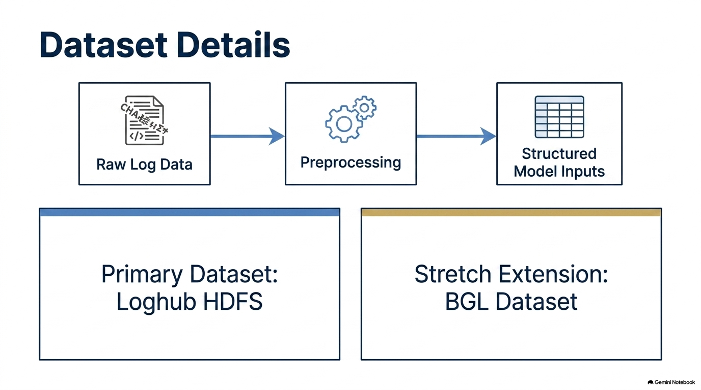

Slide 7
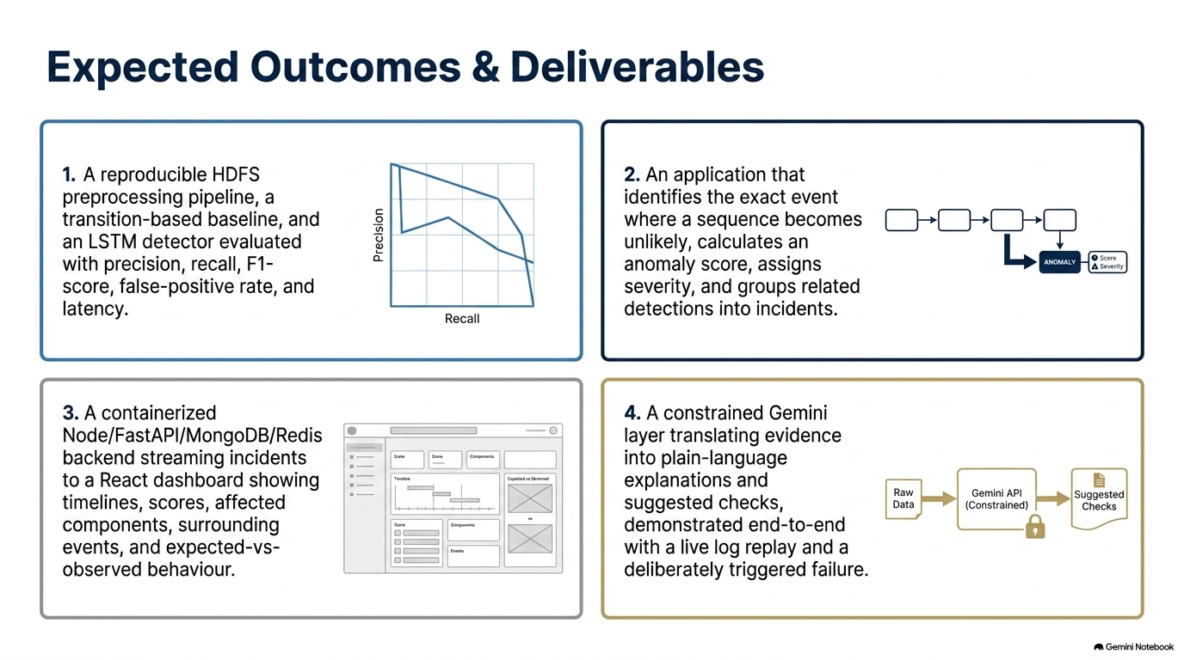

Slide 8
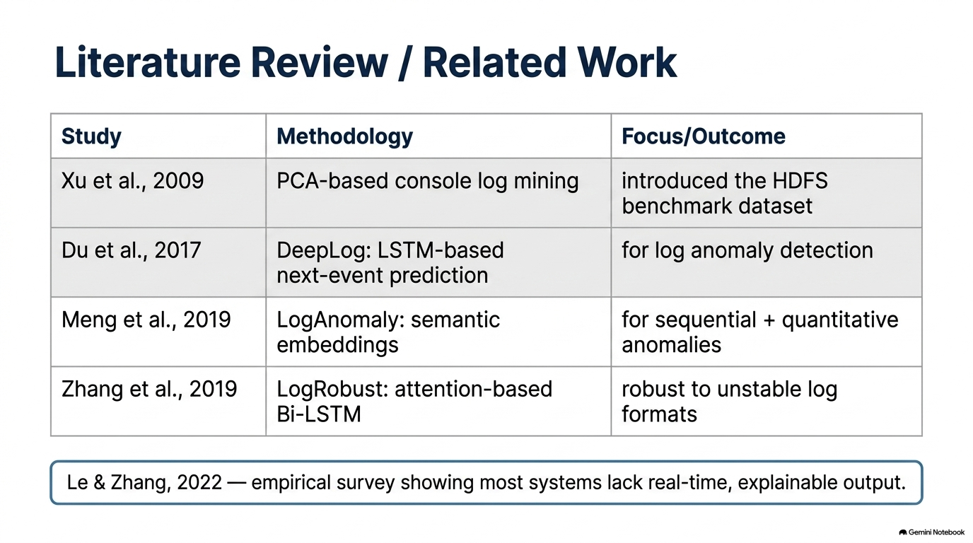
Sr. No. | Author(s) & Year | Title | Methodology / Key Contribution | Limitation / Gap
1 | Jieming Zhu, Shilin He, Pinjia He (2023) [IEEE] | Loghub: A Large Collection of System Log Datasets for AI-driven Log Analytics | Online log parser using a fixed-depth parse tree that encodes length and preceding-token rules to streamingly group messages and extract templates without source code or offline training | Needs domain-knowledge regex preprocessing and parameter tuning (depth/threshold); may underperform on highly variable or digit-heavy logs beyond the evaluated datasets.
2 | Michael R. Lyu, Zibin Zheng , (2017) [IEEE] | Drain: An Online Log Parsing Approach with Fixed Depth Tree | LogHub provides 19 diverse real-world log datasets (~77 GB) for benchmarking AI-driven log analytics, including parsing, compression, and anomaly detection. | Most datasets are unlabeled, some are lab-collected, and coverage of emerging systems and highly variable, multi-threaded logs remains limited.
3 | Min Du, Feifei L, Vivek Srikuma (2017) [IEEE] | DeepLog: Anomaly Detection and Diagnosis from System Logs through Deep Learning | Uses stacked LSTM to model log sequences and parameter-value time series for online anomaly detection, with workflow models for diagnosis and root-cause analysis. | Requires normal logs for training and problem-specific tuning of history parameters; it can miss previously unseen events and generate false positives for sudden bursty behavior.
4 | Max Landauer, Sebastian Onder (2023) [ELSERVIER] | Deep learning for anomaly detection in log data: A survey | Conducts a systematic literature review of deep-learning-based log anomaly detection, covering model architectures, preprocessing, anomaly-detection techniques, datasets, and evaluation methods. | Does not quantitatively compare existing methods; also highlights the unresolved challenge of effectively encoding diverse, raw and unstructured log data for deep-learning models.

Slide 9
