Slide 1
Backend Project
Topic: Expense Tracker Website
Team Details:
Piyush Gaur (2210992042)
Piyush Bhardwaj (2210992072)
Pranjal(2210992064)
Submitted To: Mr. Rahul Singh Rajput
Chitkara University Institute of Engineering and Technology,
Chitkara University, Punjab

Slide 2
Table of Contents
Introduction
Problem Statement
Key Features
Project Highlights/Outcomes
Code Snippets
Conclusion
References/Links used
Appendices

Slide 3
Introduction
In today's fast-paced world, managing personal finances is crucial for maintaining financial health and achieving long-term financial goals. Many individuals struggle with tracking their daily expenses, creating budgets, and analyzing their spending patterns. There is a need for an intuitive, user-friendly online platform that allows users to efficiently track, categorize, and analyze their expenses. Develop a full-stack web application that enables users to manage their personal finances by providing tools to track expenses, set budgets, and generate insightful reports. The application should offer a seamless and engaging user experience while incorporating robust features for expense management and financial analysis
Identify and analyze the common challenges users face in managing personal finances, such as tracking daily expenses, setting budgets, and analyzing spending patterns. To develop a robust backend infrastructure to handle real-time messaging and data storage.

Slide 4
Problem Statement
The objective of developing an expense tracker website is to address the common challenges individuals face in managing their personal finances. Many people struggle to keep track of their daily expenses, leading to poor financial planning and unexpected shortfalls. This website aims to provide a user-friendly interface for easily recording and categorizing expenses while setting and monitoring budgets. Users often lack insights into their spending habits, making it difficult to make informed financial decisions.
To solve this, the website will offer visualizations such as charts and graphs to help users understand their spending patterns and adjust their budgets accordingly. Another issue is the inability to track historical data, which hampers users' ability to analyze past spending trends and assess budgeting effectiveness.

Slide 5
Key features
Identify and analyze the common challenges users face in managing personal finances, such as tracking daily expenses, setting budgets, and analyzing spending patterns. To develop a robust backend infrastructure to handle real-time messaging and data storage.
Gain experience in full-stack web development by building both the frontend and backend of the expense tracker website. Understanding of frontend development technologies (HTML, CSS, JavaScript, React).
Proficiency in backend development using Node.js and Express.js.
Knowledge of database management systems (MongoDB) for data storage and retrieval.
Basic understanding of user interface/user experience (UI/UX) design principles.

Slide 6
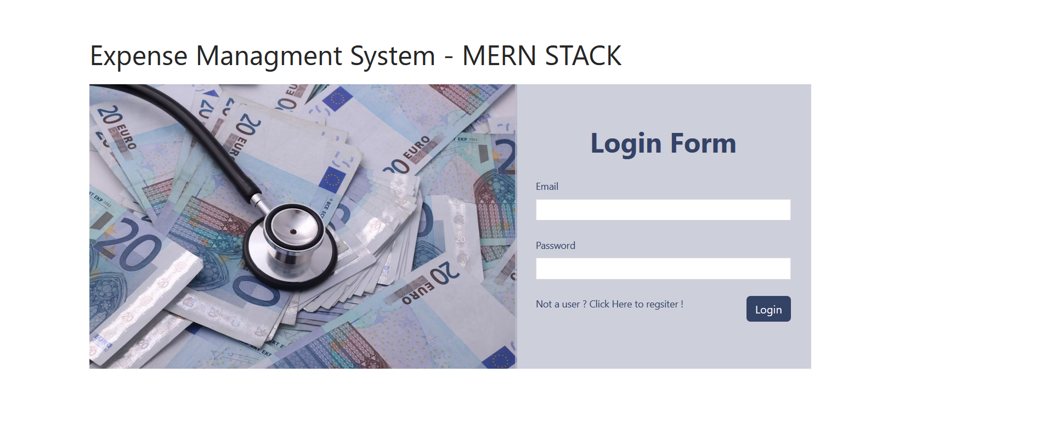
Project Highlights

Slide 7
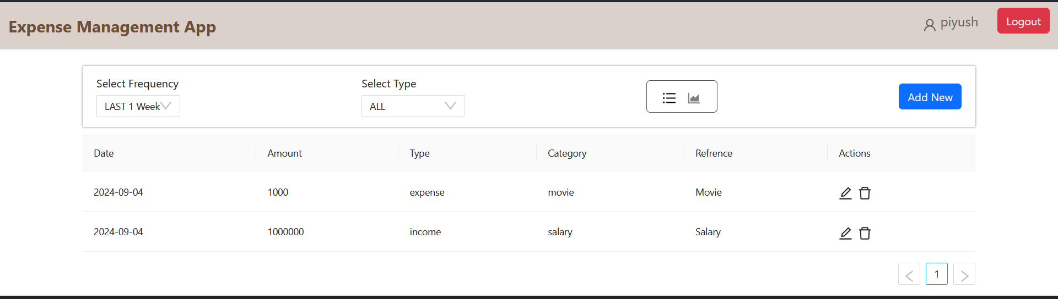
Project Highlights

Slide 8
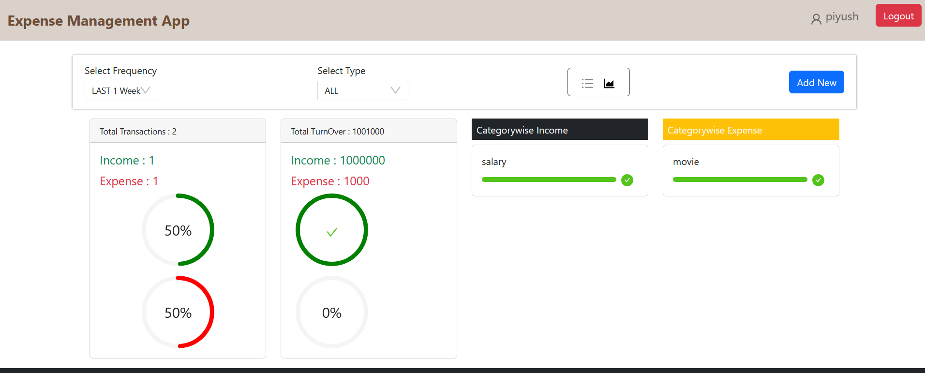
Project Highlights

Slide 9
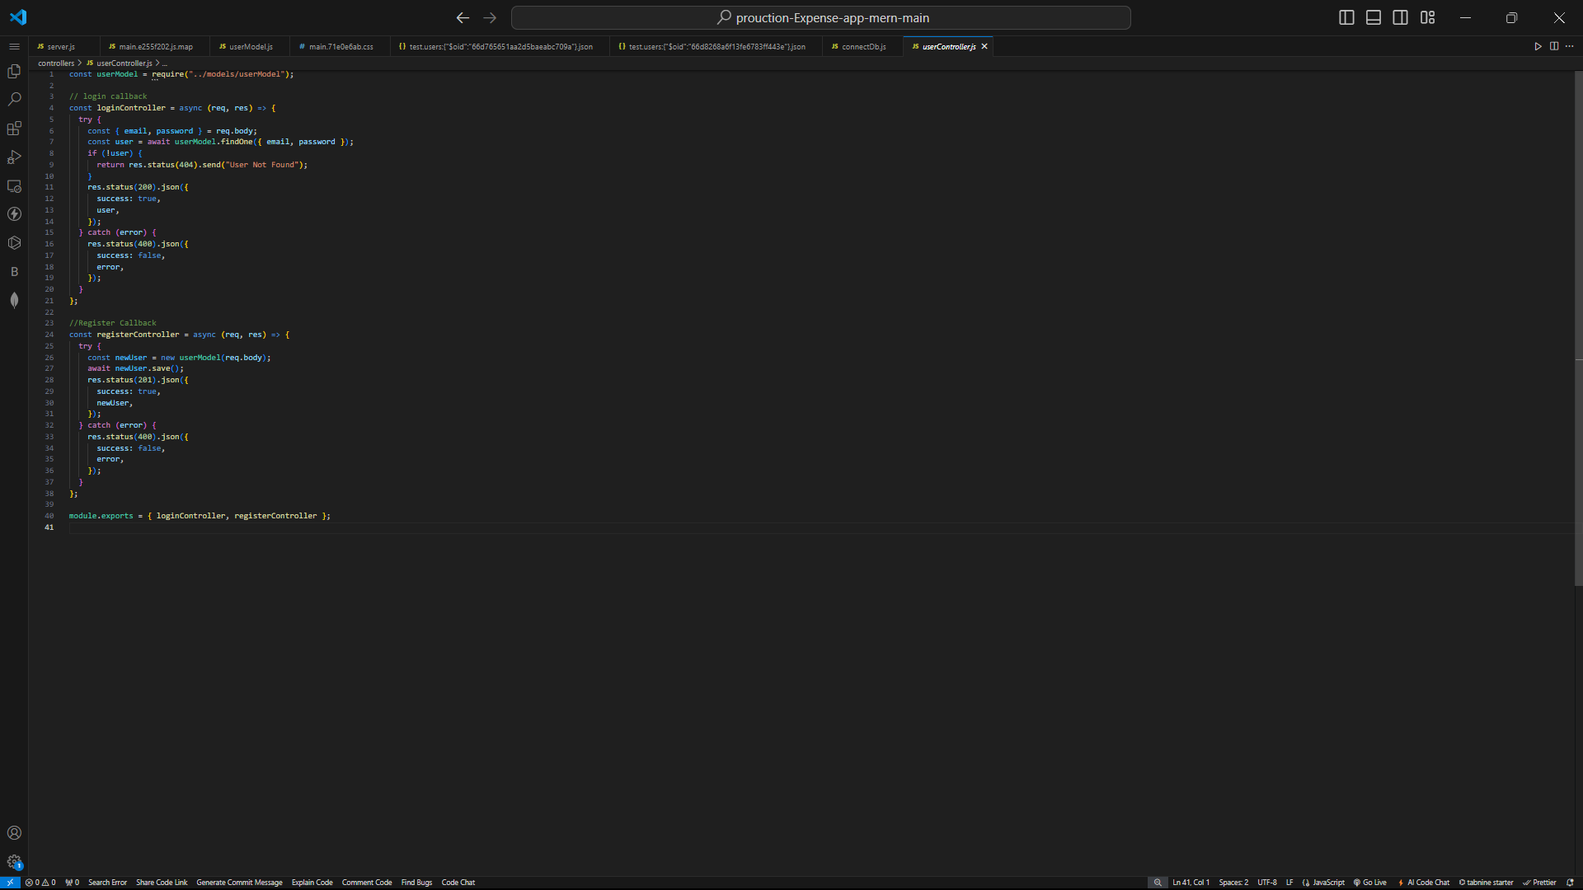
Code Snippets

Slide 10
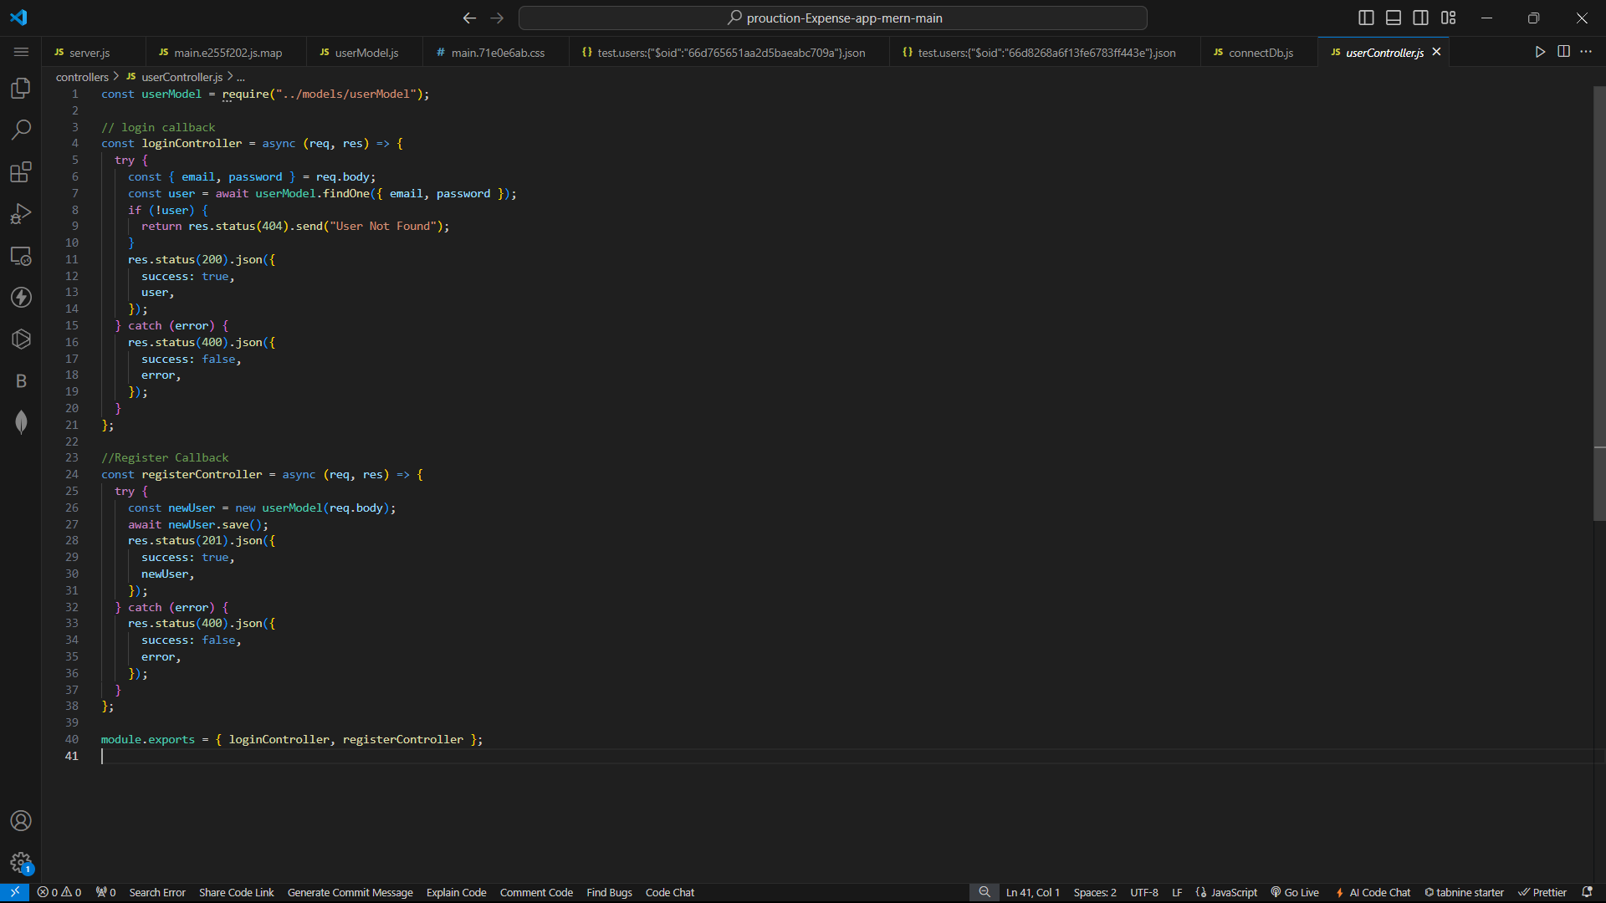
Code Snippets

Slide 11
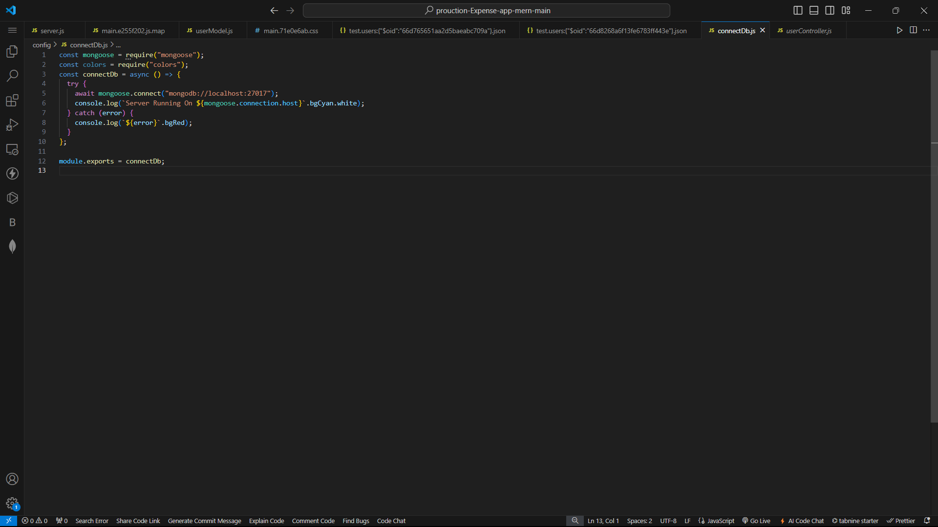
Code Snippets

Slide 12
Conclusion
In conclusion, the development of our Expense Tracker project has demonstrated a comprehensive and functional approach to managing personal finances through a web application. By integrating both front-end and back-end technologies, we have created a robust system that offers a seamless user experience and efficient data management.
The Expense Tracker project stands as a testament to our ability to integrate various technologies and development practices to solve real-world problems. It not only meets the initial requirements but also offers potential for future enhancements, such as incorporating advanced analytics, multi-currency support, or additional integrations with financial institutions.
We successfully implemented a modern, responsive design that enhances user interaction and accessibility. Leveraging cutting-edge frameworks and libraries, such as React.js o, we ensured a dynamic and intuitive user interface..

Slide 13
References
React.js: https://react.dev - Official documentation for learning and implementing
React.js.
Node.js: https://nodejs.org/docs/latest/api/ - Documentation and guides for setting up and using Node.js.
Express.js: https://expressjs.com/ - Documentation and guides for setting up and
using Express.js.
MongoDB: https://www.mongo.db.com- Documentation and guides for setting up and using MongoDB.
React - The Complete Guide: Comprehensive course on building frontend applications with React.js.
The Complete Node.js Developer Course: Covers building backend services using Node.js, Express, and MongoDB.

Slide 14


