Slide 1

Podcast Web Scraping Analysis
Douglas Pizac
NYC Data Science Academy
2/16/2021

Slide 2
Introduction
Podcast advertising revenue expected to exceed $1 billion in 2021._{[1]}
Of podcast consumers, 61% have purchased a product/service after listening to ad._{[2]}
  Listeners have 4.4x better brand recall from podcast ads than other digital ads._{[2]}
Podcast ad cost measured in per 1000 downloads._{[3]}
  Goal is to find a highly rated podcast with not a large following.
[1] https://iab.com/wp-content/uploads/2019/06/Full-Year-2018-IAB-Podcast-Ad-Rev-Study_6.03.19_vFinal.pdf
[2] https://speakerdeck.com/brendanbrits/podcast-market-deep-dive-bdmi-jan-2020?slide=40
[3] https://chartable.com

Slide 3
Objective
Collect data for top ranked podcasts in the United States.
Find insights for different networks and genres.
Determine which metrics most affect rank.
Create a custom metric to help digital marketers identify the ideal podcast to host their advertisements.

Slide 4

Limitations
Certain podcasts are not up-to-date
Podcast ‘views’ are not available

Slide 5
Apple vs. Spotify
Can we make assumptions about listeners on different platforms?
•98 podcasts in top 200 for Spotify are also in top 250 for Apple.
•After 1000 simulations, no difference in ranks across platforms.
Based on this finding, insights can be generalized to both listening platforms.
•Platforms are now signing exclusive contracts to podcasters._{[1]}
[1] https://www.wsj.com/articles/spotify-strikes-exclusive-podcast-deal-with-joe-rogan-11589913814?mod=e2tw

Slide 6
Collected/derived information
Rank
Podcast name
Podcast network (if available)
Genres (if available, else ‘Unknown’)
Stars out of 5
Number of user ratings
Episode date
Day of week episode published
Number of episodes archived
Date of first archived episode
Days since first episode
Days since last published episode

Slide 7
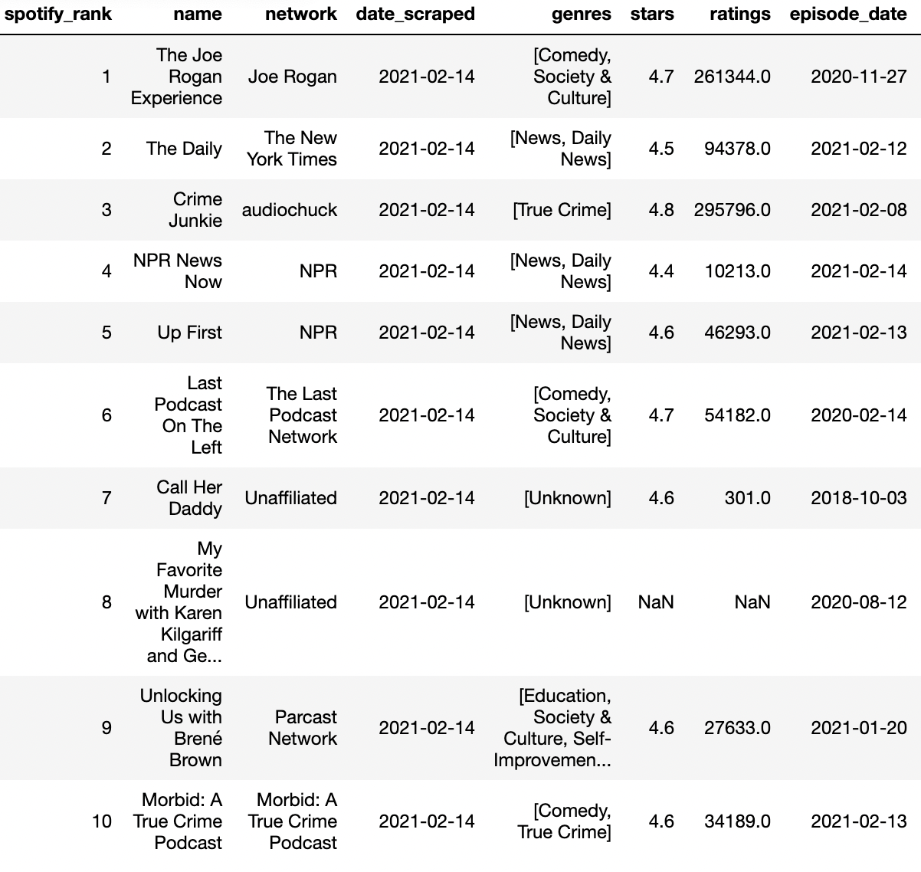
Top 10 podcasts on Spotify

Slide 8
Which genres of podcast are most successful?

Slide 9
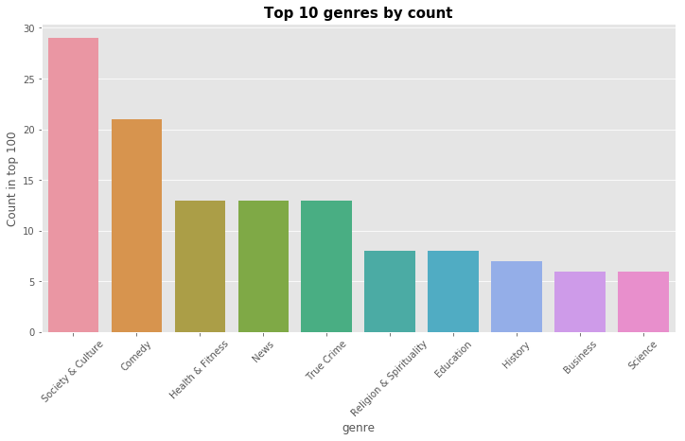
•Society & Culture is the most popular podcast genre within the top 100, followed by Comedy, Health & Fitness, News and True Crime.

Slide 10
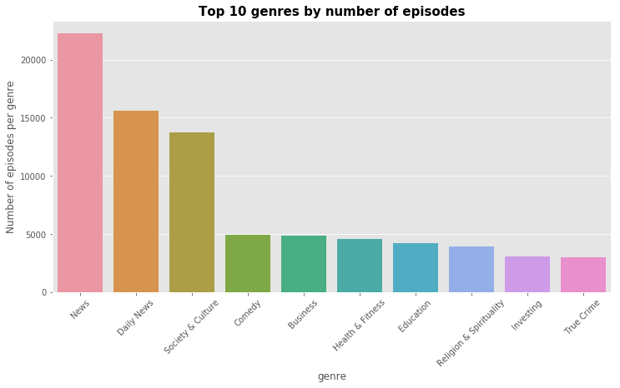
•News and Daily News publish more episodes than any other genre.
•’NPR News Now’, which publishes multiple episodes today, has more than 10,000 episodes archived.
Notes:
Most popular release days are Monday and Thursday.

Slide 11
Which networks dominate the rankings?

Slide 12
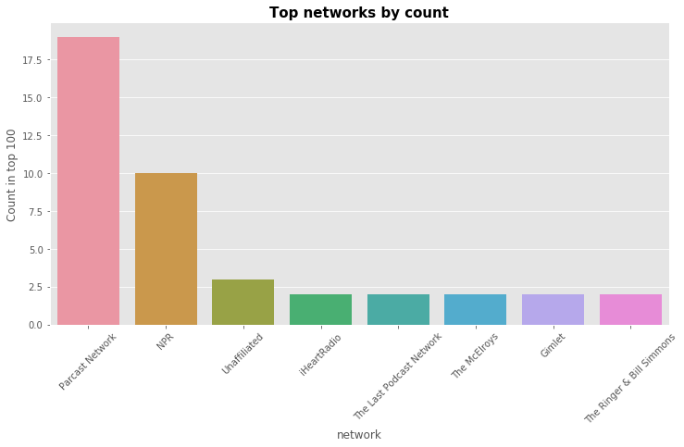
•Eight networks have more than one podcast in the top 100.
•Parcast Network includes ‘Spotify Originals’ with podcasts for each horoscope.

Slide 13
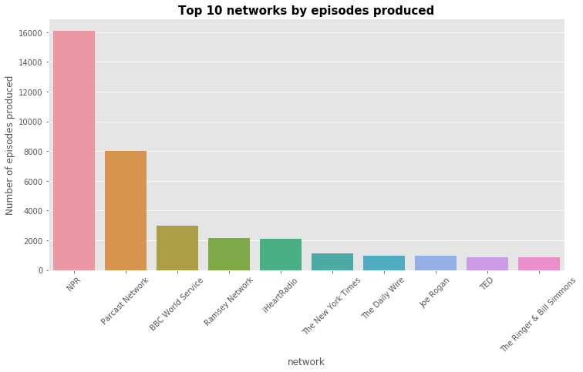
•NPR releases the most episodes, primarily driven by ‘NPR News Now.
•BBC World Service has one podcast in top 100 but publishes multiple episodes per day.

Slide 14
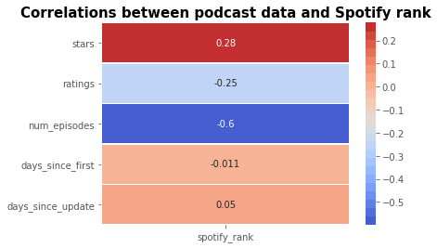
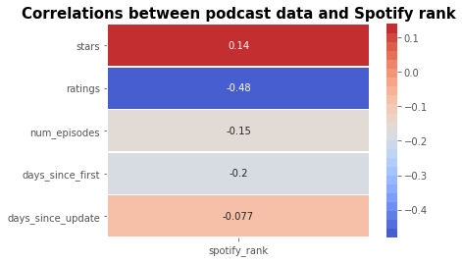
What is most influential towards ranking?
“NPR News Now” has over 10,000 episodes archived. Removing it significantly reduces the relationship between number of episodes and ranking.
Including ”NPR News Now”
Excluding ”NPR News Now”

Slide 15
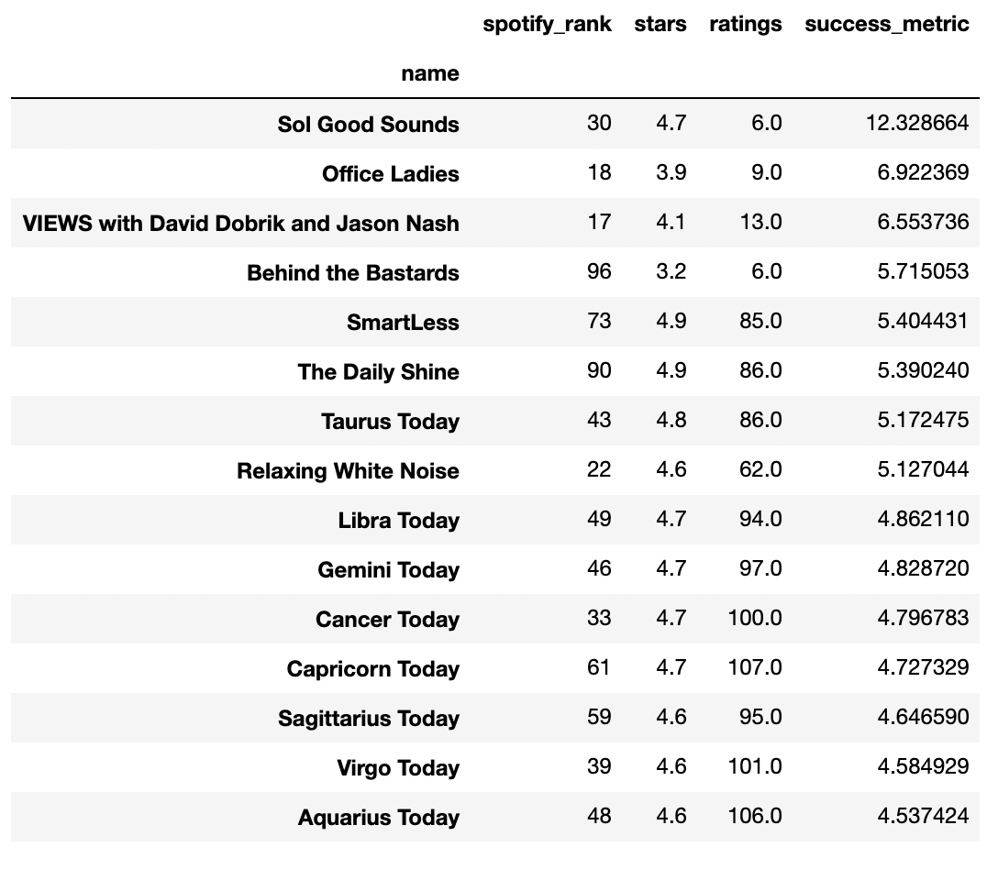
Generated metric
Find podcasts that are highly rated yet not widely known.
Integrates stars, ratings and rank
Based on metric, ‘Sol Good Sounds’ may be worth targeting advisements to.
May be easier to just to use rank or buy downloads information from platforms.

Slide 16
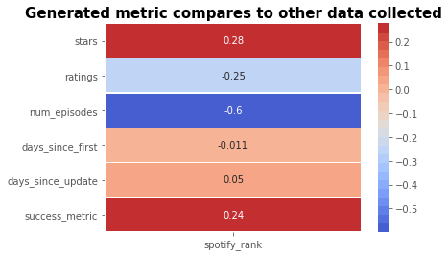

Slide 17
Conclusions
Parcast Network and NPR dominate Spotify’s US rankings by network
News, comedy and culture are the most popular genres.
Stars and number of ratings are the most valuable metrics in determining rank
This website updates certain podcasts over others, making it difficult to generate accurate but meaningful insights.

Slide 18

Future work
Develop a predictive model to determine rating.
Do analyses on more ranks/platforms.
Use an API to gather views directly from platform.

Slide 19
Fun project facts
Used Selenium
48,020 rows of podcasts and episodes
3.5 hours to scrape

