Slide 1
Hey there!
Do you like pizza?

Slide 2

How to build up team morale?

Slide 3

How to endorse a colleague?

Slide 4

Hmm, how about that?

Slide 5

It’s Pizza Time!
Spreading joy, once slice at a time.

Slide 6
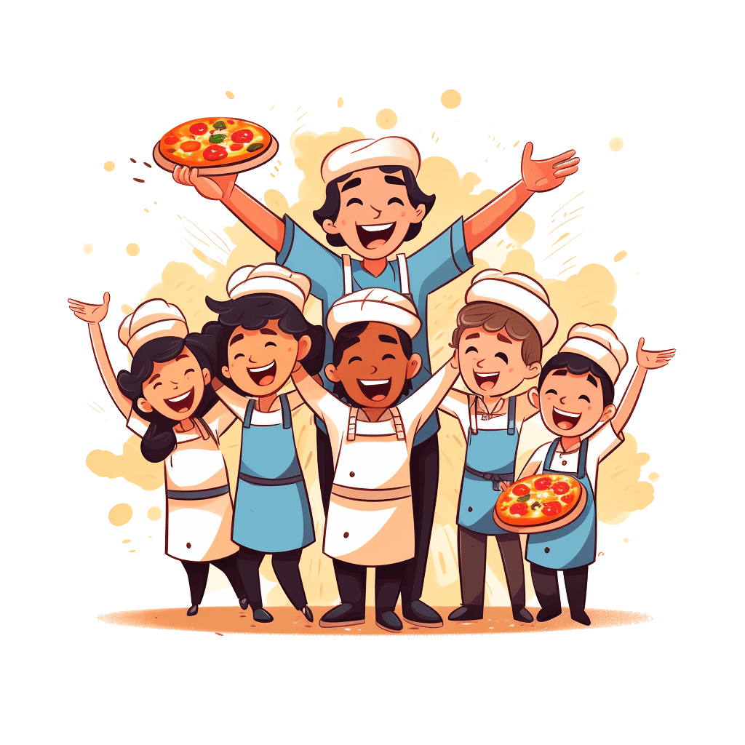
PizzaTime
Spreading joy, one slice at a time! 🍕
Celebrate your team wins, endorse your awesome colleagues, and have a blast!
Share virtual pizza slices, boost morale, and bond with your team like never before.
Join the fun, in three simple steps!

Slide 7

Share virtual pizza
It’s simple as a pie!
Mention the @PizzaTime bot
Tag your colleague @JohnDoe
Type a heartfelt message
PS: And don’t forget to add a 🍕 emoji!

Slide 8
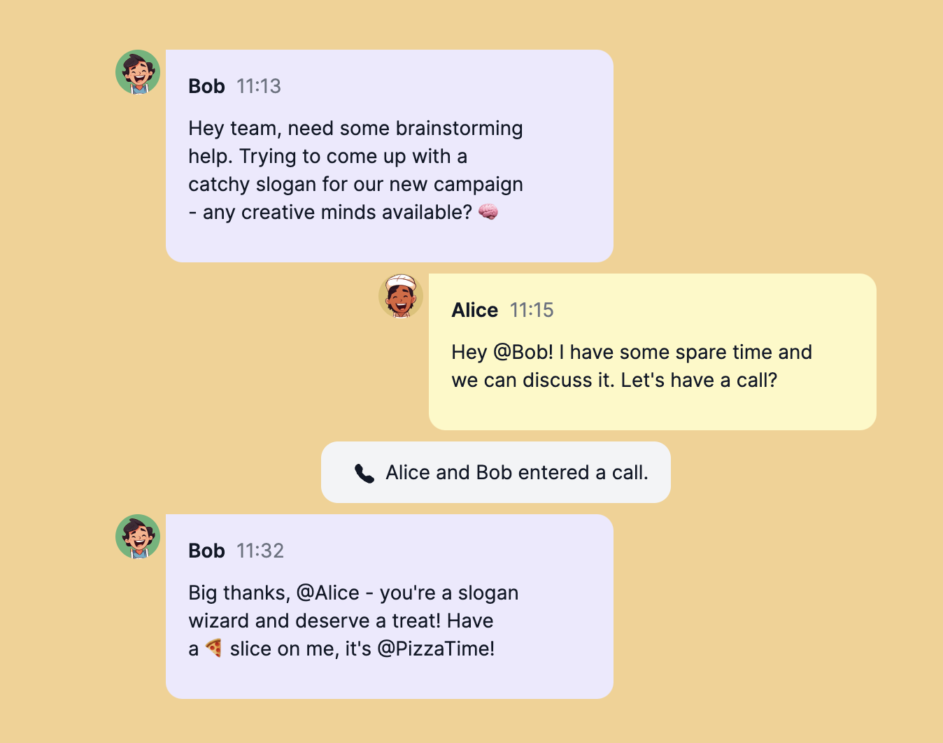
Yeah, simple as that!

Slide 9
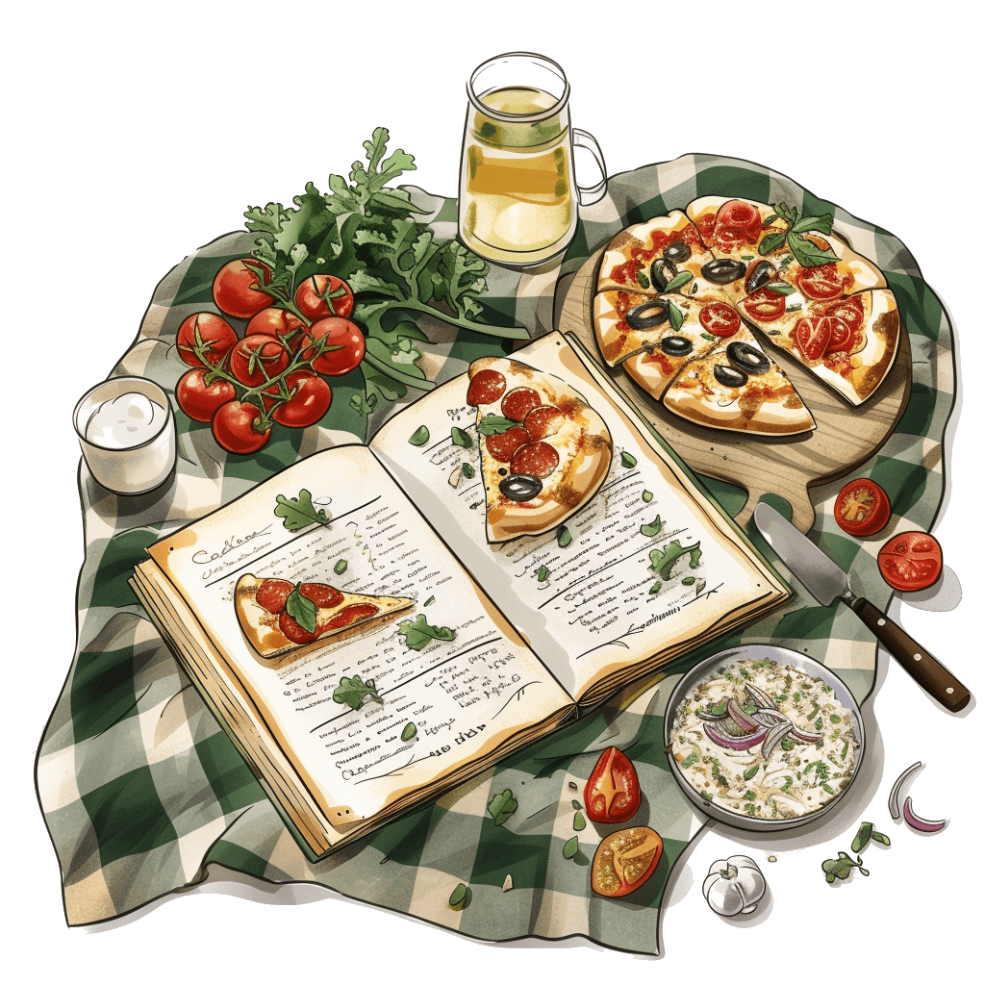
A pizza a day
makes it fun along the way!
you have new pizza every day
6 delicious slices to share with your colleagues
share your appreciation in a unique manner
And don’t forget to have fun!

Slide 10
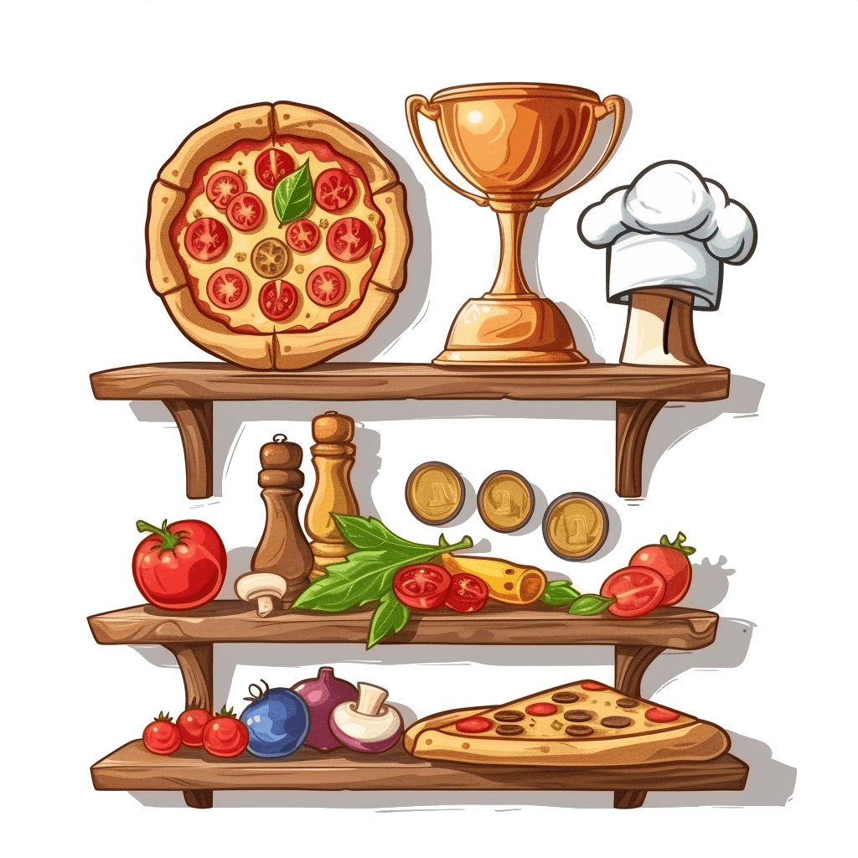
It comes with some perky stuff
Yeah, gamification indeed!
Send more pizza to level up
Unlock unique recipes for more fun
Climb the ladder in the friendly leaderboard
Unlock achievements to badge your progress
And more…

Slide 11
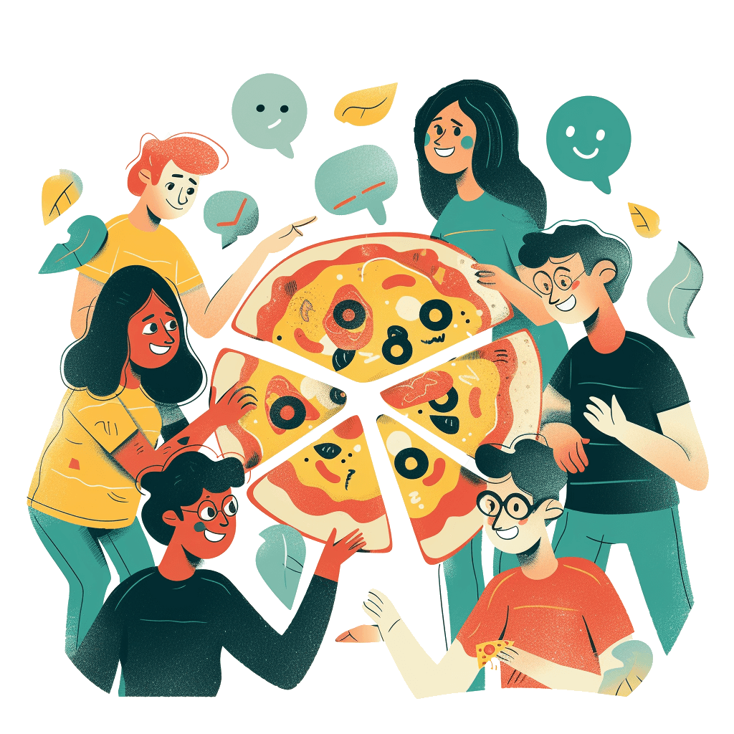
It's all about the team collaboration
The secret sauce?
Teamwork makes the dream work and we're here to turn those dreams into a pizza-fueled reality!
Boost morale, celebrate wins, and create a workplace where everyone gets a slice of the success pie.
Every click, share, and virtual pizza slice goes a long way. You're the real MVPs of this pizza party!

Slide 12
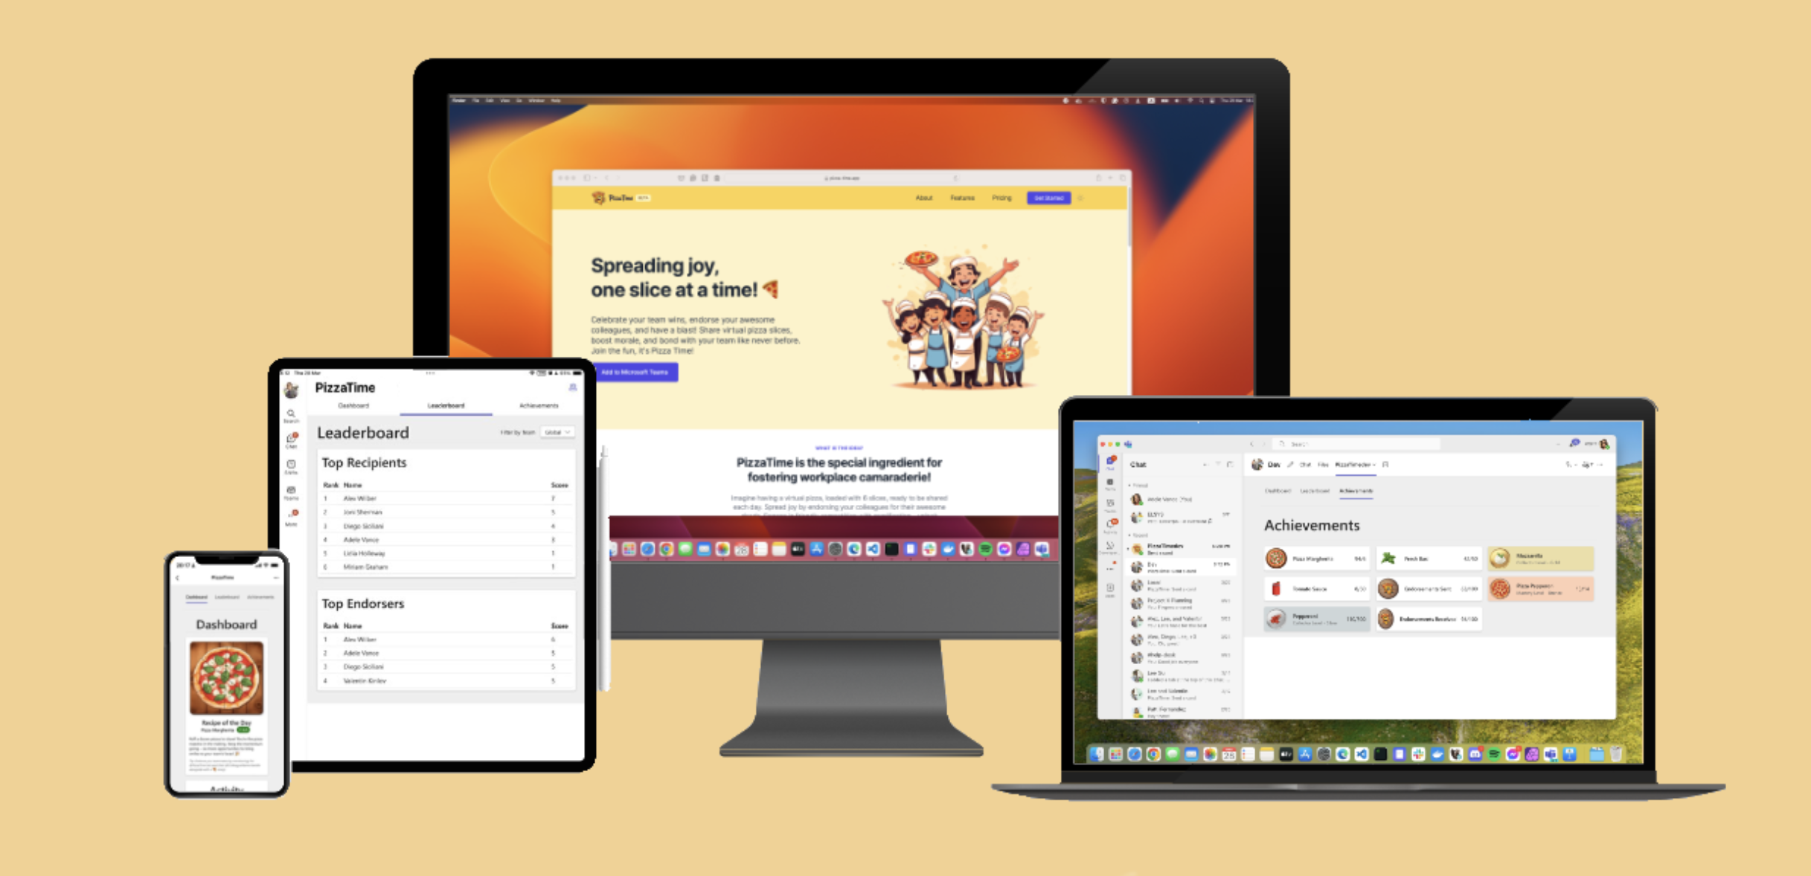
Are you ready for a demo?

Slide 13
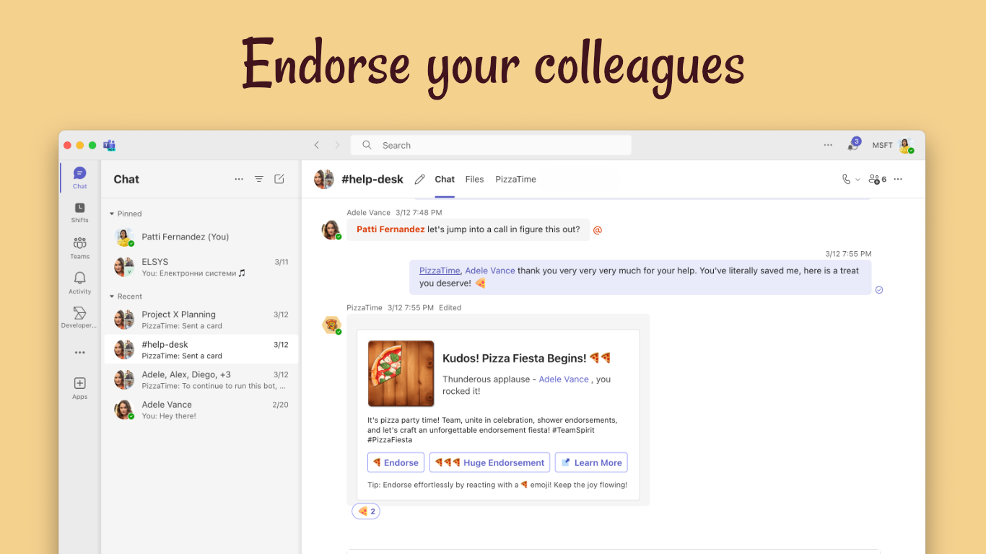

Slide 14
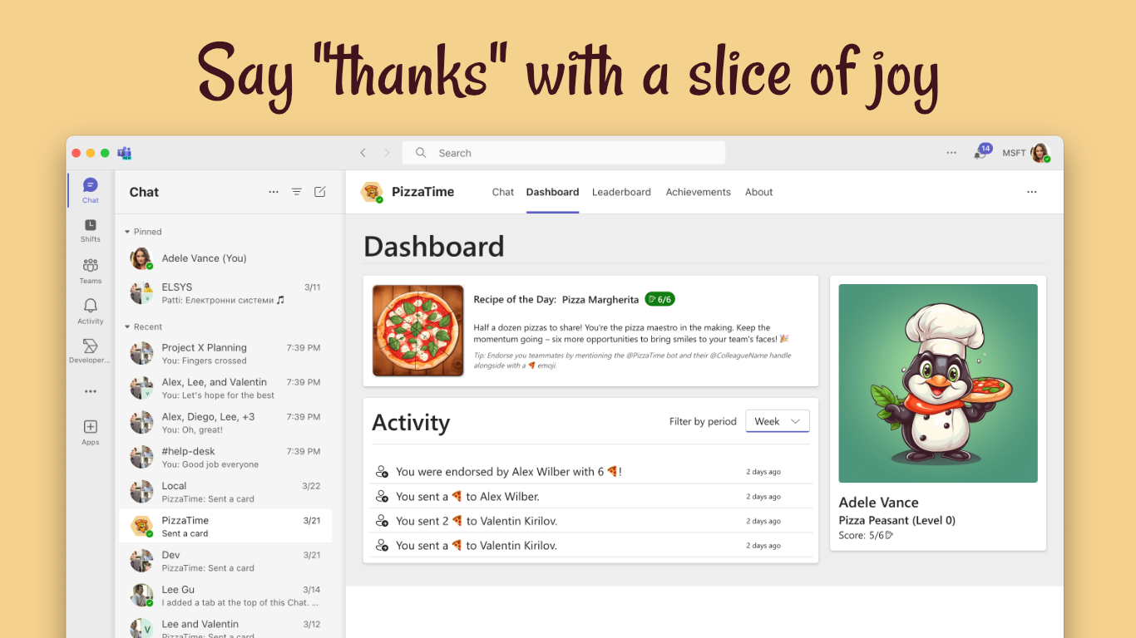

Slide 15
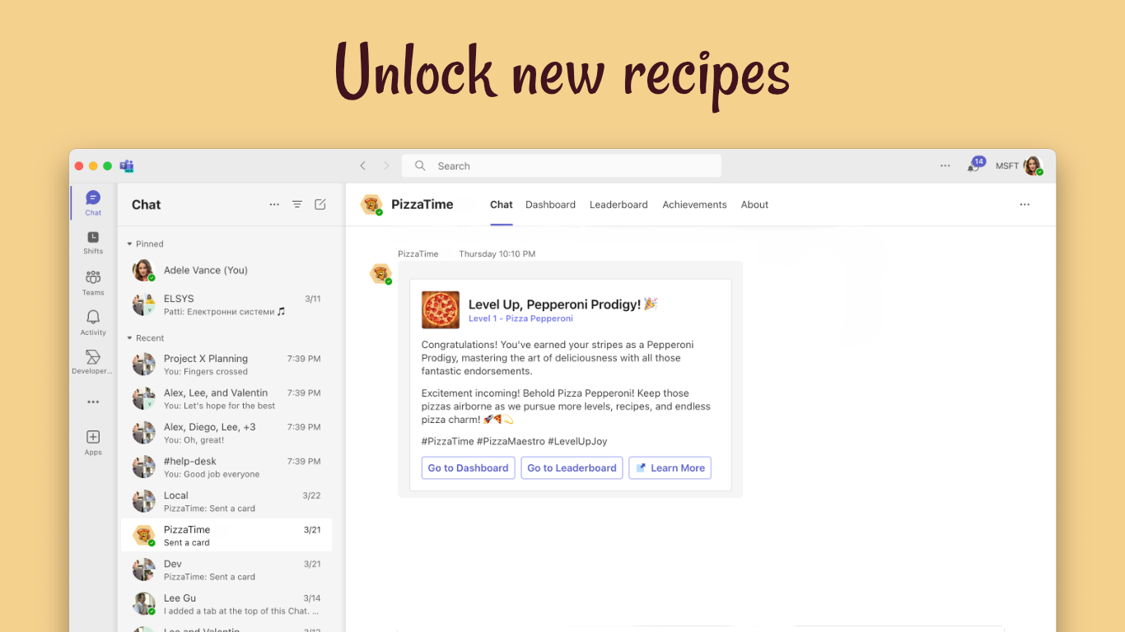

Slide 16
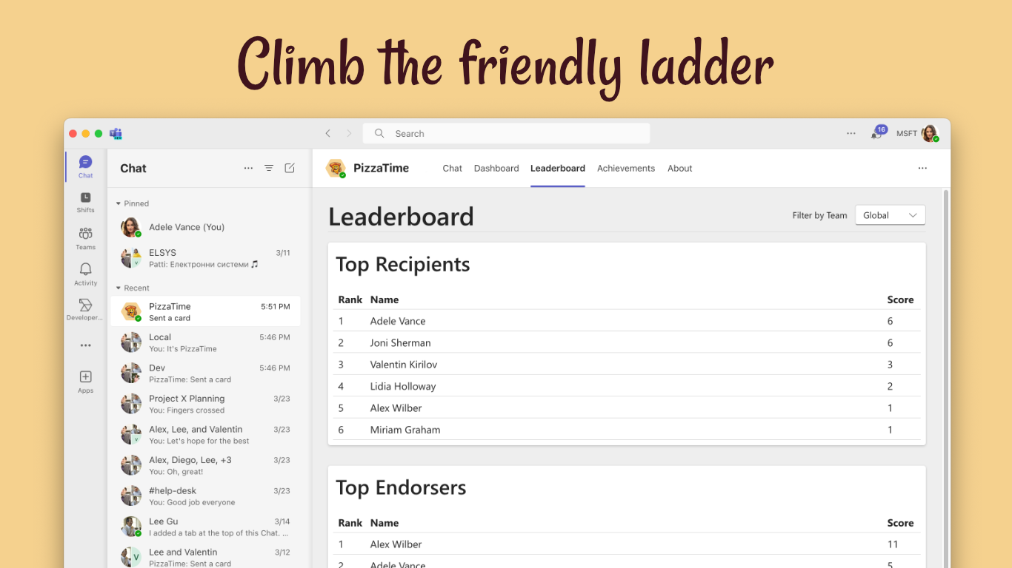

Slide 17
It’s Pizza-Time.app

