Slide 1
RabbitMQ RVALUG
Yuri Jacuk
https://github.com/pizzacodr/
https://www.linkedin.com/in/yuri-jacuk/

Slide 2

In the beginning...
At my last job, we dealt with a lot of files
  They were mostly Electronic Data Interchange (EDI) Files.
  We would receive them from Hospitals, Clearing Houses and on occasion small medical offices.
  While we accepted them 24 hours a day, most would send them around the same time, between 8 and 10 AM.
  Some of those files could run up to 2 Gigabytes, most were far smaller.

Slide 3
Sample EDI 837 File
ISA*00* *00* *ZZ*UPPLAND *ZZ*99999999 *040315*1005*U*00401*004075123*0*P*:~
GS*HP*ABCCOM*01017*20110315*1005*1*X*004010X091A1~
ST*835*07504123~
BPR*H*5.75*C*NON************20110315~
TRN*1*A04B001017.07504*1346000128~
DTM*405*20110308~
N1*PR*ASHTABULA COUNTY ADAMH BD*XX*6457839886~
N3*2817 DERBY ROAD*SUITE 130~
N4*WASHLAND*TX*78300~
N1*PE*NORTH MEDICAL CENTER *FI*346608640~
N3*38061 DALE AVE~
N4*WASHLAND*TX*44004

Slide 4
The EDI Files were converted to XML by a Microsoft Application (BizTalk).
Once converted, they were moved to a healthcare software application for processing.
During peak hours, BizTalk would grind to a halt, specially with really large files.
My idea was to build a stateless Java application to do that conversion.
This application would allow for easy horizontal scaling.
Horizontal scaling would allow me to implement the application single threaded.

Slide 5
Stateless App Definition
“An application program that does not save client data generated in one session for use in the next session with that client. Each session is carried out as if it was the first time and responses are not dependent upon data from a previous session...”
https://whatis.techtarget.com/definition/stateless-app

Slide 6
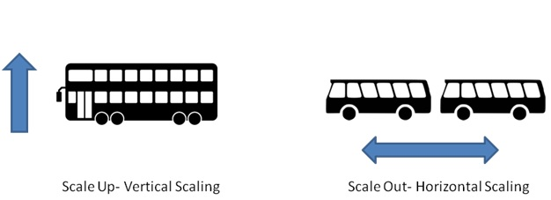
Horizontal vs Vertical Scaling
https://www.accionlabs.com/articles/2018/4/6/horizontal-versus-vertical-scaling-which-is-right-for-you

Slide 7
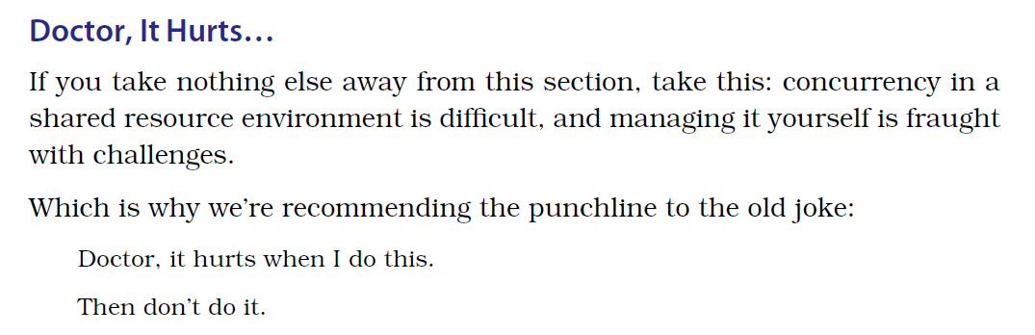
Multithreading Explained
The Pragmatic Programmer: Your Journey to Mastery, 20th Anniversary Edition, Page 183

Slide 8
Queues
I knew about queues from College.
  First-in, First-out
  Much easier to work with then Databases
  I had heard about Messaging Queues, but had never used them.
  I searched Google for Messaging Queues and RabbitMQ seemed to be the most popular.

Slide 9
RabbitMQ
Good, stable, Java client
Plenty of documentation online about it’s use.
Surprisingly simple to use in code.
A Docker image that made trying it out extremely easy.
sudo docker run -d -v /home/yuri/rabbitmq:/var/lib/rabbitmq -p 5672:5672 -p 15672:15672 --restart unless-stopped --hostname my-rabbit --name rabbit rabbitmq:3.7.15-management

Slide 10
RabbitMQ is written in Erlang
  Erlang is a functional, garbage collected language
  The only project I have ever used that was written in that language
RabbitMQ has 4 types of exchanges
  Direct Exchange
  Fanout Exchange
  Topic Exchange
  Header Exchange

Slide 11
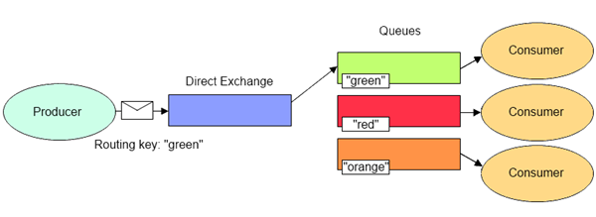
Direct Exchange
  Default exchange
  The one being used in the example
  Routing key is what distinguishes the messages
  By default, the routing key is the same as the queue name

Slide 12
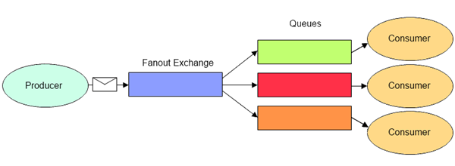
Fanout Exchange
  One exchange to many queues
  Routing key, if provided, can be ignored
  Used for messages that will be broadcast
  Usually implemented as pub/sub

Slide 13
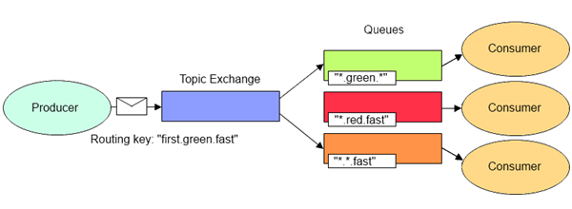
Topic Exchange
  Message routing based on the whole or partial match to the routing key
  Ex: *.nyse.* matches stock.nyse.usd

Slide 14
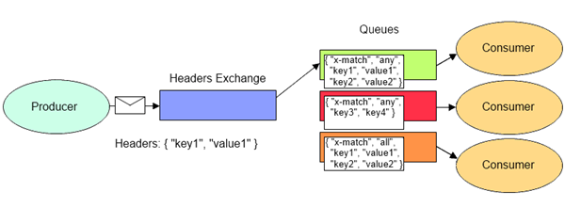
Header Exchange
  Matches the header information as opposed to the routing key

Slide 15
Two ways to administrate it
  Through the Web Interface
    http://localhost:15672/
    Default login - guest: guest
  Through the command line with rabbitmqadmin
rabbitmqadmin -V test list exchanges
# => +-------------+---------+-------+---------+-------------+
# => | name | durable | vhost | type | auto_delete |
# => +-------------+---------+-------+---------+-------------+
# => | | True | test | direct | False |
# => | amq.direct | True | test | direct | False |
# => | amq.fanout | True | test | fanout | False |
# => | amq.headers | True | test | headers | False |
# => | amq.match | True | test | headers | False |
# => | amq.topic | True | test | topic | False |
# => +-------------+---------+-------+---------+-------------+

Slide 16
Java Code
The project is setup using Maven
The code is available at
  https://github.com/pizzacodr/filenametomq
  https://github.com/pizzacodr/filenamefrommq
I used Eclipse for development
I used the official Java client for RabbitMQ

