Slide 1
13.1
Curves in Space and Their Tangents
Copyright © 2010 Pearson Education, Inc. Publishing as Pearson Addison-Wesley

Slide 2
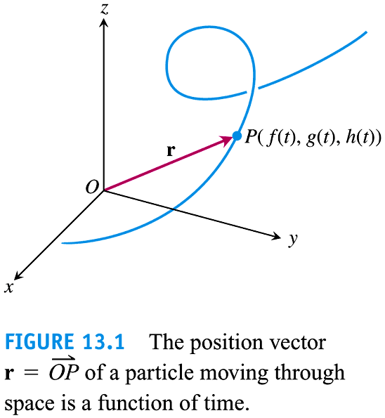

Slide 3
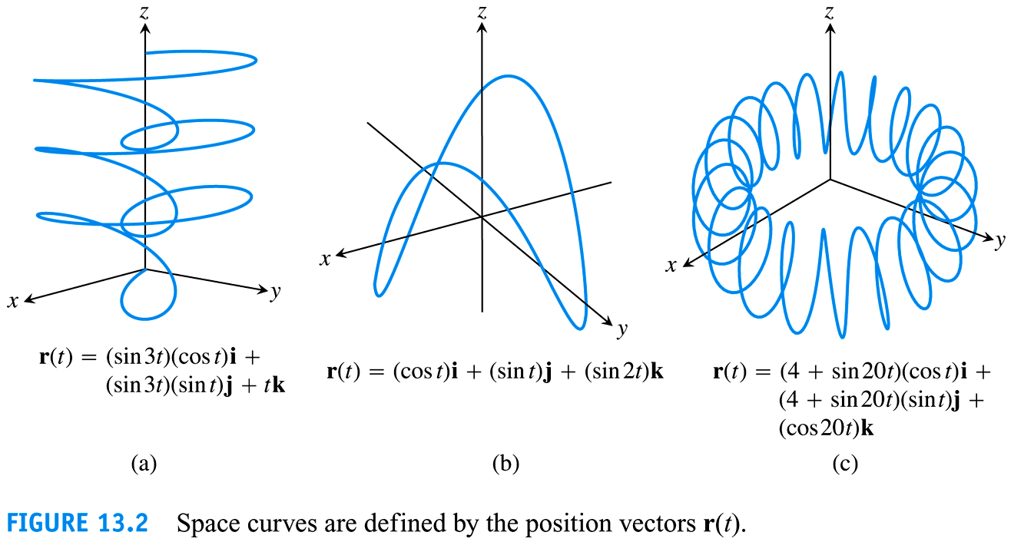

Slide 4
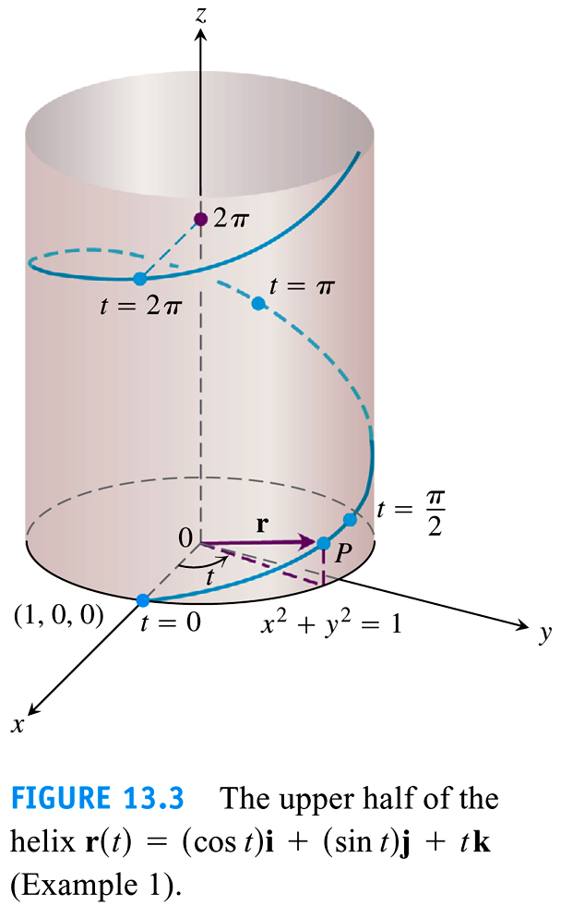

Slide 5
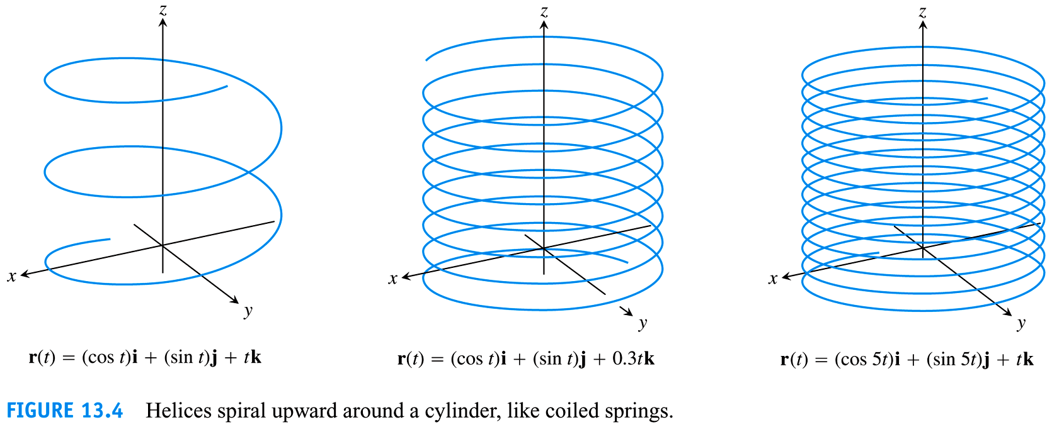

Slide 6
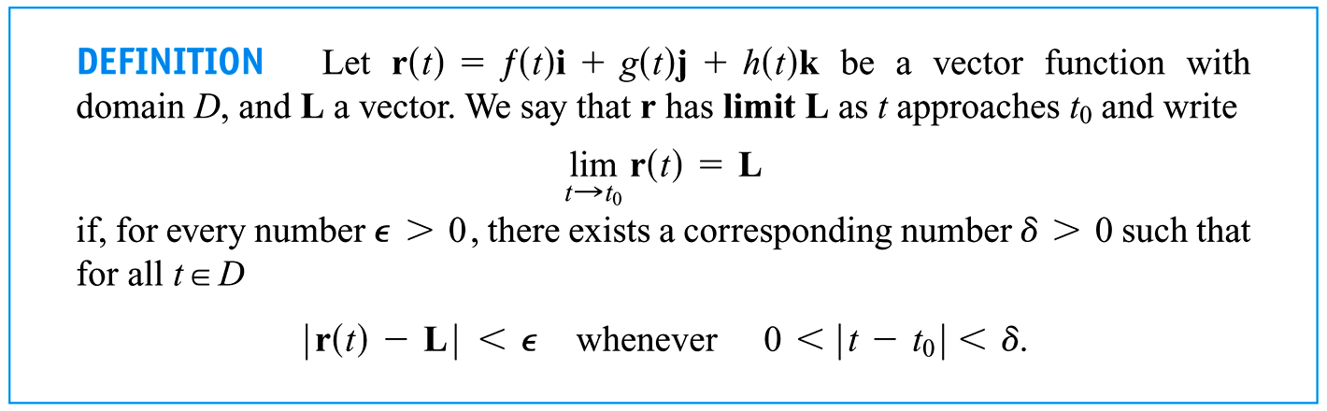

Slide 7
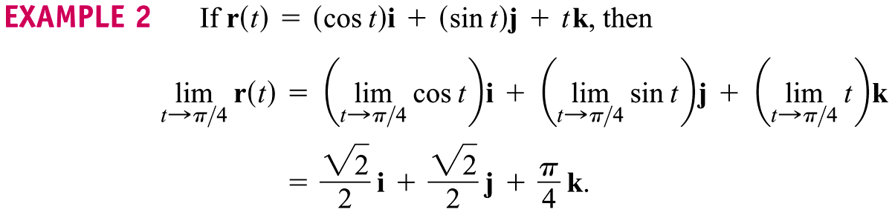

Slide 8
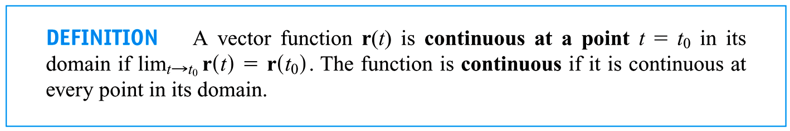

Slide 9
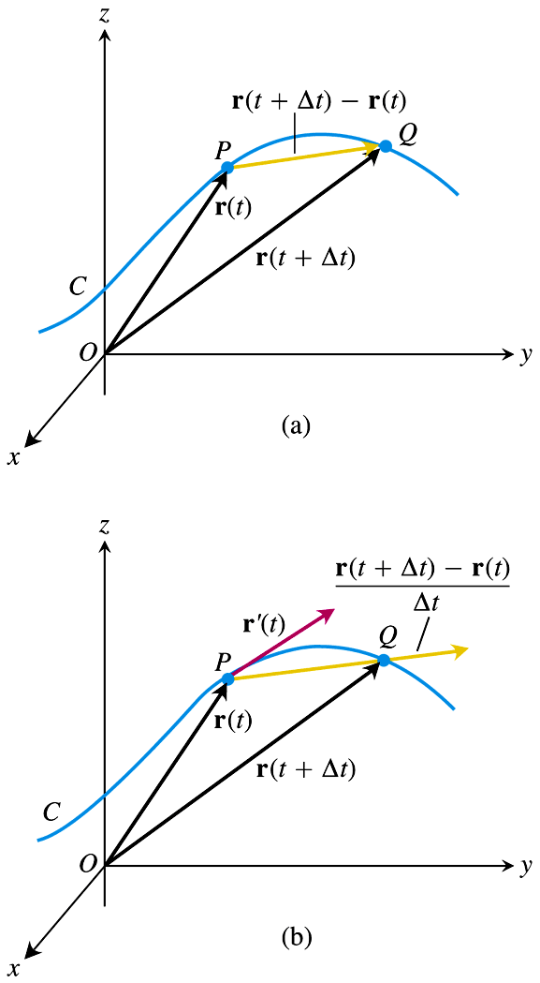
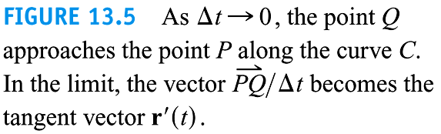

Slide 10
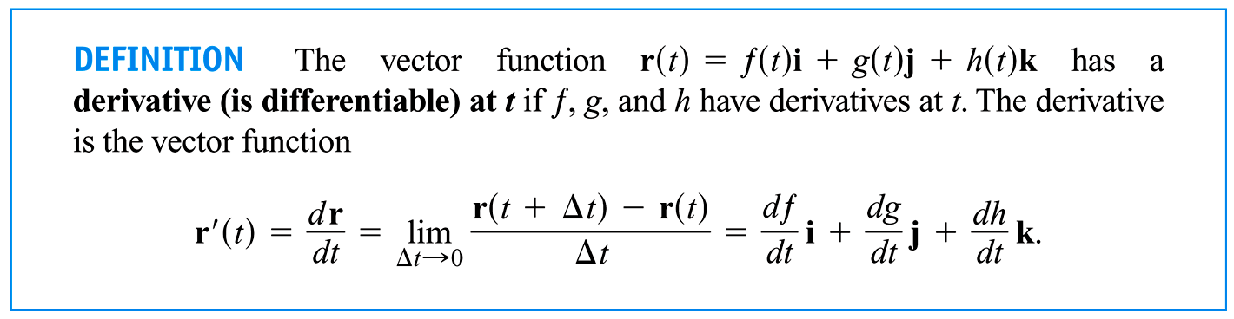

Slide 11
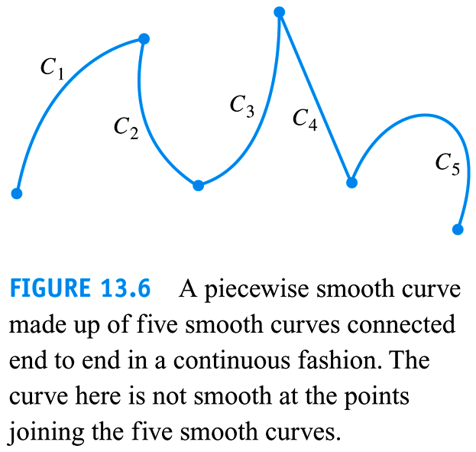

Slide 12
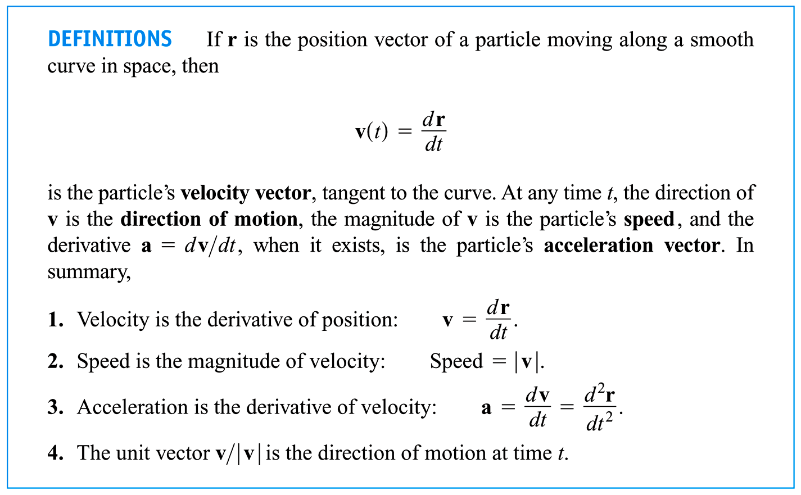

Slide 13
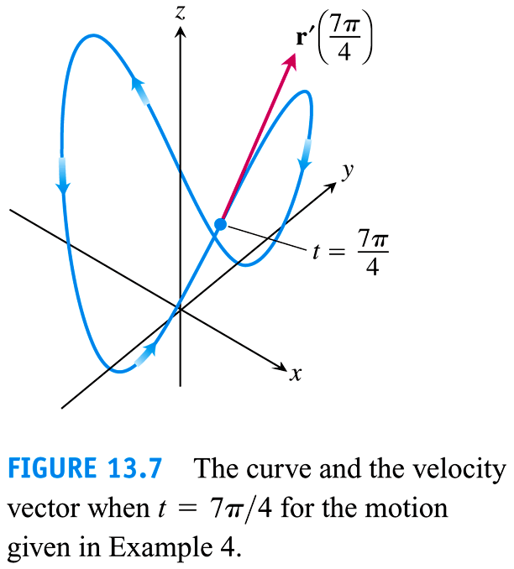

Slide 14
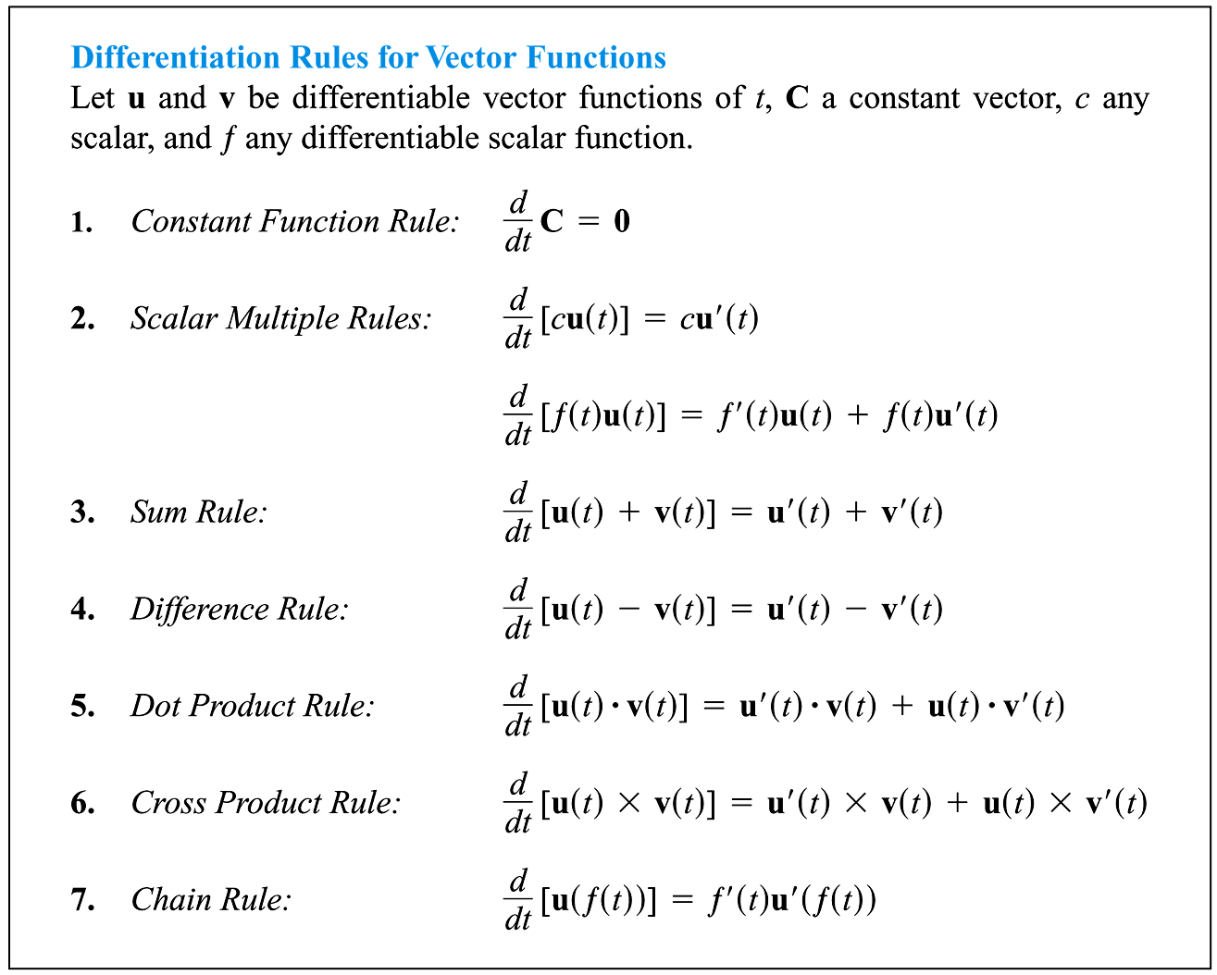

Slide 15
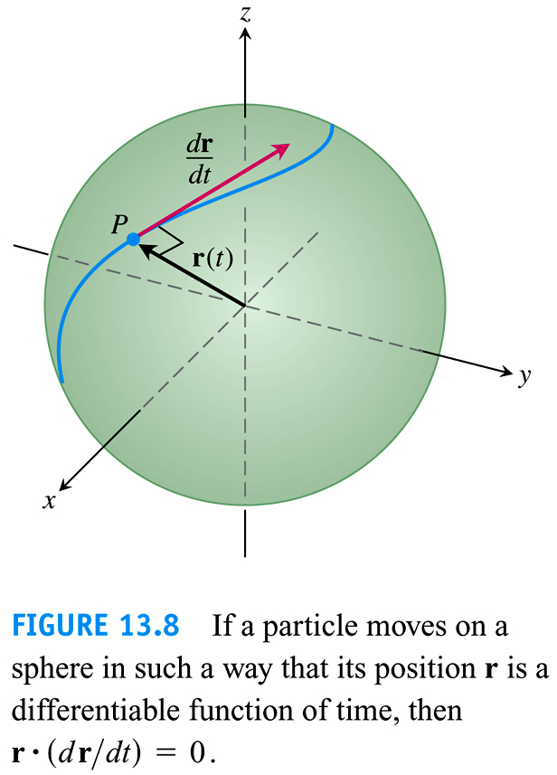

Slide 16
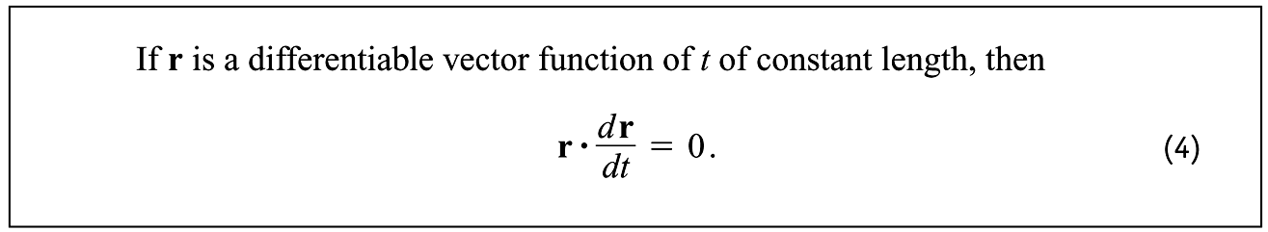

Slide 17
13.2
Integrals of Vector Functions; Projectile Motion
Copyright © 2010 Pearson Education, Inc. Publishing as Pearson Addison-Wesley

Slide 18
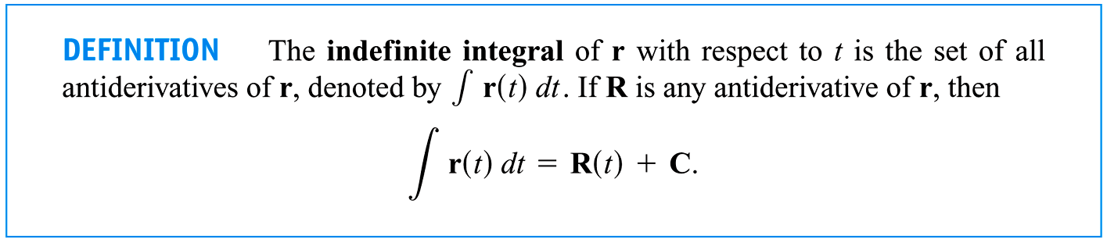

Slide 19
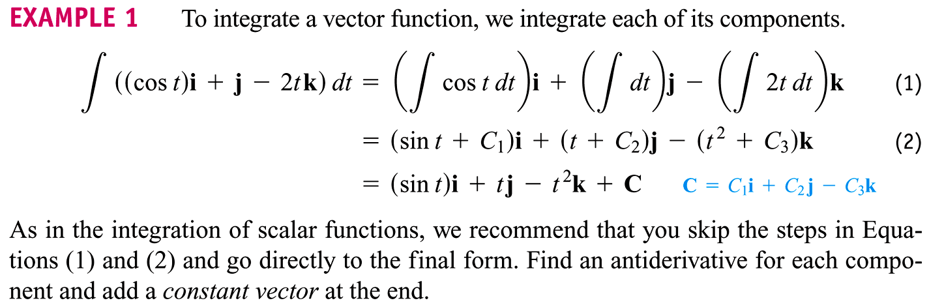

Slide 20
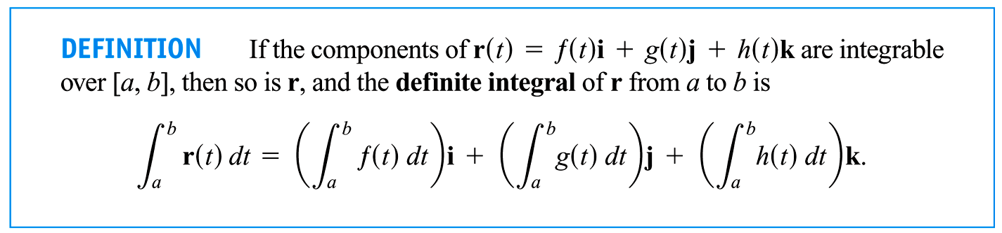

Slide 21
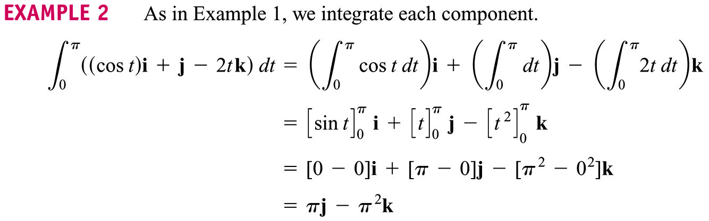

Slide 22
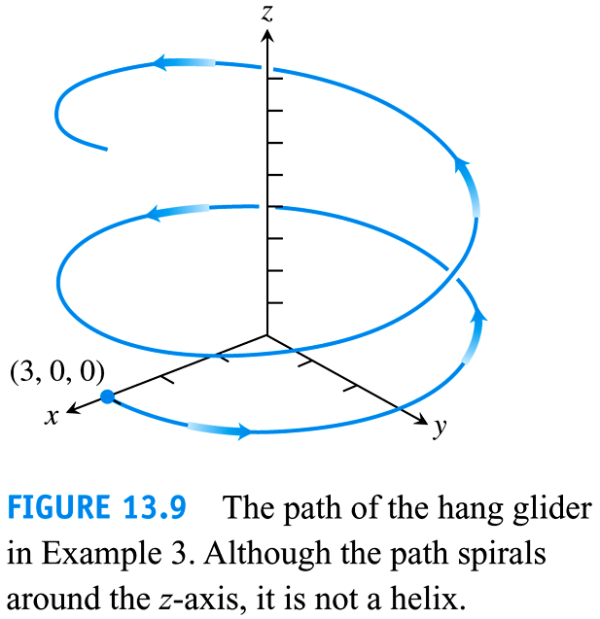

Slide 23
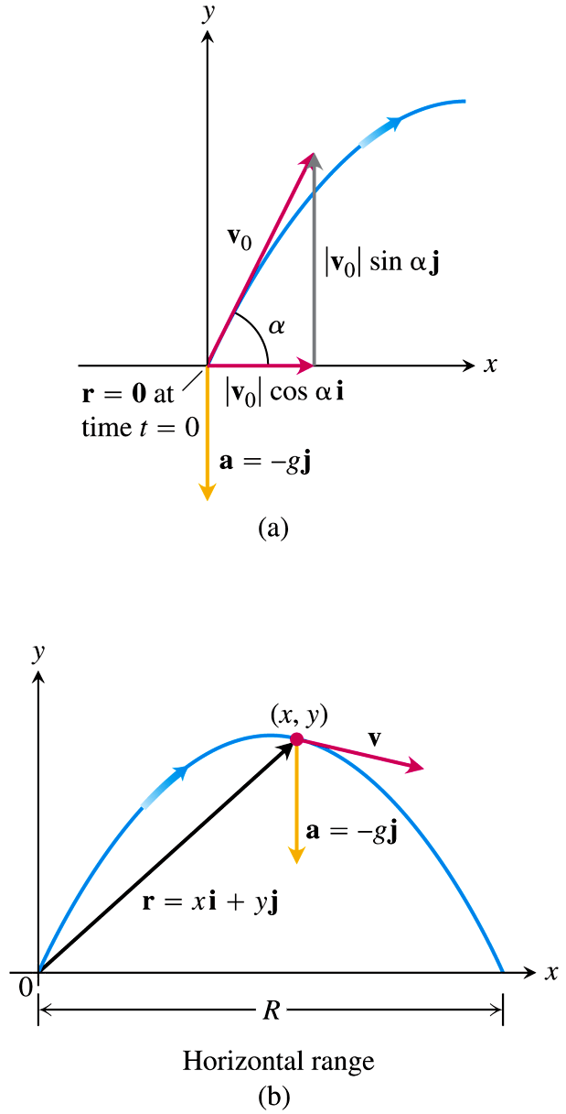

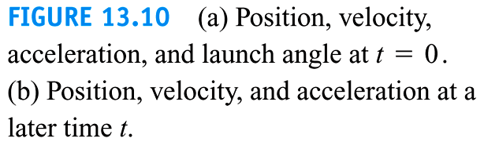

Slide 24


Slide 25
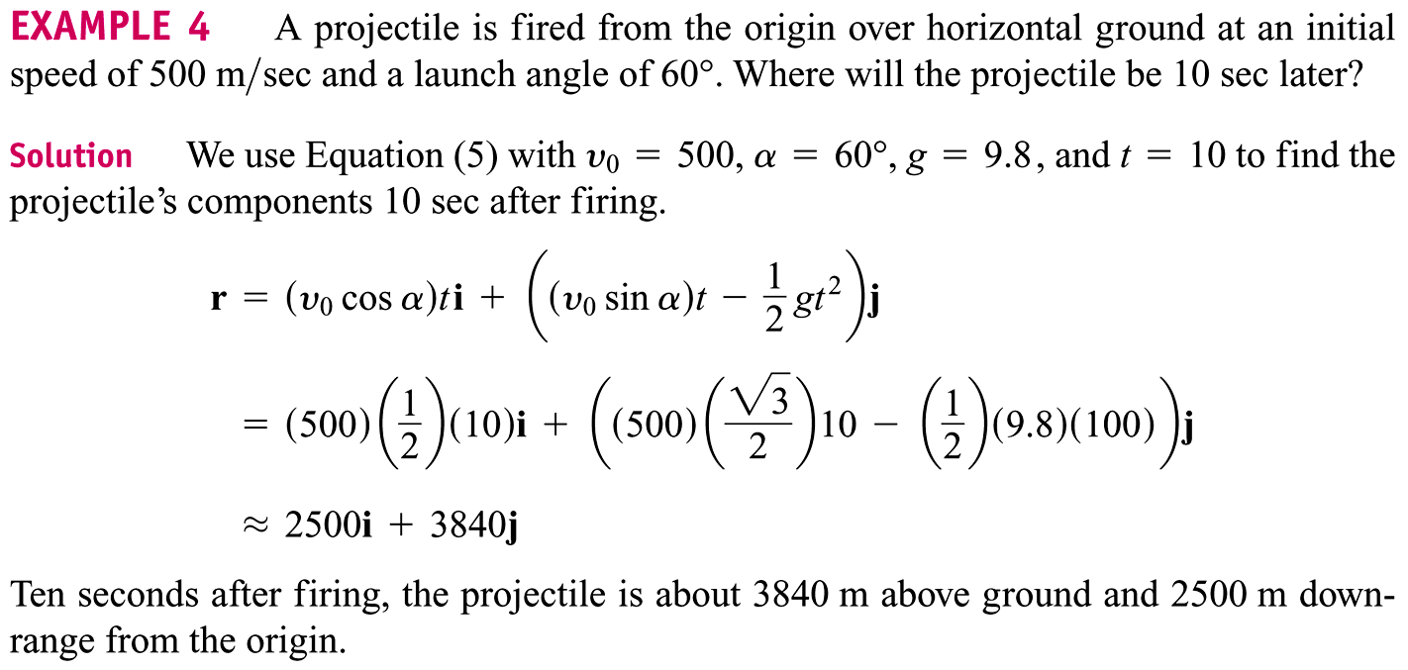

Slide 26
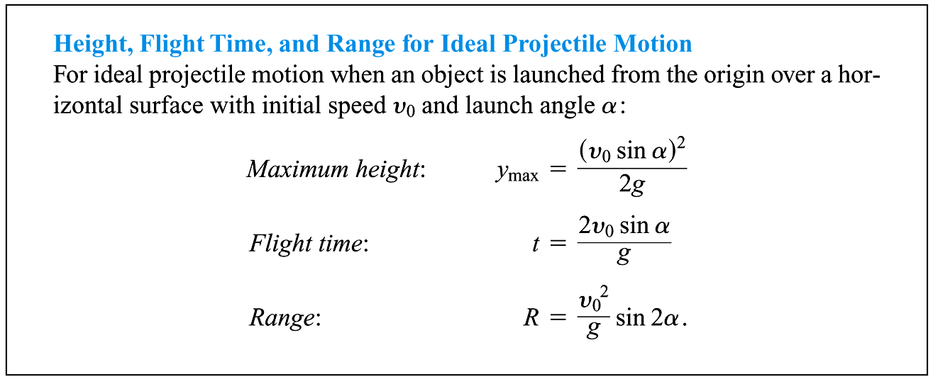

Slide 27
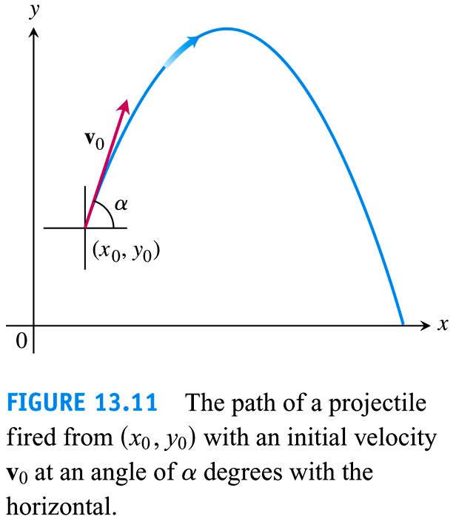

Slide 28
13.3
Arc Length in Space
Copyright © 2010 Pearson Education, Inc. Publishing as Pearson Addison-Wesley

Slide 29
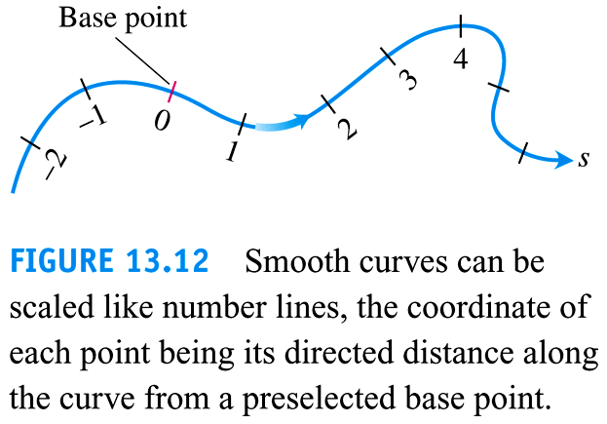

Slide 30
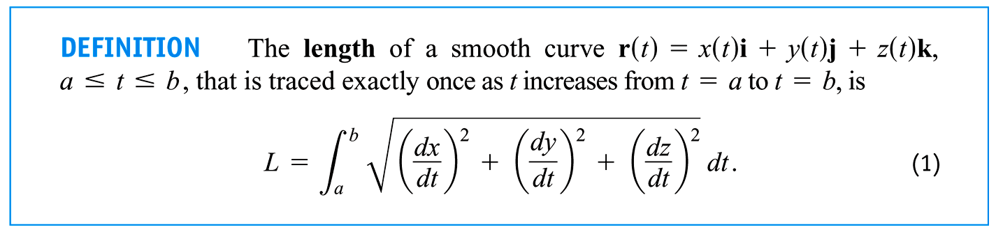

Slide 31
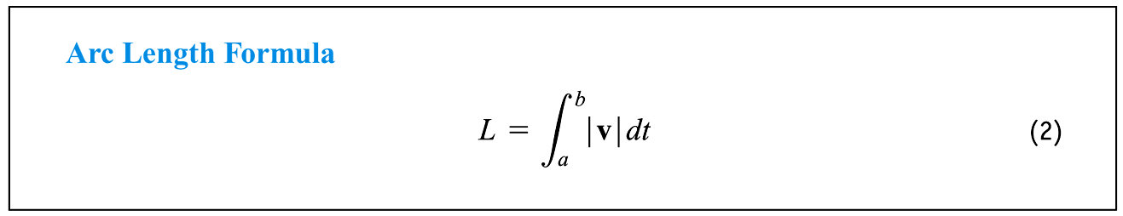

Slide 32
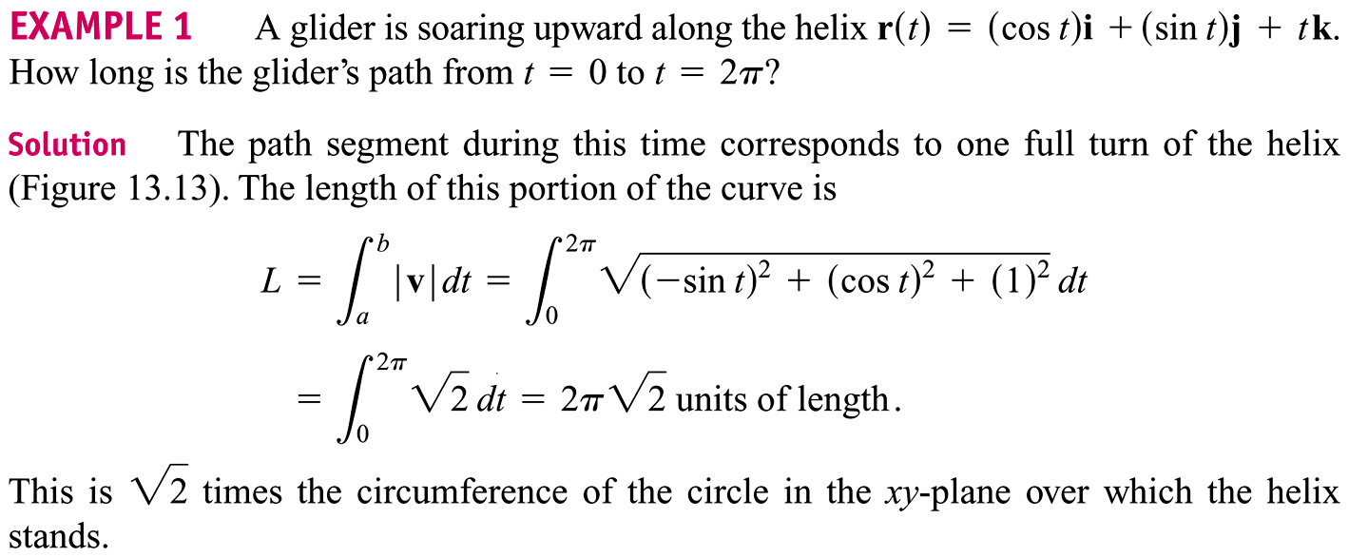

Slide 33
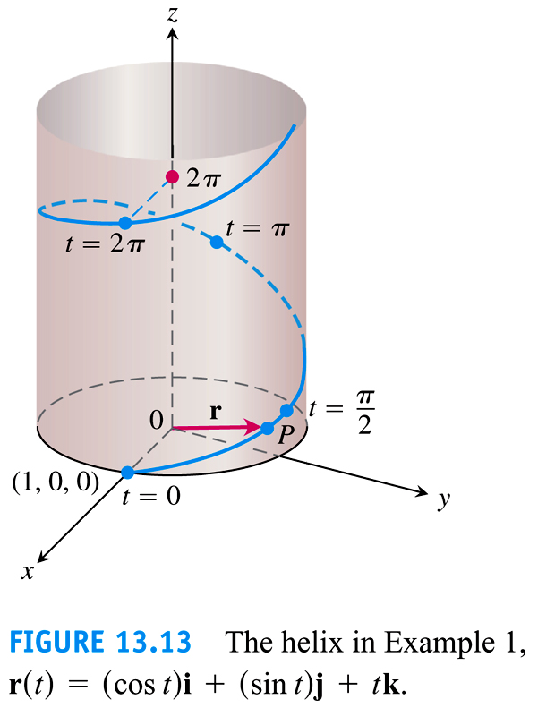

Slide 34
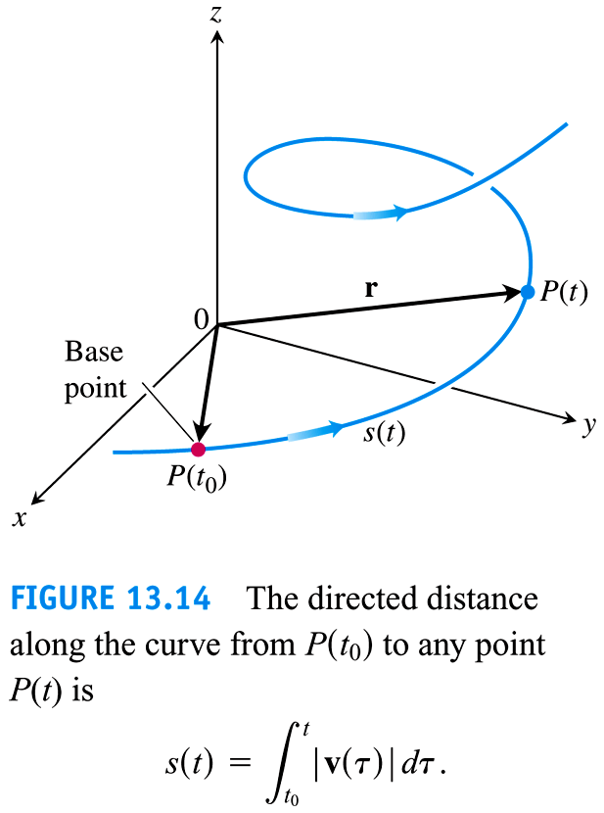

Slide 35
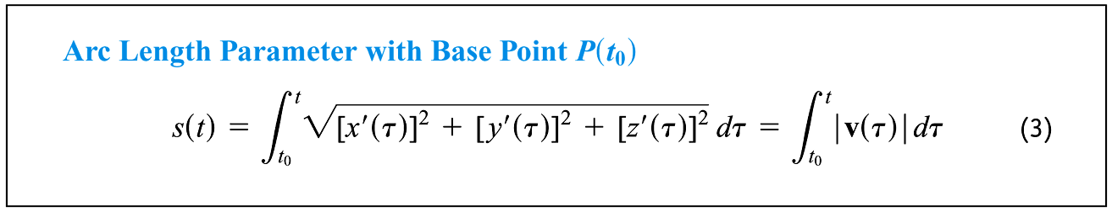

Slide 36
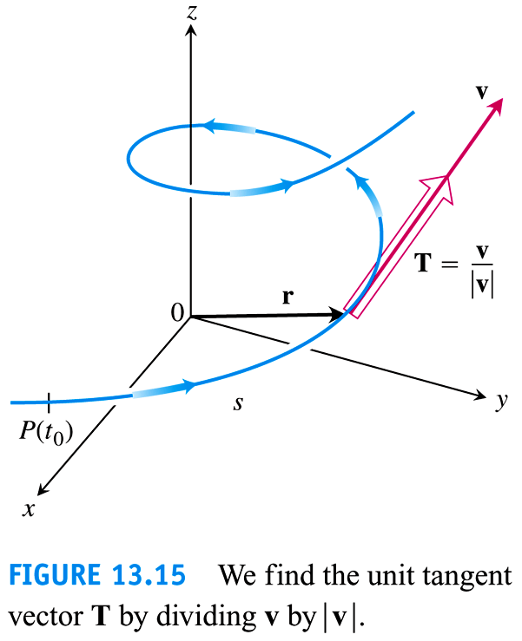

Slide 37
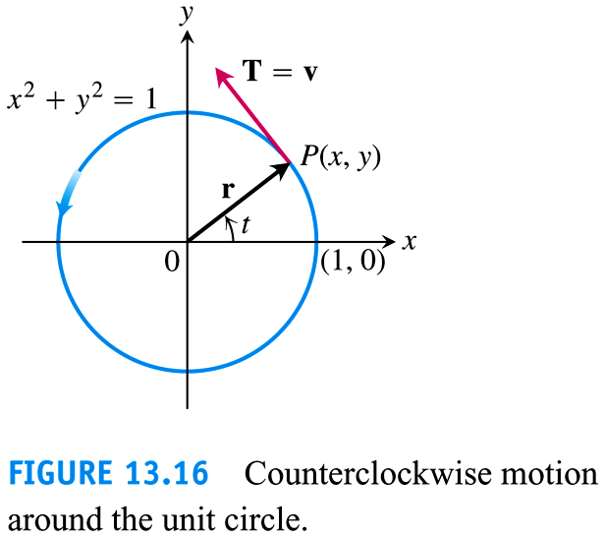

Slide 38
13.4
Curvature and the Normal Vector of a Curve
Copyright © 2010 Pearson Education, Inc. Publishing as Pearson Addison-Wesley

Slide 39
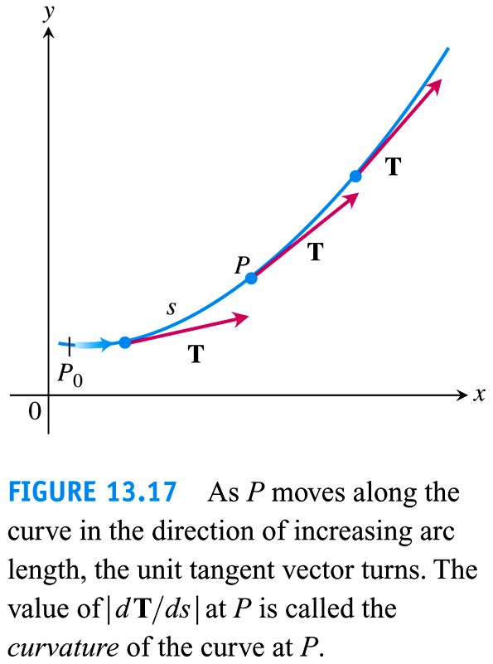

Slide 40
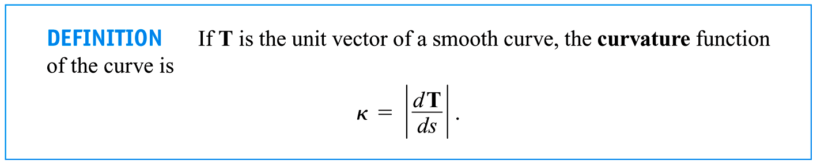

Slide 41
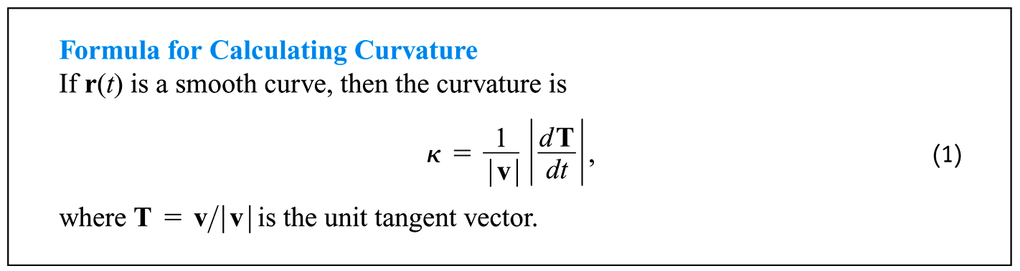

Slide 42
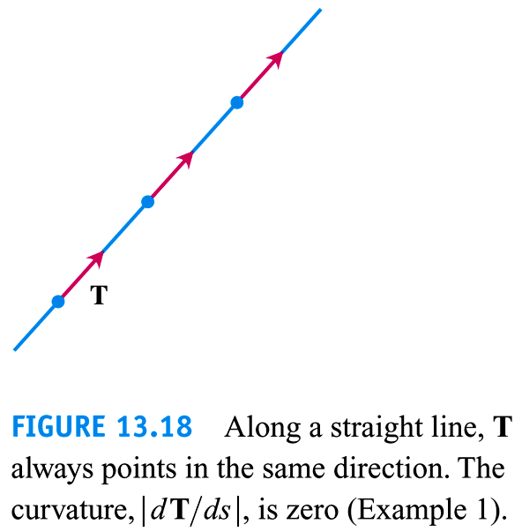

Slide 43
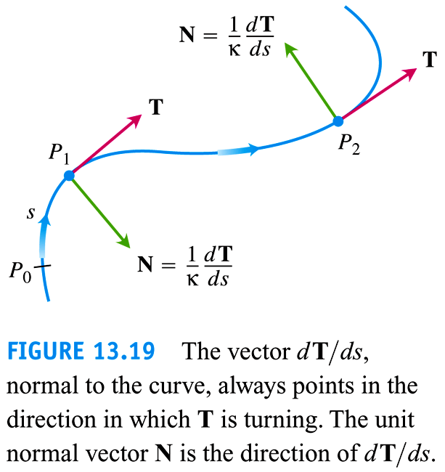

Slide 44
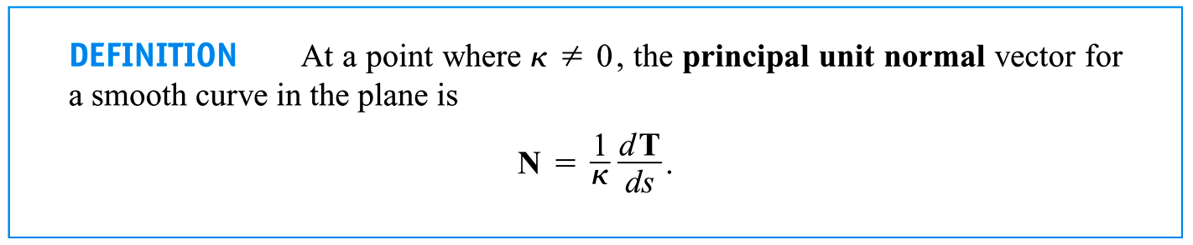

Slide 45
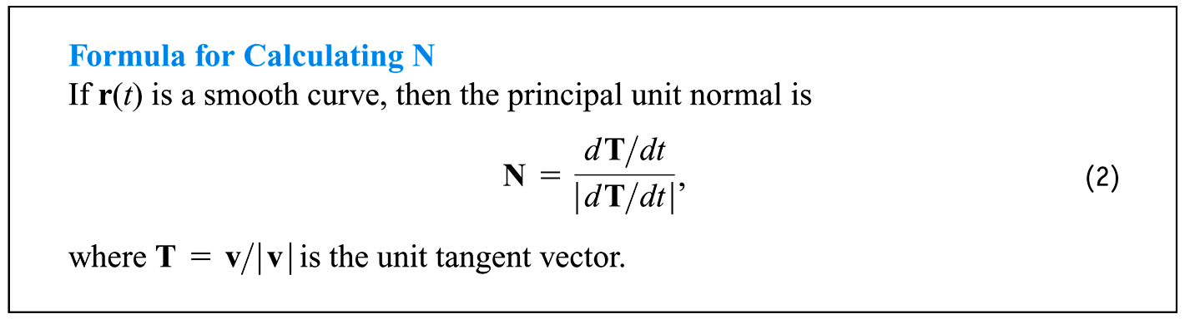

Slide 46
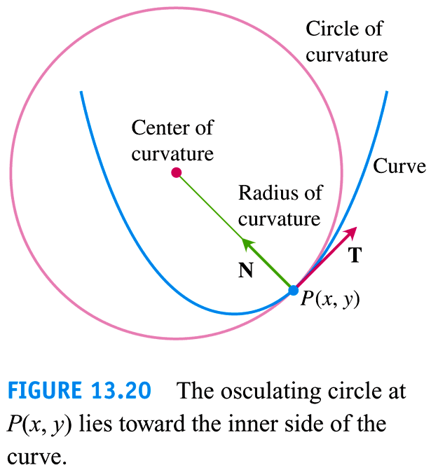

Slide 47
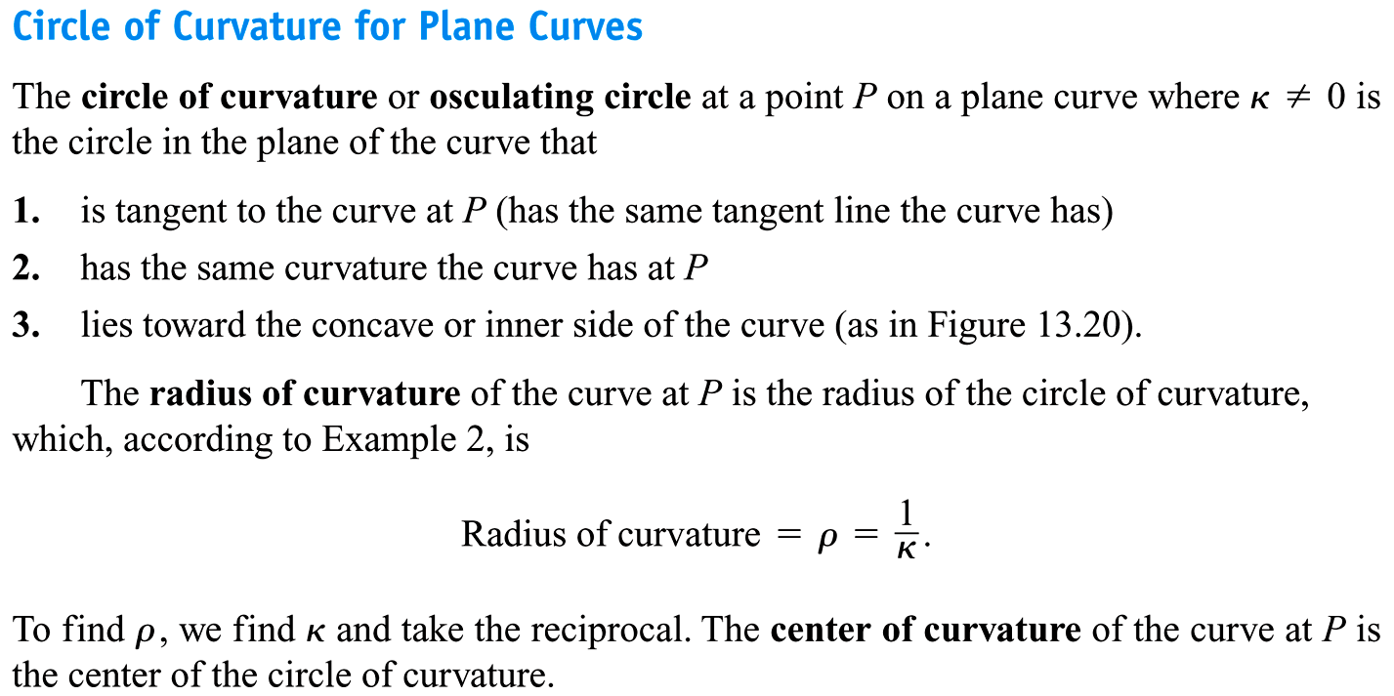

Slide 48
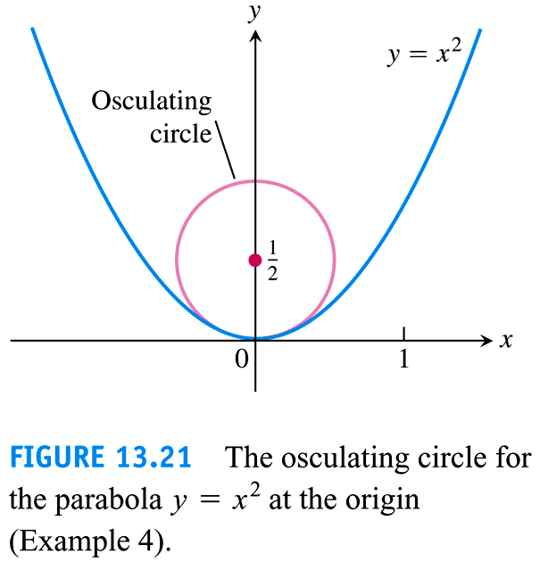

Slide 49
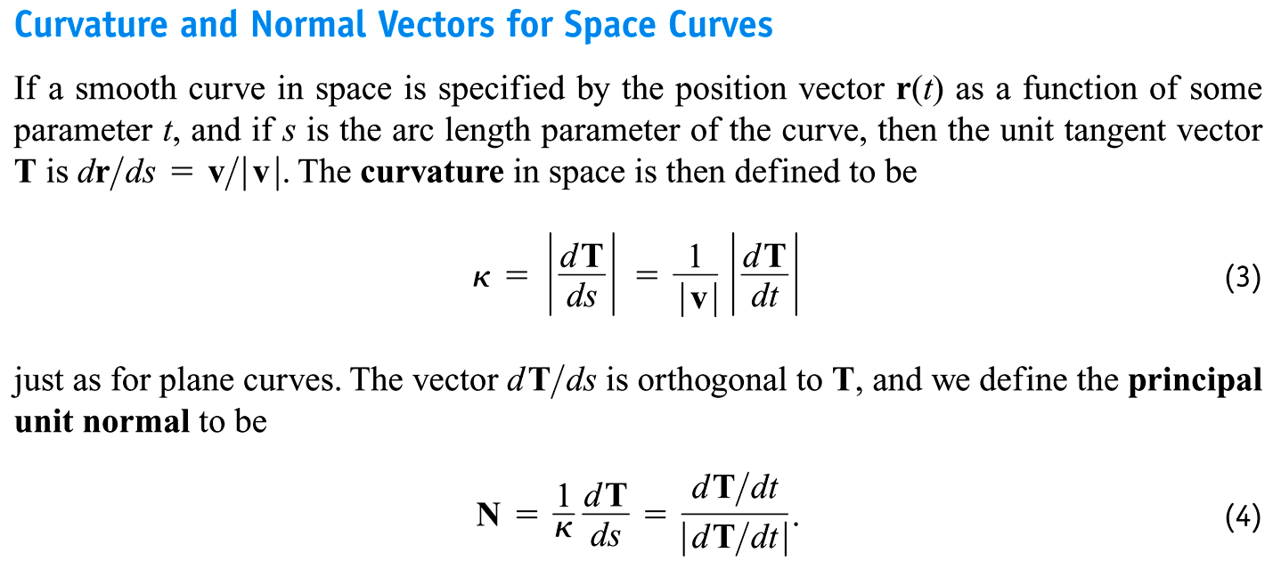

Slide 50
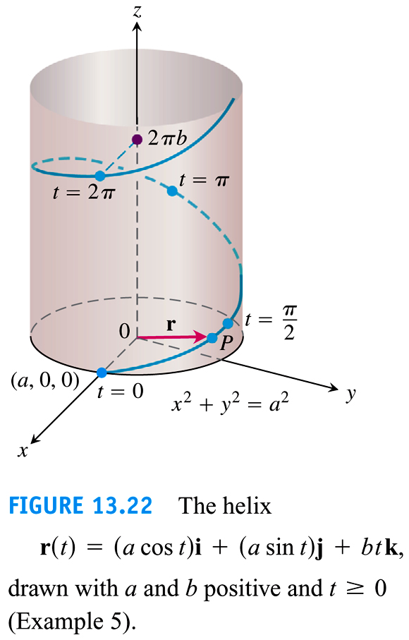

Slide 51
13.5
Tangential and Normal Components of Acceleration
Copyright © 2010 Pearson Education, Inc. Publishing as Pearson Addison-Wesley

Slide 52
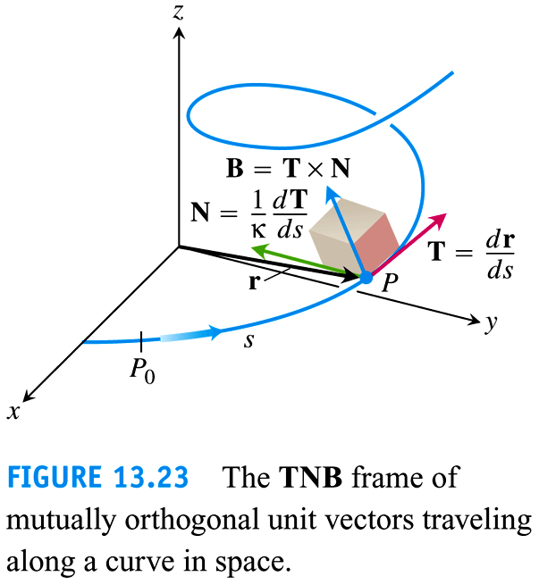

Slide 53
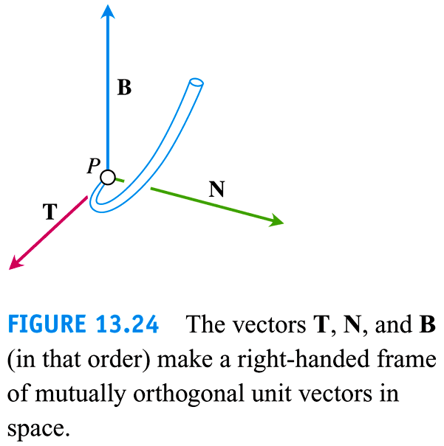

Slide 54
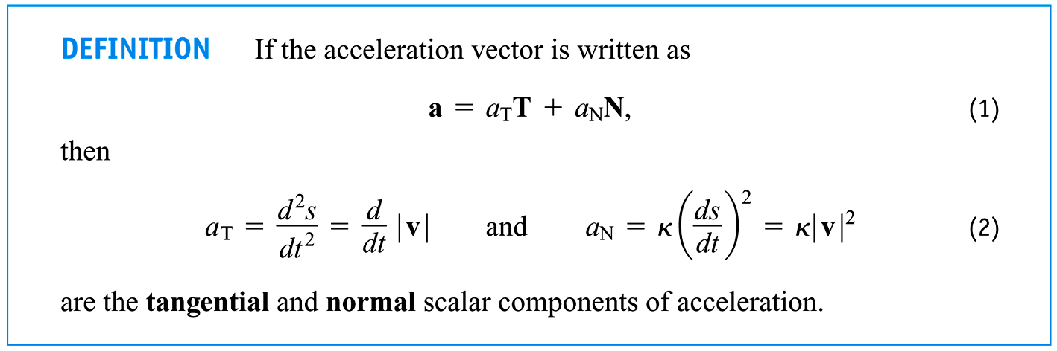

Slide 55


Slide 56


Slide 57


Slide 58



Slide 59


Slide 60


Slide 61


Slide 62


Slide 63
13.6
Velocity and Acceleration in Polar Coordinates
Copyright © 2010 Pearson Education, Inc. Publishing as Pearson Addison-Wesley

Slide 64


Slide 65


Slide 66


Slide 67


Slide 68


Slide 69


Slide 70


Slide 71


