Slide 1

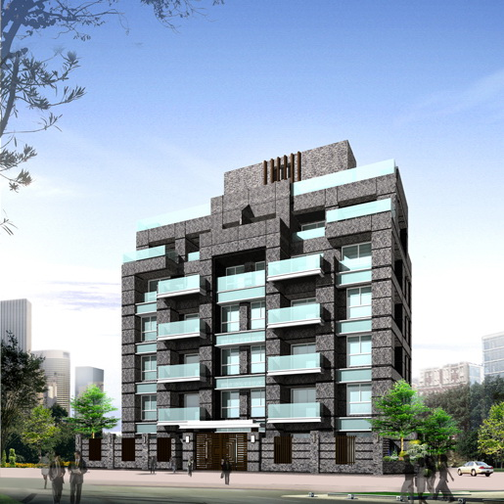
(Stock Code : 1453 TT)
Tajiang-Taipei
2018
Presentation for Investor ‘s Conference
November 22, 2018

Slide 2

This presentation is for reference only and is not a complete description of the Company’s operations. Contents within this report are based on the company’s predictions of future operations and are prospective descriptions that contain elements of risks and uncertainty. Hence the actual results of business operations might differ to the descriptions in this report.
If the content is related to the forecast information, the Company does not guarantee the correctness or reliability of the content. The user should judge and take risks at their own discretion.

Slide 3

Established in 1978/04/15
Listed on TWSE in 1993/04 (1453 TT)
Registered Capital:NT$896 ,746,710(as of 2018/09/30)
Main Business:Real Estate Development and Spinning Products(as of 2018)
Company Website:www.tajiang.com.tw

Slide 4

1978 Former chairman of the board founded the Ta Jiang textile co.,
ltd in Taipei city.
1979 The purchase of Yunlin County Cih-tong Township Tai po tail
section land , and with the government incentives, establish the
Ta Jiang industrial zone with the Ta Jiang construction company
, and the construction of cotton spinning mill, for the first domestic
to its own funds to develop industrial areas of private enterprises.
1993 The Company is approved by the Securities and Exchange
Commission and the shares are listed on the Taiwan Stock Exchange.
1998 In line with the Company's business diversification, officially
branched out into construction business.
2018 The Company sells the spinning mill land and plant to Kenda Rubber
Industrial Co., Ltd.
2018 The Company's capital is NT $ 896 million.

Slide 5
Operation Overview-Completed New Housing
Operation Overview-Construction Department
Project Name | Location | Product | Total Sales Amount (NT$ 100milion) | Remarks
Taipei City , Nanhai Sec | Taipei City , Jhongjheng Dist | Residential | 3.5 | Construction in progress
Beitou -Shou YI | Taipei City , Beitou Dist | Residential | 0.3 | Completed
Total |  |  | 3.8

Slide 6
Operation Overview-Land Bank and Planned Projects
Project Name | Location | Product | Area of Site (ping) | Total Building Area Sold (ping) | Total Sales Amount (NT$ 100 milion)
Yingge Dist , Jhongshan Sec | New Taipei City , Yingge Dist | Residential | 821.34 | 1784.27 | 4.27
Banciao Dist , Jingzicui Sec | New Taipei City ,Banciao Dist | Residential | 148.56 | 857.6 | 4.60
Total |  |  | 969.9 | 2641.87 | 8.87

Slide 7
Project Name | Location | Area of Site (ping) | Planning and Design Products | Implementation Schedule | Total Building Area Sold (ping)
New Taipei City , Sindian Dist , Guangming Sec , Wunshan Sec | New Taipei City , Sindian Dist | 1452.12 | Residential 14 F above ground,5F under ground | The second time urban renewal group review is completed | 4731.87
Taipei City , Sinyi Dist , Fude Sec | Taipei City , Sinyi Dist | 570.82 | Market Land 18 F above ground,4F under ground | Project plan and right transfer report to complete | 1836.28
New Taipei City , Sijhih Dist , Zonta Sec , Sinfong Sec | New Taipei City , Sijhih Dist | 1918.26 | Residential 11 F above ground,3F under ground | The third time urban renewal group review is completed | 3115.49
Taipei City , Songshan Dist , Meiren Sec | Taipei City , Songshan Dist | 1004.91 | Residential 14 F above ground,3F under ground | In contract with landowner | 1741.75
Taipei City, Datong Dist, Bridge North Sec | Taipei City, Datong Dist | 608.63 | Residential 12 F above ground,4F under ground | In contract with landowner | 3712.00
Total |  |  |  |  | 15137.39

Slide 8
Operation Overview-Future 5 Years Plan
Project Name | Total Building Area Sold (ping) | 2019 | 2020 | 2021 | 2022 | 2023
Yingge Dist , Jhongshan Sec | 1784.27 |  | ● | ●
Banciao Dist , Jingzicui Sec | 857.6 | ● | ●
New Taipei City , Sindian Dist , Guangming Sec , Wunshan Sec | 4731.87 |  |  | ● | ●
Taipei City , Sinyi Dist , Fude Sec | 1836.28 |  |  |  | ● | ●
New Taipei City , Sijhih Dist , Zonta Sec , Sinfong Sec | 3115.49 |  | ● | ●
Taipei City , Songshan Dist , Meiren Sec | 1741.75 |  |  |  | ● | ●
Taipei City, Datong Dist , Bridge North Sec | 3712.00 |  | ● | ●
Total | 17779.26

Slide 9
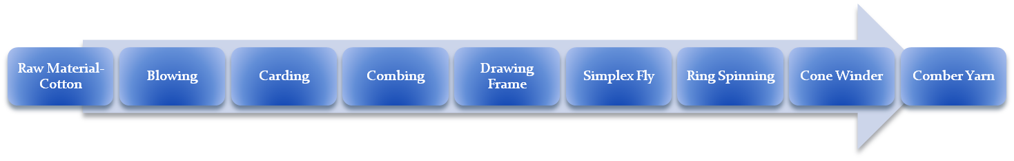
Operation Overview- Spinning Department
Plant Area 15,000 ping
Main Products ･Combed Cotton Yarn
･ Special Component Blended Yarn
Spinning Manufacturing Process
● Production and Sales status
1.Due to the long-term market downturn in the spinning industry and the impact of a
large number of Southeast Asian countries, such as low-cost competition in imports
of yarn and other factors, resulting in the Company spinning products business
tightening, continued losses,In order to improve the year-on-year loss of the spinning
business, the Board of Directors decided on May 4, 2017 to stop the production of
spinning plants that did not meet the operating efficiency.
2.After the spinning mill was discontinued, the original land and plant were sold to
KENDA RUBBER INDUSTRIAL CO., LTD for NT$578 million in November 2017
, and the registration and property rights transfer was completed in March 2018,
Proceeds from disposal of land and pland totaled NT$360 million.

Slide 10
Financial Status
In thousands of NT
Consolidated Balance Sheets | 2014年 | 2015年 | 2016年 | 2017年 | 2018年 (as of 2018.9.30)
Building and Land Held for Sale | 19,921 | 64,390 | 44,469 | 28,052 | 18,552
Land Held for Construction | 386,361 | 265,629 | 265,889 | 298,791 | 298,877
Construction in Progress | 150,522 | 158,398 | 189,809 | 208,598 | 233,080
Inventories Subtotal | 556,804 | 488,417 | 500,167 | 535,441 | 550,509
Inventories-Manufacturing | 98,049 | 53,933 | 58,791 | 19,137 | 1,045
Property,Plant and Equipment | 348,675 | 346,184 | 362,323 | 354,574 | 145,558
Cash and Other Assets | 175,076 | 85,228 | 82,951 | 99,264 | 134,452
Financial assets at fair value through profit or loss | 118,391 | 163,731 | 172,857 | 350,973 | 528,701
Total Assets | 1,296,995 | 1,137,493 | 1,177,089 | 1,359,389 | 1,360,265
Total Liabilities | 338,739 | 131,580 | 174,240 | 371,252 | 15,649
Stockholders Equities | 958,256 | 1,005,913 | 1,002,849 | 988,137 | 1,344,616
Current Ratio | 310.66 | 943.09 | 626.79 | 309.47 | 7,388.57
Debt Ratio | 26.12 | 11.57 | 14.80 | 27.31 | 1.15

Slide 11

Consolidated Income Statements | 2014年 | 2015年 | 2016年 | 2017年 | 2018年 (as of 2018.9.30)
Operating Revenue | 233,413 | 317,864 | 53,147 | 64,138 | 27,615
Operating Cost | 253,269 | 222,421 | 58,380 | 66,700 | 28,137
Gross Profit(Loss) | (19,856) | 95,443 | (5,233) | (2,562) | (522)
Operating Expenses | 38,483 | 49,349 | 29,129 | 39,250 | 28,283
Operating Income (Loss) | (58,339) | 46,094 | (34,362) | (41,812) | (28,805)
Non-Operating Income and Loss | 13,817 | 8,280 | 24,317 | 16,211 | 385,735
Pre-tax Income(Loss) | (44,522) | 54,374 | (10,045) | (25,601) | 356,930
Net Income(Loss) | (46,871) | 54,234 | (10,674) | (26,862) | 356,479
Comprehensive Income(Loss) | (51,687) | 47,657 | (3,064) | (14,712) | 356,479
Earnings per Share | (0.54) | 0.62 | (0.12) | (0.30) | 3.97
Net Assets Value | 10.76 | 11.30 | 11.04 | 10.87 | 14.85

Slide 12

TA JIANG CO., LTD.

