Slide 1
RNAInsight
Machine Learning Based RNA Target-Family Classification Using Molecular Descriptors
Sumedha Phadnis - 24BDS1104
Priyanka J – 24BDS1032
13
Models benchmarked
plus XGBoost attempt
57.2%
Best CV accuracy
Random Forest
62.8%
Best test accuracy
C5.0

Slide 2
Feature Engineering & Feature Selection
From the original molecular descriptor space to a compact, interpretable feature set
DESCRIPTOR CONSTRUCTION
14 descriptors
Retained feature space
Molecular / physicochemical descriptors used for classification
RNA family
Target
Multi-class classification across RNA target families
~605 + ~145
Validation design
Training set with repeated CV + held-out test set
FEATURE SELECTION / REDUNDANCY CHECK
WHAT THE ANALYSIS SAYS ABOUT THE FEATURES
Descriptors were retained after a collinearity-filtering step to reduce redundant predictors.
Deeper PCA analysis revealed that PC15 explains exactly 0% of variance, indicating the retained feature matrix has rank 14 rather than 15.
The most likely structural redundancy is RingCount = NumAromaticRings + NumAliphaticRings.
This is an algebraic dependency, so a simple pairwise-correlation filter may not remove it.
Recommended refinement: remove RingCount or one of its component counts and rerun PCA / model training.
All descriptors showed statistically significant family-level differences under Kruskal–Wallis after BH adjustment.
NumAromaticRings, FractionCSP3, RingCount and RotatableBonds showed relatively larger univariate effects.
However, univariate statistical ranking and model importance had essentially no agreement: Spearman ρ ≈ 0.004.
Random Forest distributed importance across FractionCSP3, FlexibilityIndex, TPSA_per_MW and MolMR, while C5.0 was dominated by TPSA.
Therefore, feature importance captures multivariate predictive utility, not simply the largest individual group differences.
Key takeaway: the 15 descriptors contain real signal, but their effective information is highly redundant and concentrated in a small number of latent dimensions.

Slide 3
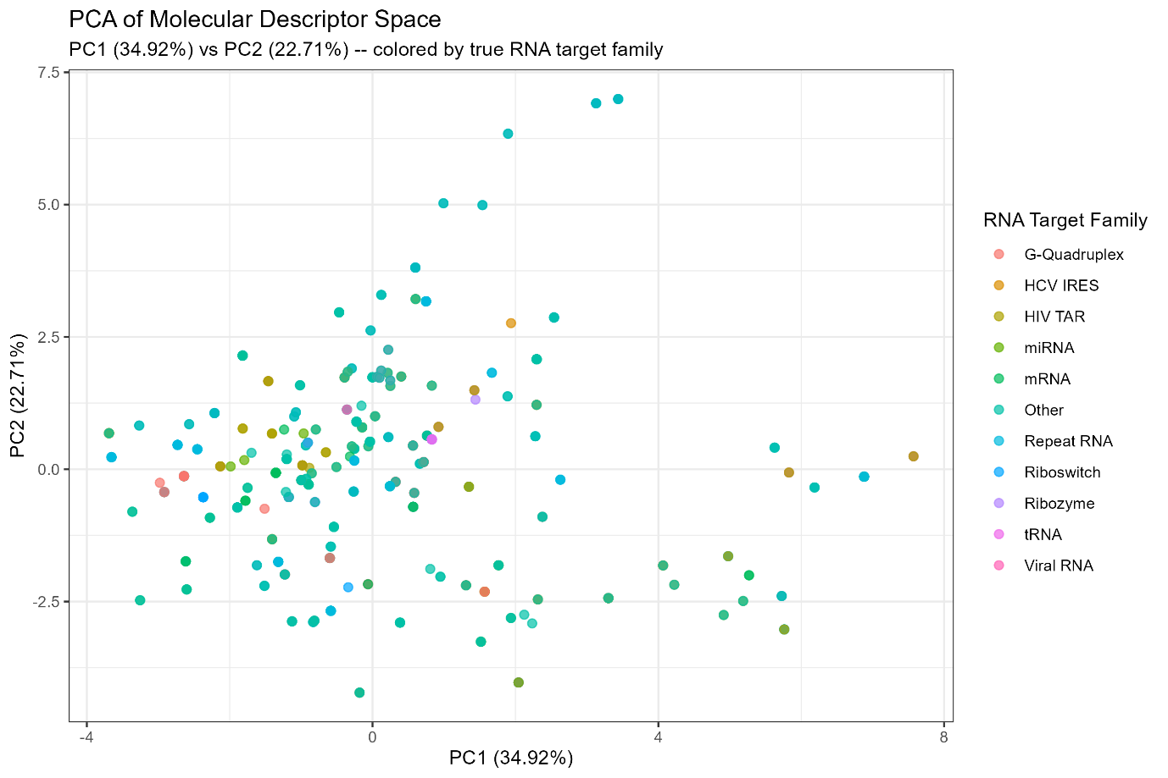
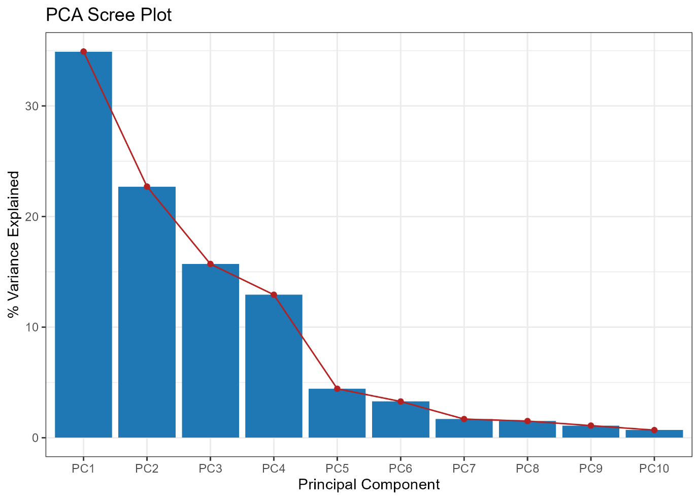
PCA — evidence for an information ceiling
The current descriptor space contains signal, but the RNA families overlap heavily.
PC1 + PC2 ≈ 57.6% variance
SCREE PLOT
PC1–PC4 ≈ 86.3% variance

Slide 4
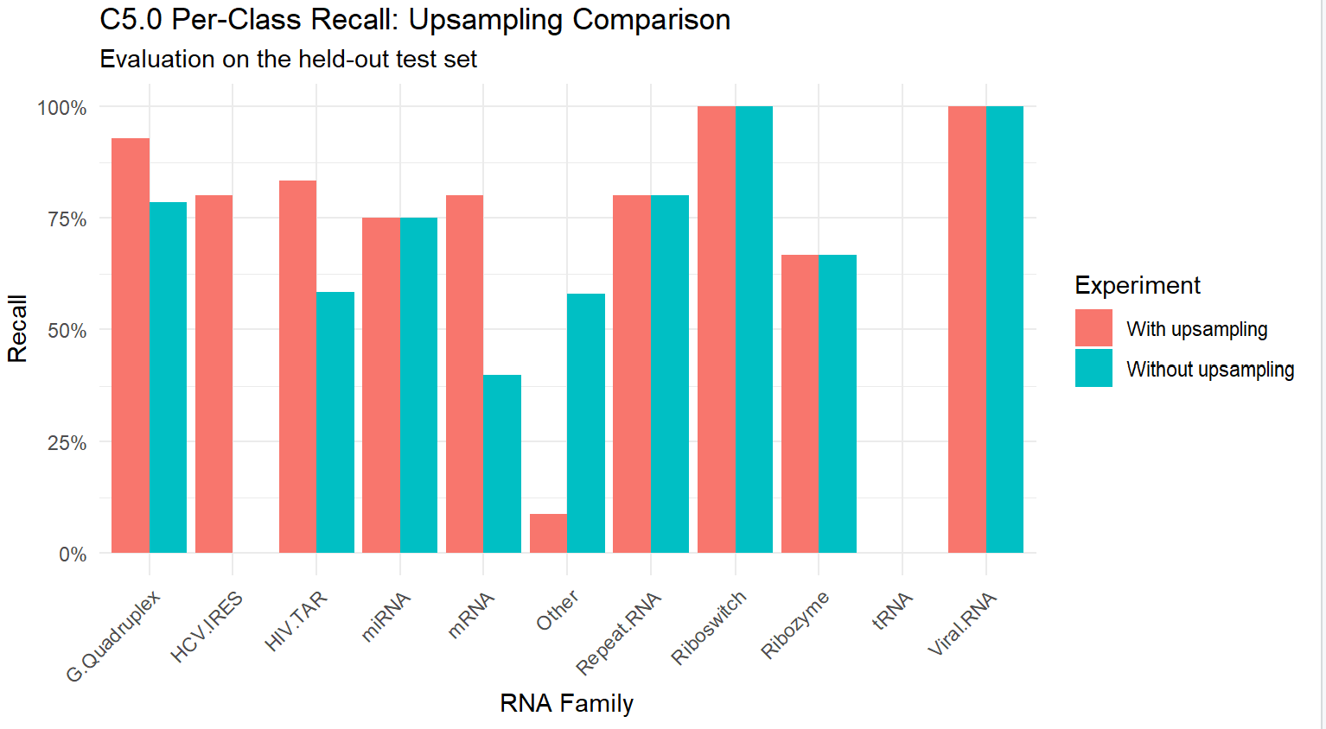
Class Imbalance: Experiment & Key Results
Upsampling improves some class-recognition rates, but introduces a clear trade-off
Method: upsampling was applied inside cross-validation training folds; the held-out test set retained its original class distribution.
Models: Random Forest, Gradient Boosting (GBM), C5.0, KNN and Multinomial Logistic Regression.
Cross-validation accuracy changed little for most models; it decreased slightly for GBM and was nearly unchanged for C5.0.
C5.0 test accuracy: 62.8% without upsampling → 52.4% with upsampling.
C5.0 macro recall: 59.7% without upsampling → 69.7% with upsampling.
Improved C5.0 recall: HCV.IRES 0% → 80%; HIV.TAR 58.3% → 83.3%; mRNA 40% → 80%.
Remaining weakness: “Other” recall fell to 8.8%; tRNA recall remained 0%.
Conclusion: Upsampling is not universally better.

Slide 5
Implementation of 10–15 ML/DL algorithms
13 successful classifiers were benchmarked; XGBoost was attempted separately.
# | Algorithm | CV | Test | Tier
1 | Random Forest | 57.2% | 61.4% | 1
2 | Gradient Boosting (GBM) | 57.0% | 62.1% | 1
3 | Bagged CART | 56.0% | 59.3% | 1
4 | Neural Network (nnet) | 55.3% | 59.3% | 1
5 | Decision Tree (C5.0) | 54.5% | 62.8% | 1
6 | K-Nearest Neighbors | 53.5% | 57.9% | 2
7 | Decision Tree (CART) | 49.7% | 46.9% | 2
8 | Regularized Multinomial (glmnet) | 49.0% | 46.9% | 2
9 | Multinomial Logistic Regression | 48.9% | 51.0% | 2
10 | Linear Discriminant Analysis | 46.2% | 51.0% | 2
11 | Naive Bayes | 41.7% | 42.8% | 3
12 | SVM (Radial) | 38.7% | 39.3% | 3
13 | SVM (Linear) | 36.1% | 37.2% | 3

Slide 6
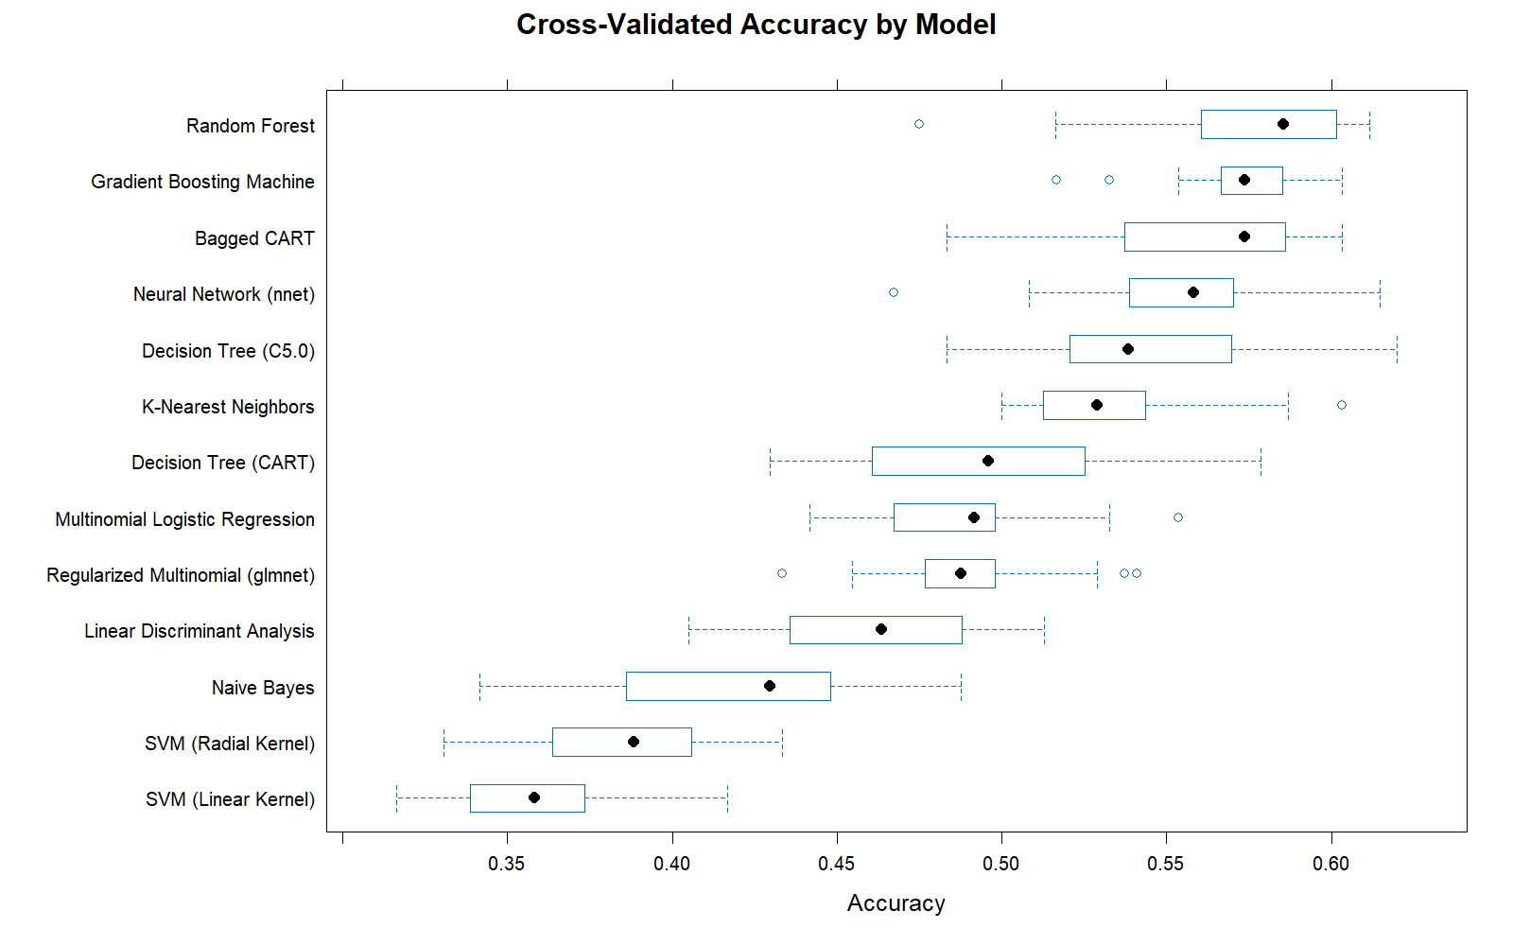
Cross-validation — primary model-selection result
Repeated CV is the more reliable basis for ranking.
Random Forest leads CV at 57.2%; GBM follows at 57.0%.
Bagged CART, Neural Network, C5.0 and KNN also belong to Tier 1.
No Tier 1 pair is statistically distinguishable after adjustment.
GBM is the most stable top model (IQR ≈ 1.9 points).
Fold-to-fold swings of roughly 9–15 points exceed many small rank gaps.

Slide 7
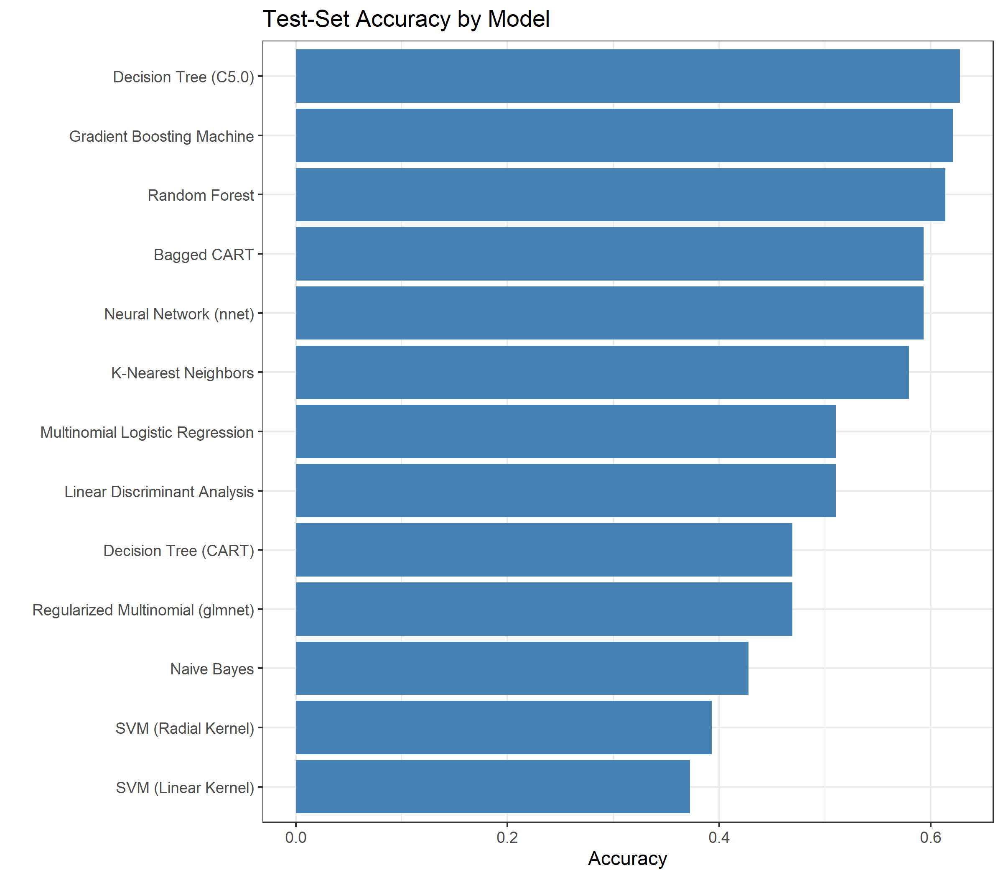
Test-set performance & comparative metrics
C5.0 leads the held-out test set, but the gap is small in molecule count.
62.8%
Highest test accuracy
C5.0
62.1%
GBM
≈90 correct
61.4%
Random Forest
≈89 correct
C5.0, GBM and RF differ by only about 1–2 test molecules.
C5.0's +8.2-point CV-to-test jump is unusually large; the deeper analysis treats this as likely sampling luck.

Slide 8
Comparative performance — Kappa, macro recall & tiers
Accuracy is interpreted together with agreement and minority-class recovery.
6 models
Tier 1
RF, GBM, Bagged CART, NN, C5.0, KNN
4 models
Tier 2
CART, glmnet, MLR, LDA
3 models
Tier 3
Naive Bayes, SVM-R, SVM-L
RF: 61.4% test, Kappa 0.516, macro recall 0.514.
GBM: 62.1% test, Kappa 0.516, macro recall 0.572.
C5.0: 62.8% test, Kappa 0.527, macro recall 0.597.
Naive Bayes: 42.8% accuracy but 0.551 macro recall, showing minority-recovery trade-off.
SVMs sit close to the always-“Other” baseline at ~37–39% test accuracy.

Slide 9
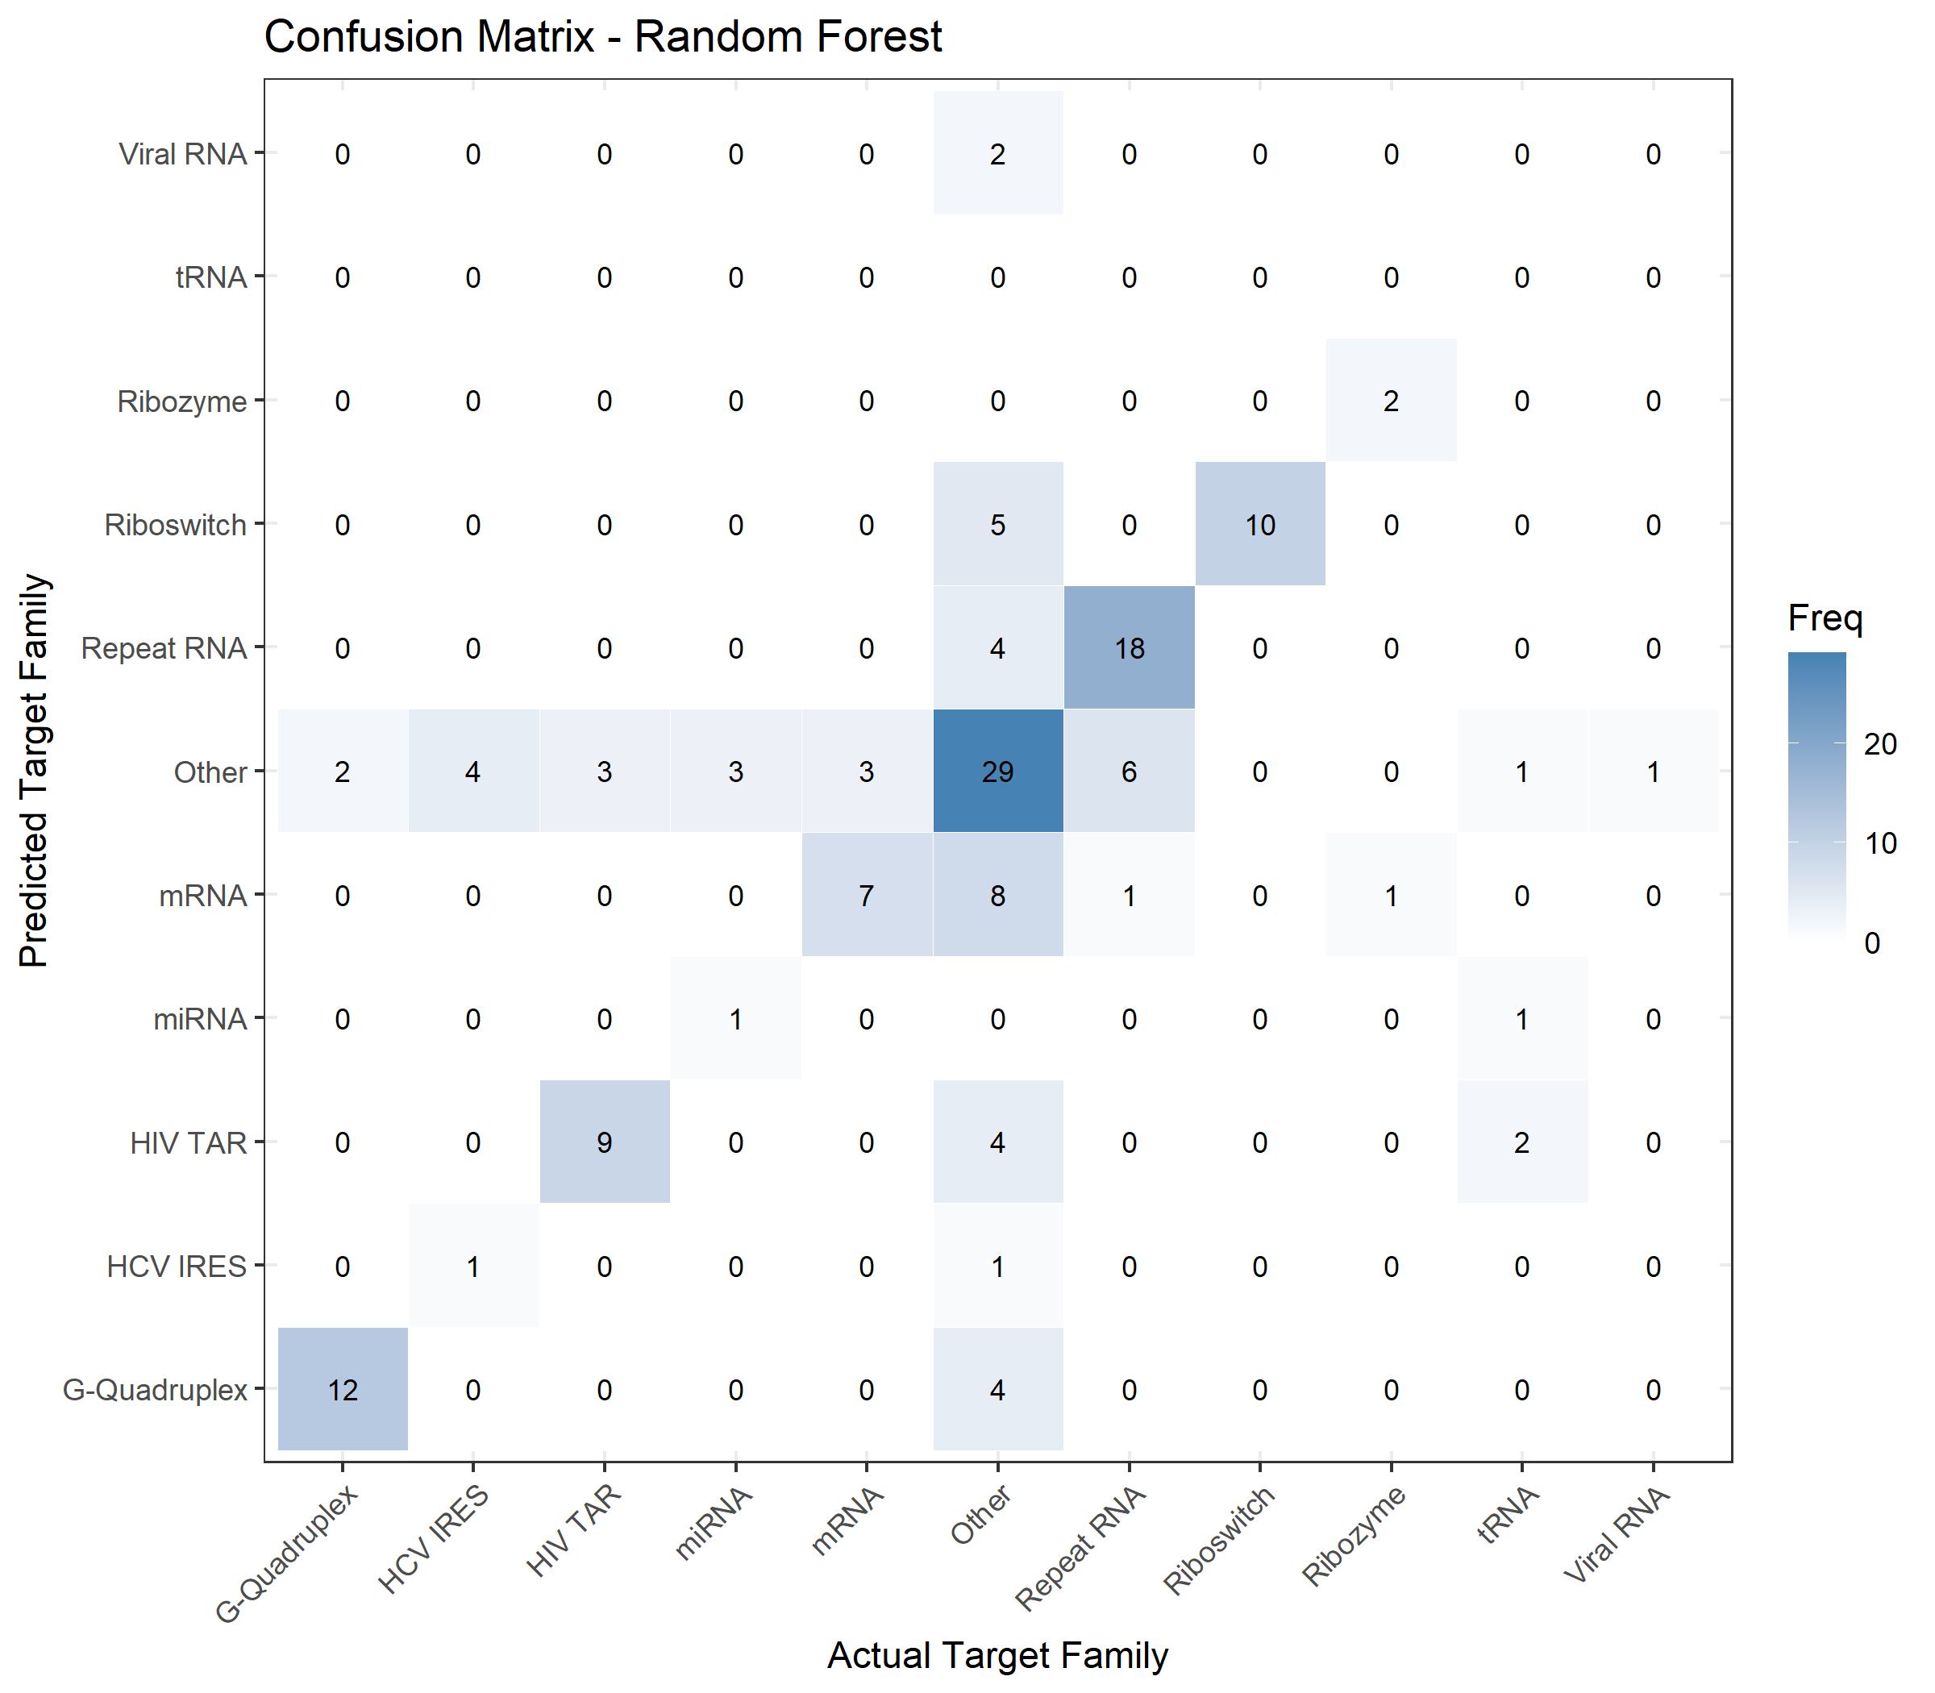
Comparative visualization — Random Forest confusion matrix
One representative confusion matrix keeps the presentation readable while demonstrating class-level behaviour.
Best HIV TAR recovery among the four detailed models: 9 correct.
Best mRNA recovery among the four: 7 correct.
Matches C5.0 on Riboswitch (10) and G-Quadruplex (12).
Viral RNA is missed completely; HCV IRES and tRNA remain very difficult.
The model is stronger on common classes than rare minority families.

Slide 10
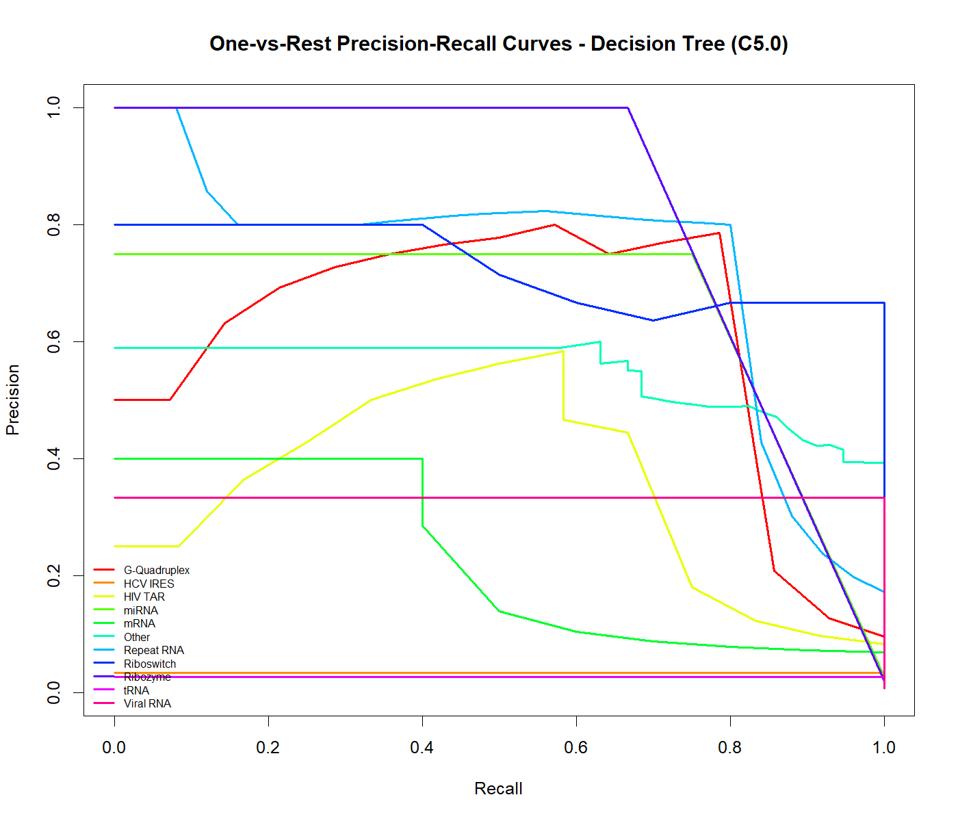
Comparative visualization — precision–recall
C5.0 has useful discrimination for some families, but rare classes remain difficult.
Riboswitch and Repeat RNA maintain relatively high precision over useful recall ranges.
G-Quadruplex reaches high precision at moderate recall, then drops.
HCV IRES, tRNA and mRNA remain near the bottom of the plot.
Tiny-class curves become step-like because there are very few positive examples.
This supports reporting per-class recall alongside overall accuracy.

Slide 11
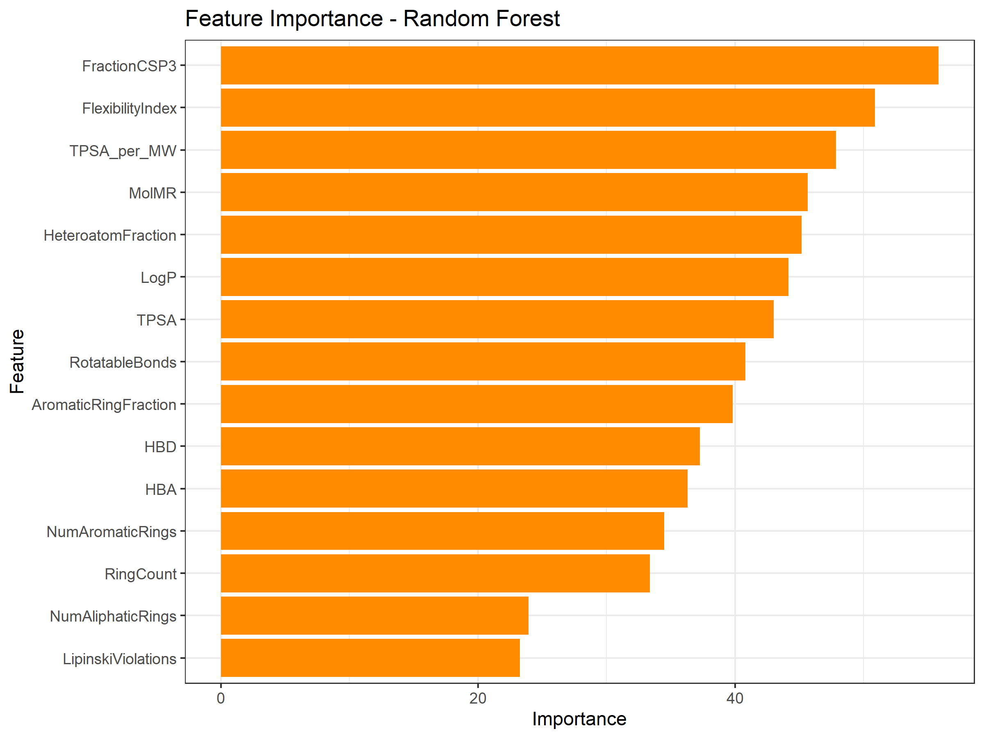
Feature importance — what drives the models?
Feature importance complements the statistical descriptor analysis.
FractionC_{sp3}
Top RF features
then FlexibilityIndex, TPSA_per_MW and MolMR
RF spreads importance across multiple descriptors.
C5.0 is dominated by TPSA, showing that different algorithms exploit the same space differently.
Kruskal–Wallis ranking vs model importance has Spearman ρ ≈ 0.004 — effectively no agreement.
Feature selection should therefore consider multivariate predictive value, not only individual statistical significance.

Slide 12
Hyperparameter tuning & optimization
Tuning changes are small compared with natural cross-validation variability.
57.18%
RF tuned CV
reported benchmark
57.02%
GBM tuned CV
reported benchmark
−0.2 to +0.7 pts
Tuning effect
small vs fold variation
Tuning changes are roughly 4–10× smaller than fold-to-fold standard deviation.
Random Forest's untuned baseline was slightly higher than its tuned score.
This suggests the current ceiling is driven more by feature information than by parameter settings.
Next optimization should target imbalance, validation quality and richer representations.

Slide 13
Conclusion
Final interpretation of the model benchmark and what it means for the project
57.2%
Best cross-validated model
Random Forest • most reliable overall ranking
62.8%
Highest held-out accuracy
C5.0 • 91/≈145 test molecules
6 models
Statistically supported top group
RF, GBM, Bagged CART, NN, C5.0 and KNN
WHAT WE ESTABLISHED
LIMITATIONS
RNA family classification is feasible from the current molecular descriptor set, but performance is moderate rather than near-perfect.
Random Forest and GBM are the most consistent choices across cross-validation and the held-out test set.
C5.0 obtains the highest test accuracy, but its 54.5% CV score and +8.2-point CV-to-test jump make the lead less convincing.
Pairwise CV testing places six models in Tier 1; no Tier-1 pair is statistically distinguishable after adjustment.
Feature-space analysis shows substantial family overlap and only about four effective dimensions, suggesting a representation ceiling.
Class imbalance causes minority families to be absorbed into “Other.”
Very small classes make some per-class AUC estimates unstable.
The supplied macro-F1 output is internally inconsistent and should not be used for ranking until the metric calculation is fixed.
XGBoost failed during training and therefore cannot yet be fairly compared.
RECOMMENDE NEXT STAGE

