Slide 1


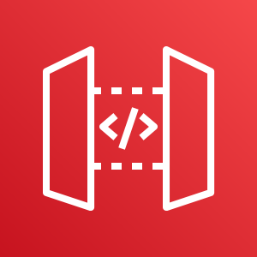
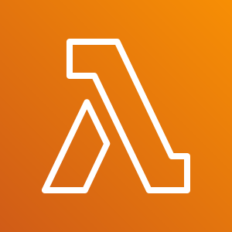
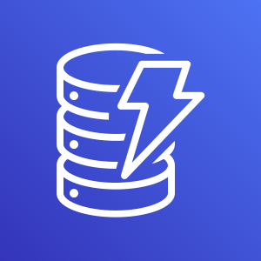



AWS Application Setup Level 101
Random User Generator
AWS Cloud
IAM
Allow Lambda Invoke
Allow Write Access to DynamoDB
API Gateway
DynamoDB
proxy
put_item (username)
get_item (username)
* Get Random User
* Save Records To DynamoDB
Application to create a random user and store it in DynamoDB and return the username to later retrieve the user details
Randomuser.me
API Gateway URL
Client

Slide 2

AWS Application Setup Level 102
App theme? Asynch
AWS Cloud
IAM
Allow SQS Invoke
Allow Write Access to DynamoDB
API Gateway
DynamoDB
SQS event
put_item (username)
get_item (username)
SQS
Randomuser.me
API Gateway URL
Client

Slide 3




AWS Application Load Balancer / Auto Scale Group
AWS Cloud
CDK to create AWS resources
Start with 2 WebServers, Max 5
Stop 1 – watch it restart
Create load and watch WebServers get added
Application VPC
Auto Scaling group
Amazon EC2
WebServers
Client
Internet
Application load balancer
Load Generation
Script

Slide 4


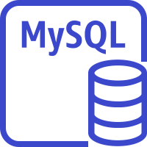



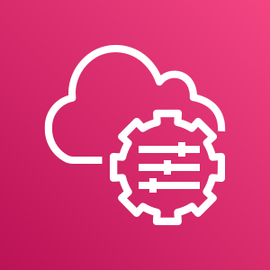
AWS Application Setup Level 103
Application Theme?
AWS Cloud
Application VPC
Only designated security groups have ingress permission
ObjCreate
Event
Lambda
Security group
Isolated subnet
Lambda
Trigger
Bucket
Read File
select/insert
Save Records
To RDS
Public subnet
tunnel
RDS DB Password
Bastion
Security group
AWS Secrets Manager
IAM
Bastion
AWS KMS key
AWS Systems Manager
Specific ip address
RDS Tunnel
Database
IDE

Slide 5



AWS Networking
AWS Cloud
Application VPC
Availability Zone 2
Availability Zone 1
Isolated subnet
Public subnet
Security group
Security group
Client
Internet
Internet gateway
Load Generation
Script
Router
Router
Endpoints
Amazon Simple Storage Service
Notes:
Create a VPC with a Public and Private subnet. Create an EC2 in each of the Subnets. The public EC2 should allow for SSH and inbound http traffic on 8000. We will create a python web server to serve a page.
The private subnet should create a security group that only allows the security group of the public subnet to ssh.
Create a VPCEndpoint for the private subnet to it can access S3. Since the private subnet has no access to internet, it has to use VPCEndpoint.
On EC2 in private subnet try:
Ping google.com
Should fail because there is no access to the internet
Aws s3 ls
Should work because of the VPCEndpoint and the route table entry send S3 traffic on the AWS backbone, not on internet.

