Slide 1


Predicting Heart Disease: Using AI and Machine Learning Algorithms
Name: Preetham John
NAU ID: 006060133
Email: pj323@nau.Edu
Northern Arizona University

Slide 2
Introduction
Artificial Intelligence (A.I.) is influencing mankind on a whole new different level. And one such field that intrigues me the most is the Medicine. AI in simple terms mean making a machine think and respond rationally. These days we have huge amounts of data and the size of these datasets are in billions so working manually on these and getting the required output is a challenging task. However, Automation has made our life easier. The Heart is an organ about the size of your fist, and it is one the most important organ in our body and it carries out one of the main functions necessary for life. It pumps blood to every part of our anatomy, And If it fails to function correctly, then the brain and various other organs will stop working, and within few minutes, the person will die. Heart diseases are considered as one of the most risky and prominent cause of death all around the world. There are many causes for a person get into this medical situation work related stress and bad food habits contribute to the increase in rate of several heart related diseases

Slide 3
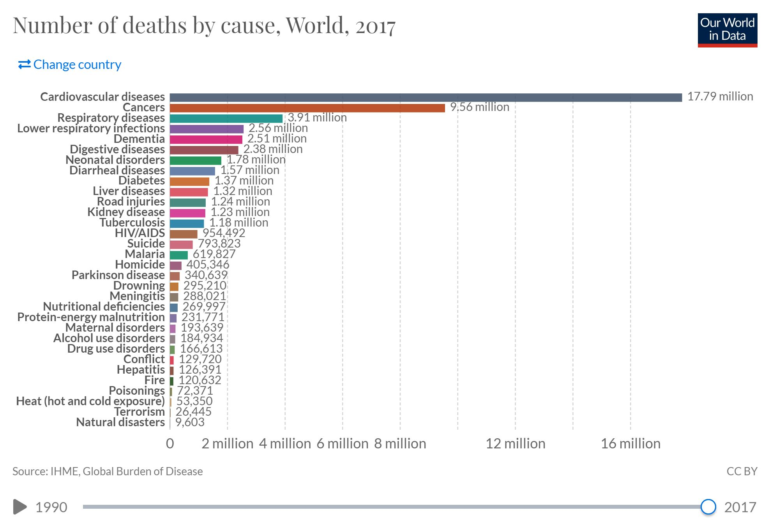
Real World Statistics
According to World Health Organization (WHO) Cardiovascular diseases (CVDs) are the number 1 cause of death globally, taking an estimated 17.9 million lives each year. CVDs are a group of disorders of the heart and blood vessels and include coronary heart disease, cerebrovascular disease, rheumatic heart disease and other conditions. Four out of 5CVD deaths are due to heart attacks and strokes, and one third of these deaths occur prematurely in people under 70 years of age.

Slide 4
Problem Statement
There are a lot of difficulties in the field of medical as we see through the world from a different perspective. If this research is made available to all we can save a lot of lives . Some of the important problems are listed below.
These days the expenses of medical facilities is extremely high all over the world. Families with low income must suffer a lot with this kind of situations.
We also need to understand the there will be some human errors at hospitals due to some issues but with proper algorithms we can make sure that they are fixed and can help us all.

Slide 5
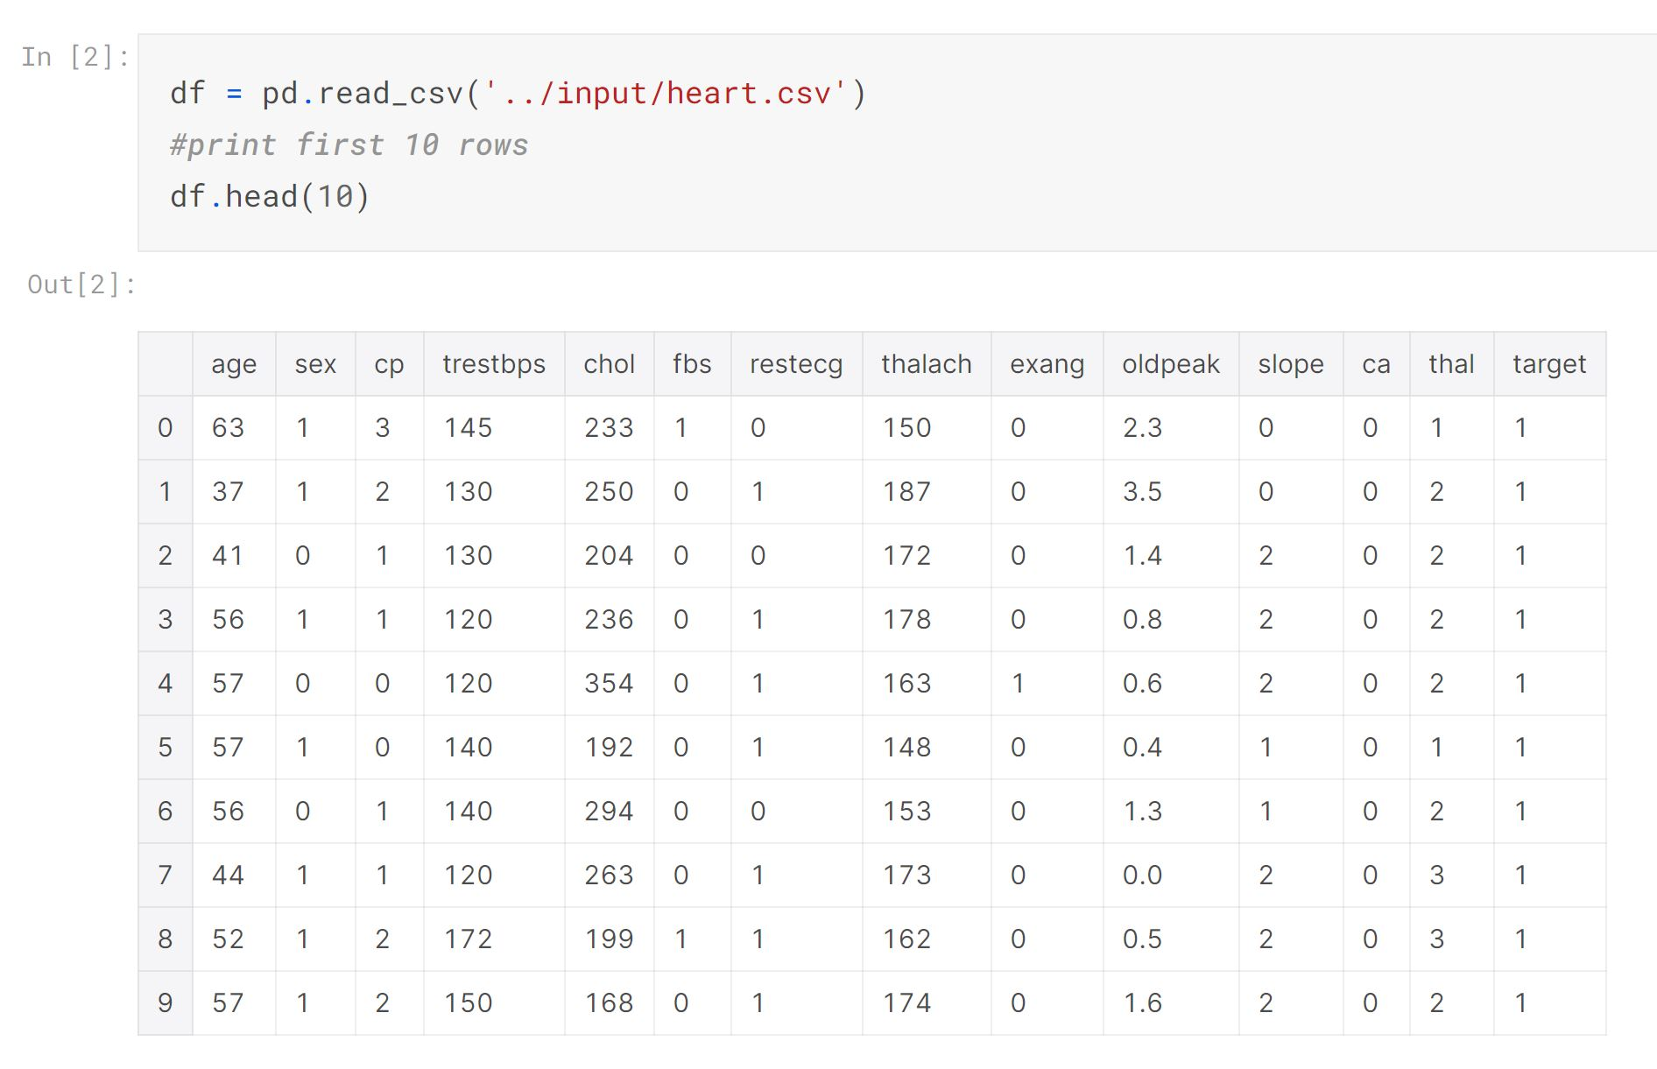
Data looks like this
age - age in years
sex - (1 = male; 0 = female)
cp - chest pain type
trestbps - resting blood pressure
chol - serum cholestoral in mg/dl
fbs - (fasting blood sugar > 120 mg/dl) (1 = true; 0 = false)
Enlarged heart's main pumping chamber
thalach - maximum heart rate achieved
exang - exercise induced angina (1 = yes; 0 = no).

Slide 6
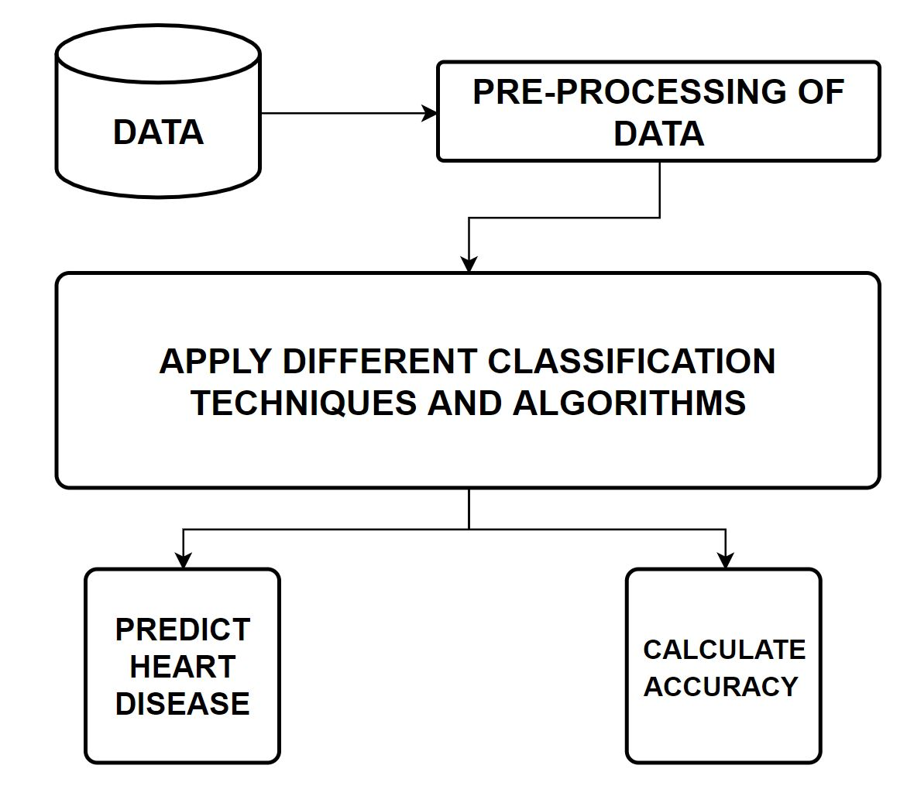
Solution / Algorithms and Techniques Used
The project will be running various algorithms on the dataset provided and most of it will include all the machine learning techniques. Based on the data given we will be deriving the required output. Figure represents as of how the sample model of the research or the project will help us arrive at the solution.

Slide 7
Review and Implementation
Ramalingam, V. (2018). Heart disease prediction using machine learning techniques: A survey. Emitter: International Journal of Engineering Technology., 7(2.8), 684.
Datasets in a perfect world is a flawlessly curated group of observations with no missing values or irregularities. However, this is not true. It can be disordered, which means it needs to be clean and wrangles. Data cleaning is a essential part in data science problems. Machine learning models learn from data .
And the Other drawback of this research is that there are some ways where the input data can be fixed and preprocessed in a better way so that we can see more accuracy and more implementation.
Techniques | Accuracy
Decision tree | 78%
KNN | 81%
Logistic regression | Results were ok can be improved
Support Vector Machine | Working on it expected to perform well

Slide 8
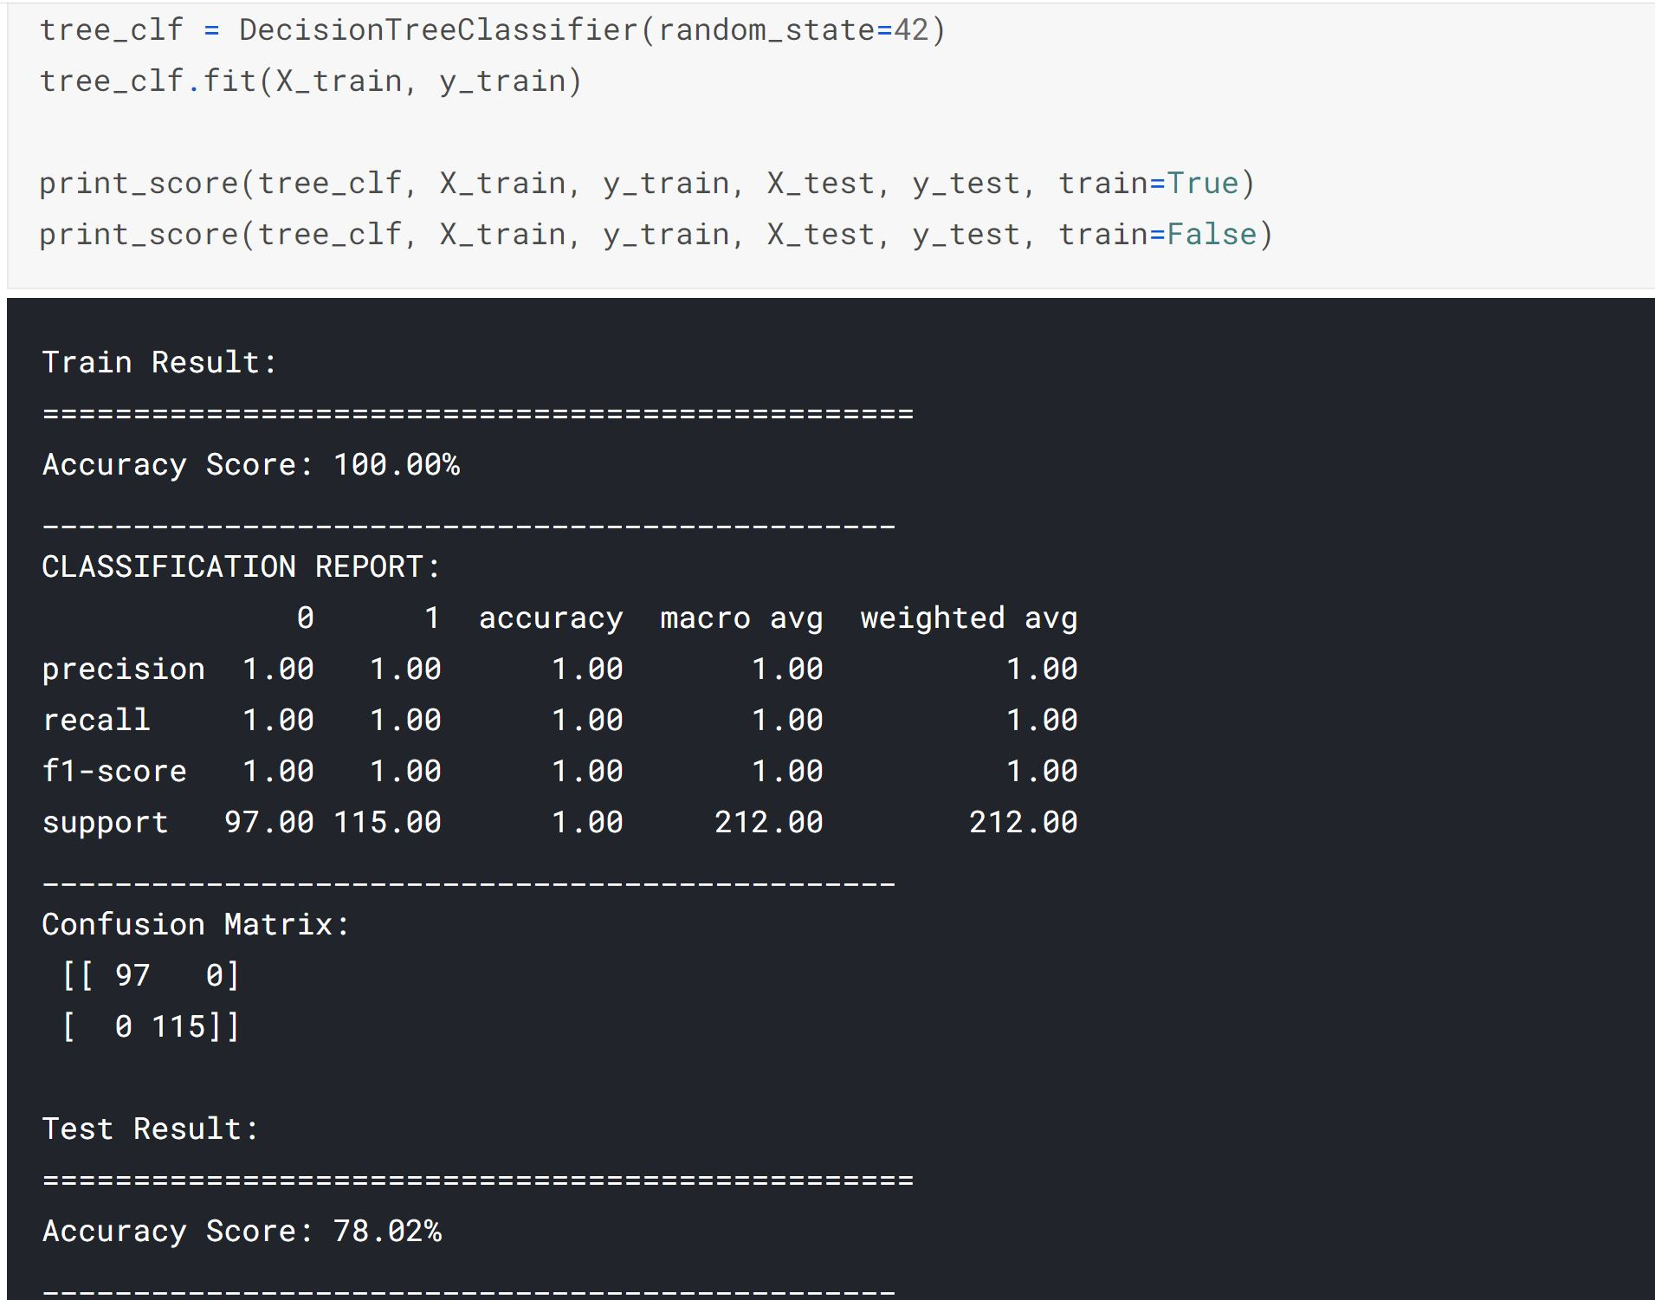
Sample Output of the pre-work

Slide 9
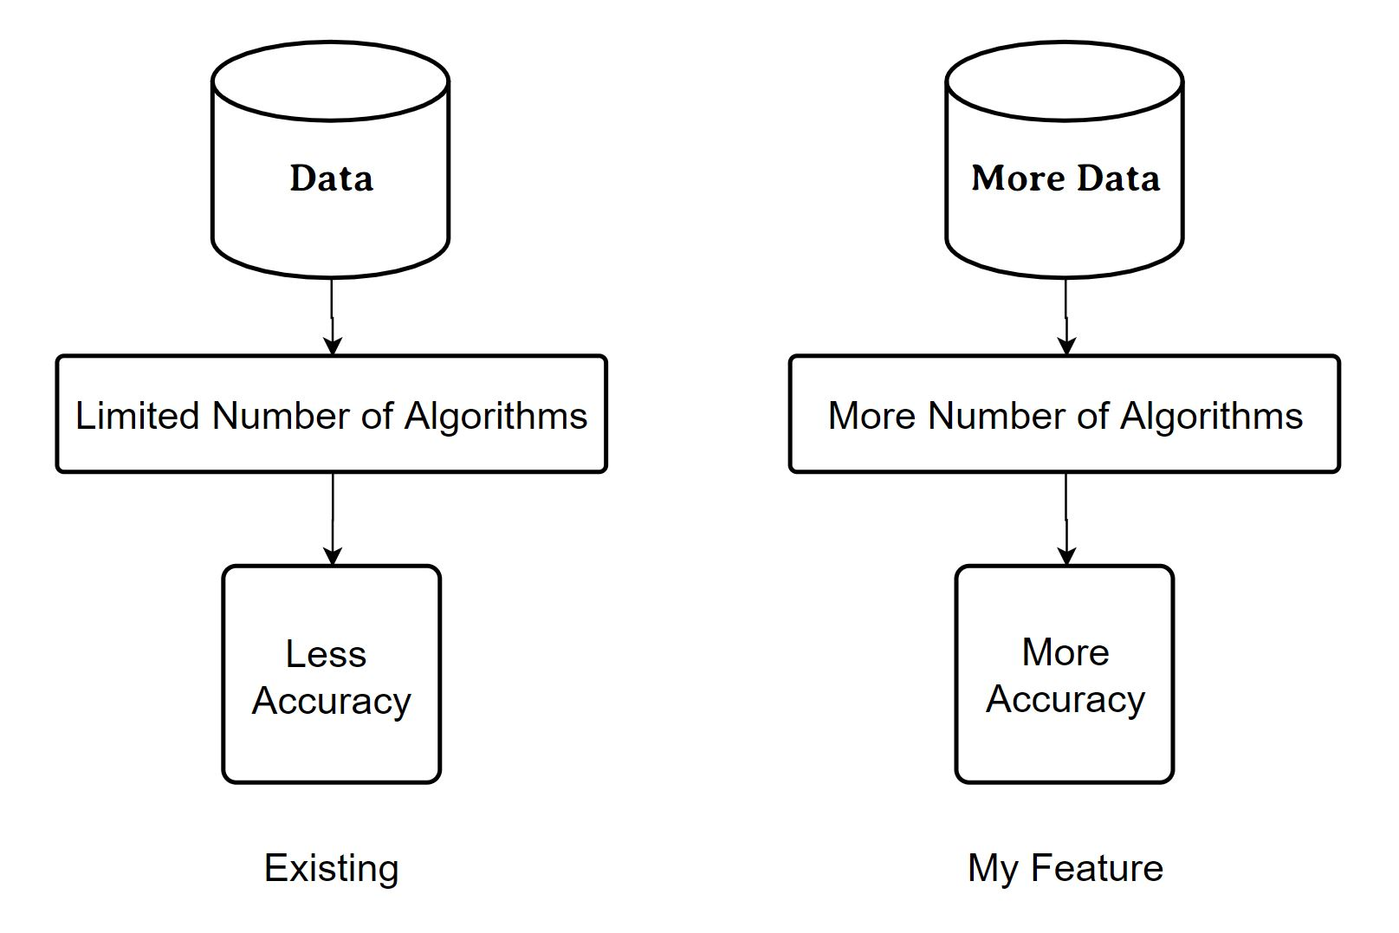
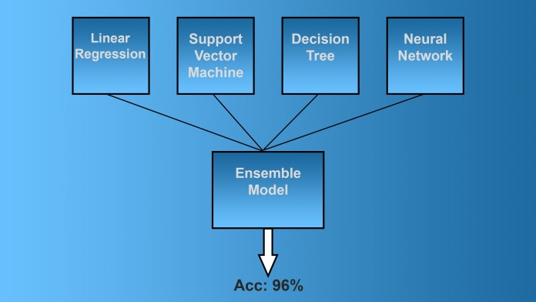
New Feature Implementation
I will be trying to create an Ensemble Model which can give an accuracy of more than 90%, In ensemble modeling two or more related but different analytical models are used and produce their results are combined into a single score.
Logistic Regression
K-Nearest Neighbors Classifier
Support Vector machine
Decision Tree Classifier
Random Forest Classifier
XGBoost Classifier

Slide 10
Conclusion
Classification algorithms are used to predict small set of relations between attributes in the databases to build a correct classifier. The main contribution of the present study to attain high calculation accuracy for early diagnoses of heart diseases. The proposed hybrid associative classification is implemented on spicy environment. Finally, a skilled system is developed for the end user to check the risk of heart diseases on the basis of assumed parameters and the best associative classification method. The experimental results show that large number of the rules support to the better determines of heart diseases that even support the heart professional in their diagnosis in decisions .

Slide 11
Thank You

