Slide 1
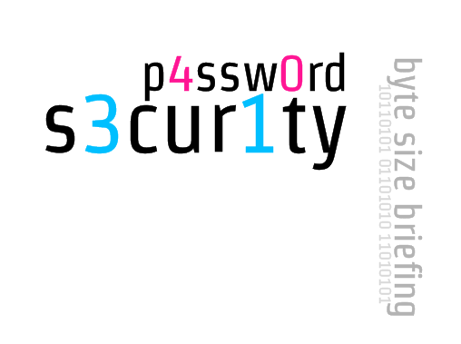

Slide 2
AGENDA
* big leaks
* access control
* password storage
* cryptographic hash functions
* attacks
* password strength factors
* passwords managers
* guidelines

Slide 3

TL/DR

Slide 4
TL/DR USER
* generate random passwords
* do not reuse
* use password manager
* backup your passwords (offline/offsite)
* use memorable passphrases

Slide 5
TL/DR PROGRAMMER
* use bcrypt, scrypt or pbkdf2 hash functions
* use dynamic salts
* require sufficient password complexity
* do not enforce very strict patterns
* do not implement anything yourself

Slide 6
BIG LEAKS

Slide 7
BIG LEAKS
* RockYou (2009), 32mln, plain text
* game changer in password cracking
* breach revealed the way people think

Slide 8
BIG LEAKS
* Gawker (2010), 1.3mln, encrypted DES
* Twitter accounts compromised due to password reuse
* top 5 passwords
* 123456, password, 12345678, lifehack, qwerty

Slide 9
BIG LEAKS
* Sony (2011), 1mln, plain text
* a lot of repetition between Sony and Yahoo dumps published next year

Slide 10
BIG LEAKS
* LinkedIn (2012), 8mln, unsalted SHA1
* SHA1 is slightly slower than MD5

Slide 11
BIG LEAKS
* Adobe (2013), 152mln, encrypted 3DES/ECB
* hints in plain text
* the greatest crossword puzzle in the history of the world (XKCD)

Slide 12
HAVE I BEEN PWNED?
haveibeenpwned.com

Slide 13
ROCKYOU ANALYSIS
* passwords are short, mostly 6-10 characters
* capital letters mostly come at the beginning of a password
* numbers and punctuation mostly show up at the end
* strong tendency to use first names followed by years

Slide 14
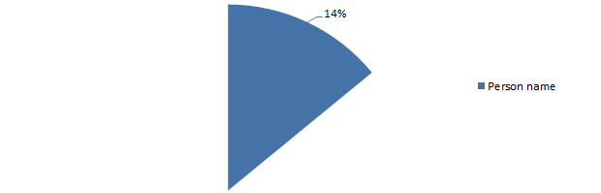
LULZSEC RELEASES 2011
* 14% personal name

Slide 15
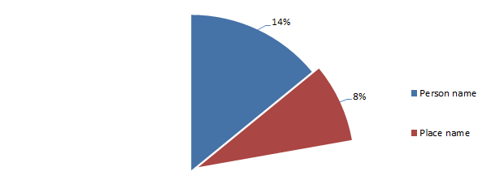
LULZSEC RELEASES 2011
* 8% place name

Slide 16
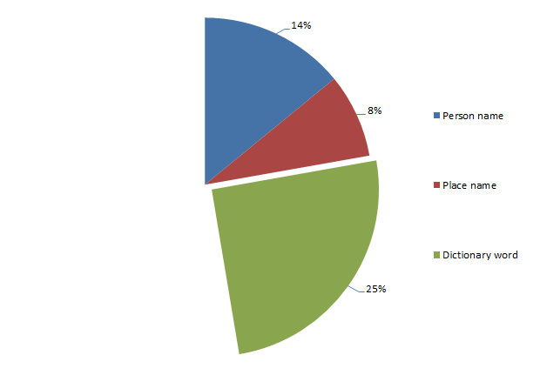
LULZSEC RELEASES 2011
* 25% dictionary word

Slide 17
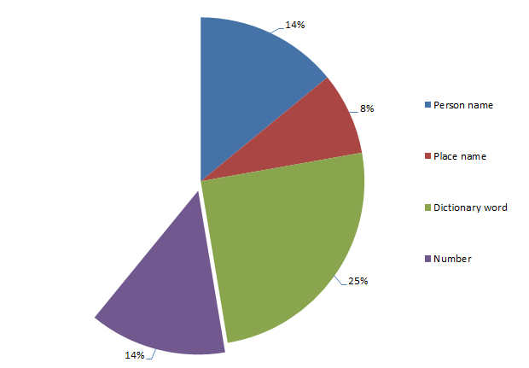
LULZSEC RELEASES 2011
* 14% purely numeric

Slide 18
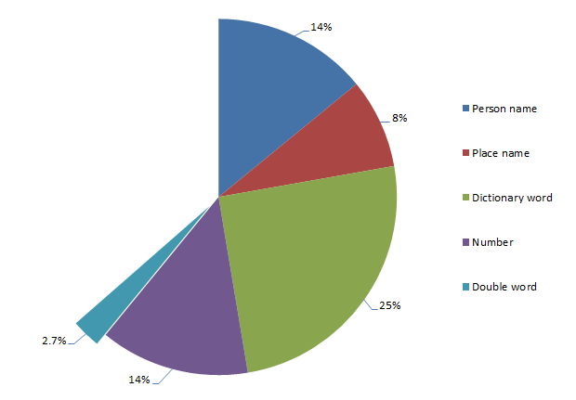
LULZSEC RELEASES 2011
* 2.7% double word

Slide 19
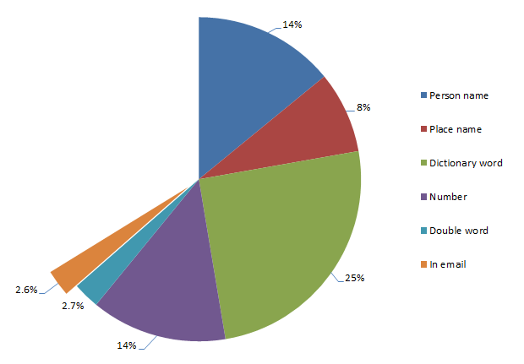
LULZSEC RELEASES 2011
* 2.6% in email

Slide 20

LULZSEC RELEASES 2011
* 1.3% short phrase

Slide 21
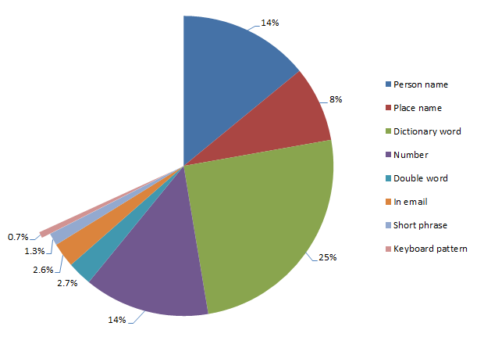
LULZSEC RELEASES 2011
* 0.7% keyboard pattern

Slide 22
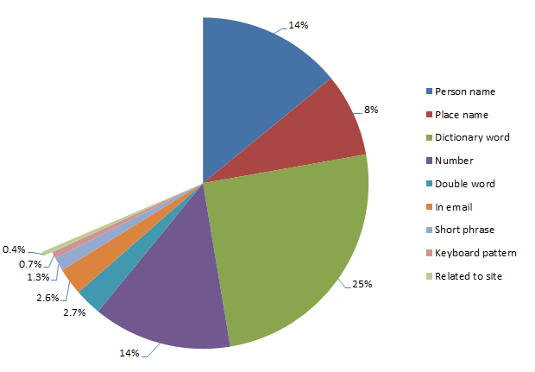
LULZSEC RELEASES 2011
* 0.4% site related

Slide 23
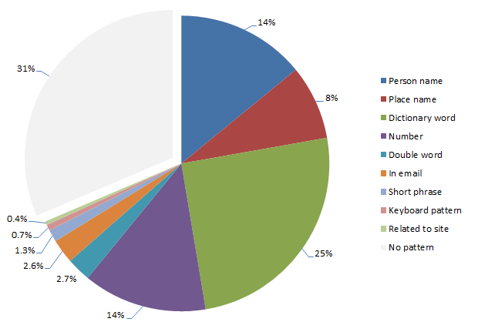
LULZSEC RELEASES 2011
* 31% unknown or no pattern

Slide 24
TOP 25 PASSWORDS 2013
123456
password
12345678
qwerty
abc123
123456789
111111
1234567
iloveyou
adobe123
123123
Admin
1234567890
letmein
photoshop
1234
monkey
shadow
sunshine
12345
password1
princess
azerty
trustno1
000000

Slide 25
ACCESS CONTROL

Slide 26
ACCESS CONTROL
* identification - who you are
* authentication - something you know/have/are
* authorization - what you can do

Slide 27
SOMETHING YOU KNOW
* static password
* PIN
* pattern (mobile phone)

Slide 28
SOMETHING YOU HAVE
* dynamic password list
* RSA token
* proximity card

Slide 29
SOMETHING YOU ARE
* biometrix
* fingerprint
* retina scan

Slide 30
MULTI-FACTOR AUTH
* authentication is critical
* improves safety
* involves various groups
* difficult to compromise both factors
* static password & PIN sent by text

Slide 31
MULTI VERIFICATION
* similar concept, but significantly weaker
* involves one group
* email accessed via phone
* PIN sent by text to the same device

Slide 32
PASSWORDS PROS
* cheap, text fields, keyboard, hashing
* simple, everybody knows how to use keyboard

Slide 33
PASSWORDS CONS
* short, characteristic string
* can be intercepted when sent over net (mitm, heartbleed)
* once stolen and changed, legitimate user might loose access

Slide 34
PASSWORD STORAGE

Slide 35
PASSWORD STORAGE
* plain text, flawless victory
* encrypted, plains will leak if private key is compromised, one to rule them all
* salted hashes, the only secure way

Slide 36
HASH FUNCTIONS

Slide 37
HASH FUNCTIONS
* not every hash function is secure
* cryptographic hash functions have to meet strict requirements

Slide 38
HASH FUNCTIONS
* one way function
* collision resistant
* provide high variability

Slide 39
ONE WAY FUNCTION
* easy to compute on every input, hard to invert output
* very difficult to compute original message (crack hash)

Slide 40
COLLISION RESISTANT
* difficult to find two distinct inputs resulting in the same hash
* difficult to access one's account with different password
* collisions happen because inputs are compressed to short bit sequence

Slide 41
HIGH VARIABILITY
* very different outputs for similar inputs
* difficult to reveal any characteristics of password
"password" | 286755fad04869ca523320acce0dc6a4
"password1" | 10b222970537b97919db36ec757370d2

Slide 42
ISSUE: GUESSING
* key stretching
* slow down computations (guesses/second)
* increase memory requirements

Slide 43
ISSUE: RAINBOW TABLES
* key stretching
* multiple level RT required
* dynamic salts
* required separate RT for each salt

Slide 44
ISSUE: COLLISIONS
* longer digest means smaller risk of collision
* normally this is not big issue

Slide 45
SALTS
* random data used as an additional input
* make pre-computed attacks ineffective
* prevent from Google hacking
* same passwords produce different hashes
* cracker will have to attack one hash at the time
* does not need to be secret

Slide 46
KEY STRETCHING
* improves security
* adds time and/or memory complexity
* additional iterations of hash function
* additional memory requirements
* makes RT ineffective and slows down BF
* secure hash functions with key stretching

Slide 47
HASH FUNCTIONS
* MD5
* SHA family
* BCrypt
* PBKDF2
* SCrypt

Slide 48
MD5
* very fast!
* general purpose function designed to hash gigabytes of data
* not designed to hash passwords
* known collisions attacks (binary data)

Slide 49
SHA/SHA2/SHA3
* very fast!
* general purpose function designed to hash gigabytes of data
* not designed to hash passwords
* known collisions attacks (binary data)

Slide 50
BCRYPT
* designed to store static passwords
* requires salt which is built into algorithm
* configurable key stretching (work factor)
* work factor determines computation complexity
* WF +1 doubles time required to compute hash

Slide 51
PBKDF2
* provides similar level of security as BCrypt
* used to secure WiFi (WPA2 standard)
* SSID is salt, pre-computed RT exists
* change default SSID if not randomized
* sample: 3com, NETGEAR, ZyXEL, linksys

Slide 52
SCRYPT
* the latest and most secure hash function
* works on binary data as well
* advanced key stretching with configurable
* computation complexity
* memory requirements

Slide 53
ATTACKS

Slide 54
EASIER THAN EVER
* attacking hashes is easier than ever
* cheap and fast hardware (GPUs), cloud computing
* modern and advanced tools are available
* massive leaks revealed real life passwords and allow to tune rules and understand people

Slide 55
TWO KINDS OF ATTACK
* online attack against live system and infrastructure
* offline, cryptographic attack against hashed passwords once database was compromised

Slide 56
ONLINE ATTACK

Slide 57
ONLINE ATTACK
* require careful planning and precision
* targeted attacks against selected accounts: root, admin, administrator
* effective against poorly secured accounts
* password == login/email/blank/default
* compact and/or personalized dictionaries

Slide 58
PHASES OF ATTACK
* collecting information
* discovering limitations
* preparing dictionaries and tools

Slide 59
DISCOVER LIMITATIONS
* password complexity requirements
* username policy
* account lockout
* captchas
* WAF, IPS/IDS, filtering, throttling

Slide 60
OFFLINE ATTACK

Slide 61
OFFLINE ATTACK
* cryptographic attack against hashes
* phases of attack
* search existing hash databases
* prepare dictionaries, rainbow tables and tools
* perform various attacks (many rounds)

Slide 62
MAIN TYPES OF ATTACK
* bruteforce
* dictionary
* hybrid
* rule based
* rainbow tables

Slide 63
BRUTEFORCE
* exhaustive, tests every combination
* it will find every password in theory
* in practice it is used in very narrow ranges
* time consuming

Slide 64
BRUTEFORCE
* effective against short passwords (up to 10 characters)
* ineffective against long passwords
* example
* a, aa, ab, ac... zzzzzz

Slide 65
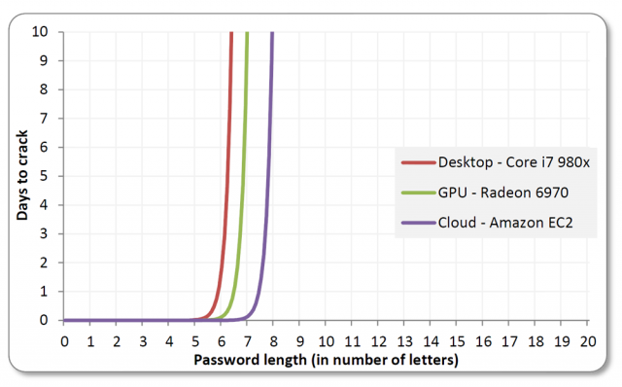
EXPOTENTIAL WALL OF BF

Slide 66
DICTIONARY
* tests all words from list called a dictionary
* does not guarantee success
* dictionary is a key, common words, names, places, dates...
* good dictionary can break 50-60% of the weakest passwords straight away

Slide 67
DICTIONARY
* attackers often use at least two dictionaries
* primary and extended
* personalized dictionaries are extremely effective against mortals

Slide 68
DICTIONARY
* ineffective against random passwords
* example
monkey, tree, car, cat, password1

Slide 69
PRIMARY
* compact and related to target
* all leaks available on the Internet
* already cracked passwords
* common word lists
* quick tests, rule based and hybrid attacks

Slide 70
EXTENDED
* content of primary dictionary
* every word you can imagine
* multiple languages
* programming languages syntax
* combination of many smaller dictionaries
* scrapped wikipedia, github, code.google

Slide 71
GIT DIGGER
* used to scrap entire github to build dictionary
* similar tools used to scrap
* wikipedia
* code.google

Slide 72
PRIMARY OBJECTIVES
* passwords, usernames, emails
* common files and directories (forced browsing)
* images to perform OCR (some people store secrets in images)
* static code analysis for vulnerabilities

Slide 73
EXTRAS
* a lot of static salts
* SSH auth keys
* .gitignore and .svn
* various hardcoded tokens (ex. csrf)

Slide 74
CUPP
* common user passwords profiler
* creates personalized dictionaries used against specific person
* extremely effective against careless mortals

Slide 75
CUPP INPUT
* name, surname, nicknames
* friends, family members
* dates, phone numbers
* keywords related to hobby, work, site
* it can generate enormous lists of passwords

Slide 76
HYBRID
* combines
* effectiveness of bruteforce
* precision of dictionary attack
* tests only variations of common passwords

Slide 77
HYBRID
* ineffective against random passwords
* example
* johnabc, john1, john2, john123, john2000

Slide 78
RULE BASED
* similar to regexp rules
* fast, can be executed by GPUs
* adding characters, digits, replacing letters, leetspeak rule

Slide 79
RULE BASED
* ineffective against random passwords
* example
* p4ssw0rd1, P4ssw0rd1, passabcd, password!

Slide 80
RAINBOW TABLES
* speed up cracking process
* time-memory trade-off
* precomputed table of hash chains
* first hash & last plain
* which resolves into millions of other pairs
* no need to compute hashes

Slide 81
RAINBOW TABLES
* do not contain all plains/hashes
* success rate is >96%
* ineffective against
* hashes with dynamic salts
* simple key stretching (hashing many times)

Slide 82
RAINBOW TABLES
* regular (hash->plain) lookup table
4 chars 35,153,041 913 MB
5 chars 2,706,784,157 70 GB
6 chars 208,422,380,089 5.4 TB
7 chars 16,048,523,266,853 417 TB
8 chars 1,235,736,291,547,681 32 PB

Slide 83
RAINBOW TABLES
* MD5/SHA1 rainbow tables
* mixed-alpha-numeric
8 chars 221,919,451,578,090 160 GB
9 chars 13,759,005,997,841,642 864 GB
* lower-alpha-numeric
9 chars 104,461,669,716,084 80 GB
10 chars 3,760,620,109,779,060 396 GB

Slide 84
HARDWARE
* hardware is fast and cheap
* cracking can run in parallel
* GPUs scale almost linearly
* GPUs are much faster due to large quantities specialized processors

Slide 85
CPU PERFORMANCE
* number of cores
* clock
* 64 bits, yes/no?
* SSE2 (few arithmetic instructions per clock)
* optimizations performed by compiler

Slide 86
GPU PERFORMANCE
* number of ALUs (Arithmetic Logic Unit)
* number of stream processors
* RADEON, yes/no?

Slide 87
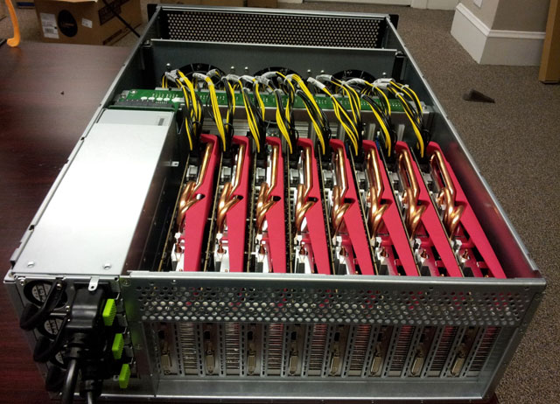
RADEON CITY 2012

Slide 88
RADEON CITY 2012
* all your passwords are belong to us ;-)
* 25-GPU cluster
* 180 billion attempts/sec against MD5
* 63 billion attempts/sec against SHA1
* 71 thousands attempts/sec against BCrypt

Slide 89
SOFTWARE
* GitDigger
* CUPP
* Hashcat

Slide 90
HASHCAT

Slide 91
HASHCAT
* advanced, fast and free hash cracker
* many algorithms implemented
* efficient, supports CPU/GPU
* Linux, Windows, MacOS builds

Slide 92
HASHCAT: STRAIGHT
* straight attack
* checks one by one all strings in dict without any modifications
* example
* alfa, beta, gamma, web, experience

Slide 93
HASHCAT: BRUTEFORCE
* bruteforce attack
* useful in narrow ranges
* example
* a, aa, ab, ac... zzzzzz

Slide 94
HASHCAT: MASK
* mask attack
* allows to specify mask to reduce entropy
* example
* |mixed-case|ass|4-letters|3-digits|

Slide 95
HASHCAT: COMBINATOR
* combinator attack
* combines words from list into pairs
* useful against longer passwords made of shorter words
* example
* correct battery horse staple (0 bits of entropy)

Slide 96
HASHCAT: HYBRID
* hybrid attack
* combined bruteforce and dictionary attack
* words from list with bruteforce prefix/suffix
* example
* johnabc, john1, john2, john123, john2000

Slide 97
HASHCAT: TOGGLE CASE
* toggle case attack
* words from list with upper/lower case variations
* example
* passWORD1

Slide 98
HASHCAT: PERMUTATION
* permutation attack
* checks permutations of each word from list
* example
* asswordp1

Slide 99
HASHCAT: RULE BASED
* rule based attack
* something like very fast regexp, run in GPUs
* adding characters, digits, replacing letters, leetspeak rule
* example
* p4ssw0rd1, P4ssw0rd1, passabcd, password!

Slide 100
HASHCAT: TABLE LOOKUP
* table lookup attack
* required map of characters, for example:
* a = 4, o = 0, i = 1
* effective against leet (1337) or similar
* variant of rule based attack

Slide 101
HASHCAT: BRUTEFORCE++
* markov attack
* hashcat builds markov chain
* advanced bruteforce attack using patterns and probability
* statistically will find password quicker than bruteforce

Slide 102
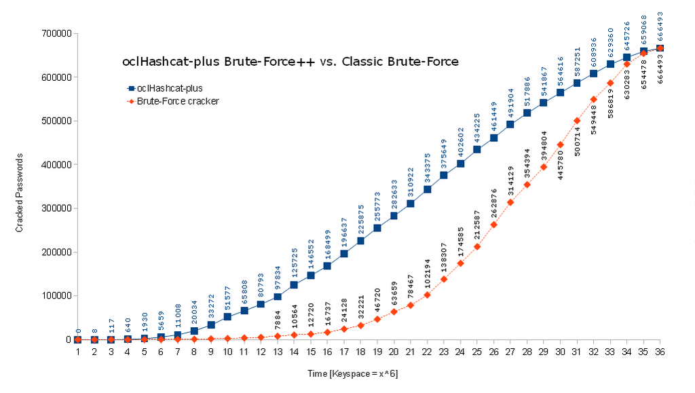
HASHCAT: MARKOV

Slide 103
SAMPLE ATTACK

Slide 104
SAMPLE ATTACK: 1st ROUND
* BF 1-6 characters (entire character space)
* BF 7-8 characters (lower letters only)
* BF 7-8 characters (uppercase letters only)
* BF 1-12 characters (digits only)

Slide 105
SAMPLE ATTACK: 1st ROUND
* straight dictionary attack
* rule based attack
* capitalize first letter
* add digits at the end
* l33t
* reverse

Slide 106
SAMPLE ATTACK: 2nd ROUND
* various hybrid attacks
* word from list + all possible 3-character long (digit or symbol) strings
* word from list + all possible 4-character long (digit) strings
* word from list + all possible 4-character long (lowercase letters) strings

Slide 107
SAMPLE ATTACK: 3rd ROUND
* use statistic to build markov chain
* extended word lists
* custom rules and masks (some patterns are already visible)
* combinator attack

Slide 108
RESULTS
k1araj0hns0n
Sh1a-labe0uf
Apr!l221973
Qbesancon321
DG091101%
@Yourmom69
ilovetofunot
windermere2313
tmdmmj17
BandGeek2014
all of the lights
i hate hackers
allineedislove
ilovemySister31
iloveyousomuch
Philippians4:13
Philippians4:6-7
qeadzcwrsfxv1331

Slide 109
PASSWORD STRENGTH

Slide 110
PASSWORD STRENGTH
* measured in bits
* strength of random passwords can be estimated
* strength of human-generated password is very difficult to estimate
* penetration testing is useful, real life tests

Slide 111
FACTORS TO CONSIDER
* two factors to consider in determining strength
* the average number of guesses to exhaust
* how many guesses per second

Slide 112
FACTORS
* depends on user
* depends on developer
* depends on attacker

Slide 113
DEPENDS ON USER
* complexity of password
* length & randomness
* character classes and patterns
* can be controlled up to certain level by password policy
* reuse yes/no

Slide 114
DEPENDS ON DEVELOPER
* password storage
* hash function fast/slow
* key stretching on/off

Slide 115
DEPENDS ON ATTACKER
* hardware involved
* identified system limitations
* quality of dictionaries
* identified other system vulnerabilities (old backups under web root?)

Slide 116
RANDOMNESS
* humans tend to follow patterns
* are unable to achieve sufficient entropy
* users rarely make full use of key space

Slide 117
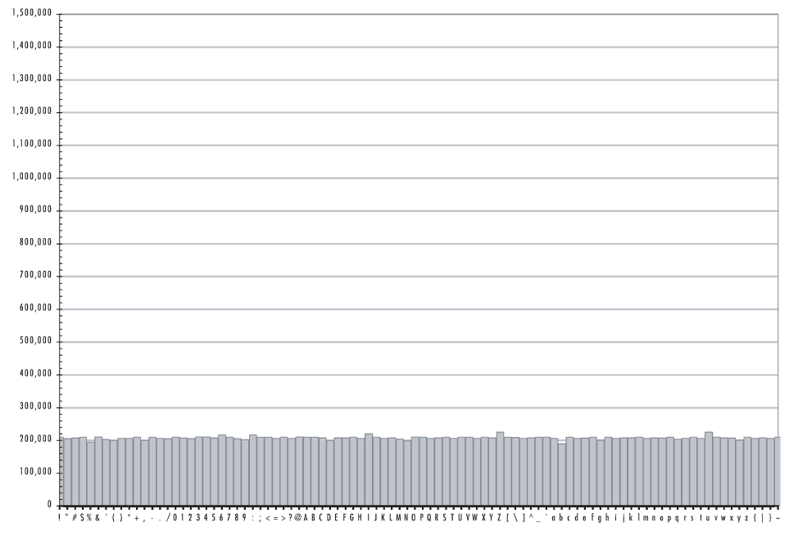
RANDOM DISTRIBIUTION

Slide 118
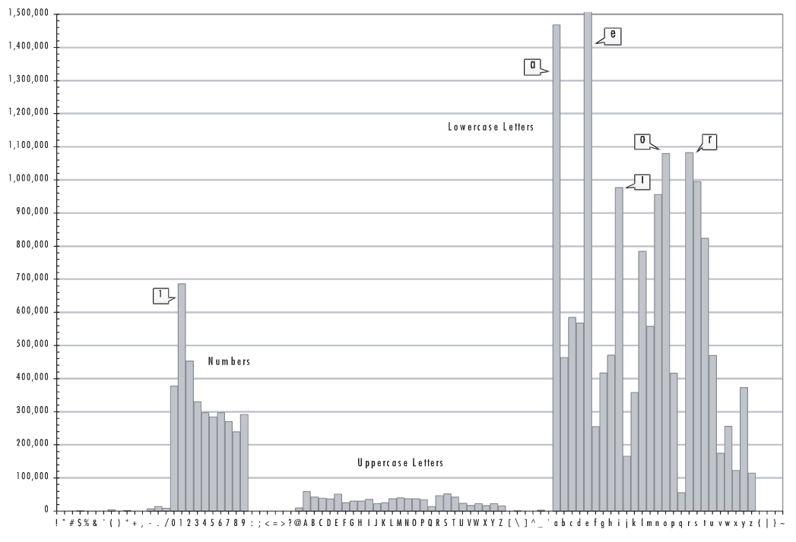
HUMAN PASSWORDS

Slide 119
WEAK PASSWORDS
* single dictionary words
* words with numbers appended
* obfuscated words (adds very little entropy)
* doubled words
* common keyboard sequences: qwerty, 123456

Slide 120
WEAK PASSWORDS
* any purely numeric passwords
* identifiers, usernames, emails
* anything personally related to an individual
* license plate, phone numbers, addresses
* dates, birthdays
* names, nicknames, initials

Slide 121
WEAK PASSWORDS
kitty
susan
jellyfish
smellycat
allblacks
jackbauer
doctorhouse
adamsandler
ilovemypiano
1Kitty
Susan53
jelly22fish
sm3llycat
AllBlacks!
jAckBauer
Doct0rH0use
adamSandler
ILoveMyPiano
1Ki77y
.Susan53.
J3lly22Fish
$m3llycat.
A11B1ack$!
jA(kBauer
.Doct0rH0use.
#adamS@ndler
ILov3MyPi@no

Slide 122
STRONG PASSWORDS
$pwgen -n 15 -sy
*?/#C"*:8lq1:jV
.n'rUXJ+jcZ\%D9
7qvmh*O.q$:P$\M
oO8seLzCUbN}h#p
#-5L=UBd6!%vH4G
$pwgen -n 15 -s
cn9KgidMrOD0zjh
Xc4dXxuZpImQFOp
NvC0xBPt60VRMmk
FgUwSOsJl5Prw8V
VE2zQMO2gQaoiQL

Slide 123
PASSPHRASES
* strong and memorable secrets
* short phrases will be cracked
* avoid popular phrases, quotes, lyrics
* introduce some variation (mixed case, digits, specials)
* dice word method

Slide 124
PASSWORD MANAGERS

Slide 125
PASSWORD MANAGERS
* too many accounts
* people can not remember so many good passwords
* secure way of storing passwords
* provide tools to generate strong passwords

Slide 126
KEEPASS
* database encryption (AES 256 bits, CBC)
* SHA-256 key derivation method (256 bit key)
* key stretching (6000 SHA-256 iterations)
* secure random number generation

Slide 127
KEEPASS
* process memory protection, passwords are encrypted in RAM
* overwrites data before releasing security-critical memory cells
* locking database, integrity tests
* 2-factor authentication

Slide 128
KEEPASS
* 2-channel auto-type obfuscation
* it sends simulated key presses to other applications
* part of the sensitive information is transferred via clipboard, the rest by sending keypresses

Slide 129
GUIDELINES

Slide 130
4 USERS
* generate random passwords
* do not reuse
* use password manager
* backup your passwords (offline/offsite)
* use memorable passphrases

Slide 131
4 USERS
* avoid known patterns
* change default passwords
* change password if compromised
* turn on 2-factor authentication if feasible

Slide 132
4 PROGRAMMERS
* use bcrypt, scrypt or pbkdf2 hash functions
* use dynamic salts
* require sufficient password complexity
* do not enforce very strict patterns
* do not implement anything yourself

Slide 133
CHECKLIST
* check hashes, passwords can not be stored encrypted or in plain text
* check if hash function is still safe (MD5/SHA1, big no no)
* check if hashes are salted with dynamic salt
* check if key stretching is strong (work factor is still sufficient)

Slide 134
CHECKLIST
* check if required password complexity is sufficient
* check if system allows obvious passwords (empty, equal to login, name or email)
* check if account is locked down after 5 failed attempts

Slide 135
REFERENCES

Slide 136
REFERENCES: WEB
* sekurak.pl
* arstechica.com
* troyhunt.com
* haveibeenpwned.com
* keepass.info
* wikipedia.org

Slide 137
REFERENCES: BOOKS
* Take Control of Your Passwords
* Perfect Password

