Slide 1
PASSWORD
SECURITY
PART 1: Basic training

Slide 2
AGENDA
* purpose of session
* big leaks
* password strength
* strong & weak passwords
* passphrases
* guidelines

Slide 3
BIG LEAKS

Slide 4
BIG LEAKS (ROCKYOU)
* RockYou (2009), 32 mln plains
* game changer in password cracking

Slide 5
BIG LEAKS (LEAKEDIN)
* LinkedIn (2012), 8 mln unsalted SHA1 hashes
* 50-60% hashes cracked within hours
* SHA1 is very fast, single iteration without salt allows to attack all hashes at once

Slide 6
BIG LEAKS (ADOBE)
* Adobe (2013), 152 mln passwords encrypted with 3DES/ECB
* the greatest crossword puzzle in the history of the world (XKCD), hints were stored in plain text

Slide 7
BIG LEAKS (ASHLEY MADISON)
*
*

Slide 8
';- - HAVE I BEEN PWNED?
* so have I been pwned?
* check haveibeenpwned.com (by Troy Hunt)
PROBABLY ;-]

Slide 9
ROCKYOU ANALYSIS
* most passwords are short, 6-10 characters
* capital letters are usually at the beginning
* numbers and symbols mostly show up at the end
* strong tendency to use first names followed by years

Slide 10
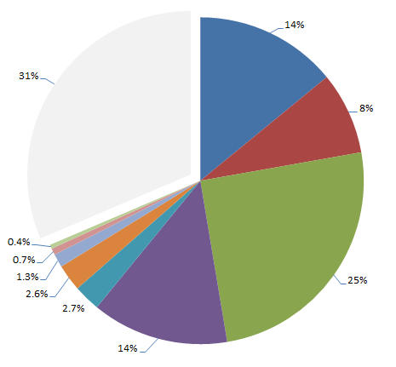
LULZSEC RELEASES 2011
14% person name
8% place name
25% dict word
14% only numbers
double words 2.7%
in email 2.6%
short phrase 1.3%
keyboard pattern 0.7%
site related 0.4%
others 31%

Slide 11
TOP 25 PASSWORDS 2015
letmein
login
princess
qwertyuiop
solo
passw0rd
starwars
123456
password
12345678
qwerty
12345
123456789
football
1234
1234567
baseball
welcome
1234567890
abc123
111111
1qaz2wsx
dragon
master
monkey

Slide 12
PASSWORD STRENGTH

Slide 13
HOW TO MEASURE
* password strength is measured in bits of entropy
* strength of random passwords can be estimated
* passwords generated by people are difficult to judge

Slide 14
RANDOMNESS
* humans tend to follow patterns
* are unable to achieve sufficient entropy
* rarely make full use of key space

Slide 15
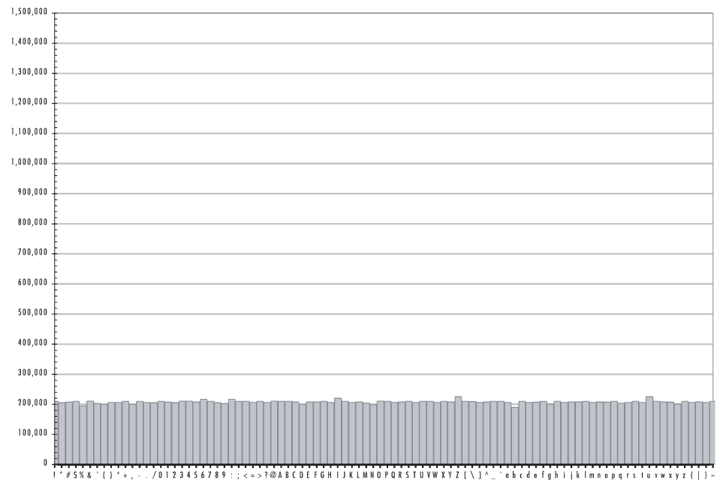
RANDOM DISTRIBIUTION

Slide 16
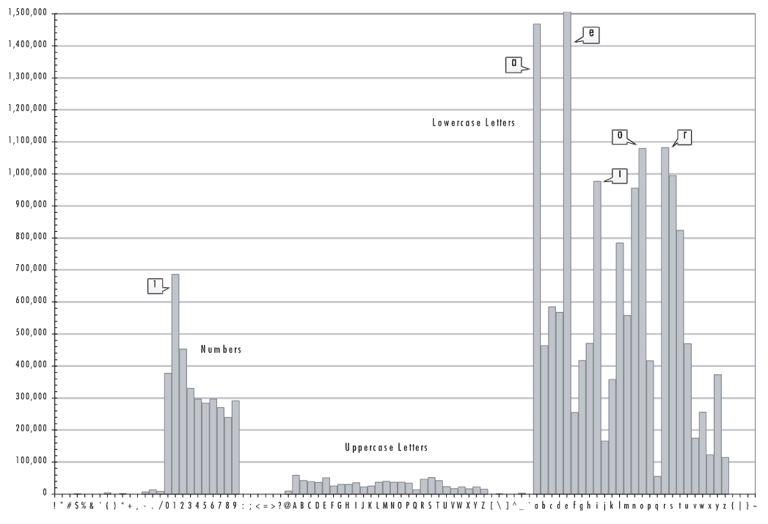
HUMAN RANDOMNESS

Slide 17
DEPENDS ON USER
* key space: length and complexity
* can be controlled up to certain level by password policy
* reusing passwords is very dangerous

Slide 18
DEPENDS ON DEVELOPER
* password storage: type of hash function and key stretching
* other system vulnerabilities

Slide 19
DEPENDS ON ATTACKER
* hardware involved
* identified password limitations
* knowledge and quality of tools
* identified other system vulnerabilities

Slide 20
WEAK PASSWORDS

Slide 21
WEAK PASSWORDS
* single or doubled dictionary words
* words with appended numbers or symbols
* obfuscated words, leet speak
* common keyboard sequences

Slide 22
WEAK PASSWORDS
* any purely numeric passwords
* anything related: identifiers, usernames, emails, license plate, phone numbers, addresses, dates, birthdays, names, nicknames, initials, content of WHOIS db!

Slide 23
EXAMPLES
kitty
susan
jellyfish
smellycat
allblacks
jackbauer
doctorhouse
adamsandler
ilovemypiano
1Kitty
Susan53
jelly22fish
sm3llycat
AllBlacks!
jAckBauer
Doct0rH0use
adamSandler
ILoveMyPiano
1Ki77y
.Susan53.
J3lly22Fish
$m3llycat.
A11B1ack$!
jA(kBauer
.Doct0rH0use.
#adamS@ndler
ILov3MyPi@no

Slide 24
MORE EXAMPLES
k1araj0hns0n
Sh1a-labe0uf
Apr!l221973
Qbesancon321
DG091101%
@Yourmom69
ilovetofunot
windermere2313
tmdmmj17
BandGeek2014
all of the lights
i hate hackers
allineedislove
ilovemySister31
iloveyousomuch
Philippians4:13
Philippians4:6-7
qeadzcwrsfxv1331

Slide 25
STRONG PASSWORDS

Slide 26
STRONG PASSWORDS
$pwgen -n 15 -sy
*?/#C"*:8lq1:jV
.n'rUXJ+jcZ\%D9
7qvmh*O.q$:P$\M
oO8seLzCUbN}h#p
#-5L=UBd6!%vH4G
$pwgen -n 15 -s
cn9KgidMrOD0zjh
Xc4dXxuZpImQFOp
NvC0xBPt60VRMmk
FgUwSOsJl5Prw8V
VE2zQMO2gQaoiQL

Slide 27
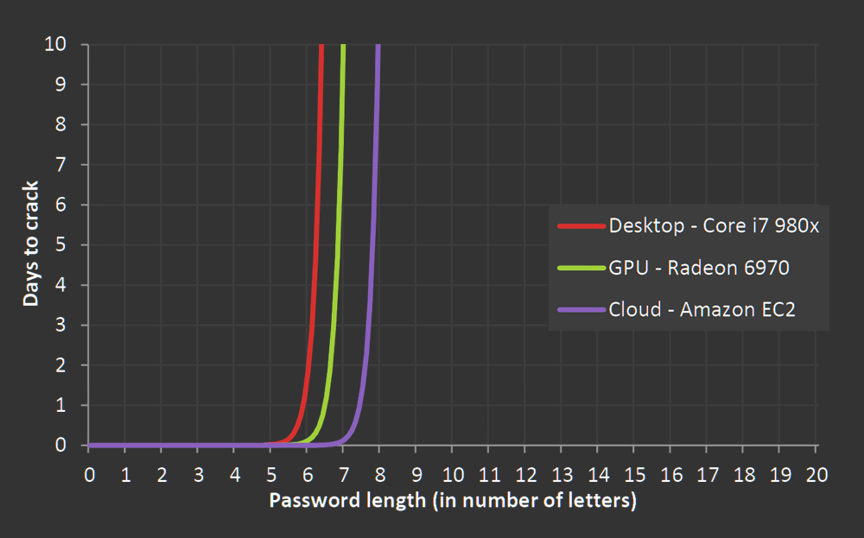
EXPOTENTIAL WALL OF BRUTE FORCE

Slide 28
PASSPHRASES

Slide 29
PASSPHRASES
* strong and memorable secrets
* short phrases will be cracked
* avoid popular phrases, quotes, lyrics, things from Wikipedia
* introduce some variation: mixed case, digits, specials

Slide 30
EXAMPLES
* correct horse battery staple
* sensible shark rubs own belly
* never_seats_ghost_main_97
* slam,rust,armor,gg,spire

Slide 31
DICEWARE METHOD
* compare entrophy with bruteforce

Slide 32
PASSWORD MANAGERS
* people can not remember good passwords for all accounts
* the only way to securely store secrets and password managers
* LastPass, Passpack, KeePassX

Slide 33
2 FACTOR AUTH
* use second factor is possible
* secure recovery codes
* lock your phone also clean screen, hide pattern

Slide 34
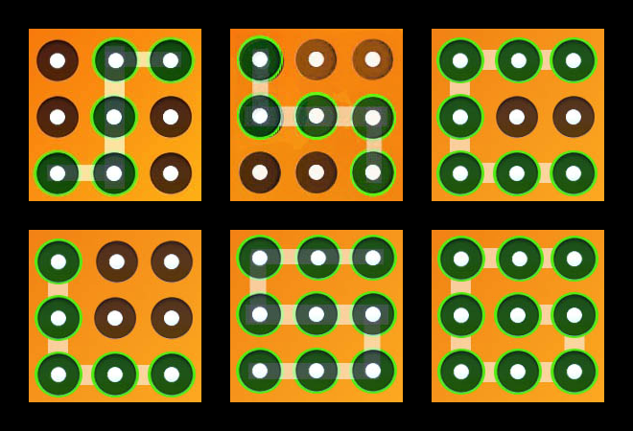
COMMON PATTERNS

Slide 35
GUIDELINES

Slide 36
GUIDELINES 4 USERS
* generate random passwords or use memorable and long passphrases
* do not reuse
* store in password manager
* backup your passwords (offline/offsite)

Slide 37
GUIDELINES 4 USERS
* avoid known patterns
* change default passwords
* change password if compromised
* turn on 2-factor authentication

Slide 38
MORE READING

Slide 39
REFERENCES (WEB)
* sekurak.pl
* arstechica.com
* troyhunt.com
* haveibeenpwned.com
* splashdata.blogspot.com
* mytrickytricks.blogspot.com
* entima.net/diceware/

Slide 40
REFERENCES (BOOKS)
* Take Control of Your Passwords
* Perfect Password

