Slide 1
PASSWORD
SECURITY

Slide 2
AGENDA
* big leaks
* password strength
* cryptographic hash functions
* hardware and software
* hashcat, offline attack
* guidelines

Slide 3
BIG LEAKS

Slide 4
BIG LEAKS: ROCKYOU
* RockYou (2009)
32 mln, plain text
* game changer in password cracking

Slide 5
BIG LEAKS: LEAKEDIN
* LinkedIn (2012)
8 mln, unsalted SHA1
* SHA1 is very fast,
50-60% hashes cracked within hours

Slide 6
BIG LEAKS: ADOBE
* Adobe (2013)
152 mln, encrypted 3DES/ECB
* hints in plain text
* the greatest crossword puzzle in the history of the world (XKCD)

Slide 7
';-- HAVE I BEEN PWNED?
* so have I been pwned?
probably yes ;)
* check haveibeenpwned.com
made by Troy Hunt

Slide 8
ROCKYOU ANALYSIS
* most passwords are short,
6-10 characters
* capital letters
mostly come at the beginning
* numbers and punctuation
mostly show up at the end
* strong tendency to use
first names followed by years

Slide 9
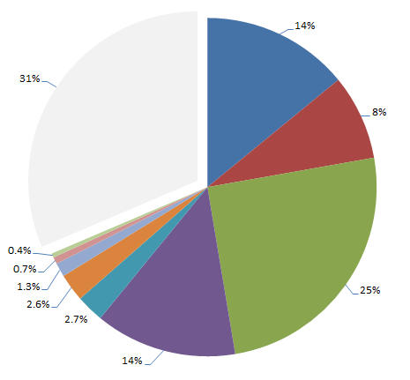
LULZSEC RELEASES 2011
14% person name
others 31%
8% place name
site related 0.4%
keyboard pattern 0.7%
short phrase 1.3%
25% dict word
in email 2.6%
double words 2.7%
14% only numbers

Slide 10
TOP 25 PASSWORDS 2013
123456
password
12345678
qwerty
abc123
123456789
111111
1234567
iloveyou
adobe123
123123
Admin
1234567890
letmein
photoshop
1234
monkey
shadow
sunshine
12345
password1
princess
azerty
trustno1
000000

Slide 11
TOP 25 PASSWORDS 2014
123456
password
12345
12345678
qwerty
123456789
1234
baseball
dragon
football
1234567
monkey
letmein
abc123
111111
mustang
access
shadow
master
michael
superman
696969
123123
batman
trustno1

Slide 12
PASSWORD STRENGTH

Slide 13
HOW TO MEASURE
* entropy, measured in bits
* strength of random passwords can be
estimated
* strength of passwords generated by
humans is difficult to estimate
* real life tests, pen-testing

Slide 14
RANDOMNESS
* humans tend to follow patterns
* are unable to achieve sufficient
entropy
* rarely make full use of key space

Slide 15
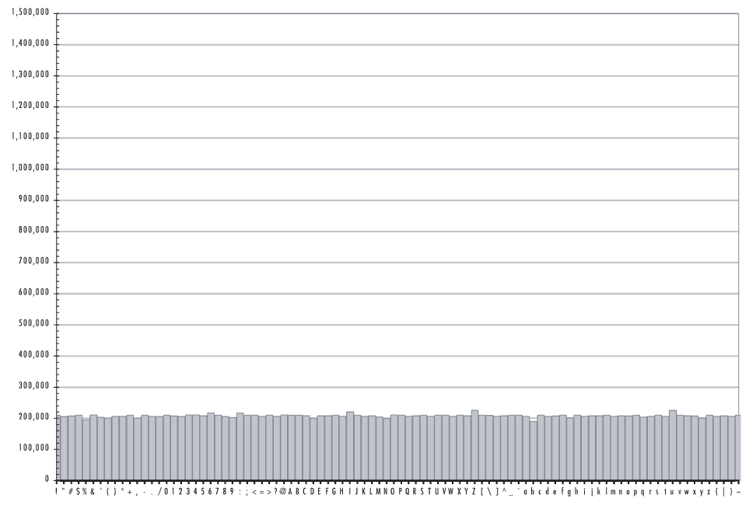
RANDOM DISTRIBIUTION

Slide 16
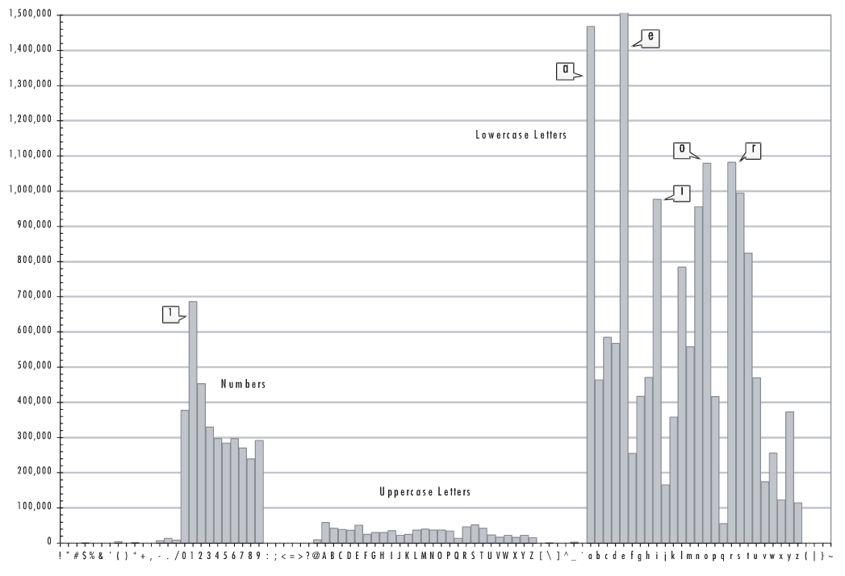
HUMAN RANDOMNESS

Slide 17
DEPENDS ON USER
* key space:
length and complexity
* can be controlled up to certain
level by password policy
* reusing passwords is dangerous

Slide 18
DEPENDS ON DEVELOPER
* password storage:
type of hash function
key stretching
* other system vulnerabilities

Slide 19
DEPENDS ON ATTACKER
* hardware involved
* identified password limitations
* knowledge and quality of tools
* identified other system
vulnerabilities

Slide 20
ANATOMY OF WEAK PASSWD
* single or doubled dictionary words
* words with appended numbers or
symbols
* obfuscated words, leet speak
* common keyboard sequences

Slide 21
ANATOMY OF WEAK PASSWD
* any purely numeric passwords
* anything related:
identifiers, usernames, emails,
license plate, phone numbers,
addresses, dates, birthdays,
names, nicknames, initials,
content of WHOIS db!

Slide 22
EXAMPLES
kitty
susan
jellyfish
smellycat
allblacks
jackbauer
doctorhouse
adamsandler
ilovemypiano
1Kitty
Susan53
jelly22fish
sm3llycat
AllBlacks!
jAckBauer
Doct0rH0use
adamSandler
ILoveMyPiano
1Ki77y
.Susan53.
J3lly22Fish
$m3llycat.
A11B1ack$!
jA(kBauer
.Doct0rH0use.
#adamS@ndler
ILov3MyPi@no

Slide 23
MORE EXAMPLES
k1araj0hns0n
Sh1a-labe0uf
Apr!l221973
Qbesancon321
DG091101%
@Yourmom69
ilovetofunot
windermere2313
tmdmmj17
BandGeek2014
all of the lights
i hate hackers
allineedislove
ilovemySister31
iloveyousomuch
Philippians4:13
Philippians4:6-7
qeadzcwrsfxv1331

Slide 24
STRONG PASSWORDS
$pwgen -n 15 -sy
*?/#C"*:8lq1:jV
.n'rUXJ+jcZ\%D9
7qvmh*O.q$:P$\M
oO8seLzCUbN}h#p
#-5L=UBd6!%vH4G
$pwgen -n 15 -s
cn9KgidMrOD0zjh
Xc4dXxuZpImQFOp
NvC0xBPt60VRMmk
FgUwSOsJl5Prw8V
VE2zQMO2gQaoiQL

Slide 25
PASSPHRASES
* strong and memorable secrets
* short phrases will be cracked
* avoid popular phrases, quotes,
lyrics, things from Wikipedia
* introduce some variation:
mixed case, digits, specials
* diceware method

Slide 26
PASSWORD MANAGERS
* people can not remember so many good
passwords, too many accounts
* the only way to securely store
secrets and password managers
* LastPass, Passpack, KeePassX

Slide 27
HASH FUNCTIONS

Slide 28
HASH FUNCTIONS
* one way function
* collision resistant
* provide high variability
* not every hash function is secure

Slide 29
ONE WAY FUNCTION
* easy to compute on every input
* hard to invert to get
original message

Slide 30
HASH FUNCTIONS
* one way function
* collision resistant
* provide high variability
* not every hash function is secure

Slide 31
COLLISION RESISTANT
* difficult to find two distinct inputs resulting in the same hash
* difficult to access account
with different password
* collisions happen because inputs
are compressed

Slide 32
HIGH VARIABILITY
* very different outputs for similar inputs
* difficult to reveal
characteristics of password
"password" | 286755fad04869ca523320acce0dc6a4
"password1" | 10b222970537b97919db36ec757370d2

Slide 33
ISSUE: GUESSING
* solution: key stretching
* slow down computations
* increase memory requirements

Slide 34
ISSUE: RAINBOW TABLES
* solution: key stretching,
(multiple level RT required)
* solution: dynamic salts
(separate RT for each salt)

Slide 35
ISSUE: COLLISIONS
* longer digest means
smaller risk of collision
* normally this is not big issue
in case of passwords

Slide 36
KEY STRETCHING
* extra iterations of hash function
make RT ineffective and
slow down attacks
* memory complexity makes
more difficult to implement
cracker in GPU

Slide 37
SALTS
* random data as an additional input
* effective against:
pre-computed attacks (RT)
Google hacking
* same passwords produce different
hashes
* guessing one hash at the time

Slide 38
SECURE HASH FUNCTIONS
* fast, general purpose hashes:
MD5, SHA family
* slow, safe password storage:
BCRYPT, PBKDF2, SCRYPT

Slide 39
MD5/SHA/SHA2
* general purpose functions,
designed to hash gigabytes of data, very fast
* not for hashing passwords!

Slide 40
BCRYPT
* designed to store static passwords
* salt built into algorithm
* configurable work factor,
rounds: 2^{WF} (2¹², 4096 rounds)

Slide 41
PBKDF2
* similar level of security as BCRYPT
* secures WiFi (WPA2-PSK),
4096 rounds of SHA1,
SSID is salt (pre-computed RT!)
* change default SSID, don't use:
c3com, NETGEAR, ZyXEL, linksys

Slide 42
SCRYPT
* the latest, secure hash function
* works on binary data as well
* advanced key stretching:
computation complexity
memory requirements

Slide 43
HARDWARE AND SOFTWARE

Slide 44
HARDWARE
* hardware is fast and cheap,
EC2 is not ;)
* hashing runs in parallel
* GPUs scale almost linearly
* GPUs are much faster than CPUs,
loads of specialized cores

Slide 45
CPU PERFORMANCE
* number of cores
* clock frequency
* 32/64 bits
* SSE2, few arithmetic instructions
per clock
* optimizations made by compiler

Slide 46
GPU PERFORMANCE
* number of ALUs,
Arithmetic Logic Units
* number of stream processors
* optimizations

Slide 47
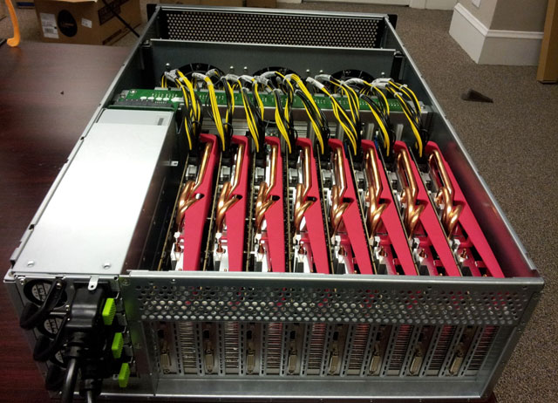
RADEON CITY DEC-2012

Slide 48
RADEON CITY DEC-2012
* all your passwords
are belong to us ;)
* 25-GPU cluster
* output
180 bln MD5 h/sec
63 bln SHA1 h/sec
71 kilo BCRYPT h/sec

Slide 49
SOFTWARE
* GitDigger
* CUPP
* Fierce2
* Twitter/Google
* Hashcat

Slide 50
GIT DIGGER
* scraped entire github to build
dictionary
* similar tools used to scrap
Wikipedia and code.google

Slide 51
GIT DIGGER: RESULTS
* passwords, usernames, emails,
common files and directories
* OCR on images for stored secrets
* static code analysis for vulns
* .gitignore and .svn folders, SSH
keys, tokens and static salts

Slide 52
CUPP
* common user passwords profiler
* creates personalized dictionaries
used against specific person
* effective against careless mortals

Slide 53


Slide 54
OFFLINE ATTACK
* possible when someone obtains
password hashes
* search existing hash databases
(Google hacking)
* use dictionaries, rainbow tables
and other tools to perform attacks

Slide 55
PRIMARY DICTIONARIES
* compact and related to target
* all leaks on the Interwebz
* recovered plains
* common word lists
* quick tests, rule based, hybrid,
combinator attacks

Slide 56
EXTENDED DICTIONARIES
* can be very large
* content of primary dictionary
* multiple languages
* scrapped wikipedia, github,
code.google

Slide 57
HASHCAT
* advanced, fast and free cracker
* many algorithms implemented
* supports CPU and GPU(OPENCL, CUDA)
* works on Linux, MacOS and Windows

Slide 58
HASHCAT: STRAIGHT
* straight attack
* checks one by one all strings in
dictionary without modifications
* example:
password, adobe123, linkedin,
admin, letmein, qwerty, trustno1,
123456

Slide 59
HASHCAT: MASK/BF
* bruteforce/mask attack
* exhaustive, but time consuming,
specify mask to reduce key space
* example:
Password1 (mask: ?u?l?l?l?l?l?l?d)
adobe123! (mask: adobe?d?d?d?s)
123456789 (mask: ?d?d?d?d?d?d?d?d?d)

Slide 60
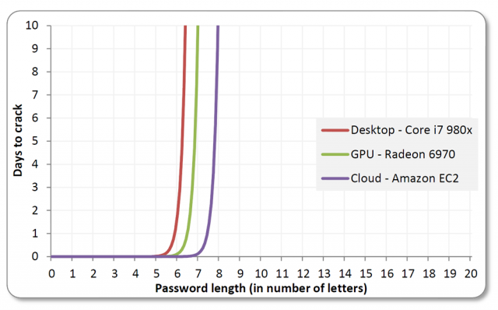
EXPOTENTIAL WALL OF BF

Slide 61
HASHCAT: COMBINATOR
* combinator attack
* combines words from list into pairs
* example:
correct battery horse staple,
awful password, awful-password1

Slide 62
HASHCAT: HYBRID
* hybrid attack
* combines bf and dictionary attack,
words from list with prefix/suffix
* example:
password1, password123, password(),
passwordabc1

Slide 63
HASHCAT: RULE BASED
* rule based attack
* very fast regexp, runs in GPUs
* modifies words:
add/replace chars, digits, symbols,
leetspeak rule
* example
p4ssw0rd1, P4ssw0rd1, passwd123,
PaSwOrD123

Slide 64
HASHCAT: MARKOV
* bruteforce++ attack
* hashcat builds markov chains
* identifies patterns and probability
* statistically will find password
quicker than regular bf

Slide 65
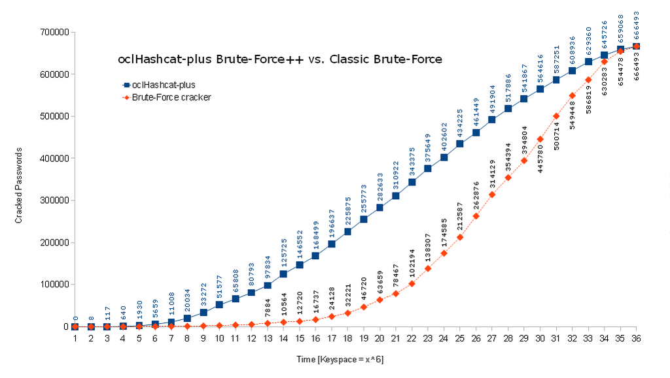
BF VS MARKOV

Slide 66
ATTACKING
LEAKEDIN

Slide 67
GUIDELINES

Slide 68
GUIDELINES 4 USERS
* generate random passwords or
use memorable and long passphrases
* do not reuse
* store in password manager
* backup your passwords
(offline/offsite)

Slide 69
GUIDELINES 4 USERS
* avoid known patterns
* change default passwords
* change password if compromised
* turn on 2-factor authentication

Slide 70
GUIDELINES 4 DEVS
* use BCRYPT, SCRYPT or PBKDF2 with
dynamic salts
* require sufficient password
complexity, but do not enforce
very strict patterns
* do not relay on secret hash
permutations

Slide 71
GUIDELINES 4 QA
* check hashes, passwords can not be
stored encrypted or in plain text
* check if hash function is still safe
* check if hashes are salted with
dynamic salt
* check if work factor is still
sufficient

Slide 72
GUIDELINES 4 QA
* check if required password
complexity is sufficient
* check if system allows obvious
passwords: empty, same as login,
name or email
* check if API is rate limitted

Slide 73
REFERENCES: WEB
* sekurak.pl
* arstechica.com
* troyhunt.com
* haveibeenpwned.com
* splashdata.blogspot.com

Slide 74
REFERENCES: BOOKS
* Take Control of Your Passwords
* Perfect Password

