Slide 1

Raspberry PI
malware honeypot

Slide 2
AGENDA
* honeypot, what is it? what is it's purpose?
* Dionaea honeypot, hardware, software and network setup
* MHN server, how to manage sensors effectively?
* system security, quick demo, todo and links

Slide 3

TL;DR
* Raspberry PI runs Dionaea honeypot for 2 months
* it is connected to our guest WiFi network
* and it catched nothing ;-]

Slide 4
HONEYPOT

Slide 5

WHAT IS HONEYPOT?
* honeypot is a decoy infrastructure that is deployed to be attacked
* since it has no other purpose, every attempt to interact is suspicious

Slide 6
WHAT IS IT'S PURPOSE?
* it can discover malicious activity, especially when deployed behind firewall
* it can slow down and mislead the attacker by providing slow responses or incorrect information
* it can collect the logs, tools and other stuff left by attacker to aid forensics

Slide 7
MY GOALS
* excuse to purchase Raspberry PI ;-]
* monitor malware activity in our network, as ½ of the office runs on Windows
* detect network scans, as our guest WiFi isn't separated

Slide 8
DIONAEA HONEYPOT

Slide 9
HARDWARE
* cheap, affordable, yet fashionable Raspberry PI 2
* 900MHz quad-core ARM Cortex-A7 CPU
* 1GB RAM
* 8GB SD card
* WiFi dongle
* costs around €65 (inc. Sue's fee;)

Slide 10
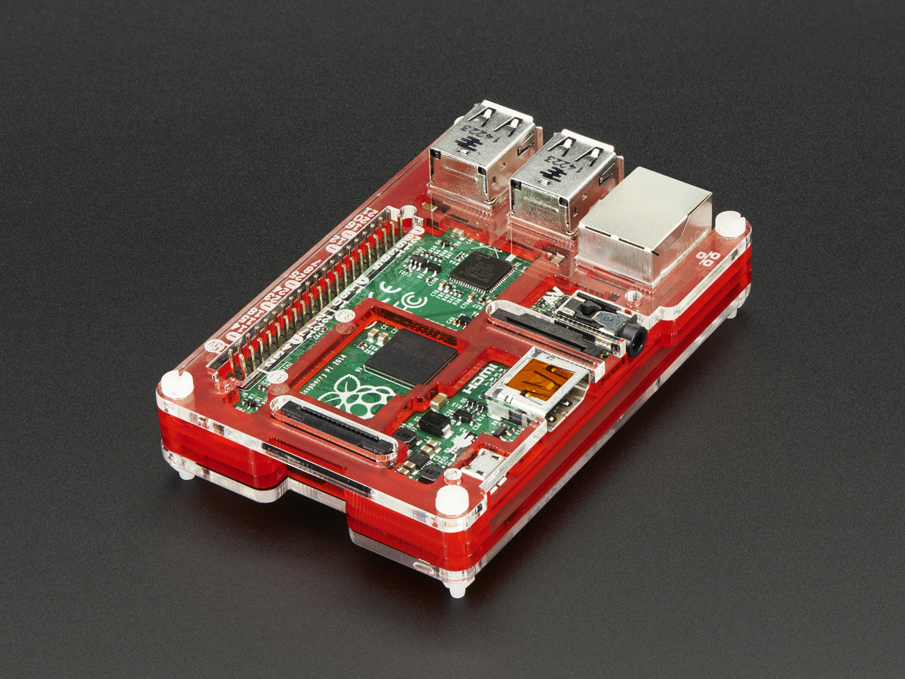

Slide 11

SOFTWARE
* Raspbian, optimized Debian for the Raspberry PI
* Dionaea, low interaction, malware detection and network reconnaissance honeypot

Slide 12
HOW DIONAEA WORKS?
* it listens on few ports and reports connections
* it waits for malware and pretends to be exploitable
* it will capture and store payload

Slide 13
NETWORK SETUP
* wlan0, auto DHCP, connects on boot to Guest WiFi
* headless setup, plug in 5V and SSH into it 30s later
* current IP and MAC address are [REDACTED ;-]

Slide 14
MORE DETAILS
* opened ports: 21 (FTP), 22 (SSH), 42 (WINS), 69 (TFTP), 135 (RPC), 445 (SMB), 1433 (MSSQL), 3306 (MYSQL), 5060/5061 (SIP/VOIP)
* hostname: accounting-dev
* detectability: spoof MAC address to imitate DELL, move SSH to non-standard port, attempt would trigger alert anyway

Slide 15
MANAGEMENT SERVER

Slide 16
MHN (Modern Honey Network)
* so if honeypots are so cool why we don't use them?
* they are difficult to deploy and maintain
* also often log to files

Slide 17
MHN (Modern Honey Network)
* guys from ThreatStream developed MHN, open-source honeypot management server
* automates deployment process
* sets up data flows with hpfeeds
* collects data and correlates it with GeoIP
* does real time visualization with honeymap

Slide 18
SYSTEM SECURITY
* MHN is running on t2.micro EC2 instance
* access to server is restricted to office and home IPs
* no extra services, only necessary ports are opened
* SSH keys everywhere, self-signed SSL cert ;-]
* regular updates are necessary

Slide 19
DEMO

Slide 20
TODO

Slide 21
TODO
* migrate MHN to proper server
* integrate with Slack or centralized logging
* persuade CTO to buy 3 boards ;-]

Slide 22
TODO continued
* use OpenVPN for consistent IPs
* deploy more sensors, ex. Kippo, high interaction SSH honeypot
* script updates, (MHN rules, Diaonea package)

Slide 23
GITHUB

Slide 24
GITHUB
* github.com/rep/dionaea
* github.com/desaster/kippo
* github.com/threatstream/mhn

Slide 25
THE END

