Slide 1



Slide 2

Project :Company Financial Profile Search Service
Presented By:
Alisha Shah & Poonam Jain

Slide 3
Introduction
We are providing a search service where user can view:
The basic profile of any company
Financial information such as Company Product, Company Revenue, Net Income and Net Profit
Performance of company’s stock( Based on Historical data)

Slide 4
Parts Of Project
Admin Part:
Access of this module will be provided to Admin.
After accessing the module the admin will be responsible for filling the company profile data to the database
Admin will also be responsible for maintaining or purging this data
Notes:
The Project is using two modules: Admin Module and Search Module

Slide 5
Parts Of Project
Search Part:
Access to this part will be provided to any user
User has to enter the company name or its ticker to access the company profile and its financial data
In the background this part will use the Yahoo data service to get the company stock performance data for a given range of time
This part will also fetch the company profile from the database which was previously saved by the admin

Slide 6
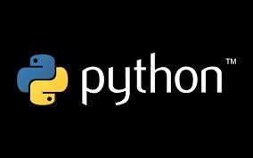


Architecture

Slide 7
Python Modules used
Bottle:
Pandas.io.data
Psycopg2
Matplotlib
DateTime
Time
HTML :
Numpy
Plotly
Web
Notes:
Bottle: Simple and lightweight WSGI micro web-framework for Python
Pandas.io.data : Extract data from various Internet sources into a Data Frame
Psycopg2 : Database API 2.0 which connects the database with the Information system
Plotly : Python gives users access to easy-to-use, serializible data structures. Namely, these are lists and dictionaries. Plotly let's you use what you already know about handling these data structures to make beautiful visualizations of your data. The figures you make in Plotly are nothing more than an organized, nested dictionary. Working with Plotly's Python API sums up to working with Python lists and dictionaries
Pandas.io.data: Functions from pandas.io.data extract data from various Internet sources into a Data Frame. Some sources are Yahoo! finance, Google Finance etc.
Matplotlib: is a python 2D plotting library which produces publication quality figures in a variety of hardcopy formats and interactive environments across platforms
Psycopg2: Psycopg2 is a Database API 2.0 which connects the database with the Information system. It is designed for multi-threaded applications and manages its own connection pool
Bottle:
Routing: Requests to function-call mapping with support for clean and dynamic URL’s. Templates: Fast and pythonic built-in template engine and support
Bottle comes with a fast, powerful and easy to learn built-in template engine called SimpleTemplate or stpl for short. It is the default engine used by the view() and template() helpers but can be used as a stand-alone general purpose template engine too

Slide 8
Demo

Slide 9
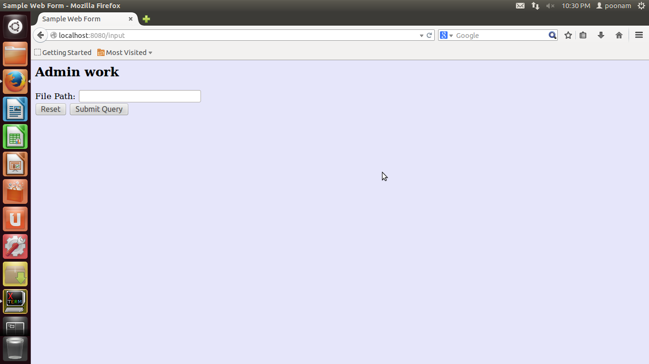

Slide 10
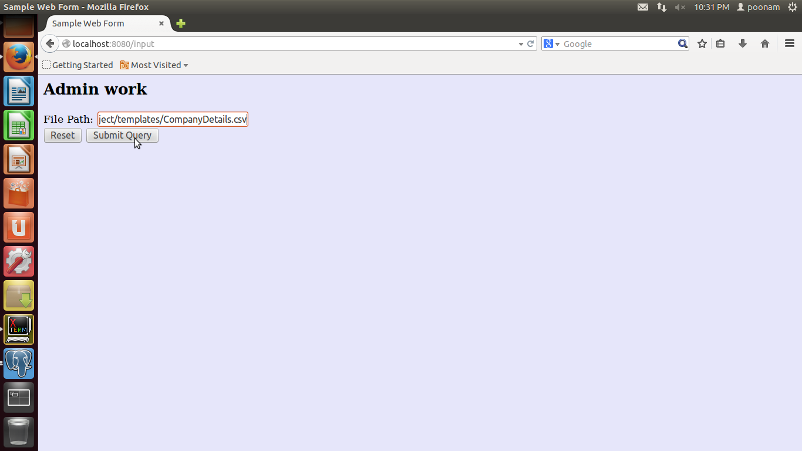

Slide 11
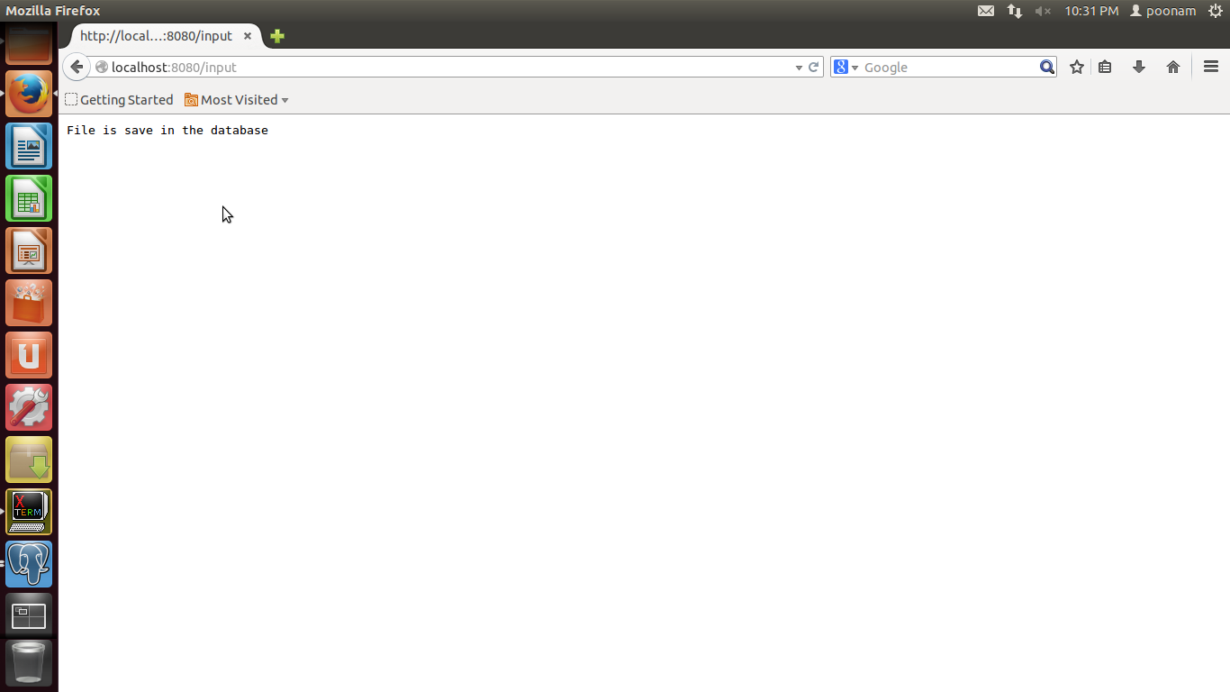

Slide 12
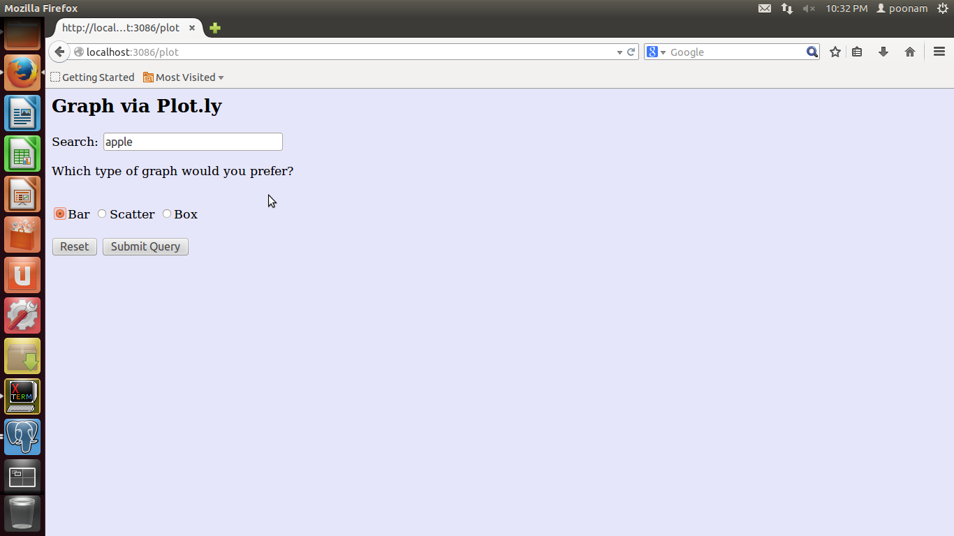

Slide 13
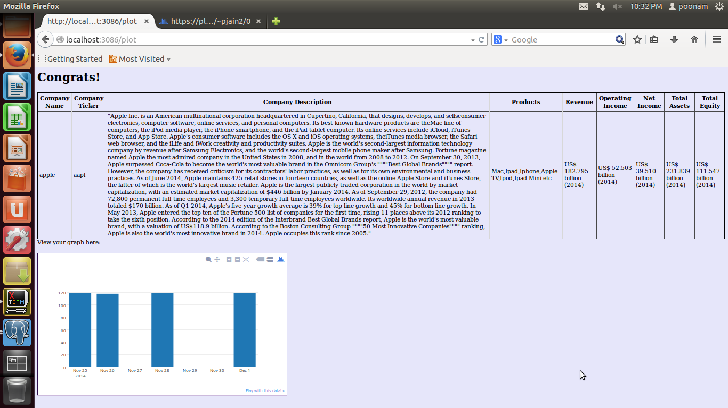

Slide 14
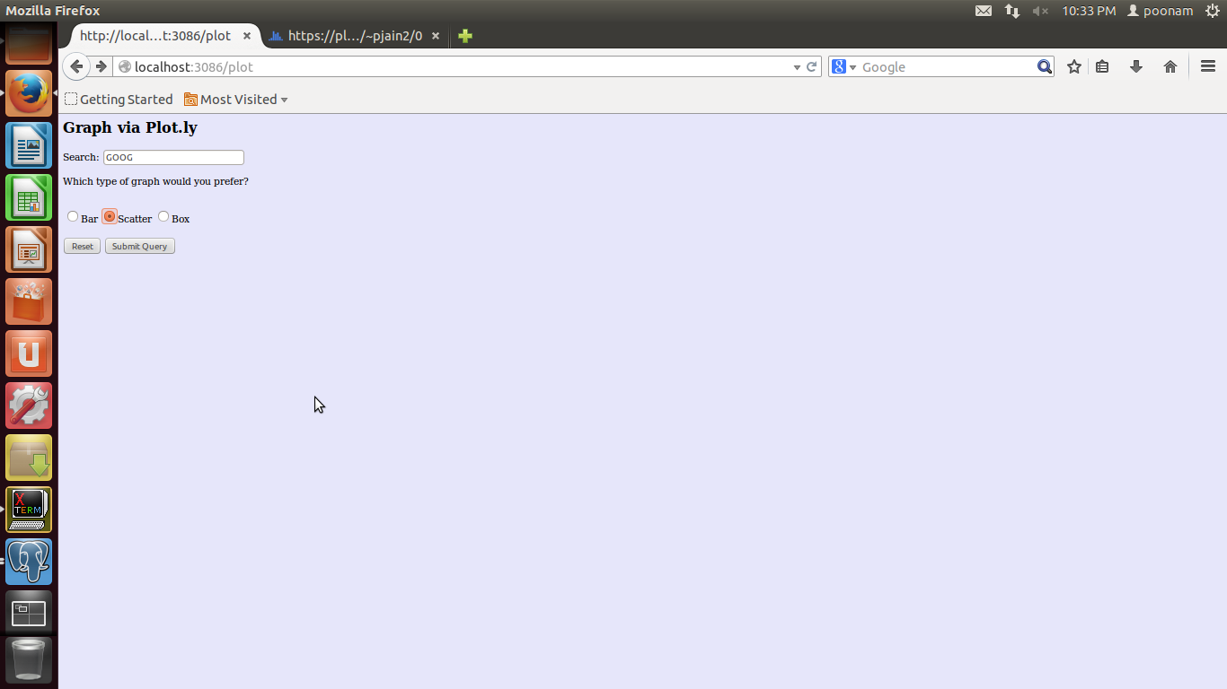

Slide 15
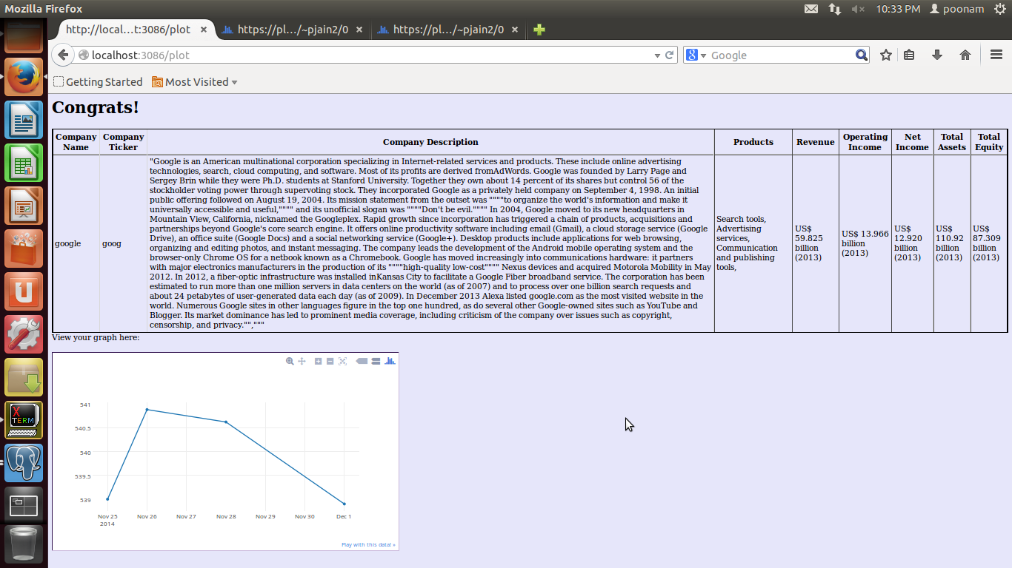

Slide 16
Future Enhancements
In the future we plan to:
Increase the number of companies in the database as well as include different industry sectors
Provide service of comparing financial data of two or three companies to enable users to analyze the companies
Use real time data along with historical data to project the financial graphs

