Slide 1
Lab: Large Language Models (LLMs) – Using RAG in FHIR Applications
Patrick W. Jamieson, M.D.
Technical Product Manager
Russ Leftwich, M.D.
Senior Clinical Advisor, Interoperability

Slide 2

LAB THEME: USING RAG TO IMPROVE LLM PERFORMANCE
Retrieval Augmented Generation
Definition: Combines retrieval of external knowledge with generative LLMs
Motivation: Address hallucinations with limited context windows
Core Idea: “Fetch relevant docs → condition LLM on them → generate”

Slide 3
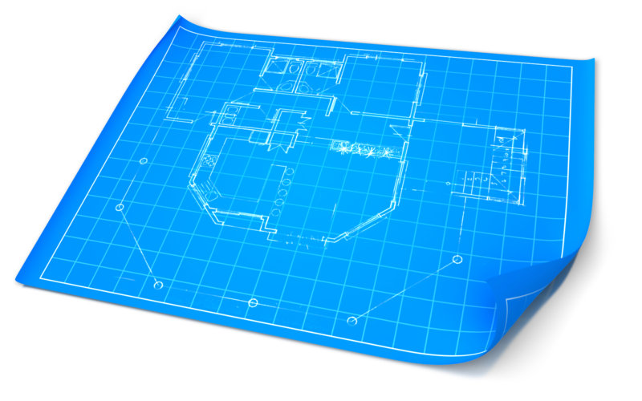
RAG Architecture
Retriever: Vector‐based or sparse index to pull top K documents
Index Store: Embeddings database (e.g., FAISS, Elasticsearch, Redis)
Reader/Generator: LLM (e.g., GPT-4, Llama) that uses retrieved context

Slide 4
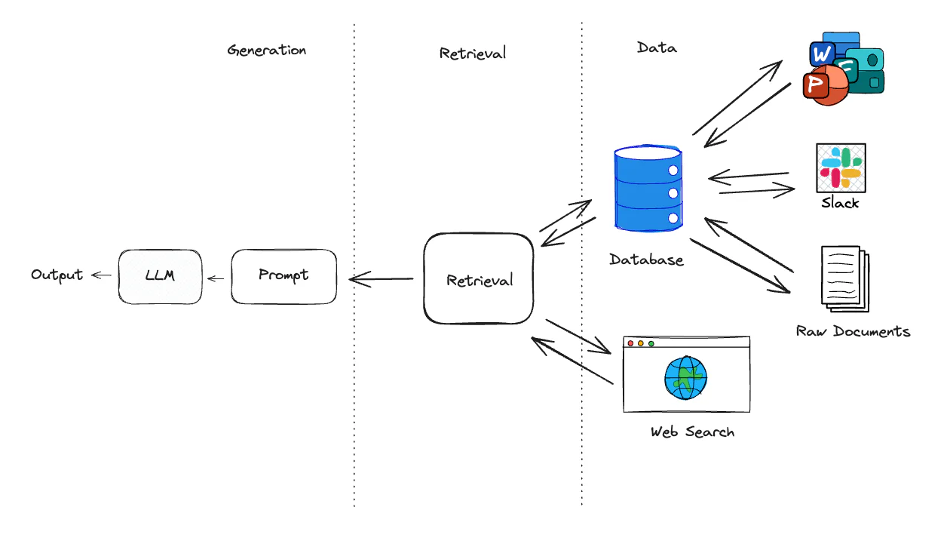
RAG Workflow
Embed Query: Compute query embedding
Retrieve Documents: Cosine similarity search to vectors in a vector store
Context Assembly: Concatenate top K docs with prompt
Generate Answer: LLM produces response grounded on retrieved text

Slide 5
Benefits & Challenges
Benefits
Improved factuality
Larger effective knowledge base
Dynamic, updatable content without full model retrain
Challenges
Latency overhead of retrieval
Prompt‐engineering for context length
Handling contradictory sources

Slide 6
Challenge One – Creating Semantic Vectors
You have been asked to build a simple proof of concept application to encode patient summaries as semantic vectors and then create a query application that uses cosine similarity. The patient summaries with the highest similarity score should be returned at the top.
Six clinical summaries in free text are provided.

Slide 7
Environment & Dependencies
Setup python virtual environment
pip install sentence-transformers tiktoken numpy

Slide 8
Two Functions You Will Need
Index
def build_index(model, summaries):
index = []
for s in summaries:
vec, count = embed_text(model, s["text"])
index.append({
"id": s["id"],
"text": s["text"],
"embedding": np.array(vec),
"tokens": count
})
return index
Search Function
def search(query: str, model, index, top_k=1):
q_vec, _ = embed_text(model, query)
q_vec = np.array(q_vec)
# compute similarity against each indexed summary
sims = [
(item["id"], cosine_sim(q_vec, item["embedding"]))
for item in index
]
sims = sorted(sims, key=lambda x: x[1], reverse=True)
return sims[:top_k]

Slide 9

Why Do We Count Tokens?
def embed_text(model, text):
enc = tiktoken.encoding_for_model("gpt-3.5-turbo")
tokens = enc.encode(text)
vec = model.encode(text).tolist()
return vec, len(tokens)

Slide 10
Sample Query & Expected Output
Query: “find a middle-aged diabetic with an elevated A1c”
Expected: Patient C has a match score of 0.6905

Slide 11
Patient One
Mrs. Thompson is a healthy 45-year-old woman who presents for her annual wellness
examination. She reports no new complaints and feels well overall.
Her past medical history is notable only for mild seasonal allergies
managed with over-the-counter antihistamines.
She exercises three times per week with moderate intensity,
maintains a balanced diet, and does not smoke or drink alcohol.
Vital signs today are all within normal limits:
BP 118/72 mm Hg, HR 72 bpm, RR 14 breaths/min, T 98.4 °F, BMI 23.
She is up to date on all age-appropriate screenings,
including a mammogram last year and colonoscopy at age 40,
both with unremarkable findings.
Physical exam is benign: clear lungs, regular heart sounds without murmurs,
soft non-tender abdomen, no peripheral edema.
Preventive recommendations include continued exercise,
a Mediterranean-style diet, and routine follow-up in one year.

Slide 12
Patient Two
Mr. Patel is a 30-year-old male who comes in for a routine physical
required by his employer. He denies any symptoms such as chest pain,
dyspnea, or gastrointestinal upset. He has no significant past medical history
and takes no prescription medications.
He follows a plant-forward diet, jogs 5 km three times a week,
and practices yoga on weekends. He does not smoke, drinks socially,
and works a desk job. Today’s vitals: BP 115/70 mm Hg, HR 68 bpm, RR 12 breaths/min,
T 97.9 °F, BMI 22. On exam, his cardiovascular, pulmonary, abdominal,
and neurological exams are within normal limits.
Laboratory tests drawn today include lipid panel, CMP, and CBC;
results are expected to return within normal ranges.
He is counseled on stress management techniques and schedules
his next annual exam in 12 months.

Slide 13
Patient Three
Mr. Garcia is a 56-year-old man with a 5-year history of type 2 diabetes mellitus,
presenting for routine follow-up. He reports occasional fasting blood sugar readings
in the 140–150 mg/dL range and postprandial values up to 200 mg/dL.
He’s on metformin 1000 mg BID and glipizide 5 mg daily.
He admits to reduced physical activity over the past three months due to knee pain.
Diet adherence is variable, with frequent high-carbohydrate snacks.
Vitals: BP 132/80 mm Hg, HR 78 bpm, RR 16 breaths/min, T 98.2 °F, BMI 29.
Foot exam shows no ulcers but reduced sensation to monofilament testing bilaterally.
Labs from last visit: A1c 8.2 %. Today, labs are drawn for A1c,
lipid profile, and renal function. Plan: increase metformin to 1000 mg TID,
refer to physical therapy for knee strengthening,
reinforce dietary counseling with a nutritionist,
and schedule a diabetes education class. Follow-up in 3 months.

Slide 14
Patient Four
Ms. Lee is a 48-year-old woman referred for evaluation of newly
diagnosed type 2 diabetes. She reports polyuria, polydipsia,
and unintentional 8-lb weight loss over the past two months.
Family history is positive for diabetes in both parents. Her current medications
include lisinopril 10 mg daily for hypertension.
She exercises infrequently and follows a high-carb diet.
Vital signs: BP 140/88 mm Hg, HR 82 bpm, RR 18 breaths/min, T 98.6 °F, BMI 31.
Labs drawn today show fasting glucose 160 mg/dL, A1c 8.5 %.
Exam reveals no acanthosis nigricans; foot exam is normal.
Plan: start metformin 500 mg BID, refer for dietary counseling,
encourage brisk walking 30 minutes/day, order repeat labs in 6 weeks,
and schedule diabetes self-management education.
Discussed signs of hypoglycemia and when to seek urgent care.

Slide 15
Patient Five
Mr. Johnson is a 72-year-old man with chronic systolic congestive heart failure
(EF 35 %) presenting for routine follow-up.
He reports mild exertional dyspnea when climbing two flights of stairs,
no orthopnea or PND. He takes lisinopril 20 mg daily,
carvedilol 12.5 mg BID, and furosemide 40 mg daily.
He weighs himself daily; he notes a 2 lb increase over the past week.
Diet is low in sodium but occasional lapses.
Vitals: BP 110/68 mm Hg, HR 64 bpm, RR 16 breaths/min,
T 98.0 °F; weight 180 lb (was 178 last visit). Physical exam reveals
mild bibasilar crackles and trace peripheral edema.
Labs show stable renal function and potassium 4.2 mEq/L.
Plan: increase furosemide to 60 mg daily for one week,
reinforce sodium restriction, schedule echocardiogram in 3 months,
and arrange home health nursing to monitor weight and symptoms. Follow-up in 4 weeks.

Slide 16
Patient Six
Mrs. Davis is a 68-year-old woman with heart failure with reduced ejection fraction
(LVEF 30 %) presenting with worsening dyspnea and lower extremity swelling
over the past five days. She notes orthopnea requiring two pillows and 2 + pitting edema
to mid-calves. Her regimen includes enalapril 10 mg BID,
metoprolol succinate 50 mg daily, and spironolactone 25 mg daily.
She admits to skipping her morning dose of furosemide last week.
Vitals: BP 100/60 mm Hg, HR 88 bpm, RR 20 breaths/min, T 98.3 °F;
weight up 5 lb since last week. Exam: jugular venous distension, bibasilar crackles,
and 3 + edema bilaterally. Labs show mild hyponatremia and rising creatinine.
Plan: admit for IV diuresis, restart home diuretics upon discharge
with closer monitoring, educate on daily weights and medication adherence,
and schedule close outpatient follow-up.

Slide 17
Challenge Two (A) – Create Hybrid Vector Table
    Store all the vectors you created in step one using IRIS for Health. Create a “hybrid” table consisting of a vector column and two text columns.
    The table definition should look like this:
    CREATE TABLE PatientSummaryVectors (
    summary_id VARCHAR(10) PRIMARY KEY,
    summary_text VARCHAR(4000),
    embedding VECTOR(DOUBLE, 768)
    )

Slide 18
Challenge Two(B) – CREATE A HNSW
    Create a Hierarchical Navigable Small World (HNSW) to speed up search
    The index will look like this:
    CREATE INDEX idx_summary_vectors
    ON PatientSummaryVectors (embedding)
    AS HNSW(Distance='Cosine')

Slide 19
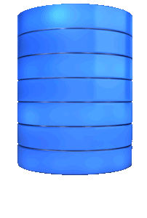
Why IRIS Uses HNSW for Vector Search
Fast: Sub-linear time retrieval even for millions of vectors.
Accurate: Returns high-quality approximate matches.
Incrementally updatable: New vectors can be inserted without full reindexing.

Slide 20
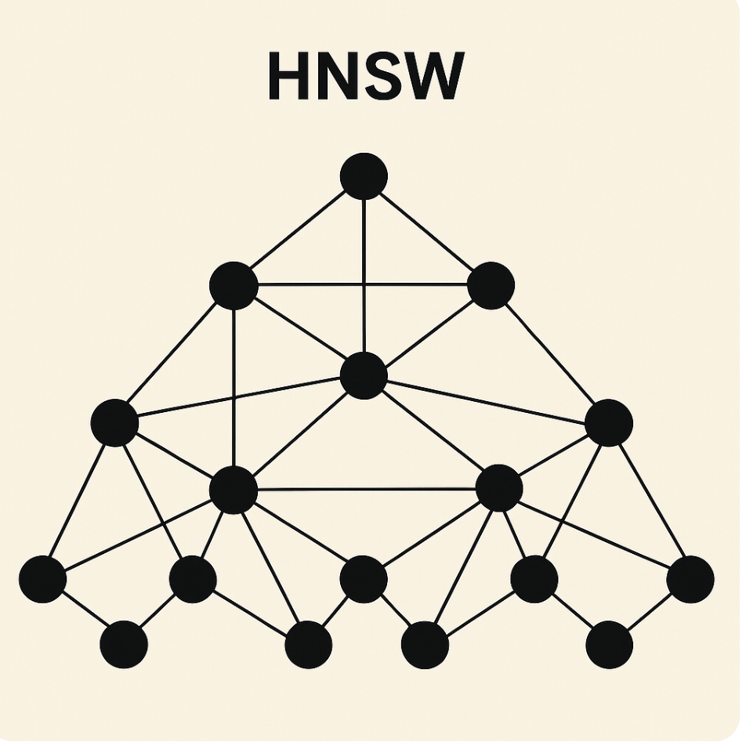
Hierarchical Navigable Small World (HNSW)
High-performance algorithm for Approximate Nearest Neighbor (ANN) search in high-dimensional spaces — like vector embeddings.
Hierarchical: The index is organized in layers, from coarse to fine granularity, which speeds up search by allowing quick elimination of large areas of the space.
Navigable: The graph structure allows for efficient greedy traversal to find approximate neighbors.
Small World: Based on the small-world phenomenon — the idea that any two nodes can be reached via a short sequence of hops. The graph is sparsely connected but still efficient for navigation.

Slide 21

Challenge Two(C) – Load Vectors into Your Hybrid Table
Use the following SQL Code to insert your vector
INSERT INTO PatientSummaryVectors (summary_id, summary_text, embedding)
VALUES (?, ?, TO_VECTOR(?,FLOAT))

Slide 22
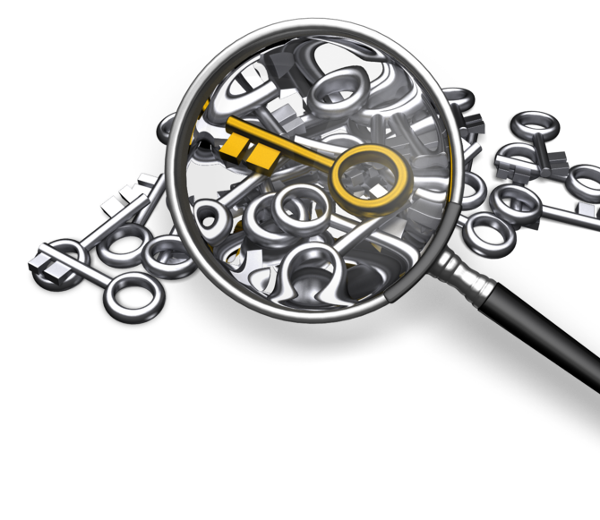
Step Two(D) –Search Your Vector Table
      SELECT TOP {top_k}
      summary_id,
      VECTOR_COSINE(embedding, ?) AS similarity
      FROM PatientSummaryVectors
      ORDER BY similarity DESC

Slide 23
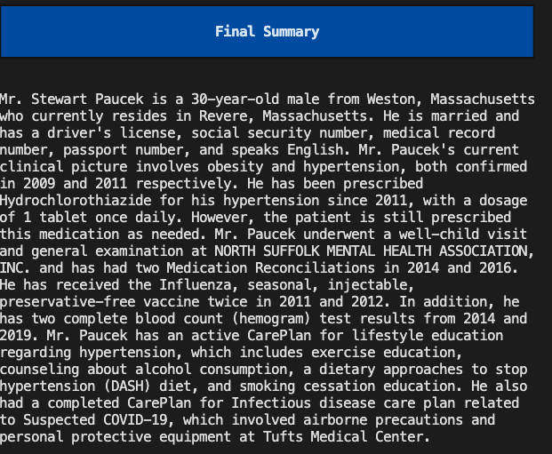

Challenge Three- Creating A Summary that Combines Partial Summaries over Resource Types

Slide 24
Challenge Three (A) – Create a Hybrid Table over all Resources in the Patient Compartment
CREATE TABLE PatientVectors (
patient_id VARCHAR(75),
patient_lastname VARCHAR(75),
patient_firstname VARCHAR(75),
resource_type VARCHAR(50),
resource_id VARCHAR(75),
embedding VECTOR(DOUBLE, 768),
resourcetext VARCHAR(4000)
)
cursor.execute("""
CREATE INDEX vector_index
ON TABLE SQLUser.PatientVectors (embedding)
AS HNSW(Distance='Cosine')
""")

Slide 25

Does RAG Require a Hybrid Vector Table?
Retrieval-Augmented Generation (RAG) simply means “fetch some external context, then feed it to an LLM to generate a response.” The “retrieval” step can be implemented in many ways—vector search is merely the most popular today because it excels at finding semantically similar passages. But RAG itself does not strictly require vectors.
This Photo by Unknown Author is licensed under CC BY

Slide 26
Retrieval Techniques
1. Traditional (Sparse) Retrieval
Keyword/Boolean search (e.g. SQL LIKE, Elasticsearch BM25)
Works by matching exact words or weighted term frequencies.
Pros: mature, easy to index, explainable scores.
Cons: brittle to synonyms and paraphrases; may miss relevant docs.
2. Hybrid Retrieval
Combines vector (dense) embeddings with term-based (sparse) methods.
You might first filter by keywords (e.g. date ranges, metadata) then re-rank top hits by cosine similarity.
Balances precision, recall, and speed.
3. Non-Vector “Retrieval”
RAG via API calls: e.g. query a search engine or knowledge base over HTTP, then feed top snippets to your LLM.
Database lookups keyed by structured attributes (patient ID, date, category).

Slide 27
Comparison
When Vector Search Shines
Semantic matching: paraphrases, synonyms, varied jargon
Noisy or user-generated text where exact keywords are rare
Filtering huge corpora (millions of docs) for closest matches
When You Can Skip It
Small, well-structured collections where keyword or metadata filters are sufficient
Highly domain-specific retrieval (e.g. you know the exact document ID or date window)
Cost or complexity constraints—if you already have an Elasticsearch cluster, you may use its BM25 ranking without adding a vector index

Slide 28
Challenge Three (B) – Get All Patient Ids in the FHIR Repository
def search_patients_get_ids(search_params: str) -> list:
"""
Executes a FHIR search for Patients based on `search_params`
(e.g., "name=Smith"), retrieves a Bundle, and uses fhirpathpy
to extract an array of Patient IDs.
"""
# Construct search URL (e.g., /Patient?name=Smith)
base_url = "http://127.0.0.1:8080/csp/healthshare/demo/fhir/r4"
url = f"{base_url}/Patient?{search_params}”
# Parse response JSON into a Python dictionary
bundle_dict = response.json()
# Optional: parse into a Bundle resource for validation (not strictly required for fhirpath)
# bundle_resource = Bundle.parse_obj(bundle_dict)
# Use FHIRPath to gather all Patient IDs
# The path "Bundle.entry.resource.id" will collect "id" from each resource within the entries
patient_ids = fhirpath(bundle_dict, "Bundle.entry.resource.id")
return patient_ids

Slide 29
Challenge Three (C) -Index Each Resource by Patient Id, Patient Name, Resource Type, Resource Id
bundle = self.get_patient_bundle(self.fhirId)
patientResources = self.extract_resources(bundle, "Patient")
if not patientResources:
print("Can not find the patient resource, vector creation terminated")
return
elif len(patientResources) > 1:
print("Found more than one patient resource, vector creation terminated")
return
else:
pt = patientResources[0]
name = pt['name'][0]
self.firstName = name['given'][0] if name['given'] else ""
self.lastName = name['family'] if name['family'] else ""

Slide 30
Challenge Three (D) – Flatten the Resource into a String
def flatten_fhir_resource(self, resource: dict) -> str:
def recurse(obj, prefix=""):
lines = []
if isinstance(obj, dict):
for k, v in obj.items():
lines.extend(recurse(v, prefix + k.capitalize() + ": "))
elif isinstance(obj, list):
for item in obj:
lines.extend(recurse(item, prefix))
else:
lines.append(f"{prefix}{str(obj)}")
return lines
return "\n".join(recurse(resource))

Slide 31
Challenge Three (E) – Truncate Resource String and Create Embedding
text_bytes = text.encode('utf-8', errors='ignore')
text = text_bytes[:max_chars].decode('utf-8', errors='ignore')
# Skip blank or invalid text
if not text.strip():
print(f"❌ Skipping insert: text is empty.")
return
# Generate embedding
embedding = self.model.encode(text).tolist()
embedding_strs = [f"{x:.8f}" for x in embedding]
embedding_csv = ",".join(embedding_strs)

Slide 32
Challenge Three (F) – Insert Vector into Hybrid table
embedding_strs = [f"{x:.8f}" for x in embedding]
embedding_csv = ",".join(embedding_strs)
params = [pid, last, first, rtype, rid, embedding_csv, text_sql]
sql = f"""
INSERT INTO PatientVectors (patient_id, patient_lastname, patient_firstname, resource_type, resource_id, embedding, resourcetext) VALUES (?, ?, ?, ?, ?, TO_VECTOR(?,FLOAT), ?)
"""

Slide 33
Challenge Three (G) – Retrieve and Summarize FHIR Resources
Get all FHIR Resources for a Given Patient
Create A Partial Summary of Each FHIR Resource
Combine all the Summaries
Create A Final Summary that Summarizes all the Partial Summaries

Slide 34
Challenge Four – Combine Regular Search with Vector Search
Build a chatbot that has two inputs – the patients FHIR Id, and clinical question
Answer the user’s question precisely and concisely
Return in the User prompt the Patient’s first and Last Name
Return the Bot’s answer

Slide 35
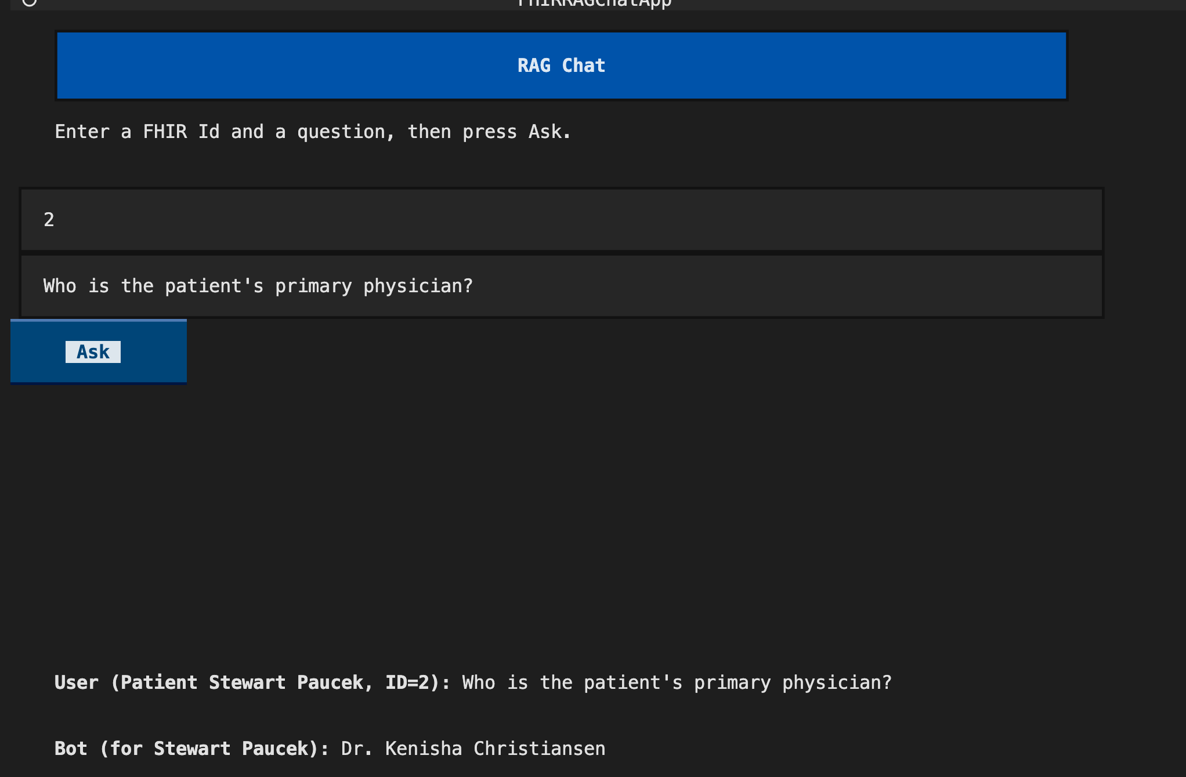
Example Output

Slide 36
Errata for Hybrid Vector Search
Step One
sql = f"""
SELECT TOP {TOP_K}
resource_id,
VECTOR_COSINE(embedding, TO_VECTOR(?,DOUBLE)) AS score
FROM {VECTOR_TABLE}
WHERE patient_id = ?
ORDER BY score DESC
""”
cur.execute(sql, [csv, fhir_id])
id_sim_pairs = cur.fetchall()
if not id_sim_pairs:
return "No matching data found for that patient."
cur = self.conn.cursor()
Step Two
for each ID, fetch the text separately
results = []
text_sql = "SELECT CAST(resourcetext AS VARCHAR(4000)), patient_lastname, patient_firstname FROM PatientVectors WHERE resource_id = ?"
for rid, sim in id_sim_pairs:
cur.execute(text_sql, [rid])
(text, ptLastName, ptFirstName) = cur.fetchone()
results.append((rid, text, ptLastName, ptFirstName,sim))

Slide 37
Common Pitfalls
Vector search is only as good as three things: your embeddings, the texts you’re indexing, and how you query them.
Embedding Model Isn’t Medical-Specialized
You’re using nomic-embed-text-v1.5, which is a great general-purpose encoder, but it may not capture the nuance of clinical terms as well as a biomedically-tuned model (e.g. Bio_ClinicalBERT, Clinical-SBERT). A generic model often “sees” long, narrative med-rec texts as more semantically rich, drowning out the shorter Condition entries.
No Resource-Type Filtering
SELECT TOP 4 resourcetext, … FROM PatientVectors WHERE patient_id = ? ORDER BY VECTOR_COSINE(… ) DESC
only constrains by patient. You could boost relevance dramatically by also filtering to resource_type = 'Condition' when you’re specifically looking for conditions, or by returning 8–10 rows and then post-filtering by type in Python.

Slide 38
Comparison of RAG vs Graph RAG
Feature | RAG | Graph RAG
Structure of Knowledge | Flat document chunks | Nodes and relationships (graphs)
Retrieval Strategy | Top-N via embeddings | Targeted traversal of graph paths
Reasoning Capability | Single-hop | Multi-hop reasoning
Context Quality | Redundant, unstructured | Deduplicated, linked, and relevant
Explainability/Updates | Low | High

Slide 39
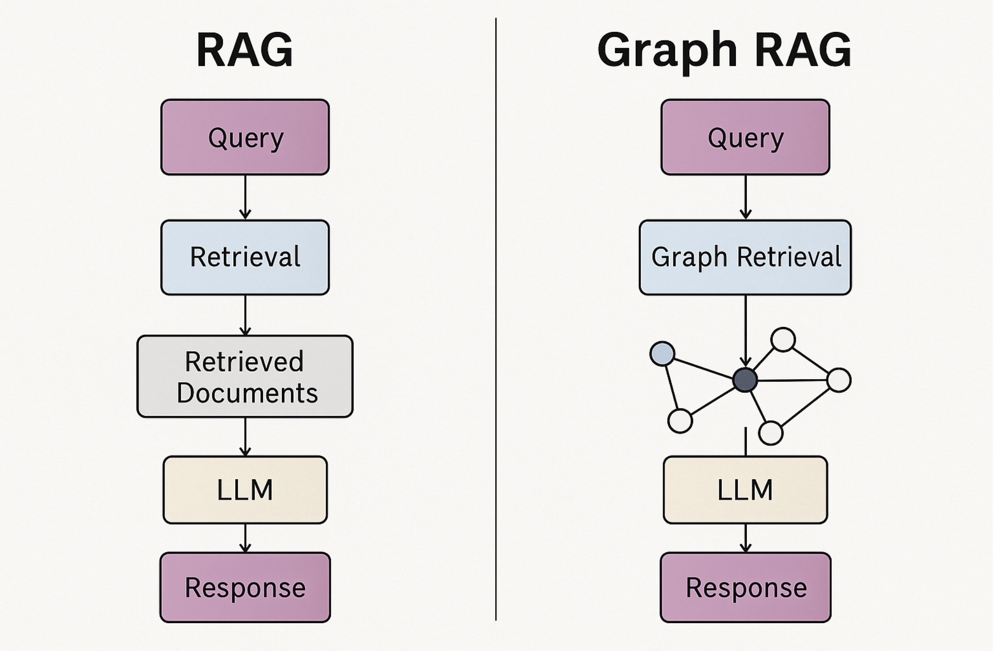

Slide 40
How Graph RAG Data Structures Are Built
Text Chunking and Parsing
Like RAG, the source documents (docs, webpages, transcripts, etc.) are chunked into passages.
Each passage is parsed to identify entities and relationships using NLP techniques (NER, dependency parsing, co-reference resolution, etc.).
2. Knowledge Graph Construction
Entities become nodes (e.g., people, drugs, concepts).
Relationships become edges (e.g., “treats,” “is a subtype of,” “causes”).
Optionally, each node and edge can store metadata (like provenance, source chunk, timestamp, or embedding).

Slide 41
Advantages of Graph Search in Graph RAG
Feature | Graph RAG Search Benefit
Relevance | Finds paths that logically connect concepts
Multi-hop Reasoning | Enables chain-of-thought via graph traversal
Explainability | Can trace which nodes/edges contributed to the answer
Compact Context | Avoids redundant or loosely relevant text chunks

Slide 42
How Graph RAG Can Help in FHIR Context
Challenge in Flat RAG | What Graph RAG Enables
Isolated text chunks may lose clinical context | Traverse patient → observation → code hierarchies
Difficult to reason over timelines or encounters | Use edge types like "preceded by", "performed during"
Complex joins needed to assemble a case | Graph traversal can walk relevant resource links
Limited control over what gets retrieved | Retrieve context by subgraph (e.g., all Observations for one Encounter)

Slide 43
There are three common methods to build the graph:
Rule-based extractors for specific domains (e.g., biomedical).
LLMs with structured prompts to generate triples.
Ontology-aligned systems (e.g., mapping to SNOMED CT, FHIR resources, etc.).

Slide 44
Thank you

