Slide 1
GROUP 1 GLOBAL SUICIDE RATES

Slide 2
Master.csv
Dataset on kaggle compiled from WHO, United Nations Development Program and World Bank.
Measures global suicide rates from 1985 to 2016.
Attributes contained in datatset:
Age
Sex
HDI
GDP
Suicide and Suicide/100k pop
Country
Generation
Weather data sourced from National Centres for Environmental Information. Used to extract information like max, min and average temperature for each country.

Slide 3
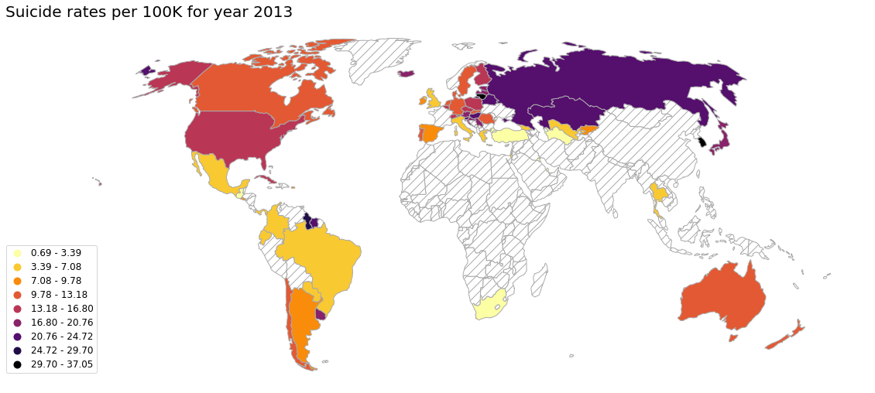
2013 GLOBAL RATES

Slide 4
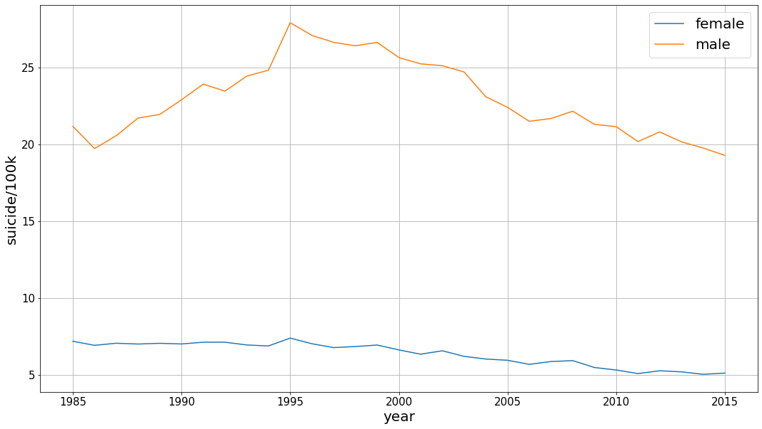
Male vs Female suicide

Slide 5
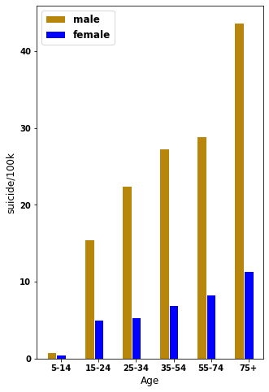
Male vs Female suicide contd
Rates for men significantly higher than women. (3 to 4 times as much.)
According to research, unresolved mental health problems and alcohol addiction main factor.
In US, attempts are higher for women, so men choose more lethal ways.
Difference is most extreme for age group ‘75+’.

Slide 6
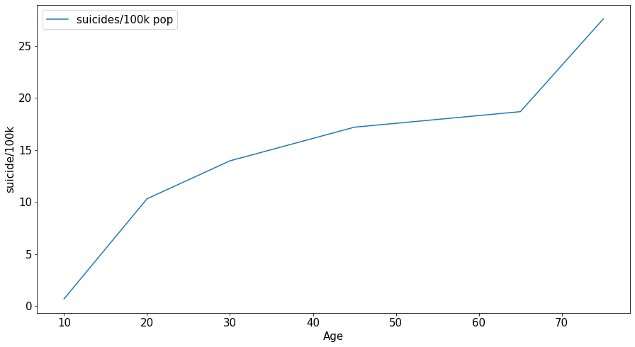
Age correlation

Slide 7
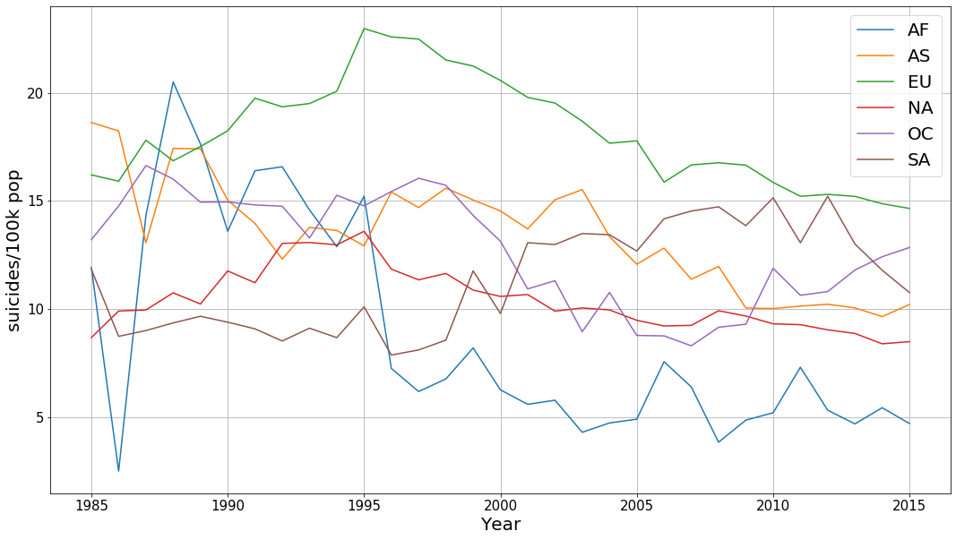
SUICIDES BY CONTINENT

Slide 8
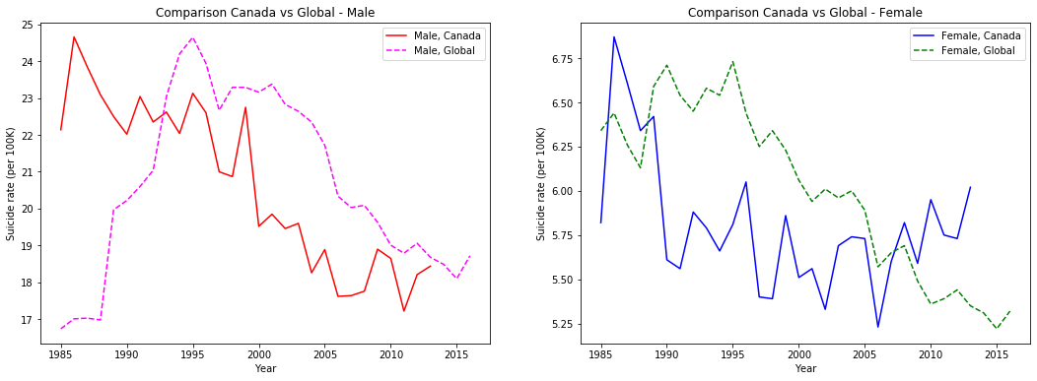
CANADA vs GLOBAL
Male rate for canada been lower mostly, but gap closing.
Female rates have been lower, but became higher recently.

Slide 9
CORRELATION TO TEMPERATURE

