Slide 1
Building a Canjo
Notes:
Instructions

Slide 2

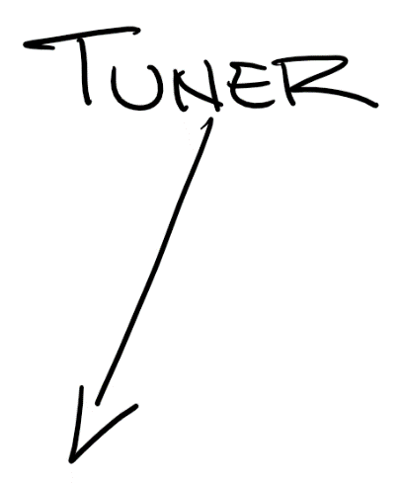
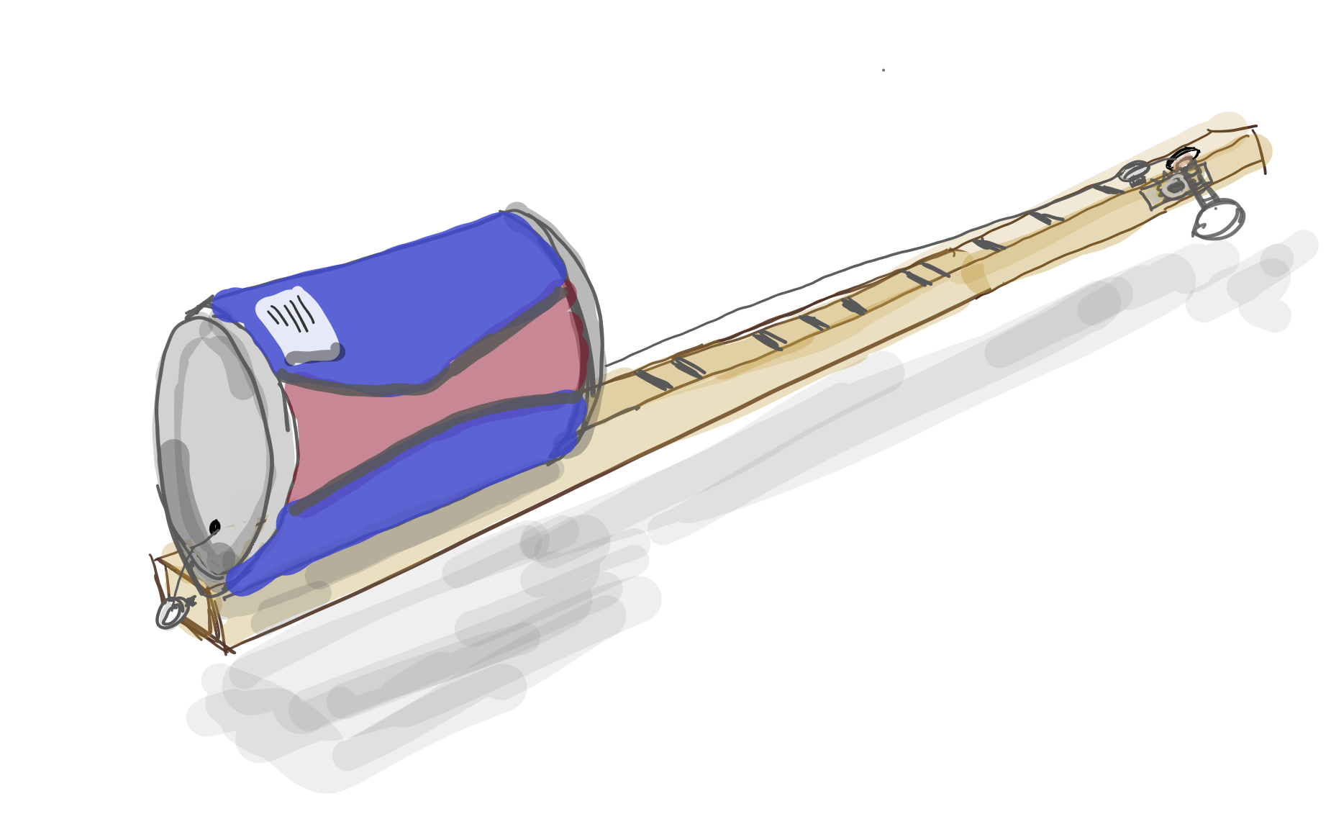
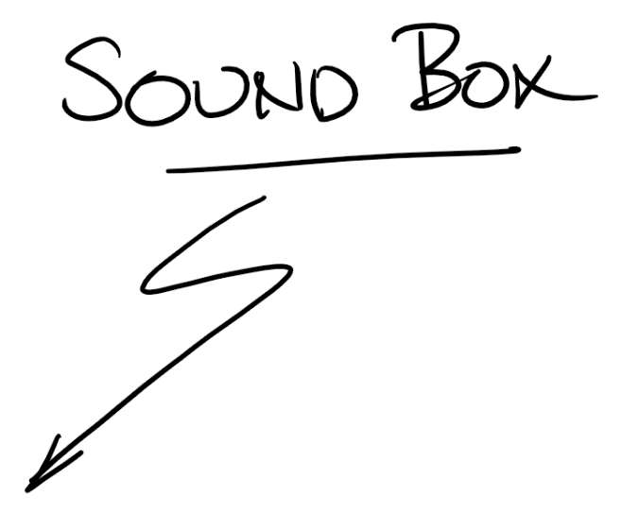
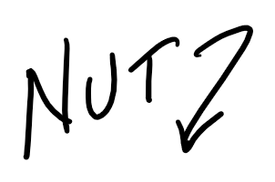
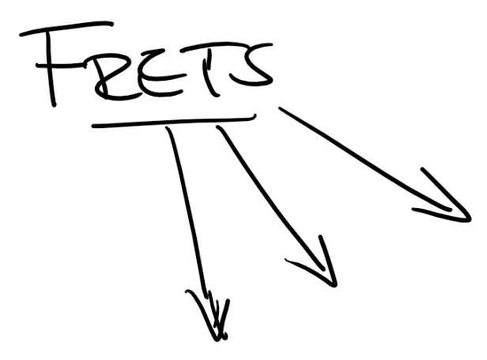
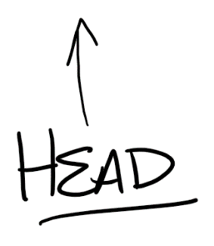
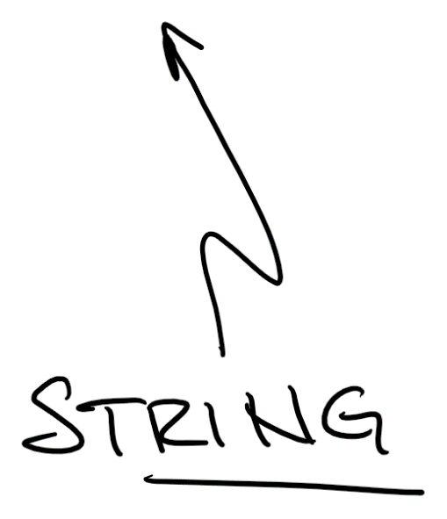
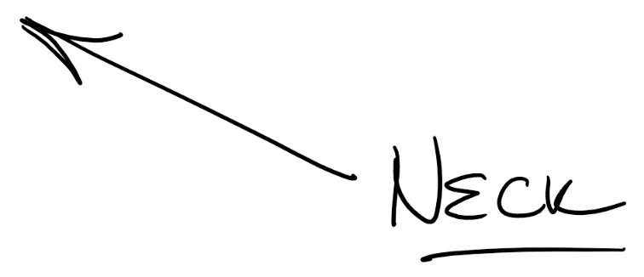

Notes:
The canjo features the same basic components as a guitar. The neck is a simple straight stick of wood. Our nut is a slotted screw. The bridge is a hole in the can. The can acts as the “sound box” to amplify the sound of the single string.
Unlike the guitar’s “chromatic” fret layout, the frets of a canjo are arranged to create a “diatonic” scale comprising the seven pitches of a whole, major scale. This is the same as the “white” keys on a piano.

Slide 3
Assembling Your Canjo

Slide 4
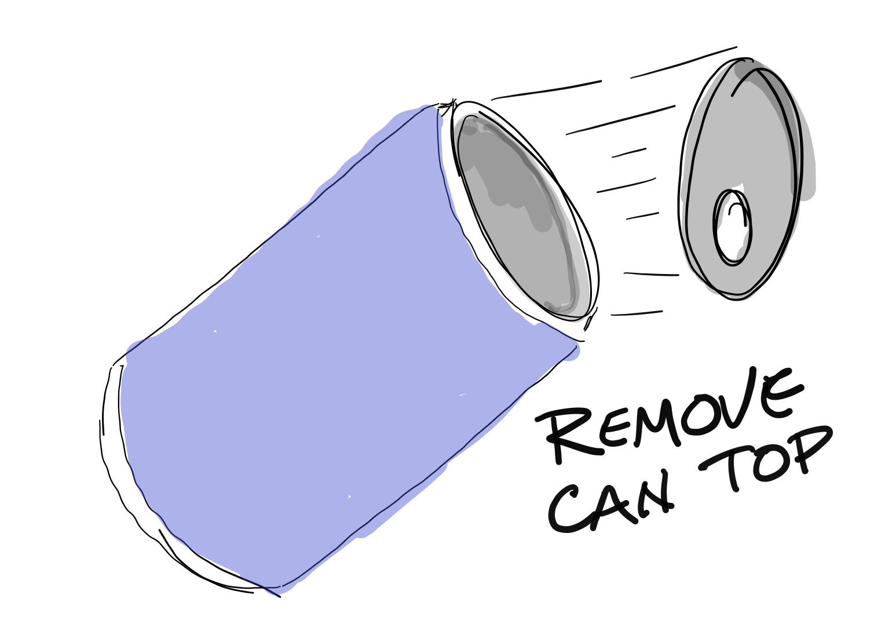
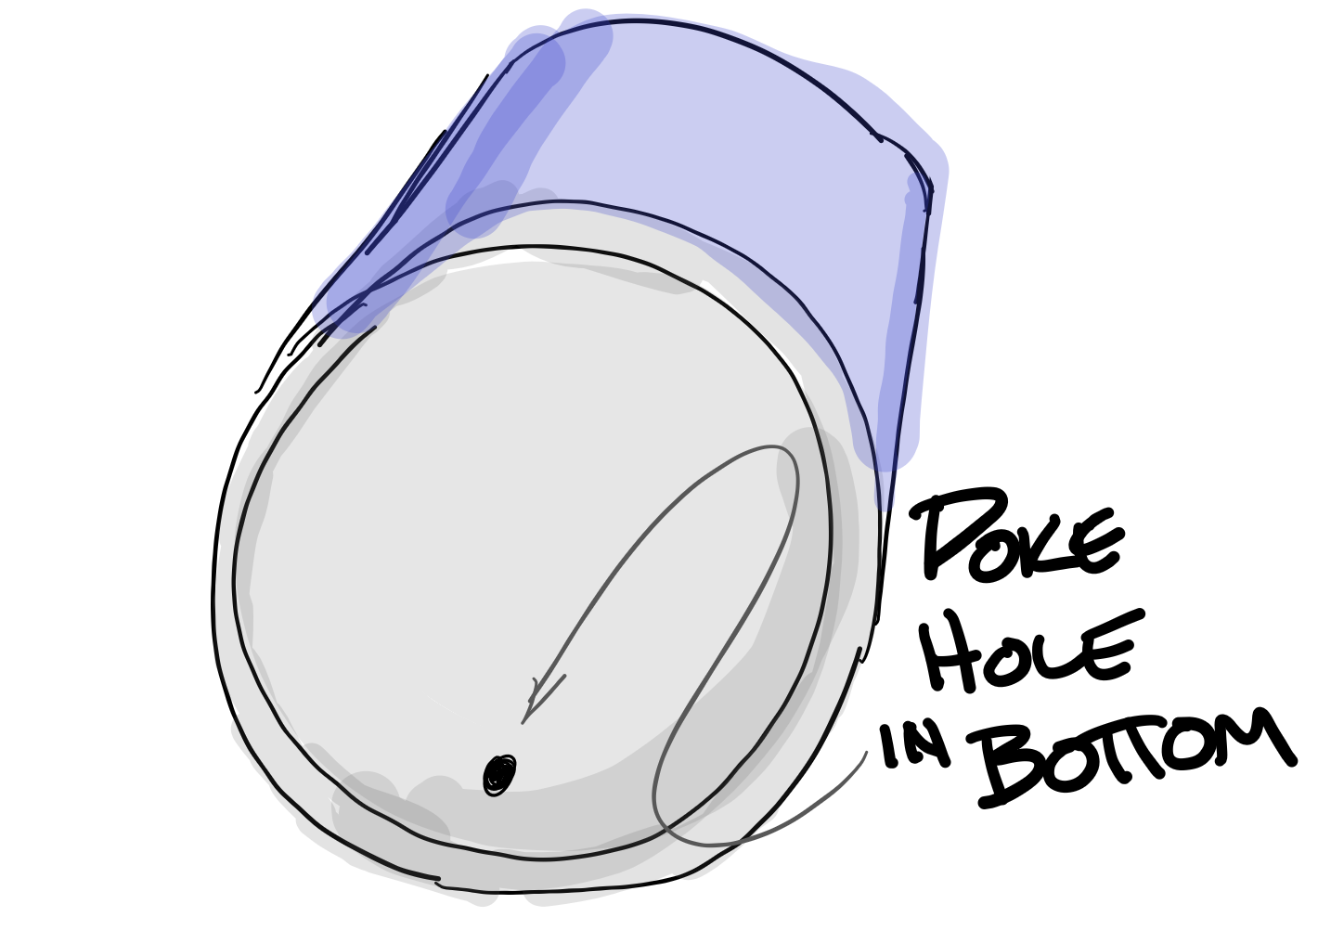
Prepare the can (SOUND BOX)
Notes:
Use a safety can opener to remove the lid from your can. I find it easiest to hold the can upright in my lap to help hold the can and can opener in the proper orientation with constant pressure.
Poke a small hole in the bottom of your can with a hammer and nail, awl, or similar. Be sure to align the hole at the bottom with your can’s “best side” facing up.

Slide 5
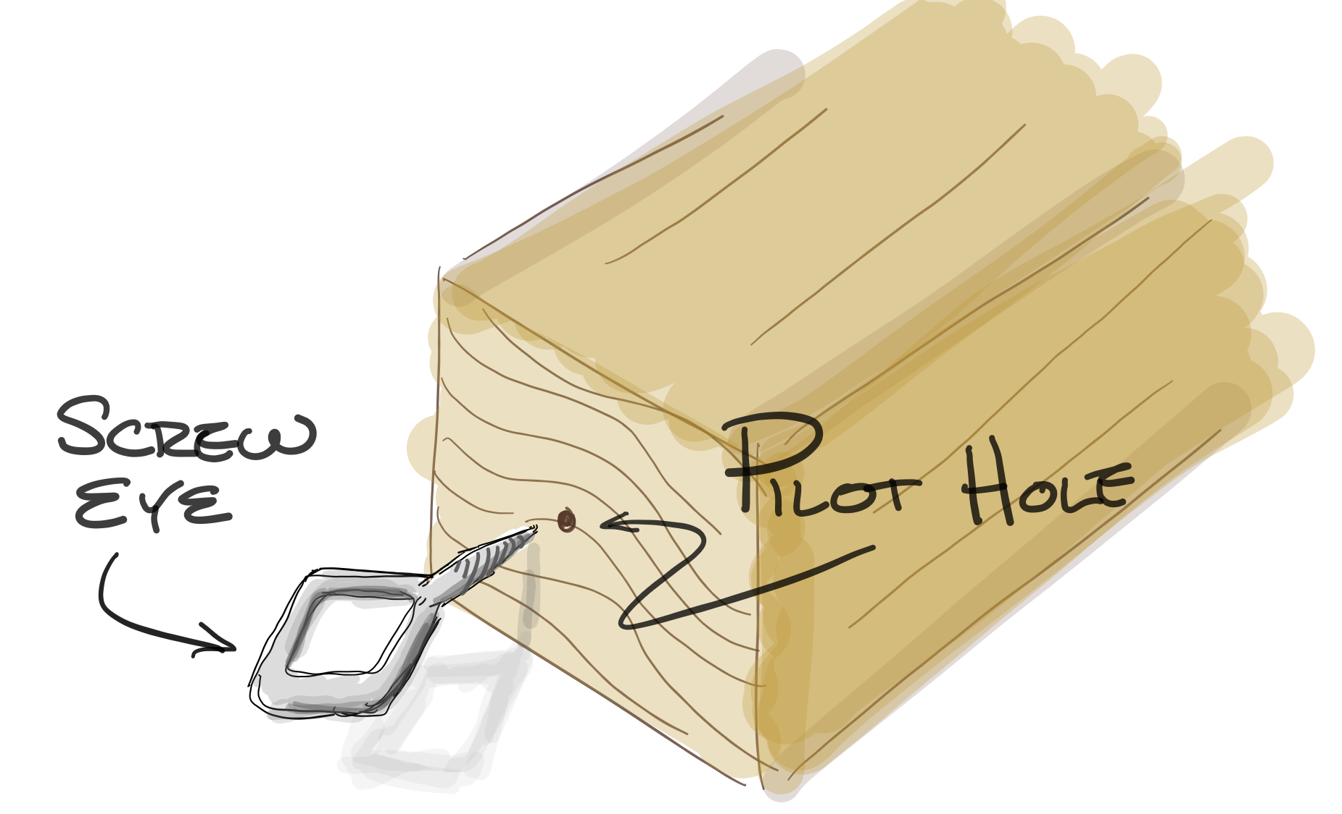
Screw in the “tail”
Notes:
Locate the pilot hole in the end of the stick (neck). Insert and screw in the eye screw.
We will attach the ball end of our string to this screw eye.

Slide 6
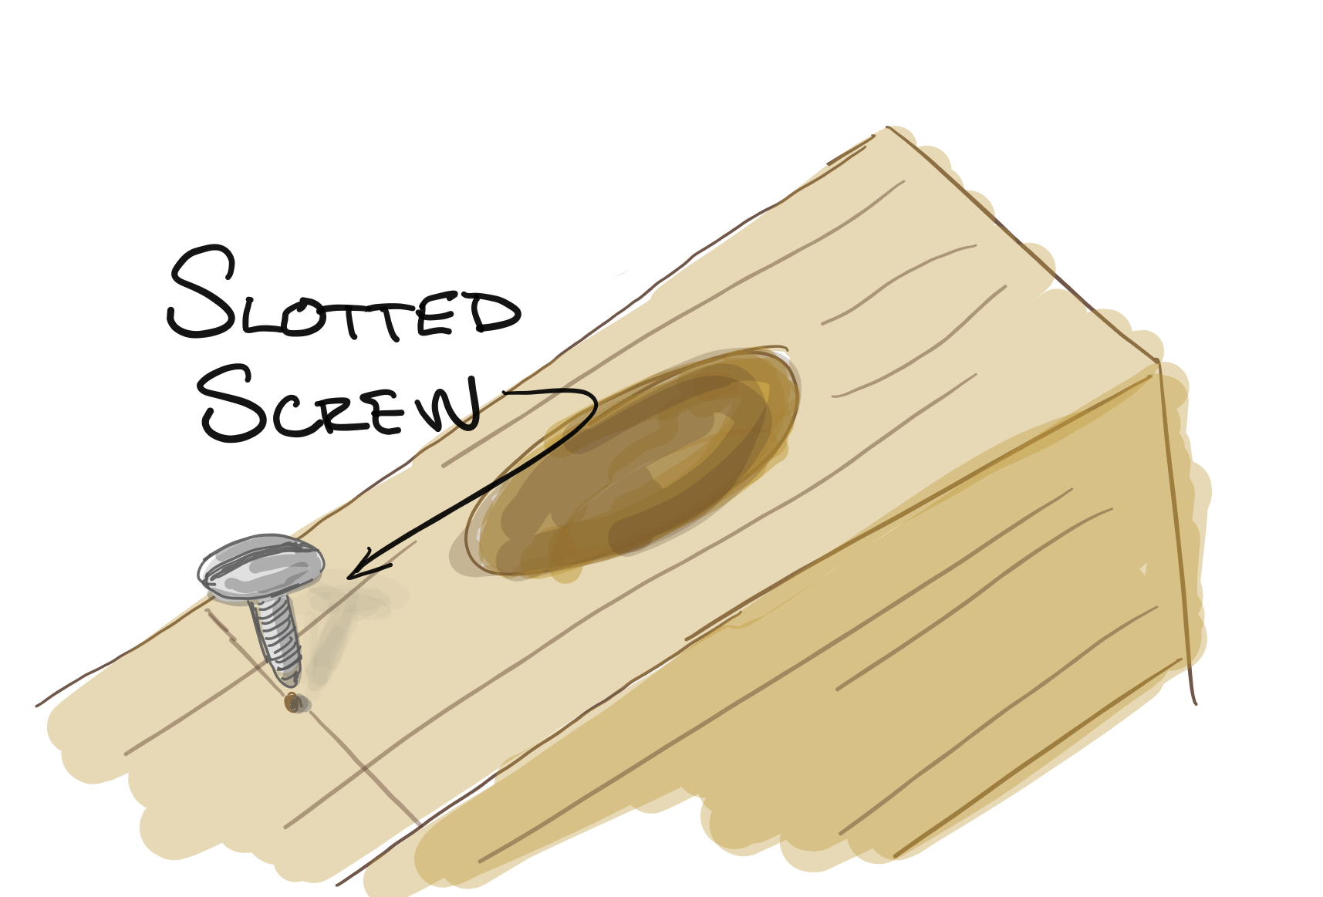
Screw in the “nut”
Notes:
Screw the slotted “nut” screw into the pilot hole on the top part of the stick nearest the tuner hole.
The long slot should be aligned with the long dimension of the stick to form a channel for our string.

Slide 7
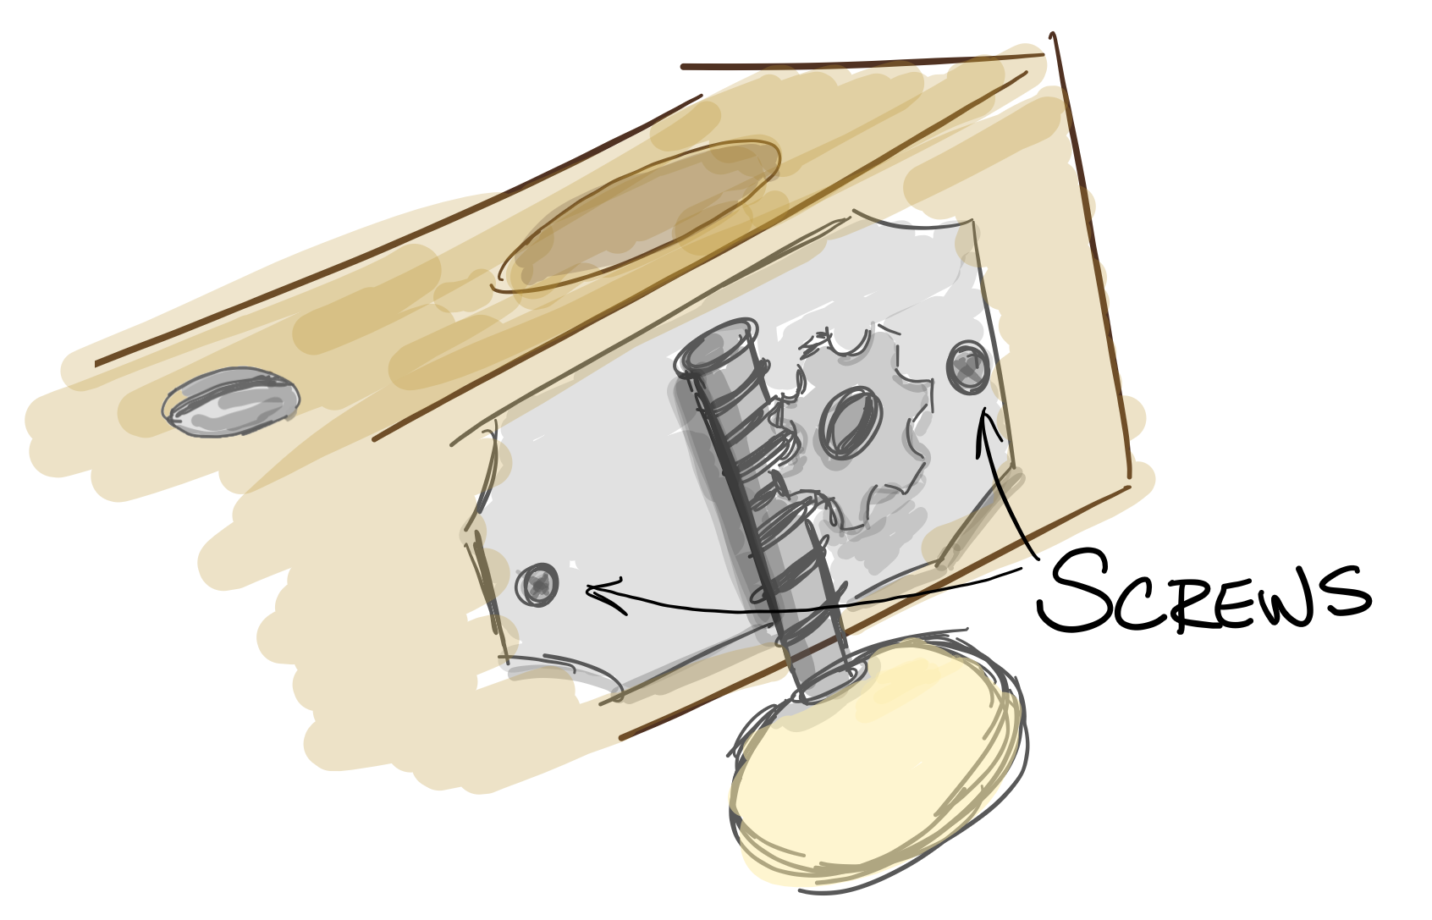
Install the tuner
Notes:
Install the tuning peg into the pre-drilled holes. (Note that the tuning knob in your kit will face UP – opposite the drawing above)
Align the holes in the tuner plate with the pilot holes on the side of the stick
Screw in the small tuner screws with a small phillips head screw driver.

Slide 8
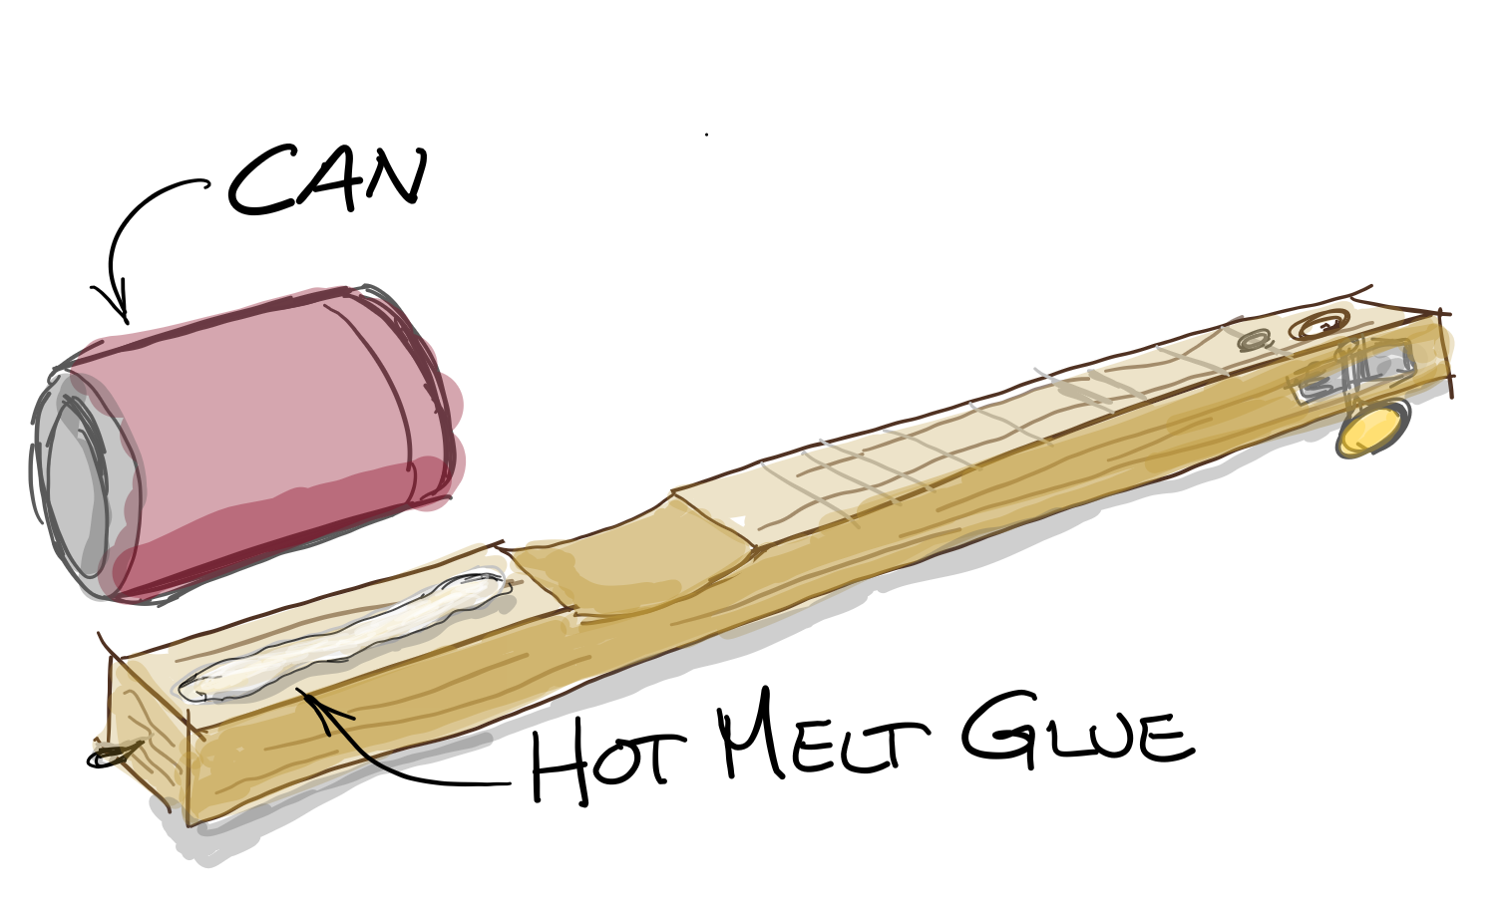
Glue on the can
Notes:
Using a hot melt glue gun, glue the can to the end of the stick opposite the tuner. (CAUTION: HOT. Have an adult assist with this step)
The “bridge” hole should be aligned to the end of the stick – or 25-1/2” from the middle of the “nut”.
This is our “scale” length and the placement ensures our notes are in proper tune.

Slide 9
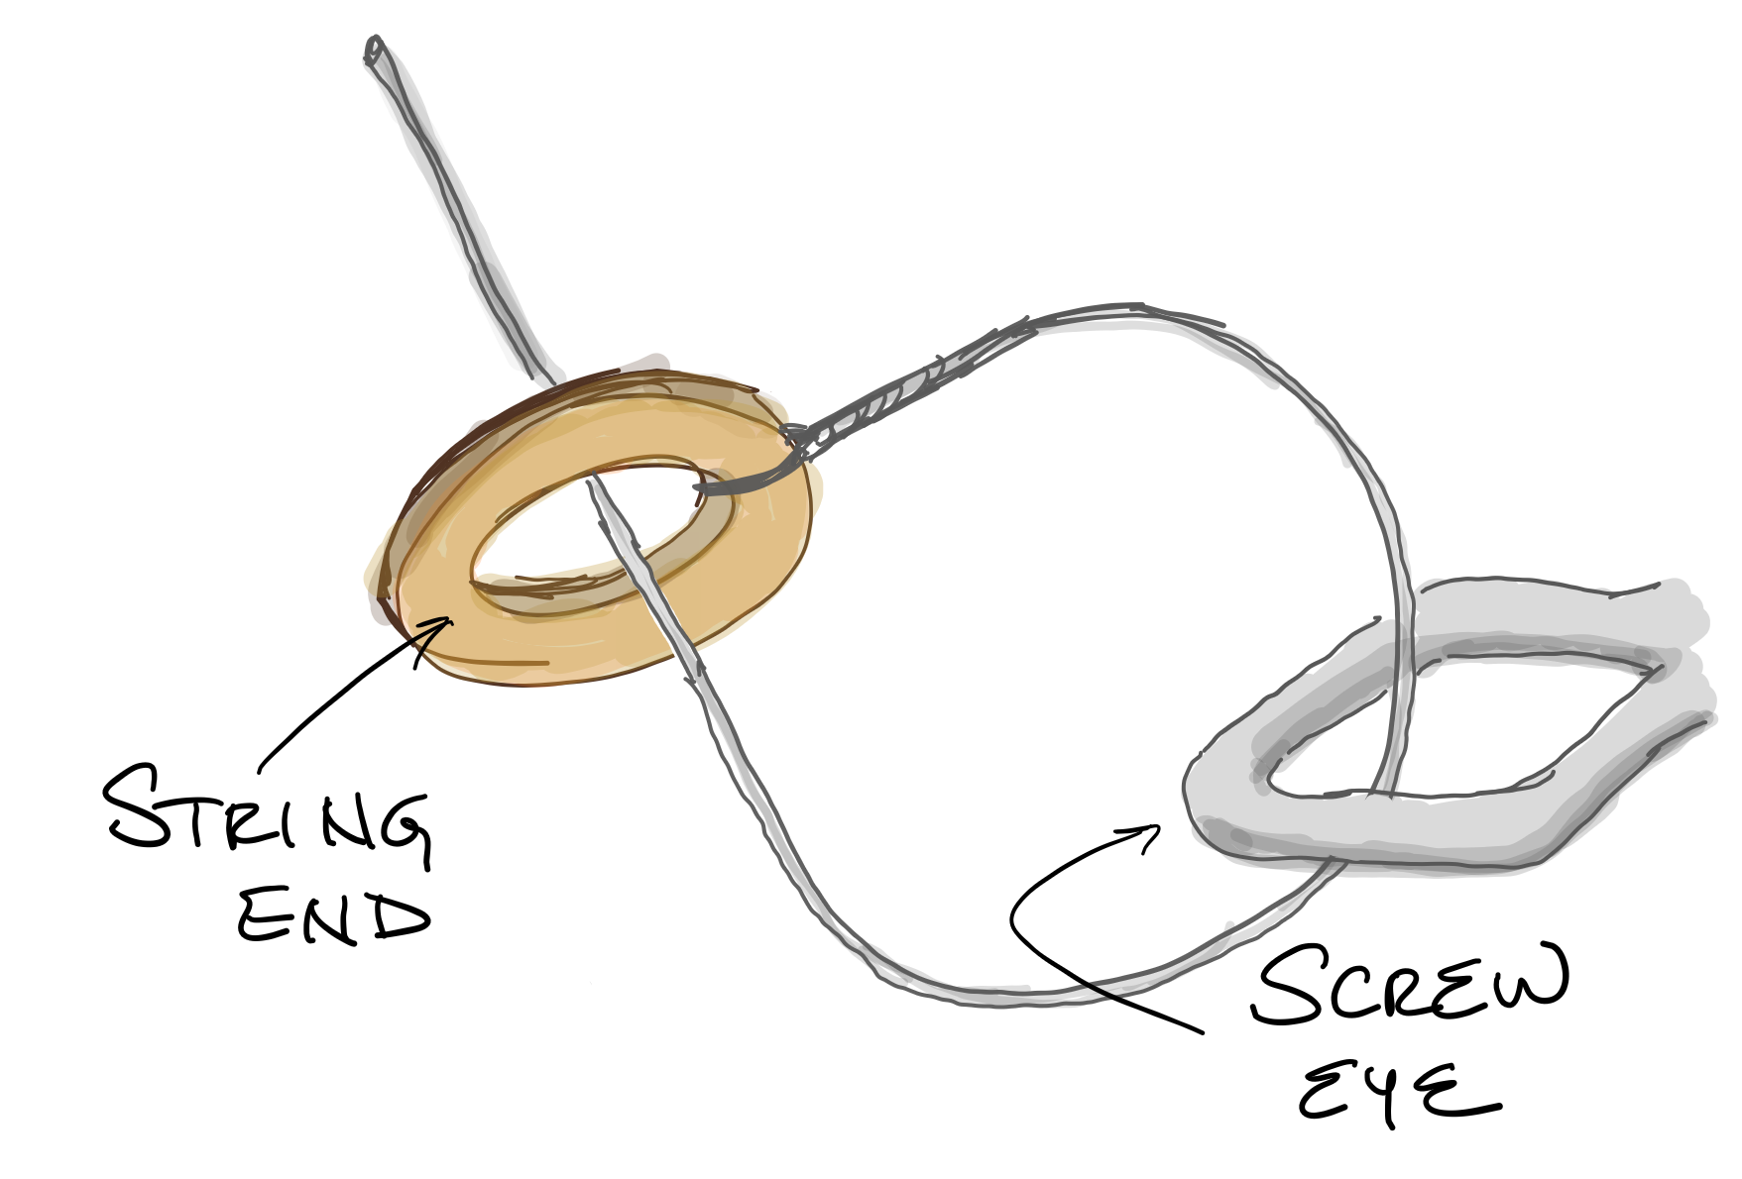
Attach the string and tune it up!
Notes:
Feed the string through the tail screw eye and then through the round eyelet on the end. Continue by feeding it through the hole in the bottom of the can, up the neck, over and within the nut screw slot, and finally into the tuner hole.
Wind the tuner until the string is taught and to a pleasing pitch.
You’re now ready to play your first tunes on your new canjo!

Slide 10
ENJOY Playing YouR Canjo!

