Slide 1
MODULE-2 DIRECTING & CONTROLLING

Slide 2
TOPIC-2.1 MEANING & NATURE OF DIRECTING

Slide 3
I [O ]
I:
O: S:
W: R
S: S
S: S

Slide 4
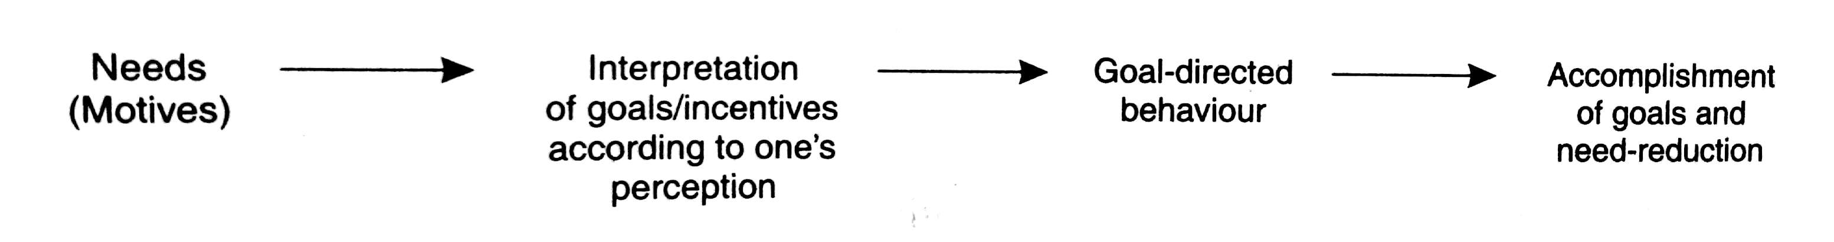
N [T]
Diagram-: Motivation process indication diagram

Slide 5
TOPIC-2.3 MOTIVATION THEORIES

Slide 6
TOPIC-2.3.1 MEANING FEATURES & NATURE OF MOTIVATION

Slide 7
MOTIVATION THEORIES [O ]
I:
OVERVIEW OF BASIC OF MOTIVATION: S:
Definition & Basic Features Of Motivation: R
S: S

Slide 8
N [T]
Diagram-: Motivation process indication diagram

Slide 9
TOPIC-2.3.2 COMPLEXITIES INVOLVED IN UNDERSTANDING TRUE MOTIVATION

Slide 10
MOTIVATION THEORIES [O ]
I:
OVERVIEW OF BASIC OF MOTIVATION: S:
Complexities Involved In Understanding True Motivation: R
Individuals differ in their motivation: S
S: S
S: S
Individuals himself is unaware of his motivation: S
S: S
S: S
Motivation changes: S
S: S
S: S

Slide 11
MOTIVATION THEORIES [O ]
I:
OVERVIEW OF BASIC OF MOTIVATION: S:
Complexities Involved In Understanding True Motivation: R
Motivations are expressing and dealing differs among individuals: S
S: S
S: S
Motivation study and dealing is difficult and complex: S
S: S
S: S
Multiple Motivation goal problem: S
Approach-Approach conflict: S
Avoidance-Avoidance conflict: S
Approach-Avoidance conflict: S

Slide 12
TOPIC-2.3.3 OVERVIEW OF DIFFERENT MOTIVATION THEORIES

Slide 13
TOPIC-2.3.3.1 MASLOW’s THEORIES

Slide 14
MOTIVATION THEORIES [O ]
I:
OVERVIEW OF MOTIVATION THEORIES: S:
Basic introduction & features of MASLOW’s motivation theories: R
M: S
S: S
S: S
M : S
S: S
S: S
MASLOW’s priority order of human needs: R
Physiological needs: S
S: S
S: S

Slide 15
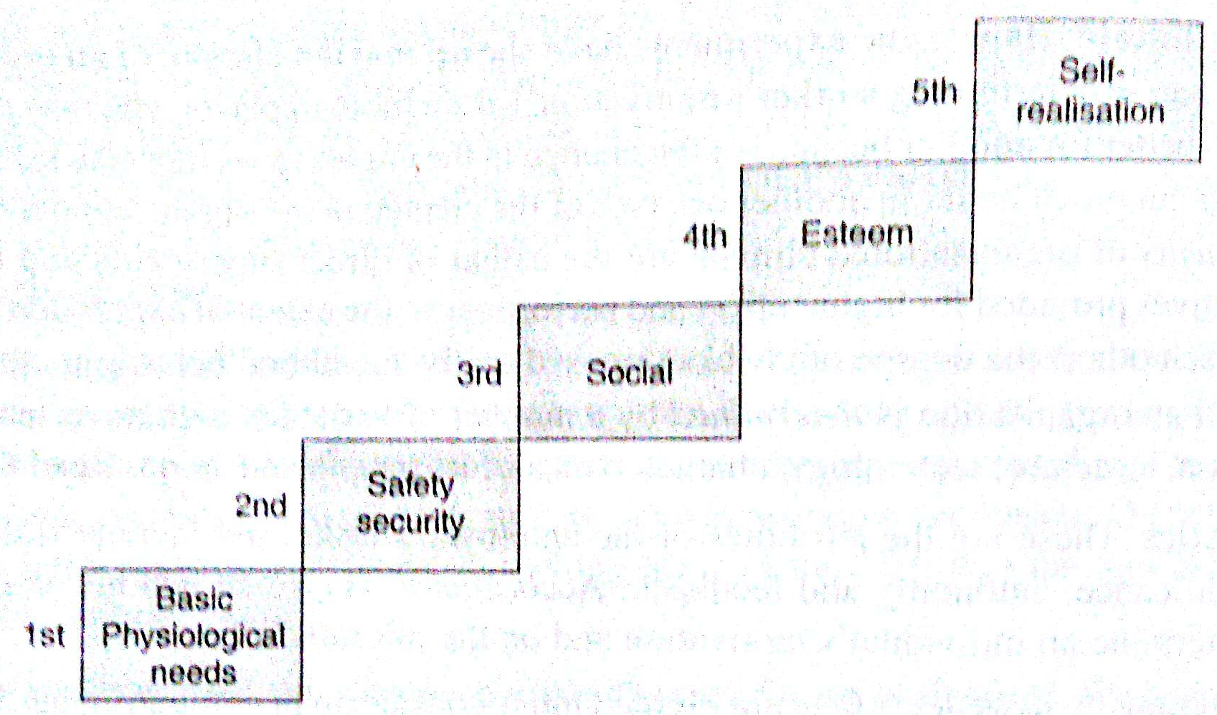
MOTIVATION THEORIES [T]
Diagram- : Order of Priority of human needs

Slide 16
MOTIVATION THEORIES [O ]
I:
OVERVIEW OF MOTIVATION THEORIES: S:
MASLOW’s priority order of human needs: R
Safety & security needs: S
S: S
S: S
Social needs: S
S: S
S: S
Esteem needs: S
S: S
S: S
Self-realization/self fulfillment needs: S
S: S
S: S

Slide 17
MOTIVATION THEORIES [O ]
I:
OVERVIEW OF MOTIVATION THEORIES: S:
MASLOW’s priority order of human needs: R
Low order needs: S
Physiological needs: S
Safety/ security needs: S
high order needs: S
Social needs: S
Esteem needs: S
Self-realization needs: S

Slide 18
MOTIVATION THEORIES [O ]
I:
OVERVIEW OF MOTIVATION THEORIES: S:
Merits & Demerits MASLOW’s Theory: R
Merits: S
Identifies different needs: S
Extends to study of all areas of human needs: S
Gives the insight of history & future: S
Identifies the fact that a satisfied need is not motivator: S
De-merits: S
Order of needs and scale of needs change: S
Identifying a person’s needs from his behaviors analysis is difficult: S
Untested Theory: S

Slide 19
TOPIC-2.3.3.2 HERZBERG’s 2-FACTOR THEORIES

Slide 20
MOTIVATION THEORIES [O ]
I:
OVERVIEW OF MOTIVATION THEORIES: S:
Basic introduction & features of HERZBERG’s 2-factor motivation theories: R
M: S
S: S
S: S
M : S
M: S
M: S
2-factors of HERZBERG’s Theory: R
Maintenance/hygiene factors[Intrinsic rewards]: S
S: S
S: S
Motivators/satisfiers[Extrinsic rewards]: S
S: S
S: S

Slide 21
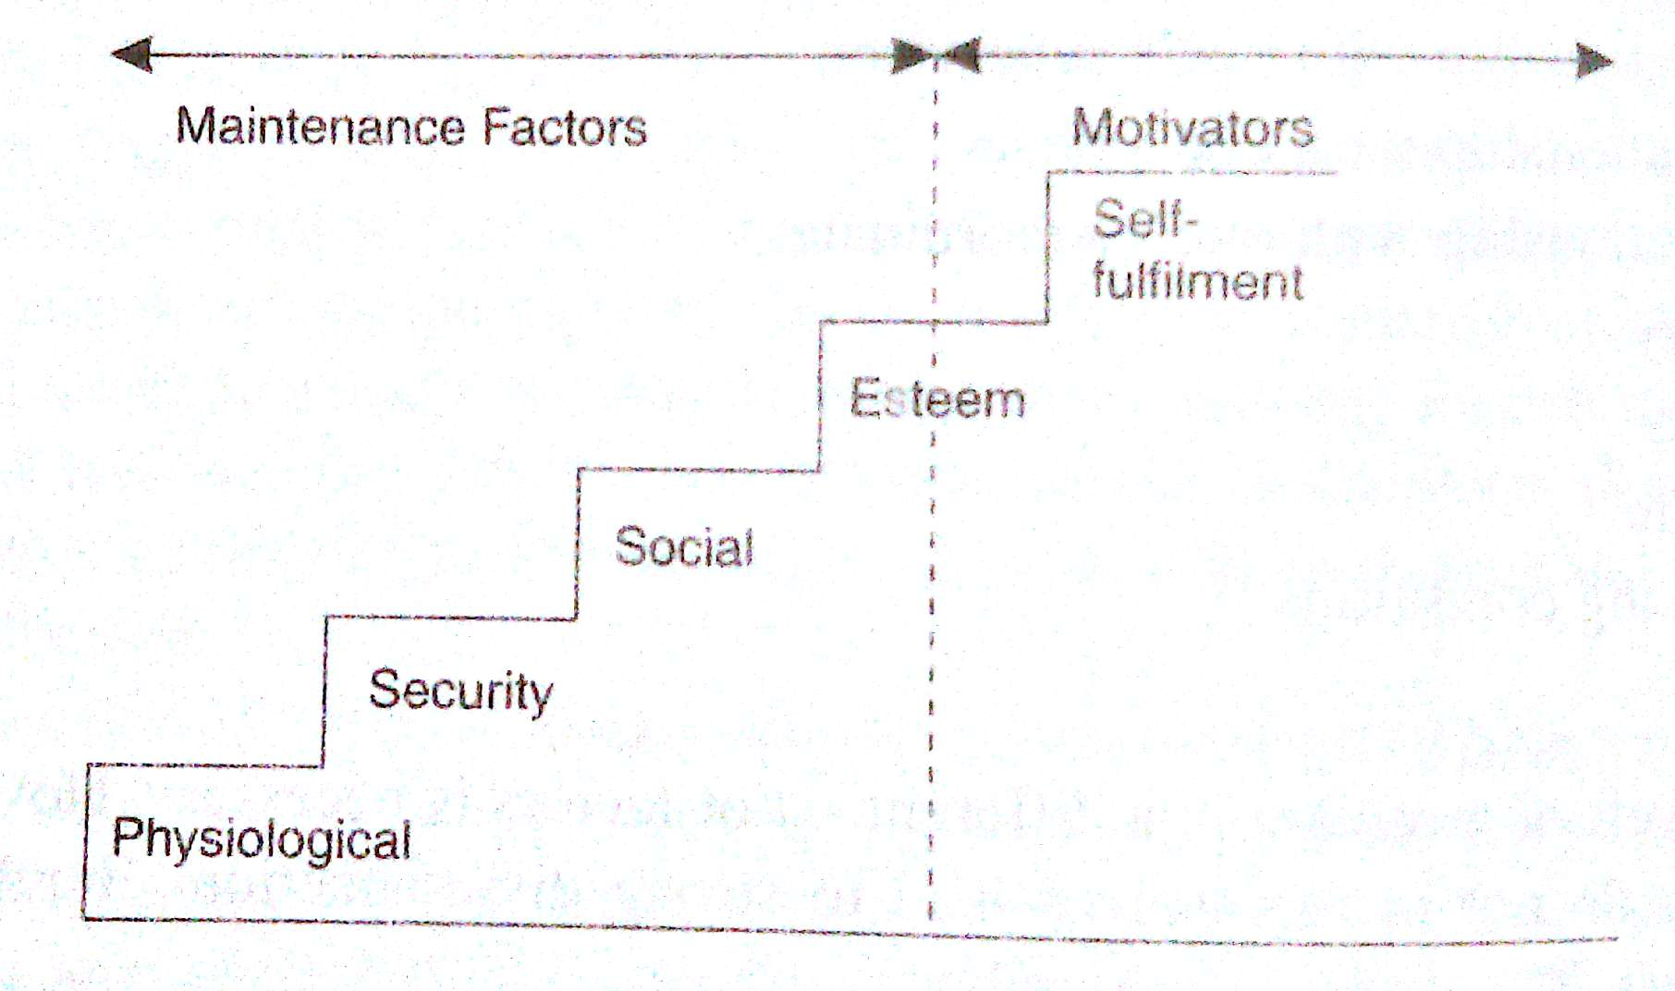
MOTIVATION THEORIES [T]
Diagram- : HERZBERG’s & MASLOW’s theory compared

Slide 22
MOTIVATION THEORIES [O ]
I:
OVERVIEW OF MOTIVATION THEORIES: S:
2-types of workers according to HERZBERG: R
Motivation seeker: S
S: S
S: S
Maintenance seeker: S
S: S
S: S

Slide 23
MOTIVATION THEORIES [O ]
I:
OVERVIEW OF MOTIVATION THEORIES: S:
Merits & Demerits HERZBERG’s Theory: R
Merits: S
I : S
I: S
I: S
De-merits: S
Deemphasizes economic motivation: S
Of the job needs not concentrated: S
Around the job needs not concentrated : S

Slide 24
TOPIC-2.3.3.3 Mc-CLELLAND’S NEED FOR ACHIEVEMENT THEORY

Slide 25
MOTIVATION THEORIES [O ]
I:
OVERVIEW OF MOTIVATION THEORIES: S:
3-Important needs of an employee are: R
Need for affiliation: S
S: S
S: S
Need for power : S
M: S
M: S
Need for achievement : S
M: S
M: S
3-distinct characteristics of a person in need for achievement: R
Sets moderately difficult to achieve goals: S
S: S
S: S
Eager to take & manage responsibilities & execute on his own: S
M: S
M: S
Accepts concrete feedbacks: S
M: S
M: S

Slide 26
MOTIVATION THEORIES [O ]
I:
OVERVIEW OF MOTIVATION THEORIES: S:
Advantages of Mc-CLELLAND’s Theory: R
Helps in identifying the achievement needs of an employee: S
S: S
S: S
Results in improved faculty performance: S
M: S
M: S
Identifies the needs to achieve a set of tasks and places based on behavior matching: S
M: S
M: S

Slide 27
TOPIC-2.3.3.4 VICTOR’s V-room EXPECTENCY THEORY

Slide 28
MOTIVATION THEORIES [O ]
I:
OVERVIEW OF MOTIVATION THEORIES: S:
Main features: R
Main consideration: considers that under free choice, an individual is motivated towards that activity he is most capable of rendering & which he believes that has highest probability of leading him to his most preferred goal.
S: S
S: S
M : S
M: S
M: S
Basic concepts of this theory: R
First and second-level outcomes: S
Valence: the distinct value that is hold for a 2nd level outcome according to individual.
Valence ranges: valance of any outcome may be +ve, -ve or ‘0’
Instrumentality : S
Definition: It is the subjective measure of probability of achieving 2nd level outcome from 1st-level outcome, according to an individual and ranges from -1 to +1
Purpose: They help in finding the valence of 1st level outcome.
Formulae for valence of 1st level outcomes: The valence of each 1st level outcome =
summation of different( valence of 2nd level outcomes x instrumentalities).

Slide 29
MOTIVATION THEORIES [O ]
I:
OVERVIEW OF MOTIVATION THEORIES: S:
Basic concepts of this theory: R
Expectancy: S
Definition: Measure of the probability of each individual efforts that joins to 1st level outcomes.
Ranges: always ranges from 0-1.
Motivation: I
Definition: Is a multiplicative function of valence for each 1st level outcome(V₁) & believed Expectancy(E).
S: M = f (V₁ x E)

Slide 30
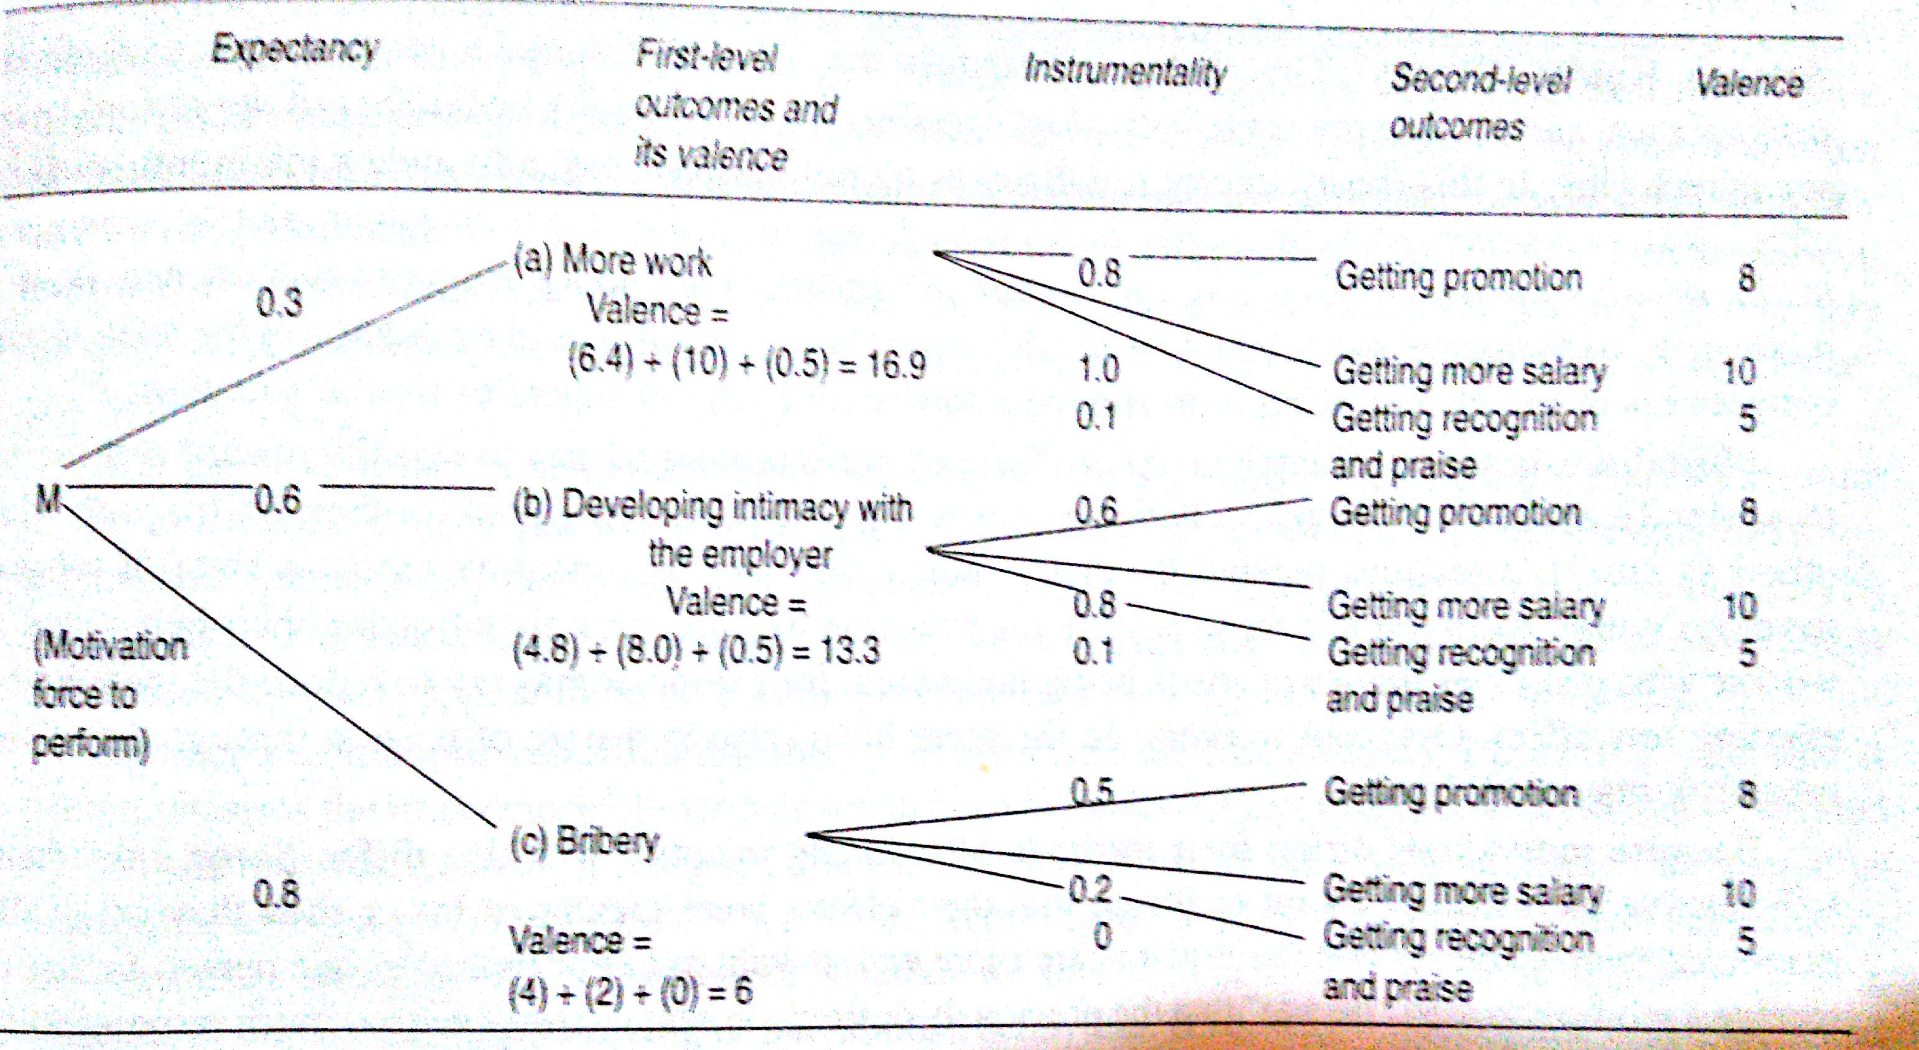
MOTIVATION THEORIES [T]
Diagram- : Working of VICTOR’s V-room’s motivation Theory

Slide 31
MOTIVATION THEORIES [O ]
I:
OVERVIEW OF MOTIVATION THEORIES: S:
Basic concepts of this theory: R
Some inferences from this theory: It indicates that to motivate people, it is not enough to offer them rewards, it should be made them to feel:
Attracted towards the awards: M
Convinced that the prescribed effort will lead them to those rewards: a
They have the ability to put in the prescribed effort: a

Slide 32
TOPIC-2.3.3.5 ADAM’s EQUITY THEORY

Slide 33
MOTIVATION THEORIES [O ]
I:
OVERVIEW OF ADAM’s EQUITY THEOREM: S:
Main features: R
Main consideration: c
S: S
S: S
Inferences from most discussions: S
M: S
M: S
Behavioral inferences of each individuals upon comparison of equity: R
normal: c
S: S
S: S
Rational behavior : S
M: S
M: S

Slide 34
TOPIC-2.3.3.5 SKINNER’s BEHAVIOUR MODIFICATION THEORY

Slide 35
MOTIVATION THEORIES [O ]
I:
OVERVIEW OF SKINNER’s BEHAVIOR MODIFICATION THEORY: S:
Basic features of Skinners behavior modification theory: R
M: c
Pleasant outcomes: S
Un-pleasant outcomes : S
I: S
M: S
M: S
Consequences increase the frequency of behavior: R
Positive reinforcement: c
S: S
S: S
Negative reinforcement : S
M: S
M: S
Consequences decrease the frequency of behavior: R
extinction: c
S: S
S: S
punishment: S
M: S
M: S

Slide 36
TOPIC-2.4 COMMUNICATION

Slide 37
COMMUNICATION [O ]
I:
OVERVIEW OF BASICS OF COMMUNICATION: S:
M: R
Definition & purpose: c
definition: S
purpose: S
Clarity of communication: S
What is being communicated: S
What is being received: S
Advantage: directs the human action towards accomplishing goals.
OVERVIEW OF SYSTEMS OF COMMUNICATION: S:
According to organizational structure: R
Formal communication: c
P: Information proceeds through proper formal channel, predefined by the organization.
P: E.g., orders, instructions, decisions etc…
2-types of formal communication channels/paths: S
Single channel/path: S
Multiple channel/path: S

Slide 38
COMMUNICATION [O ]
I:
OVERVIEW OF SYSTEMS OF COMMUNICATION: S:
According to organizational structure: R
Merits of Formal communication: c
Maintenance of power of authorities to the officers: I
Sound & proper communication: E
De-Merits of Formal communication: c
Overload of work to line officers: I
Decay in accuracy as the information travels through the communication path: E.
Overlook of sub-ordinates by line officers: E.
Useful only in downward communication: E.

Slide 39
COMMUNICATION [O ]
I:
OVERVIEW OF SYSTEMS OF COMMUNICATION: S:
According to organizational structure: R
IN-Formal communication: c
Definition: communication through informal channels.
Source: operated by personal, social or group relationship of the people.
Purpose: Used to communicate non-programmed activities within formal boundaries of the system.
2-: S
Faster than formal: S
Flexible than formal: S

Slide 40
COMMUNICATION [O ]
I:
OVERVIEW OF SYSTEMS OF COMMUNICATION: S:
According to organizational structure: R
Merits of IN-Formal communication: c
Positive service to the organization: I
Operates at greater speed: I
Fulfills the communication needs of various persons: I
Informal network involves peoples of same level of an organization: I
De-Merits of IN-Formal communication: c
Less orderly & static: I
Messages communicated will be erratic & uncertain: I
Communicates rumors, half truths, incinerate: I
Origin & direction of information is unpredictable: I
By the time the information completes its cycle may be distorted: I

Slide 41
COMMUNICATION [O ]
I:
OVERVIEW OF SYSTEMS OF COMMUNICATION: S:
According to direction of communication: R
Downward communication: c
Communication flow path: communication flowing from upper position towards lower positions
Participating authorities: c
E.g.,: rules, minutes of the meetings, notices etc…
Upward communication : S
Communication flow path : communication flowing from lower positions towards upper positions
Participating authorities: c
E.g.,: reactions, suggestions, reports, proposals, statements, grievances etc…
Horizontal communication : S
Communication flow path : horizontal
Participating authorities: Employees working under same level or of equal designation.
E.g.,: meetings of HODs, meetings of general managers.

Slide 42
COMMUNICATION [O ]
I:
OVERVIEW OF SYSTEMS OF COMMUNICATION: S:
According to way of expression: R
Oral/vertical communication: c
Communication style: Both the communicating parties communicate face to face.
E.g.,: meetings, conferences, interviews, phone conversations etc…
Written communication: S
Communication style: communicate in the form of written words, graphs, diagrams, pictures, etc…
E.g.,: rules, notices, manuals, reports etc…

Slide 43
COMMUNICATION [O ]
I:
OVERVIEW OF BASICS OF COMMUNICATION: S:
Barriers of successful communication: R
Information has to pass among more levels of organization: c
C: B
Long & structure less channels of communication: c
C: B
Heavy loads at certain levels of organization: c
C: B
Prestige/superiority complex: c
C: B

Slide 44
COMMUNICATION [O ]
I:
OVERVIEW OF BASICS OF COMMUNICATION: S:
Barriers of successful communication: R
Lack symbolizing capacity of the sender: c
C: B
Attitude of the receiver: c
C: B
Ignoring of conflicting information: c
C: B
Information evaluation by receivers own angle: c
C: B

Slide 45
COMMUNICATION [O ]
I:
OVERVIEW OF BASICS OF COMMUNICATION: S:
Techniques to overcome the barriers of successful communication: R
Sending direct & simple messages using multiple channels: c
C: B
Feedback system to confirm the successfulness of the communication: c
C: B
Adopting face to face communication: c
C: B
Timing transmission of the message: c
C: B

Slide 46
COMMUNICATION [O ]
I:
OVERVIEW OF BASICS OF COMMUNICATION: S:
Techniques to overcome the barriers of successful communication: R
Prepare & deliver the message to the receivers vocabulary, interests & values: c
C: B
Introduce sufficient amount of redundancy during communication: c
C: B

Slide 47
COMMUNICATION [T]
Diagram- : H

Slide 48
TOPIC-2.5 CO-ORDINATION

Slide 49
CO-ORDINATION [O ]
I:
OVERVIEW : S:
M: R
Definition & purpose: c
definition: S
purpose: S
OVERVIEW: S:
A: R
F: c
P: I.
P: E
2-: S
S: S
M: S

Slide 50
COORDINATION [T]
Diagram- : H

Slide 51
TOPIC-2.6 CONTROLLING

Slide 52
CONTROLLING [O ]
I:
OVERVIEW : S:
M: R
Definition & purpose: c
Definition: S
E.F.L BRECH Definition: S
Henry FAYOL definition: S
GEORGE R TERRY definition: S
Purpose: S
Point out weaknesses & errors & rectify them: S
To ensure adequate progress & satisfactory performance: S

Slide 53
TOPIC-2.6.1 STEPS IN CONTROLLING

Slide 54
CONTROLLING [O ]
I:
OVERVIEW OF STEPS IN CONTROLLING: S:
Establishing standards: R
What is establishing standards: c
F: S
S: S
Features expected from standards established: c
Flexible in adopting changes: S
S: S
Result oriented: S
S: S
Types of standards established: c
Qualitative standards: S
S: S
E.g.,: employees morale, faster communication, good will reducing costs, quality of the product etc..
Quantitative standards: S
S: S
E.g.,: profit percentage, standard hours, number of units produced, total cost incurred etc..

Slide 55
CONTROLLING [O ]
I:
OVERVIEW OF STEPS IN CONTROLLING: S:
Establishing standards: R
Types of standards established: c
Cost standards: S
S: S
E.g.,: e
Revenue standards: S
S: S
E.g.,: e
Capital standards: S
S: S
E.g.,: e

Slide 56
CONTROLLING [O ]
I:
OVERVIEW OF STEPS IN CONTROLLING: S:
Measuring & comparing actual results against standards: R
Measuring function basics: c
P: S
S: S
Methods for measuring: c
Personal observation: S
S: S
Various summaries: S
S: S
E.g.,: evaluation reports, chats plotted & statements etc…
Usual actions taken: c
Take corrective action for deviated standards: S
S: S
Report to top management for deviation beyond limits: S
S: S

Slide 57
CONTROLLING [O ]
I:
OVERVIEW OF STEPS IN CONTROLLING: S:
Taking corrective actions: R
Basics: c
2-: S
S: S

Slide 58
CONTROLLING [O ]
I:
OVERVIEW OF STEPS IN CONTROLLING: S:
Taking corrective actions: R
Different Causes of deviation: c
Ineffective communication: S
S: S
Defective system of wages: S
S: S
Negligence from workers: S
S: S
Wrong tools & machines: S
S: S
Lack of training: S
S: S
Ineffective supervision: S
S: S
Inadequate facilities: S
S: S

Slide 59
CONTROLLING [T]
Diagram- : H

Slide 60
TOPIC-2.6.2 ESSENTIALS OF SOUND CONTROL SYSTEMS

Slide 61
CONTROLLING [O ]
I:
OVERVIEW OF ESSENTIALS OF SOUND CONTROL SYSTEMS: S:
Different sound control systems essentials: R
Feedback: c
2-: S
S: S
Objective: c
2-: S
S: S
Suitability: c
2-: S
S: S

Slide 62
CONTROLLING [O ]
I:
OVERVIEW OF ESSENTIALS OF SOUND CONTROL SYSTEMS: S:
Different sound control systems essentials: R
Prompt & Timely reporting: c
2-: S
S: S
Forward looking: c
2-: S
S: S
Flexible: c
2-: S
S: S

Slide 63
CONTROLLING [O ]
I:
OVERVIEW OF ESSENTIALS OF SOUND CONTROL SYSTEMS: S:
Different sound control systems essentials: R
Economical: c
2-: S
S: S
Simple: c
2-: S
S: S
Effective & operational: c
2-: S
S: S

Slide 64
CONTROLLING [O ]
I:
OVERVIEW OF ESSENTIALS OF SOUND CONTROL SYSTEMS: S:
Different sound control systems essentials: R
Motivation: c
2-: S
S: S

Slide 65
TOPIC-2.6.3 METHODS OF ESTABLISHING CONTROL

Slide 66
CONTROLLING [O ]
I:
OVERVIEW OF : S:
Different methods of Establishing control: R
Personal observation: c
Definition, Processing style & disadvantages: S
S: S
Budgeting: c
Budgeting definition, activity & purpose: S
S: S
D: S
Different types of budget: S
S: S
D: S
Cost accounting & control: c
Definition & processing style: S
definition: evaluating & controlling the investment cost

Slide 67
CONTROLLING [O ]
I:
OVERVIEW OF : S:
T: R
Break even analysis: c
Definition & processing style: S
S: S
Purpose: S
S: S
Standard costing: c
Definition, features & purpose: S
S: S
Steps involved in standard costing: S
Setting the costs for various components: S
Comparing the actual cost with the standard cost: S
Evaluate the variance: S
Taking corrective measures to avoid future variances: S
Return on Investment[ROI]: c
Definition purpose: S
S: S
ROI =profit / total investment

Slide 68
CONTROLLING [O ]
I:
OVERVIEW OF : S:
T: R
Responsibility accounting: c
Definition, purpose & operation style: S
Definition: S
purpose: S
Operation style: S
Management audit: c
Definition, purpose & operation style: S
Definition: checking planning, organizing other management functions.
purpose: S
Operation style: S
Internal audit: c
Definition, purpose & operation style : S
Definition: S
purpose: S
Operation style: S

Slide 69
CONTROLLING [O ]
I:
OVERVIEW OF : S:
T: R
External audit: c
Definition, purpose & operation style : S
Definition: S
purpose: S
Operation style: S
Statistical control report: c
Definition, purpose & operation style : S
Definition: quantitative reports of sales, production etc…
purpose: S
Operation style: S
Gant Milestone chart: c
Definition, purpose & operation style : S
Definition: S
purpose: S
Operation style: S

Slide 70
CONTROLLING [O ]
I:
OVERVIEW OF : S:
T: R
Production control: c
Definition, purpose & operation style : S
Definition: S
Purpose: S
Operation style: S
Program evaluation & review techniques[PERT]: c
Definition, purpose & operation style : S
Definition: S
purpose: S
Operation style: S
Critical path method[CPM]: c
Definition, purpose & operation style : S
Definition: S
purpose: S
Operation style: S

