Slide 1
Direct Payment Calculator built in Mosaic Care and Support Plan
The Direct Payment Enquiries Team

Slide 2
What has changed?
From 15th November 2021 the Direct Payment Calculator will be available in the Care and support plan and the Review of Care and support plan.
From 31st December 2021 the excel version will not be available
Presentation title

Slide 3
What has changed?
The Mosaic version of the DP Calculator is an improved version of the excel version;
It will now work out the average hourly rate for agencies that charge different rates for different length of calls and/or bank holidays/weekends
You do not need to complete a Direct Payment Calculator for each change where there are multiple changes in one step

Slide 4
When is a DP Calculator required?
A DP Calculator is always required where a Personal Assistant is used for support
You do not need a DP Calculator where you are using an Agency/Day Service only (It can be completed to support with calculating variable rates to provide an average hourly rate)

Slide 5
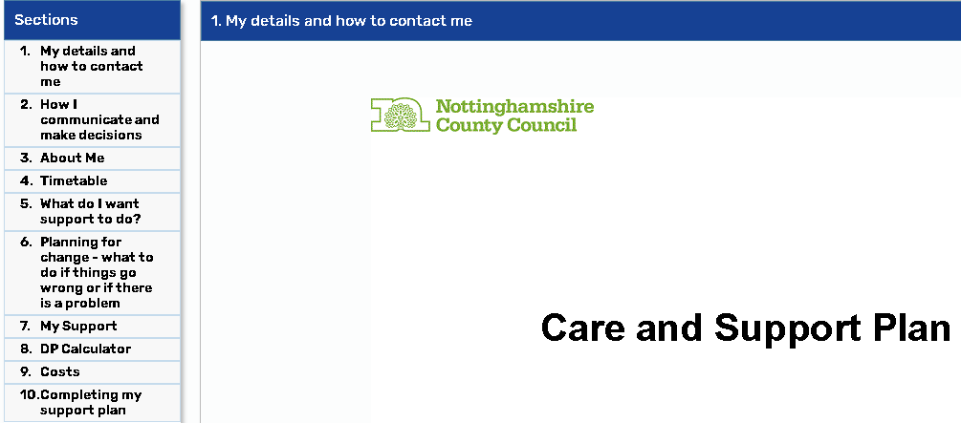
Where is the DP Calculator?
Care and Support Plan/Review of Care and Support Plan Section 8 – DP Calculator

Slide 6
How do I access the DP Calculator?
Open a Care and Support Assessment / review of care and support assessment
Add the Care and Support Plan / Review of care and support plan
Complete section 7 my support, with the DP package information such as how will the DP be managed, what support will be purchased and Agency name if required. You will be able to see/use the DP Calculator at any time, but the DP Calculator tab will be mandatory where a PA is used/selected in section 7.
Section 8 DP Calculator, start date required (most recent/current change only)
Please select which services are going to be used, multiple options can be selected Agency/Self Employed PA’s, or Day services, Employed PA’s or any other weekly service which will then expand new sections out to be completed
Section 9 – Costs - Please complete the DPSS (if any) on this tab before you complete the DP Calculator tab, as the DPSS costs pull through so that this is calculated in the personal budget, but NOT the total on-going costs

Slide 7
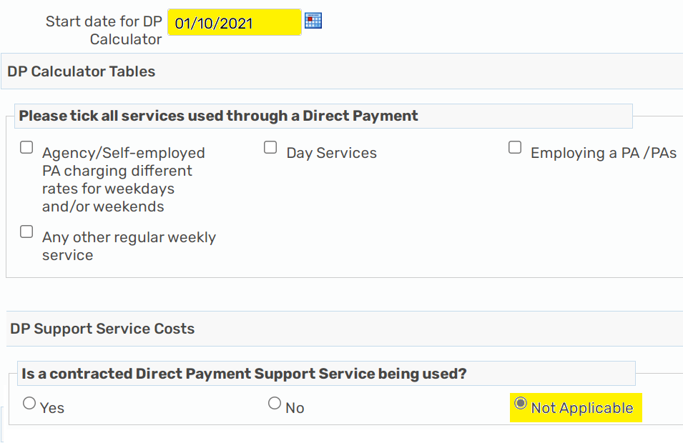
If the DP Calculator is NOT required
Where the DP Calculator is showing as mandatory but you do not have a PA or DPSS provider in place, please input the start date of the DP into the DP Calculator, and select not applicable to the contracted DPSS question:

Slide 8
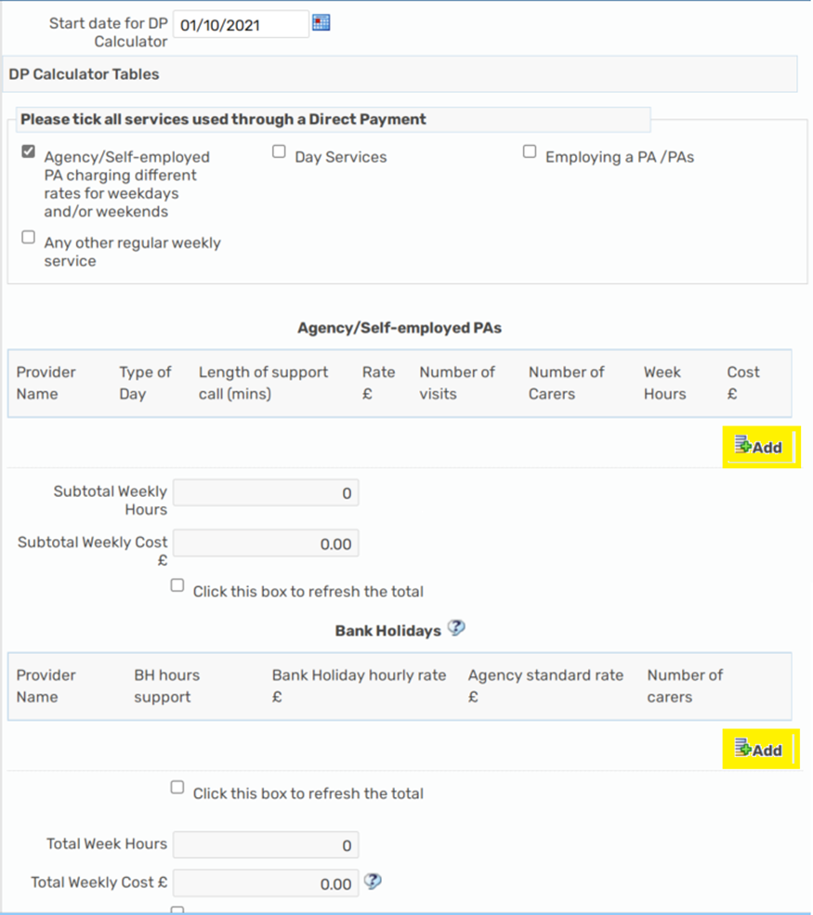
Agencies and Self employed PA’s
Please click add to input the Agency/Self-employed PA name, day (weekday, evening, weekend where rates are different), length of call (15/30/45/60mins) the rate per call, the number of visits per week (NOT HOURS), the number of carers, this will then work out the costs/total hours for you, please remember to click refresh each time you add a service.

Slide 9
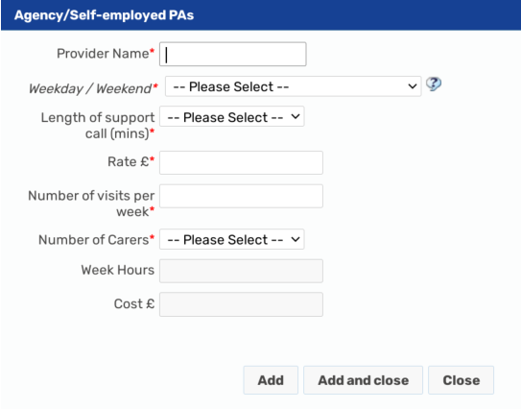
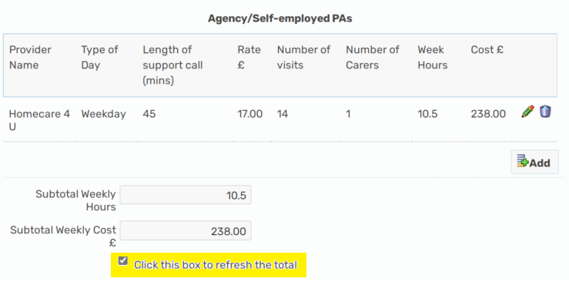
Agencies and Self employed PA’s You can add as many different rates as required and as many separate calls, these will all be added into the total costs/total hours

Slide 10
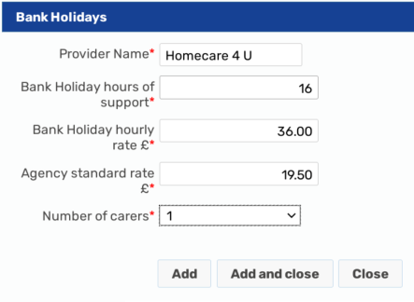
Bank Holiday hours/rates
There are currently 8 bank holidays in a year and we always work out the bank holiday costs based on the full 8 days of the year. The bank holiday hours of support is the total annual hours allocated for this. If someone usually has a total of 2.5 hours a day you times this by 8 days to give you a total of 20 bank holiday hours. Some providers charge different rates on Xmas/New Year, so you would put 5 x normal day hours through at one rate, and then 2 x normal day hours at the different rate. You will need to know what the normal hourly rate is to complete this section:

Slide 11
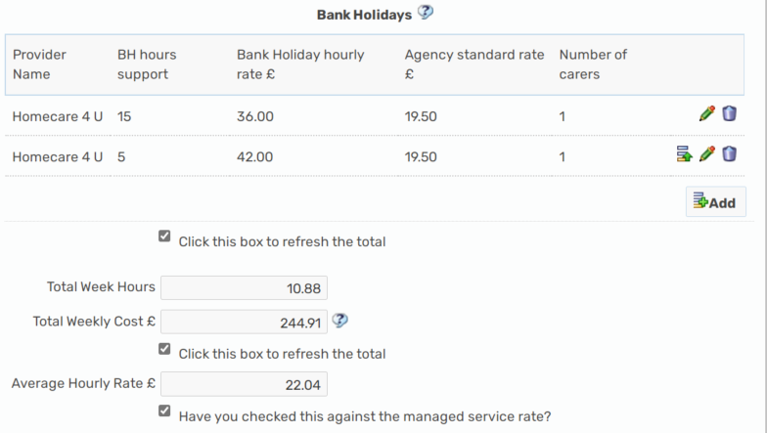
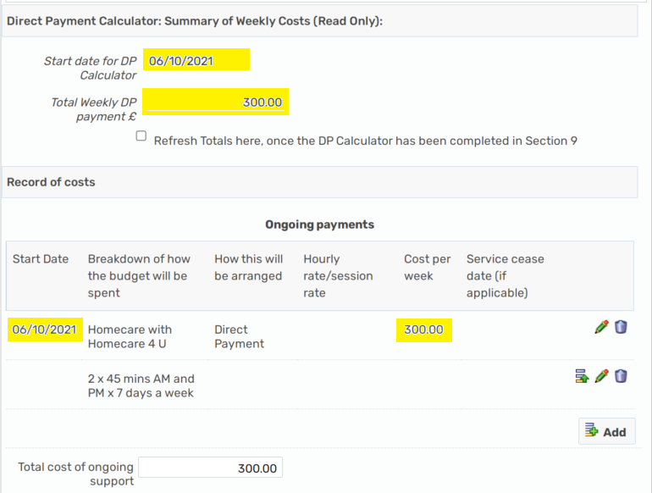
Bank Holiday hours/rates
Once you have completed all support via a DP onto the DP Calculator, please refresh the totals then complete the cost section with the costs as per calculated for you and pulled through as a summary to the top of the cost section.

Slide 12
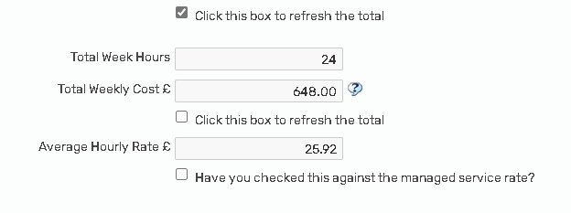
Average hourly rate
Where an agency is used some may charge different rates for different lengths of calls or days, this section firstly works out the average hourly rate. You then have to tick to ensure you have checked this average hourly rate against the Home Based Care managed rates for your district; http://home.nottscc.gov.uk/working/departments/asch/promoting-independence-care-act/home-care

Slide 13
Average hourly rate – top up
If the average hourly rate is higher than the managed Home Based Care provider rates for your district then manager approval will be required. If this is not approved then a top-up to the Direct Payment may be required, for more information please see;
Section 6.7.1, page 49 Direct Payments Staff Guidance
What happens if the person with a DP chooses a more expensive provider than an equivalent managed service available?
Where it has been evidenced that all of the assessed needs can be met through an equivalent available managed provider, an individual does have the right to use a more expensive provider and can choose to top-up the difference to their Direct Payment, this would be the difference between the chosen provider’s average hourly rate and the highest managed service whether that be lead or additional provider for that area. You will need to have to have spoken to the Manged providers and evidence the managed service had the capacity and availability to take on the package by recording this as a case note. The DP Recipient then must sign and complete a Top Up Agreement :- direct payment Top-up Agreement which should be uploaded onto Mosaic as evidence that the individual is both aware and in agreement of paying towards the service. This needs to be reviewed annually as the managed services rates uplift and a top-up may not then apply. You should record the information on the cost section of the CASP under the voluntary DP Top-up, however it will be down to the individual to make this payment directly to the provider.

Slide 14
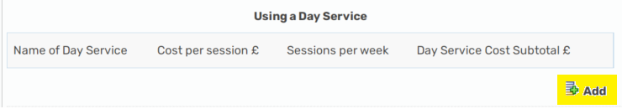
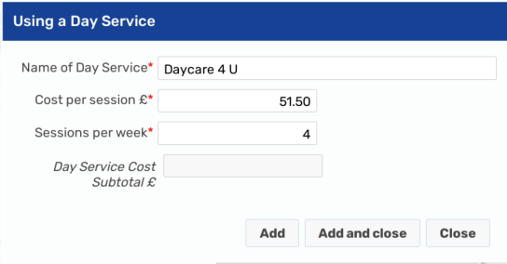
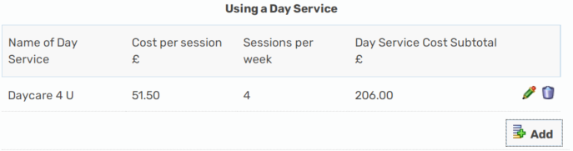
Day Services Please click add to add the Day Service Name, cost per session and sessions per week, this will the calculate the total cost and include this in the total cost summary

Slide 15
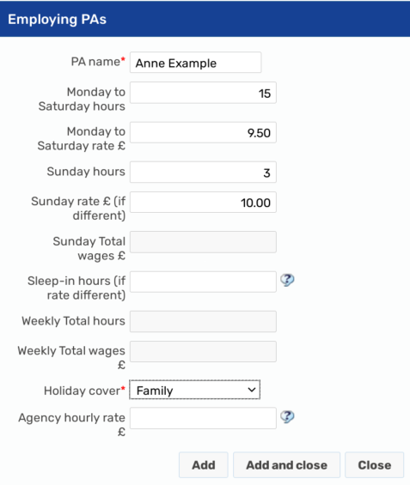
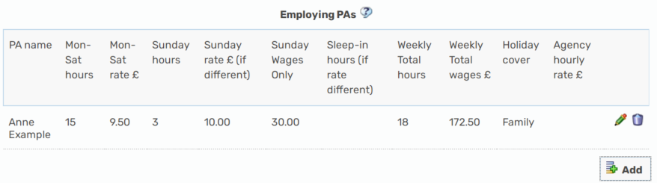
Employing a PA/PAs
The mandatory fields where a PA is employed are – PA Name, Holiday cover arrangements, Employers Liability, and is a DPSS being used, this is because these are requirements for an Employed PA.
We have tried to copy over all the information from the Excel DP Calculator PA table, some information might not be relevant, please only input information in the relevant boxes, we do NOT need 0 to be input at all. You can only input information into the white boxes, the slightly greyed out boxes are going to calculate figures for you.

Slide 16
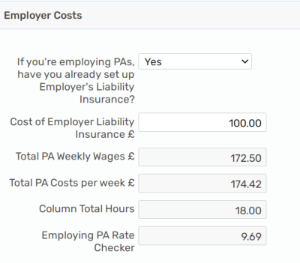
Employing a PA/PAs
Where there is more than 1 PA Employed, you will need to add a new line for each PA
Please state whether the Employers Liability insurance has been set up Yes/No – it is a requirement where a PA is employed. The answer to this question will determine whether a one off should be calculated for the initial set up of the insurance or not, where this has NOT been set up and a one off is required, the worker will need to ensure this is put onto the one off section in the Cost section 9 of the plan to be commissioned by DIT.

Slide 17
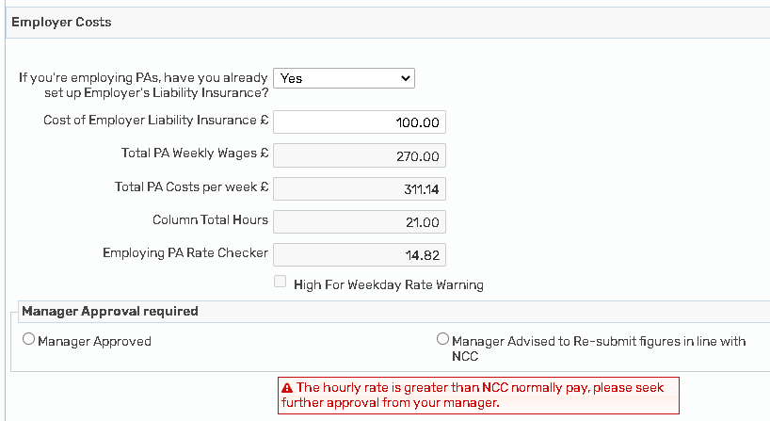
Personal Assistant rate checker
Where a PA is employed, NCC also need to consider the on costs of employment such as HMRC Contributions (Tax, national insurance and pensions), any annual leave payments, the cost of any Direct Payment Support Service (DPSS) and employers liability.
This section will work out the hourly rate including all oncosts (not the actual rate payable to the PA)
If the average hourly rate is higher than NCC would usually pay then you will get a warning for manager approval.
If this is not approved by your manager then a top up maybe required, please see slide 13 average hourly rate top-up for more information.

Slide 18
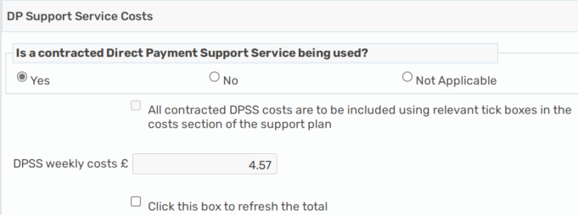
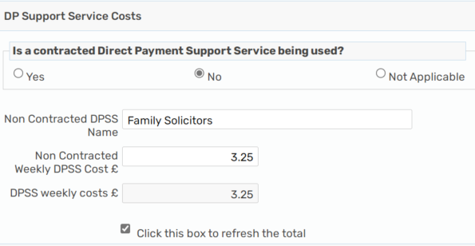
Direct Payment Support Services (DPSS) Any contracted DPSS costs will NOT be included in the total weekly DP payment, but for Non-contracted DPSS this will be paid into the DP account as the DP Recipient will need to pay the provider directly
Contracted DPSS provider (Purple, SOLO, Penderel’s Trust, People Plus and Rosekel)
Where a contracted DPSS is used, this information will pull through from the cost section, please ensure you have completed the contracted DPSS provider details in the cost section 9:
NON-CONTRACTED DPSS - Where a non-contracted DPSS provider is used, we need to ensure this money is calculated and paid into the DP account to be paid directly by the DP Recipient (as it used to be):

Slide 19
DPSS Notice Period
As the DPSS costs are NOT included in the total cost of the Mosaic DP Calculator you would not need a separate calculator or the DPSS notice date as the start date.
Please put the start/change date on the DP Calculator section as the actual date of provider/support/hours start/change date.
The DPSS start date will be recorded in the cost section 9 under the DPSS sections – and will not necessarily be the same start/change date as the support.

Slide 20
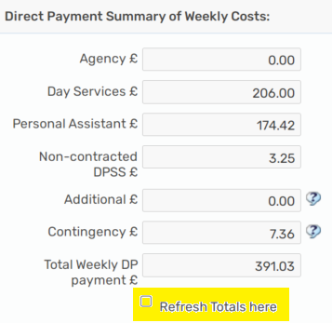
DP Calculator summary section
All the associated DP costs will be calculated at the bottom in the Direct Payment Summary of weekly costs, please ensure you have refreshed the totals:

Slide 21
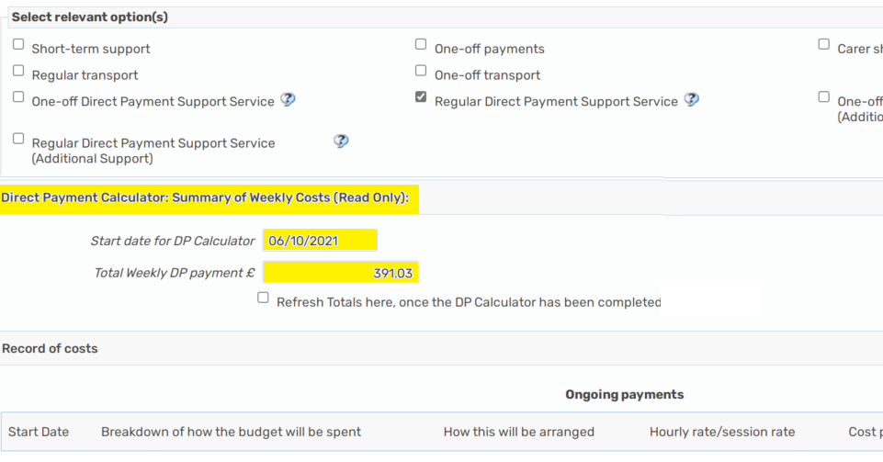
Completing the Cost section
Once the DP calculator section has been completed, the total summary costs and start date will pull through onto the cost section to make it easier for you to copy the total DP costs into the on-going cost section now that they have all been calculated for you, YOU NO LONGER HAVE TO ADD CONTINGENCY IN SEPARATELY, this is included in the PA costs

Slide 22
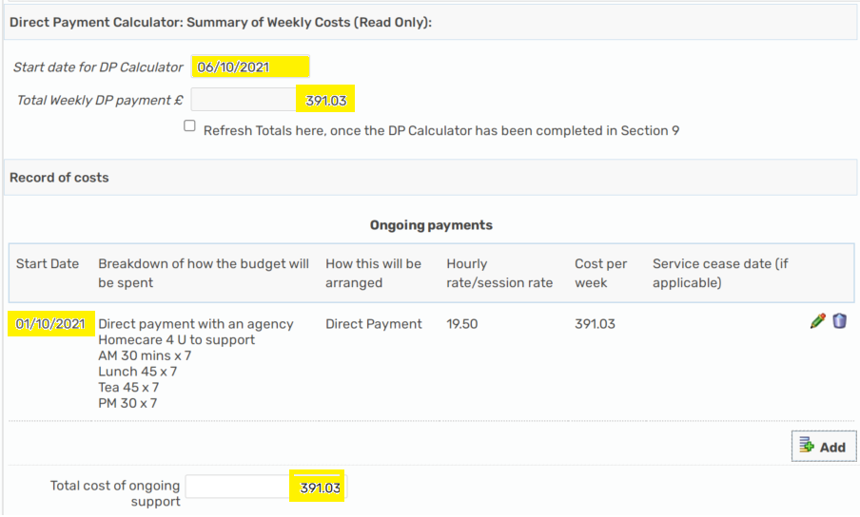
Completing the Cost section
Please then add the normal breakdown/detail of support into the on-going costs using the DP Calculator costs for the Direct Payment elements of the on-going support ensuring the start date and the total cost of DP matches:

Slide 23
Multiple Change dates
Where there are multiple change dates to a package you can use the DP calculator to work out the costs for each date, however you can only have 1 version of this and you would need to overwrite any information with the most recent/current change ensuring the date is correct.
There is no requirement for a DP Calculator for each change date. DIT only need to the most recent change date and detail of support. If you wanted to do so, you can print the CASP DP Calculator section to a PDF document and save/upload to the Mosaic record but this is not a commissioning requirement.

Slide 24
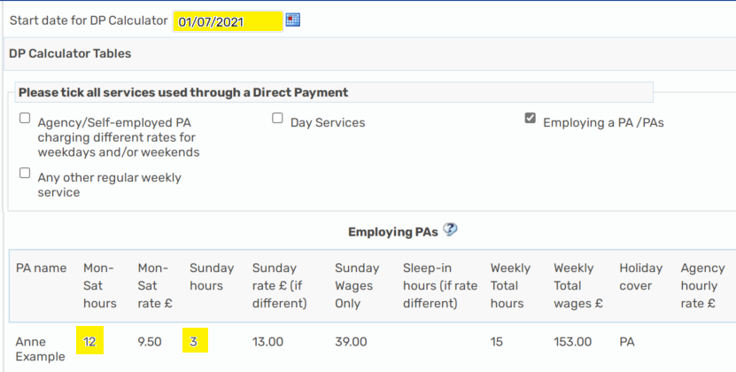
Multiple Change dates
For example:
If you have 2 changes to the DP to commission, one from 1.7.21 to increase the hours from 10 to 15, and then another change on 1.9.21 to 2x PA instead of 1 and total of 20 hours. You can do this as below:

Slide 25
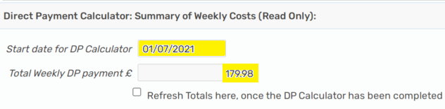
Multiple Change dates
Put the date and hours and all other details onto the DP Calculator section
Refresh the totals
Go to the Cost section
Complete the DP date, detail and cost as per the summary and put an end date as the date before the next change (31.8.21) :
Go back to the DP Calculator section
Change the date to the next change date, this example is 1.9.21
Delete the current information, update with new information
Refresh the totals
Go back to the cost section and copy the new information over

Slide 26
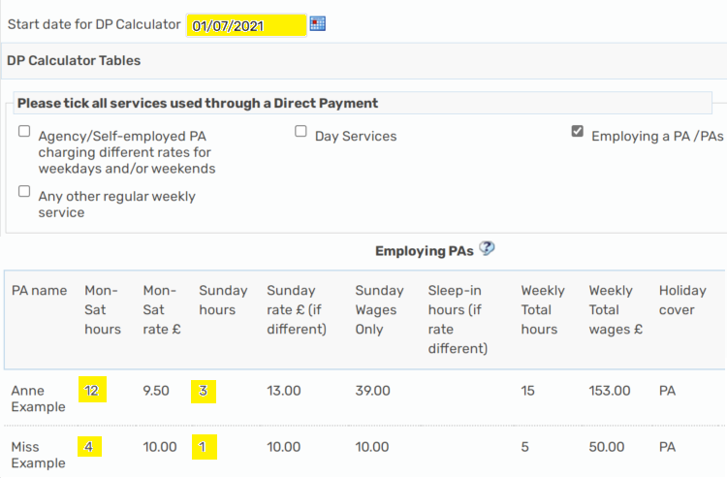
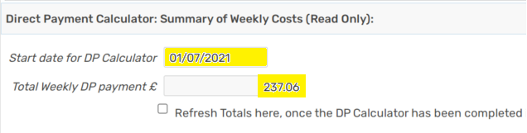
Multiple Change dates

Slide 27
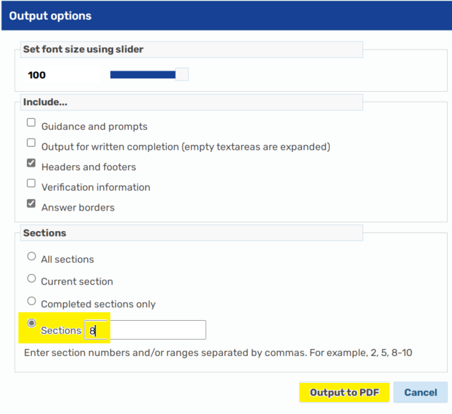
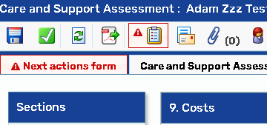
How to PDF the DP Calculator
It is not mandatory to create a PDF of the DP Calculator but if you wanted to you can by;
To create the DP Calculator as a PDF document, please click on the PDF icon within your step at the top of the screen:
Select section 8 for the DP Calculator, then output to PDF, you can then save/upload this if you wish to do so:

Slide 28
Uplift to costs
Where there is an uplift provider rate only (no change to services provided/hours of support/provider) a ‘Request care package amendment step – Care and Support Plan update’ should be used. If there is also a change in support hours or provider, then this should be done via a review step.

Slide 29
Rules for DIT
DIT check the following before they are able to commission, if you have not completed the step correctly or have not uploaded the correct forms, then your step will not be commissioned by DIT:
A DP Agreement – ACM39 is required for ALL Direct Payments and uploaded as a financial document - at least one annually, March 19 version or newer, signed by all required parties, no change to how DP will be taken, no change to authorised/nominated persons
An Order form is required for contracted DPSS commissioning, signed by all and uploaded as a financial document
Section 7 – My Support should be completed fully for the Direct Payment options, including how the DP will be taken (PPC/TPMA) and what support will be commissioned under the DP (PA/Day service/Agency including Agency name)
Section 8 – DP Calculator is required where a PA is used for support with the DP
Section 9 – Costs should have the same start date and total cost of DP matching the DP Calculator section 8

