Slide 1
Direct Payment Personal Assistant Commissioning Team
Natalie Moffat-Bailey

Slide 2
Introduction to the team
Natalie Moffat-Bailey – Senior Commissioning officer Direct Payments strategic commissioning team
Catherine Choi - Commissioning Support Officer
Dorin Marinescu – Commissioning Support Officer
Neha Avasthy - Commissioning Support Officer
Susan Breach– Commissioning Support Officer
Team e-mail address – DPPACommissioningteam@nottscc.gov.uk

Slide 3
Reasons for Change
Improve DP PA processes
PAs should be considered as the 1st option
SLT PA Target - 3 PA per Team per month is equal to 45 new PA packages
Quality and consistency in data for accurate reporting
Supports capacity in Home Based Care market
Notes:
DP PA processes - such as recruiting a PA, completing the DP Calculator and order forms are difficult or confusing feedback on processes
1st option - for care but some operational team workers see the DP PA processes as a barrier to commissioning when there is a lack of knowledge

Slide 4
What is changing?
From April 2023
DP PA team will complete commissioning processes for ALL DP requests for Personal Assistants (except planned short breaks) such as;
DP Agreement for DP PA packages
DP Calculator
DPSS Order form
Which will free you up
Notes:
For example, DP Calculator, DPSS order form and DBS

Slide 5
Who can have a DP PA package?
Where a person has mental capacity or an authorised person supporting a DP PA package should be offered first as an option to the person to choose
Where no provider has been identified
Incomplete HBC requests sent before 5th Sept 2022, you will need to send a request to the DP PA after 3x unsuccessful attempts of finding HBC a provider

Slide 6
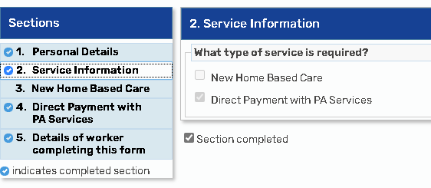
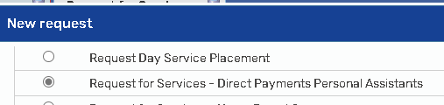

Stage 1 – to request DP PA set up
Use the Request for Services form to send the request to the DP PA commissioning team

Slide 7
Stage 1
What you need to do;
Complete the Care and Support Plan section 1 – 4
Identify anyone who could be paid as a PA
Complete the Request for Services – Direct Payment Personal Assistants
Send the request to the DP PA team

Slide 8
Stage 2
You will receive a notification once the DP PA process has been completed
You can now complete any other services requests if you have not already done so
Once any other requests have been completed including manager approval you can send your step to SPT/DIT to be commissioned
Notes:
Ask if this is clear or more information required around other services

Slide 9
Initial 6 week review
DP PA Team will undertake an initial phone review
They will check the PA package is working
Check if there are any questions from the PA or DP Recipient
If there are any issues this will be referred to the operational team as a duty task

Slide 10
Annual Review of a DP PA package
The annual review will be completed by the operational social care teams, to ensure all the support in place is appropriate. Once you have undertaken this any DP with a PA will need to then be sent to the DP PA commissioning team to check the following to ensure you complete the commissioning step correctly and it is not returned by the Service Placement Team
The DP PA Team will also complete all the PA checks, we have a legal responsibility to ensure the PA’s employment status is accurate, that the PA has a current DBS in place, and contingency arrangements have been agreed and understood. Where the PA is claiming to be self-employed the DP PA Team will undertake the checks and ensure the PA understands their roles and responsibilities.
The DP PA team can provide consistent and accurate employment advice, they will discuss and agree the PA rates ensuring they are in line with the affordability within the personal budget
The DP PA team will complete any forms required such as DP Agreement, DPSS order form and section 5, 6 and 7 of the care plan for the PA services only.

Slide 11
Sending to Service Placement Team
Once all services requests have been completed and are ready to be sent to the SPT for commissioning please ensure the Care and Support Plan is up to date for all services.
Please note, when sending your step to SPT for commissioning, if you have added any other Direct Payment Services such as an Agency or Day Service this will need to be added to the DP Calculator to give the total DP costs.

Slide 12
Help and support
For general support around Direct Payments please contact;
DP Enquiries DPEnquiries@nottscc.gov.uk
Direct Payment Personal Assistant and employment related queries;
DPPAcommissioningteam DPPAcommissioningteam@nottscc.gov.uk
Business Systems Support Officers
BSSO Team BSSO.Team@nottscc.gov.uk
All Direct Payment information and guidance can be found;
Direct Payments support area | Nottinghamshire County Council Intranet (nottscc.gov.uk)

