Slide 1
Direct Payments What you need to know for 2026

Slide 2
What will be covered?
Changes to the National Living Wage
Maximum rates for Direct Payments
Direct Payment Voluntary Top Up’s
Providers uplift process 2026
Change in Employers Liability Insurance Premium Cost
Know Your Customer (KYC) Checks – Pre-Paid cards
Improving Systems and Communications
Questions

Slide 3
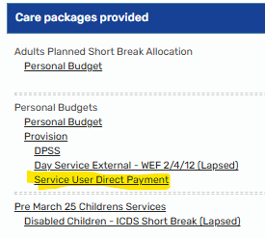
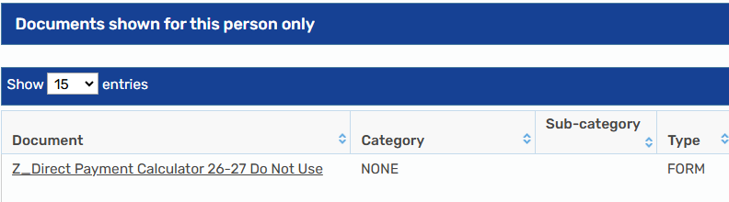
Changes to the National Living Wage
From 1st April the NLW is £12.71 per hour
The DP team and Mosaic team have centrally uplifted over 470 known DP Recipients packages with Employed PA’s, to ensure their hourly rate falls in line with the NLW from 06/04/2026. This will be recorded in the care packages provided on the front screen of mosaic.
There will also be a Direct Payment Calculator in documents as shown below

Slide 4
Changes to the National Living Wage cont…
NLW Uplifts not completed by the DP Team
For those individuals who had active reviews open to workers, the worker will have been emailed and a case note added to mosaic, advising of the NLW increase. The worker will need to request the increase of NLW is implemented on a Request for Services form and send over to the DP Commissioning Team.
Common issues faced
We often see instances where the Support Plan was not accurately completed during the last review. This results in inaccurate data being pulled from Mosaic.
In the instance where a PA is commissioned, please can the teams complete a request for services form, from the review step and send to the DP Commissioning team to complete commissioning.
No changes being made at the next review
When carrying out reviews, it is important that if there are no changes to the package, the worker ensures the current costs being commissioned, in accordance with the care packages provided is recorded correctly on the support plan in section 6 and 7.

Slide 5
Maximum rates for Direct Payments
The Council plans to continue to align DP rates to ensure fairness across the market. Those rates are available for the Council and Public viewing via the link below.
Guidance for staff can be found 2026-2027 Annual Fee Increase - Staff Guidance.docx
What does this mean?
It means the Council are setting Direct Payment (DP) rates, so they are fair and match what other care providers in the market usually charge. The link shows the rates so everyone can see them clearly.
This ensures transparency so that both the public and care providers can see how DP amounts are calculated.

Slide 6
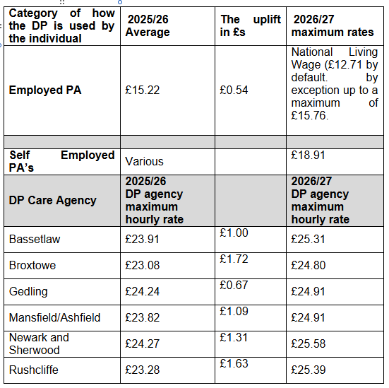
Maximum rates for Direct Payments
Published rates for 2026/2027
There are now published rates for both Employed and Self-Employed PAs.
Important!
Where an Employed PA is already commissioned above the max rate, the Council will honour this rate but decline requests for further increases until the rate aligns in the future (unless deemed exceptional by HOS).
The maximum rates for Agencies that do not hold a contract with NCC home care. In this instance, the maximum rate would be what the contracted rate under the home care contract
Home Based Care services | Nottinghamshire County Council Intranet

Slide 7
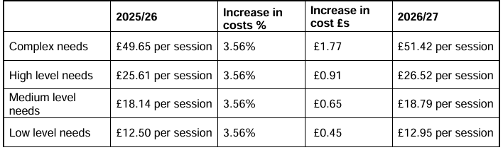
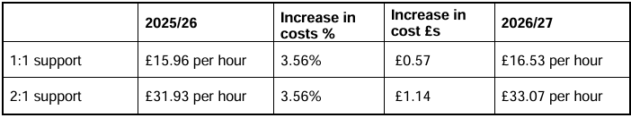
Maximum rates for Direct Payments
The rates for day services will continue to be matched against the current day service matrix costs.
Important!
If 1:1 or 2:1 support is commissioned alongside Day Service attendance, then the council will match the framework and commission the Day Service rates at the Low matrix.

Slide 8
Direct Payment Voluntary Top Up’s
If rates exceed the maximum Direct Payment rates, the Council will engage in negotiations with the provider in the first instance.
If the provider is unable to match the maximum rate, then a Voluntary Top up will be discussed with the DP Recipient.
Important!
If the individual is unable to pay the top‑up, the Council may discuss alternative care options that meet their needs within the standard rate.
If suitable care is available at the standard DP rate, but the individual chooses a more expensive provider, they must pay the top‑up themselves.
Additionally exceptional circumstance may apply, for example
If a person (or the Council) cannot secure care at the standard Direct Payment (DP) rate, the Council must pay the higher provider rate to make sure the person’s care needs are met.
There is rationale such as the person resides in a remote area or the impact not having the service commissioned would have on the person
Should exceptional circumstances apply this will need to be agree by Head of Service to be waivered and case noted.

Slide 9
Direct Payment Voluntary Top Up’s
Section 117 Top Up’s
New Sec 117 setup/commissioning
For individuals who are newly eligible for s117 aftercare, a top-up can be considered where the individual chooses a provider that is above the usual rate.
This is on the basis that the Council can evidence that a suitable and available provider exists within the maximum Direct Payment rates that can meet the person’s assessed mental health aftercare needs.
Should exceptional circumstances apply this will need to be agree by Head of Service to be waivered and case noted.
Ongoing Section 117 commissioning
Where a person has been receiving care from an established provider for a significant period of time, additional considerations must be taken into account.
In these circumstances, the decision cannot be based solely on the ability to identify a lower cost provider. The worker must also consider the potential impact that a change of provider may have on the individual’s mental health and recovery.
Example
Where a person has developed long-standing relationships with staff, familiarity with the environment, and stability in their care arrangements, a change in provider may present a risk of deterioration in their mental health. The Council must be able to demonstrate that any proposed change would not negatively impact the individual’s mental health or undermine the purpose Sec117 aftercare.

Slide 10
Providers uplift process 2026
Last year the DP team collated and processed over 450 provider uplifts requested. 111 of those required a review due to the rates exceeding and the person being unable to pay a top up.
Between April and July 2025, the DP Team released £5,274 per week in recurrent cashable savings through 322 renegotiated rates, equating to £275,000 full year effect.
Flexible Response Service delivered a further £1,637 per week from 90 renegotiated packages.
Equating to £100,000 full year effect. This was also thanks to the operational teams carrying out reviews, having difficult conversations and implementing Top up’s.
Uplifts 2026
This year the Council has written to all Direct Payment Recipients in January to advise the rates for April have not yet been confirmed but advised how to notify NCC of any fee changes. Then again in March to confirm the rates and where those can be viewed.
What have we learnt?
We have taken feedback from last year's process and used this to improve the approach for 2026 uplifts.
This year NCC will only accept requested uplifts from the DP Recipient, Authorised person or the DPSS provider. NCC will not accept the requests directly from the provider.
Who will complete the uplifts this year?
The Direct Payment Team will undertake all Direct Payment uplifts requested by either the DP Recipient/Authorised Person or Direct Payment Support Service.
Actions for operational teams
If requests are received from DP Recipients/Authorised Persons or DPSS providers on mosaic send the step to Direct Payment Uplift or to Emma Richards.
Requests received via email, please forward to Directpayments.Upliftrequests@nottscc.gov.uk

Slide 11
Change in Employers Liability Insurance Premium Cost
Employer’s Liability Insurance (ELI) premium will increase from 01/04/2026.
To ensure the Council is covering the highest premium of ELI insurance for Direct Payment Recipients Employing PA’s, as standard the annual cost for this service will be commissioned at £115.
When amending any rates within the Direct Payment or completing a review, please ensure the ELI insurance is increased to £115.00.
The DP Commissioning Team will also check this as part of the request for services.

Slide 12
Know Your Customer (KYC) Checks – Prepaid Cards
KYC Checks in Relation to Pre-Paid Cards
When a Pre-Paid card is selected and the person receiving the Direct Payment has either/both an Authorised Person or Nominated Person, a KYC check must be completed before the request for DP Commissioning can be submitted.
This requirement ensures:
The individual responsible for managing the funds is fully verified
Financial controls are in place before any public money is released
The organisation fulfils its compliance responsibilities
Risk is minimised and accountability is established from the outset
This step safeguards both the DP Recipient and the organisation by ensuring that the appropriate person is legitimately and safely managing the Direct Payment.
The Agreement will need to be emailed over to yotichecks@nottscc.gov.uk
When the KYC check has been completed there will be a case note added to confirm, at this point the worker can then submit the Commissioning request to DP Commissioning Team.
Useful guides and relevant forms can be found on Direct Payment Support Area
Direct Payment Agency Commissioning Maps [PDF]
Direct Payment Personal Assistant Commissioning Map 2026 [PDF]
Direct Payment Know Your Customer Agreement [Word]
Pre-Paid cards- Know Your Customer Fact sheet [PDF]

Slide 13
Improving Systems and Communications
Our team is continuing to grow, improve, and strengthen the way we work, and one of our biggest focuses right now is enhancing both our processes and our communications across Direct Payments.
We want everyone to feel informed, confident, and connected. For us that means making sure the right information reaches the right people at the right time.
What support is currently available?
There are many step-by-step guides and a staff guidance document uploaded to the DP Support Area.
We ask that workers refer to these documents or support from their peers in the first instance.
Should the information you require not be available your can contact
DPEnquiries@nottscc.gov.uk – For support with the DP Policy, quality concerns or complex discussions relating to DP’s
DPCommissioningteam@nottscc.gov.uk – For support with commissioning, rates, top ups or recruitment of PA’s
Improving the way we work
We’re committed to refining and streamlining our processes so that staff have the clarity and tools they need to work efficiently and provide the best outcomes for the people we support. This includes reviewing our workflows, identifying areas where things can be smoother, and sharing updates as new improvements come into place.
Your feedback and experiences continue to shape this work, and every suggestion helps us make meaningful changes. Please continue to share this feedback by emailing DPEnquiries@nottscc.gov.uk

Slide 14
Improving Systems and Communications cont…
Clearer, Stronger Communication
To support better communication across the service, we’re using two key channels to keep everyone updated, informed, and connected:
1. Weekly Practice Newsletter
Our Practice Newsletter, published every week, is designed to give you quick, accessible updates on:
Changes to Direct Payment processes
New guidance and reminders
Good practice examples
Helpful tips, insights, and development opportunities
It’s your go‑to place for consistent updates and a great way to stay aligned as a team
2. Direct Payments Viva Engage
We’re also strengthening real‑time communication through our Viva Engage page. This is where we share:
Live updates
Quick announcements
Resources and links
If you haven’t joined yet, we’d love to have you there. It’s a brilliant way to stay connected, ask questions, and be part of an active space focused on Direct Payments and continuous improvement.

