Slide 1
Interim Home Based Care Amendments
Quick Reference Guide
To assist with requesting amendments to an existing Home Based Care package through the Interim solution

Slide 2
Contents
What is the Home Based Care Amendment Interim Solution? Page 3
Amendment Summary Page 4
Increases and Decreases Page 5
Provider picks up the amendment Page 6
Cannot contact the provider Page 7
Provider cannot accept the amendment Page 8
Package closures Page 9

Slide 3
What is the Home Based Care Amendment Interim Solution?
What is happening?
A new way to request increases, decreases and ceases to current home care packages has been developed based around feedback from social care staff.
What is different?
Instead of all amendments going through to the brokers, it has been agreed with providers that social care staff can contact them direct to request increases and decreases.
Why are we doing this?
Feedback was given by social care staff that the current process of requesting an amendment to a package was to time consuming.
When does the new process start?
This process will be in place from 10/09/2018
How do I find out more?
Click here to view the Home care information page.
Alternatively find the page by navigating through:
Intranet Home Page, Working for NCC, Departments, ASCH, Promoting Independence and Care Act, Home Care.
Please note this process is only for service users who receive a managed home care service from one of the contracted providers.

Slide 4
Amendment Summary
The amendment process starts as part of the Review step.
Complete the Review as usual.
Contact the provider:
If the provider agrees to the amendment:
Confirm that you have agreed the amendment with the provider via email – Providers will not increase hours delivered without this email.
Case note the agreement.
From the Forms and Letters section of the Review step, create the Home Based Care Amendment
Complete the Home Based Care Amendment including the details of the change.
Send the next action, Adjust Support Package Following Review – Inc Home Care to DIT for commissioning.
If you cannot contact the provider:
The Brokers can still contact the provider on your behalf.
To do this add a request from the clipboard icon, Home Based CareAmendment Request.
Send this request to the Brokers and detail the change you are requesting.
They will complete the request with the details of the package.
Create and complete the Home Based Care Amendment
Send to DIT.
If the provider cannot pick up the increase or decrease:
The package will have to be treat as if you are requesting a new Home Based Care service.
Add a next action to the Review, Home Based Care Request, assign to yourself and send immediately.
Follow the process through for new packages.

Slide 5
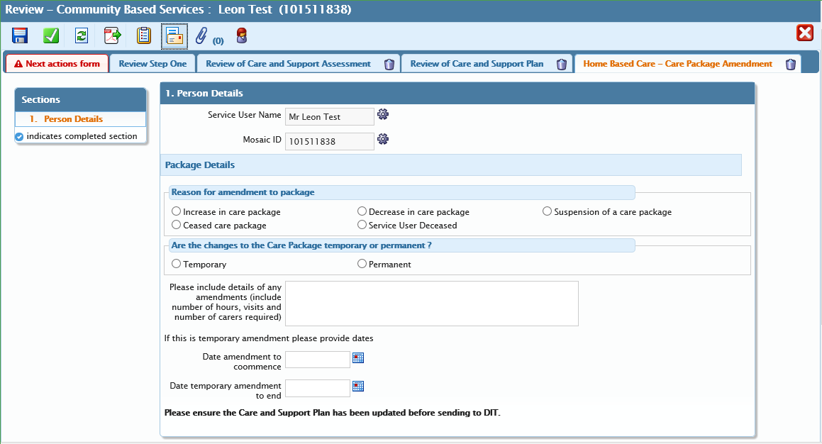
Increases and Decreases
This process is for requesting increases and decreases to current home based care packages.
This process lies within the Review form.
Complete the Review as you are normally required to do.
Attempt to contact the provider.
If the provider accepts the amendment follow the below process.
If you cannot contact the provider go to page …
If the provider cannot pick up the amendment go to page …
Create the Home Based Care Amendment form.

Slide 6
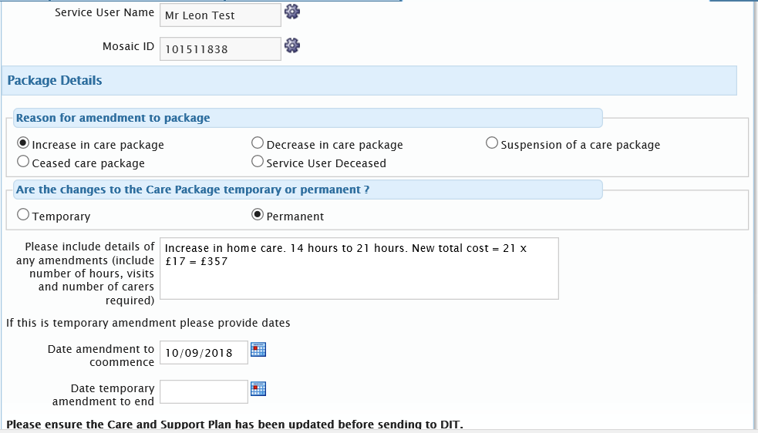
Increases and Decreases – Provider picks up the Amendment
Below is the Home Based Care Amendment form.
You will need to:
Select the type of amendment.
Whether this is Temporary or Permanent.
Include the details of the change, as shown below.
Add the date of the change. If it is a temporary change, also include the date that the amendment is ending.
Once you have completed this form you are ready to send to DIT for commissioning.
Add a next action to the Review step, Adjust Support Package Following a Review – Inc Home Care.
Finish the step DIT will be able to commission the change.

Slide 7
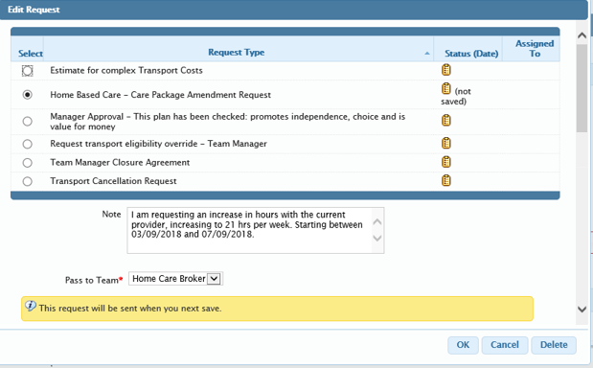
Increases and Decreases – Cannot contact the provider
If you cannot contact the Provider you can use the Brokers to contact the Providers on your behalf.
Once you have Opened the Review and attempted to contact the Provider you can add a request to the Brokers.
Through the Clipboard icon, add the Home Based Care Amendment Request.
Add a note detailing the change and assign this to the Brokers.
Save the Step and the Brokers will attempt to contact the Provider.
Once the Provider has accepted the Broker will return the request with information of the accepted amendment.
Create and complete the Home Based Care Amendment form.
Add the next action to DIT and finish the Step.

Slide 8
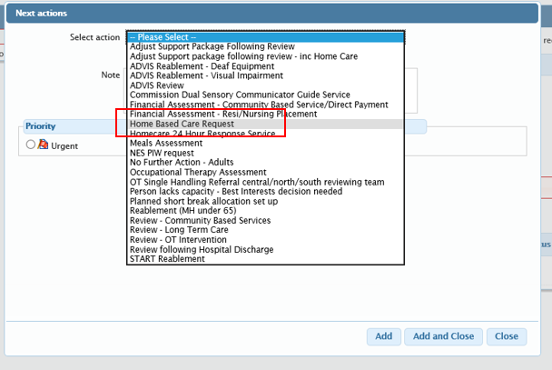
Increases and Decreases – Provider cannot pick up amendment
If the Provider cannot pick up the amendment you will need to go through the full process of requesting a new home care package.
From the Review go into the next actions, add the Home Based Care Request, assign this to yourself and tick the send immediately.
Follow the process for new packages of Home Care.

Slide 9
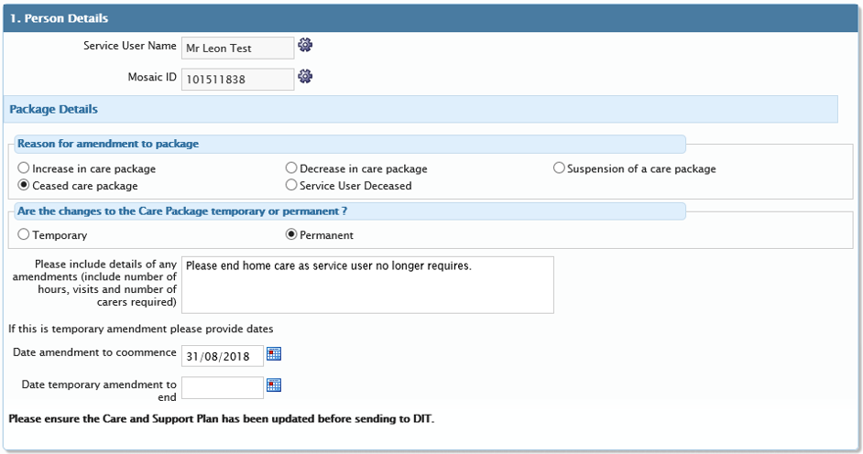
Package Closures
To close a home based care package, you will need to access the Home Based Care Amendment form within the review.
Fill the form in, ticking the type of closure and include an end date.
For deceased service users the end date should be the date of death.
When a service is ending as a service user no longer requires the service anymore, put in the last date of service.
Once you have filled the form in you are ready to send to DIT from the Adjust Support Package Following a Review – Inc Home Care next action.

